Slide 1
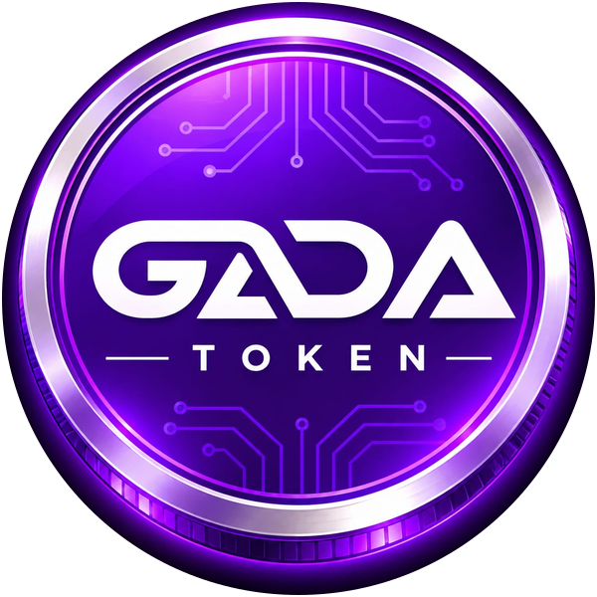
GADA TOKEN
WHITEPAPER
The utility token powering the Gada ecosystem of chat, social, streaming and commerce.
GDT | BNB Smart Chain | Version 1.0
gadatoken.com

Slide 2
ABSTRACT
One token across the Gada ecosystem
Gada Token (GDT) is issued on BNB Smart Chain with a fixed supply of 50 billion tokens. It connects messaging, social interaction, streaming and marketplace trade through a transparent, efficient value layer, with planned bank partnerships and future exchange listings.
50,000,000,000
BNB Smart Chain
BEP-20
Total supply
Network
Token standard
GADA TOKEN | gadatoken.com
2

Slide 3
VISION AND PROBLEM
Why Gada Token exists
Our mission
Fragmented platforms
Costly, slow payments
To power a trusted digital ecosystem where people can communicate, create, trade and transact using one efficient and transparent token.
Messaging, social, streaming and trade run on separate payment systems.
Cross-border payments carry high fees and delays.
Limited creator rewards
Crypto apart from banking
Platforms control monetization and take most of the value.
Digital assets sit outside the banking system, limiting adoption.
GADA TOKEN | gadatoken.com
3

Slide 4
THE GADA ECOSYSTEM
Where GDT is used
gada.chat
gadavoice.com
A social media platform owned by GADA CHAT LTD. Profiles, communities and shared content, with GDT supporting creator rewards, community participation and user-to-user value transfer.
A chat messenger and platform combining private and group communication with a marketplace for goods and services, a streaming system for creators, and community tools. GDT acts as the payment and value layer.
The ecosystem is extensible. New products and integrations will be announced through official channels.
GADA TOKEN | gadatoken.com
4

Slide 5
TOKEN OVERVIEW
Gada Token at a glance
Token name | Gada Token
Symbol | GDT
Blockchain | BNB Smart Chain
Standard | BEP-20
Total supply | 50,000,000,000
Contract | 0x090458b49D6deAA9F7334a5e628aa26D82A3A082
Website | gadatoken.com
GADA TOKEN | gadatoken.com
5

Slide 6
TOKEN UTILITY
Five ways GDT is used
1. Payments
2. Creator support
3. Community rewards
Marketplace purchases and services on gadavoice.com and partners.
Audiences support creators and streamers directly.
Rewards for participation and content on both platforms.
4. Value transfer
5. Financial integrations
Fast, low-cost transfers inside and beyond the ecosystem.
Bridge asset for future banking and payment partnerships.
Utilities are released in stages and are live only once announced.
GADA TOKEN | gadatoken.com
6

Slide 7
TOKENOMICS
Allocation of 50 billion GDT
Allocation | Share | Purpose
Ecosystem and platform development | [X]% | Building gada.chat, gadavoice.com and future products
Liquidity and exchange listings | [X]% | Market liquidity and listing requirements
Banking and strategic partnerships | [X]% | Integrations and partner programs
Community and rewards | [X]% | User incentives, creator rewards, campaigns
Team and advisors | [X]% | Long-term contribution, subject to vesting
Reserve | [X]% | Operational continuity and future needs
Final percentages, vesting and liquidity lock details to be published before public release.
GADA TOKEN | gadatoken.com
7

Slide 8
BANKING AND FINANCIAL PARTNERSHIPS
Bridging blockchain and traditional finance
GDT is set to partner with local and international banks.
On and off ramps
Payment settlement
Convert between local currency and GDT through regulated channels.
Merchants accept GDT and settle in fiat currency.
Cross-border transfers
Compliance and trust
Lower the cost and time of sending value across countries.
Work with regulated institutions for responsible operation.
Partnerships are announced only after agreements are concluded.
GADA TOKEN | gadatoken.com
8

Slide 9
TECHNOLOGY AND SECURITY
Built on BNB Smart Chain
BNB Smart Chain
Security practices
GDT is a BEP-20 token. The network offers fast confirmations, low fees and wide compatibility with wallets, decentralized applications and exchanges.
The contract is publicly verifiable on BscScan. An independent audit will be published once completed. Official information appears only on gadatoken.com and verified channels. Never share your private keys or seed phrase.
GADA TOKEN | gadatoken.com
9

Slide 10
ROADMAP
Five phases of growth
1
2
3
4
5
Foundation
Ecosystem
Partnerships
Market
Global growth
Token on BNB Smart Chain
Website and whitepaper
Contract verification
GDT in gadavoice.com
GDT in gada.chat
Creator incentives
Local bank talks
International banks
On and off ramps
DEX liquidity
Exchange applications
Top exchange listings
New use cases
Regional partners
Community-led updates
GADA TOKEN | gadatoken.com
10

Slide 11
EXCHANGE LISTING STRATEGY
Aiming for all top exchanges
1. Build real usage
2. Be transparent
3. Provide liquidity
4. Meet requirements
Active users through gada.chat and gadavoice.com.
Verified contract details and clear documentation.
Adequate liquidity and a healthy holder base.
Satisfy each exchange's compliance and technical review.
Listings depend on each exchange's own approval and are announced only once confirmed.
GADA TOKEN | gadatoken.com
11

Slide 12
RISK FACTORS AND DISCLAIMER
Know the risks
Market volatility
Regulatory change
Technology and smart contract risk
Adoption not guaranteed
Partnership and listing delays
Liquidity risk
This presentation is for information only. It is not financial, investment, legal or tax advice, nor an offer to sell securities. GDT is a utility token and carries no promise of profit or future value. Statements about plans, partnerships and listings are forward-looking and may change. Do your own research.
GADA TOKEN | gadatoken.com
12

Slide 13
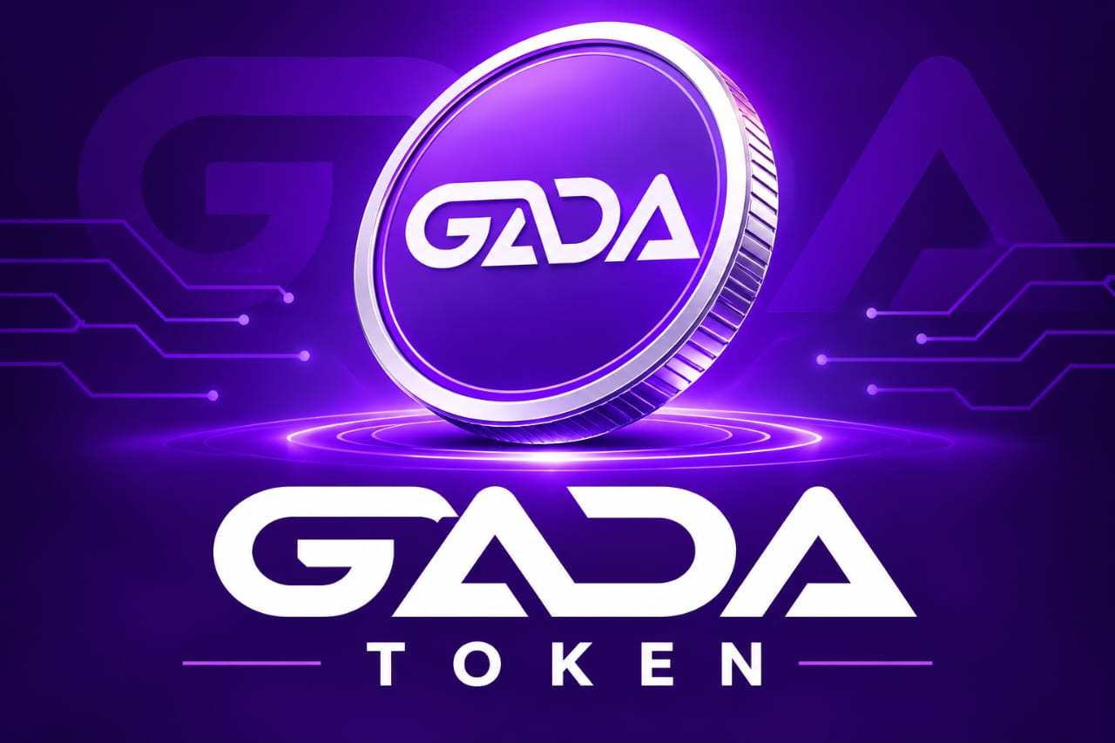
Join the Gada ecosystem
Website gadatoken.com
Social platform gada.chat
Messenger gadavoice.com
Email [INSERT EMAIL]

