Slide 1





ADOPTING AN IMPROVEMENT SCIENCE APPROACH TO INFORM IMPLEMENTATION OF THE MANA AKE INITIATIVE IN CANTERBURY
Caralyn Purvis Ph.D.
Evaluation Lead, Mana Ake - Stronger for Tomorrow
Canterbury District Health Board

Slide 2


PROBLEM
Increase in mental health and wellbeing concerns amongst tamariki in Aotearoa New Zealand
2
“Flexible and Responsive”
1
Collaborative co-design
How to evaluate and determine effectiveness and impact?
Implemented at speed
Holistic early-intervention
Universal and Targeted

Slide 3

APPROACH
“
Improvement science focuses on systematically and rigorously exploring ‘what works’ to improve quality in healthcare and the best ways to measure and disseminate this to ensure positive change. Whereas ‘improvement’ focuses on optimising the benefits of change, ‘improvement science’ focuses on maximising learning from improvement.
HEALTH FOUNDATION (2011)
POINT OF DIFFERENCE
Integrated evaluation as part of service-delivery
”

Slide 4

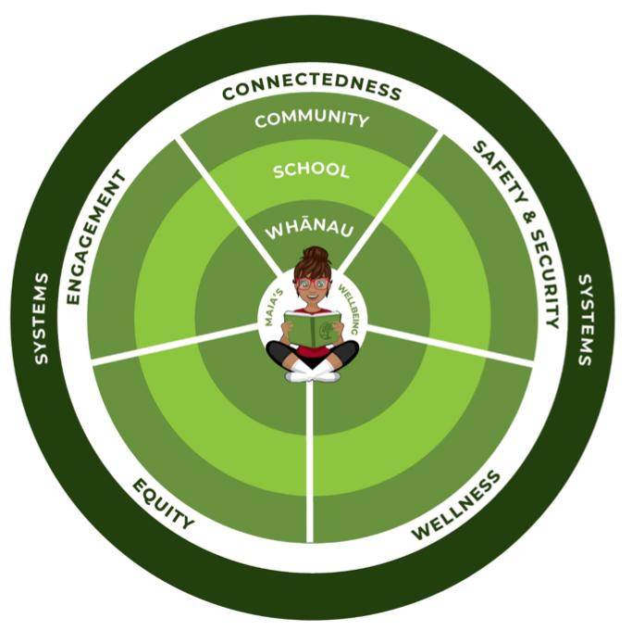
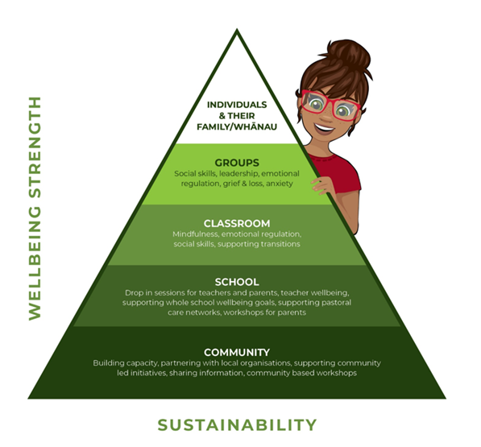
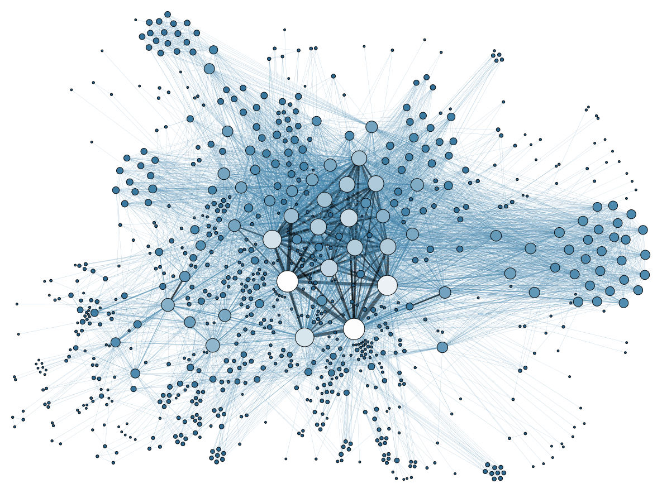

APPLICATION
DESIGN
IMPLEMENT
DATA
EVALUATE
REFINE
Improvement
Science

Slide 5



LEARNINGS & NEXT STEPS
Value of integrated evaluation
Improvement science aligns with agile projects/initiatives
Greater understanding of wellbeing needs for different communities and contexts
Informing a “flexible and responsive” approach
DATA OPPORTUNITY
Positioned to connect with wider datasets across sectors
CARALYN PURVIS: caralyn.purvis@cdhb.health.nz WEBSITE: manaake.health.nz/

