Slide 1
Can behavioural science help stop callers from hanging up?
Caitlin Spence
Caitlin.Spence@justice.govt.nz

Slide 2


Collections Contact Centre
2,000-3,000 calls per day
Variable waiting times
5-20% abandonment rate
Progress
“The queue behind you has been growing while you’ve been waiting”
“Stay on the line so you don’t lose your place
Control
Distraction
“Get your PPN number on your notice of fine. This will save you time on the call”
“Think about how often you can make a payment”

Slide 3
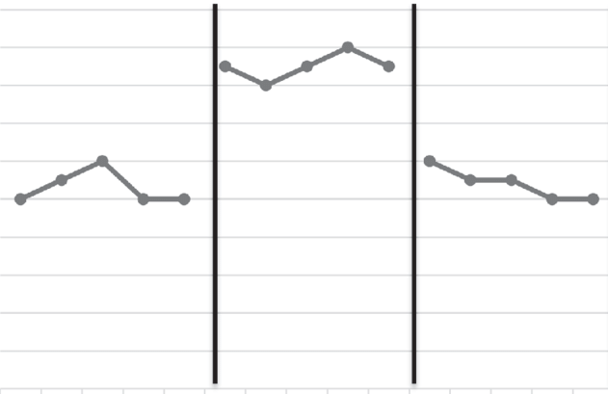
How to test which messages work best?
A B A
Variable waiting times:
Abandonment rates are influenced by waiting time, which will vary between weeks
Censoring:
Most people get picked up, so we don’t observe how long they would wait before abandoning the call
(demonstration only)

Slide 4
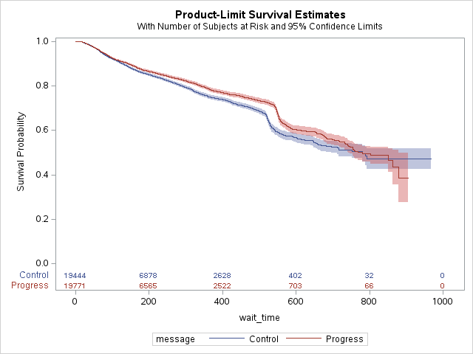
Results so far: Progress v Control
Contact: Caitlin.Spence@justice.govt.nz

