Slide 1
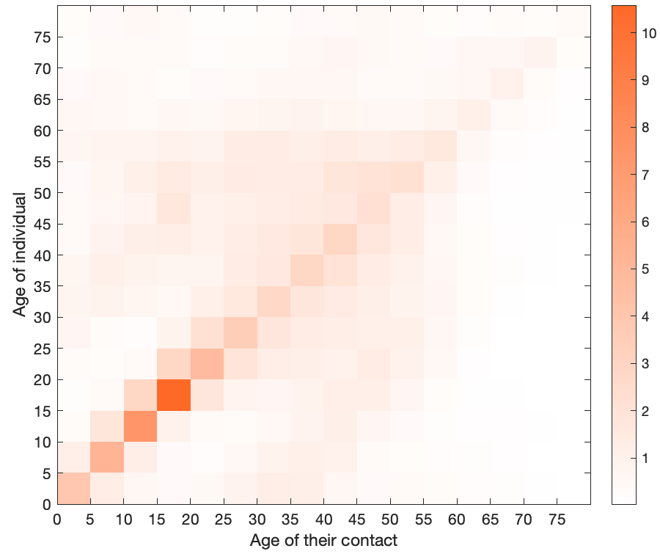
Contact Matrices and Disease Modelling
What if you don’t want to build a network of the entire population?
Introduce some structure into “well-mixed” models with contact matrices!
Vaccination?
Lockdowns?
Lockdowns and vaccination?
Variation between communities?
But we need good data….
Vaccinate this group first to slow spread…
…but this group is most at risk

Slide 2
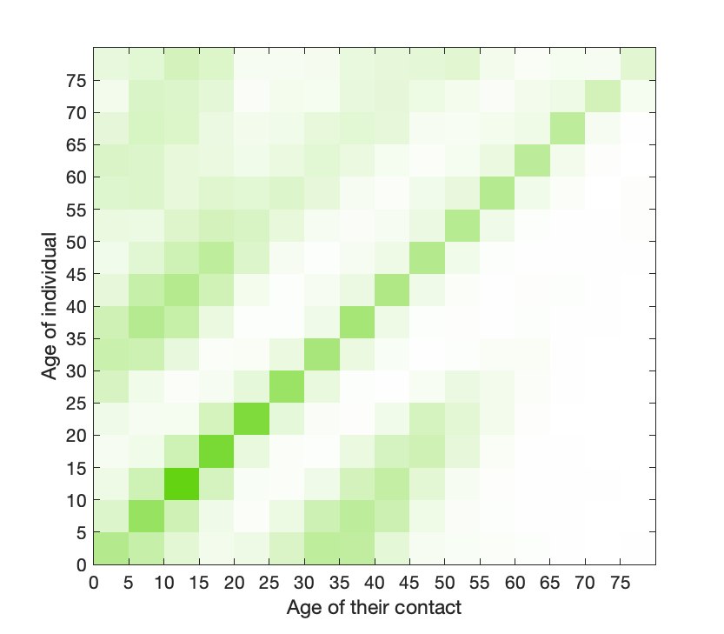
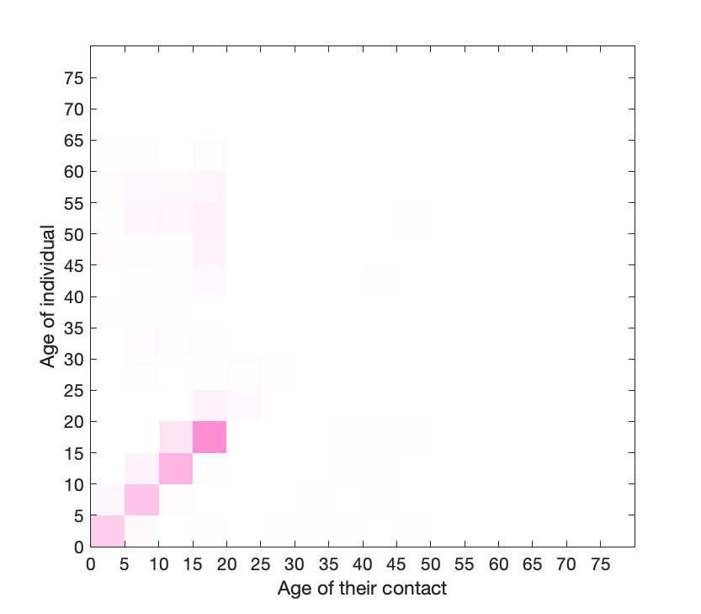
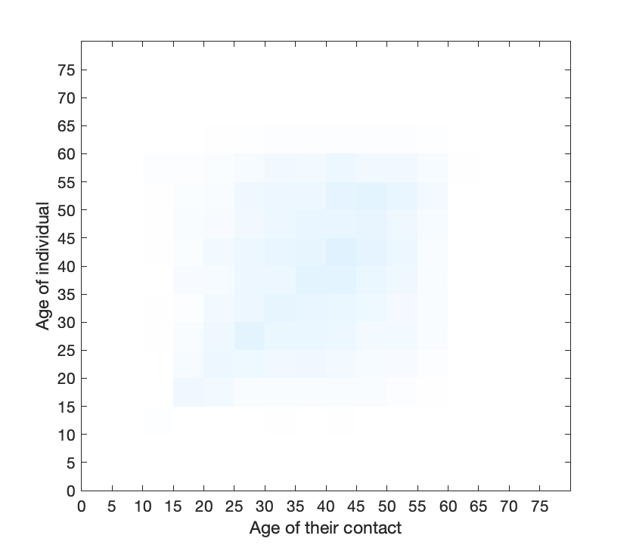
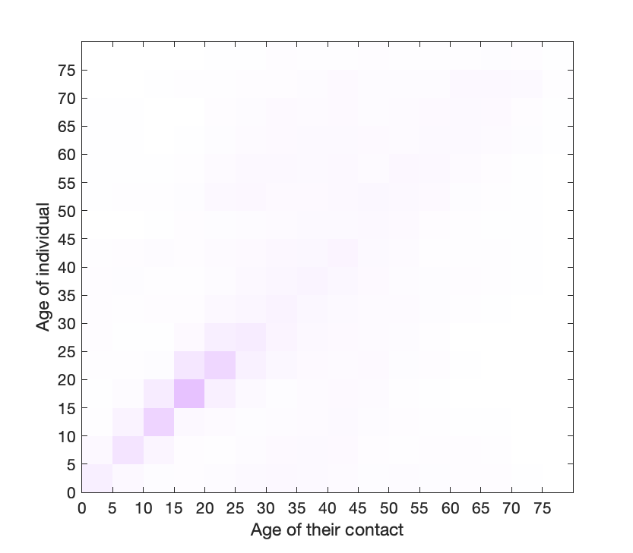
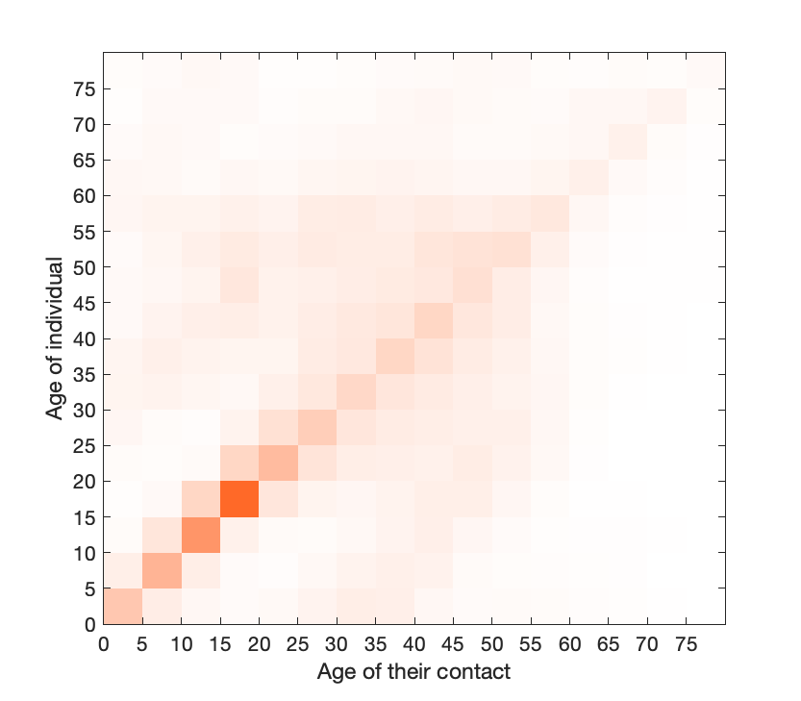
What do we have?
Internationally:
POLYMOD, weekly surveys in UK, for different communities!
In New Zealand:
Synthetic … informed by POLYMOD … fit to census & other data ...
+
+
+
=
Home
+
School
+
Work
+
Other
=
NZ

Slide 3
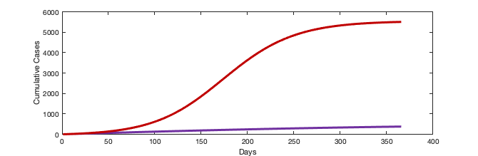
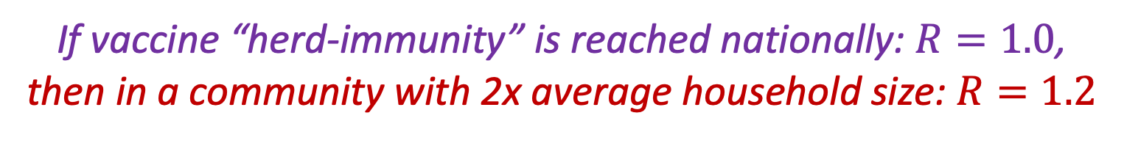
What are we missing?
Temporal Effect
Spatial Effect
School holidays? Christmas? … Lockdowns?
Household structure? School size?
… and it matters!
If vaccine “herd-immunity” is reached nationally: $R=1.0$,
then in a community with 2x average household size: $R=1.2$
*10 seed cases in a town of 20,000 people

Slide 4



With far-reaching consequences:
Household size is correlated with other risk factors
Larger household implies more contact with elderly & at-risk
Cases in one community will cause outbreaks in the other
Nic Steyn
nicholas.steyn@auckland.ac.nz

