Slide 1
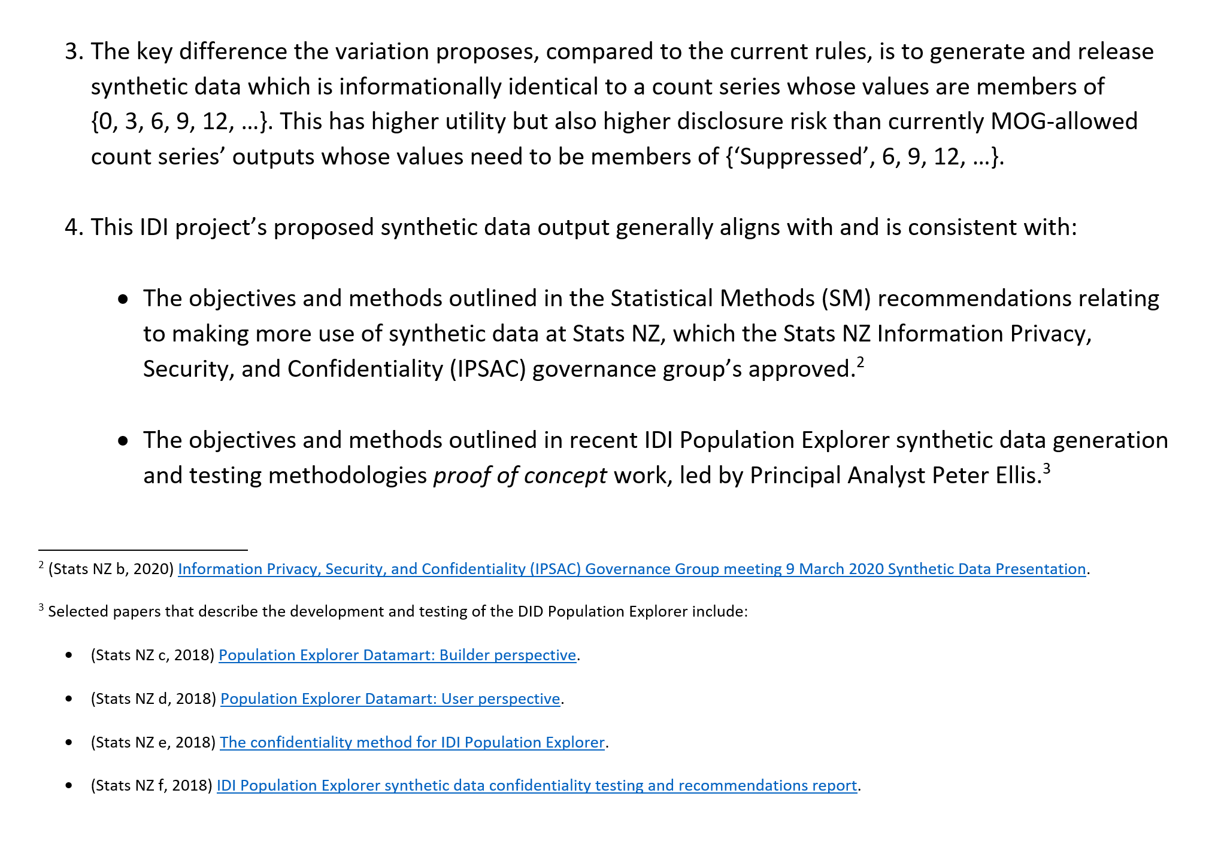

Slide 2
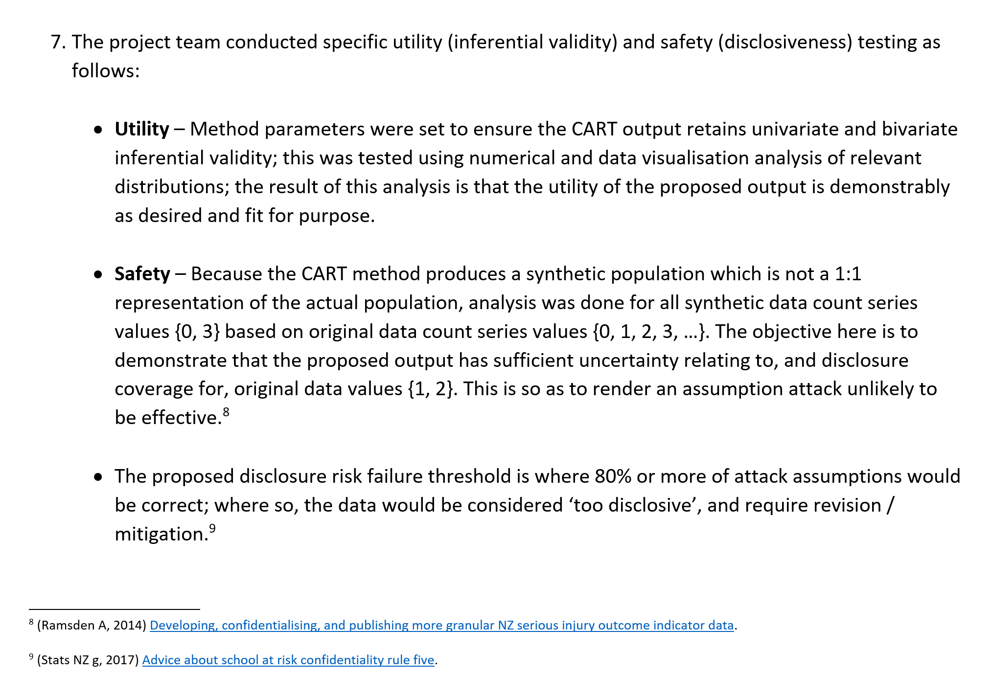

Slide 3
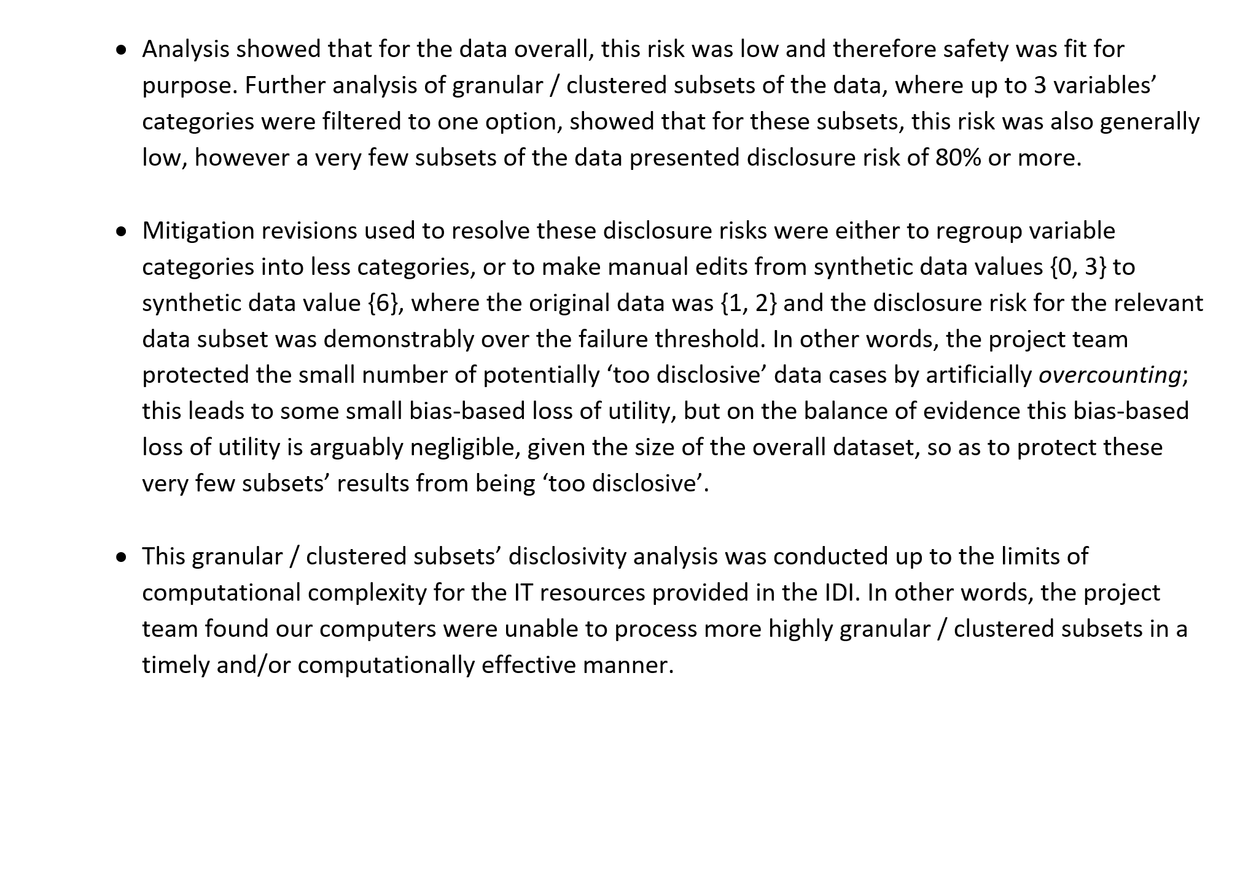

Slide 4


IDI Synthetic Data
Case Study
Alistair Ramsden, Senior Design Analyst, Statistical Methods
June 2021
alistair.ramsden@stats.govt.nz

