Slide 1

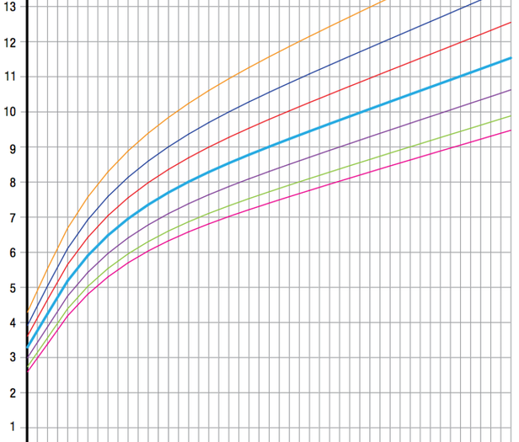
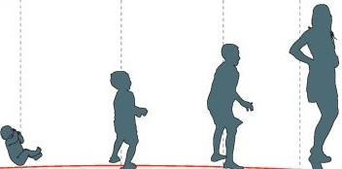






Growth monitoring Aotearoa:
Scoping a national system for tamariki and rangatahi
Presenter:
Dr. Teresa Gontijo de Castro
Senior Research Fellow (University of Auckland, UoA)
Other investigators:
Prof Boyd Swinburn (UoA)
Assoc Prof Lisa Te Morenga (Massey University)
Prof Rachael Taylor (University of Otago- Healthy Weight Theme- ABS/NSC) Assoc Prof Barry Milne (UoA, Big Data Theme- ABS/NSC)
Dr Arier Lee (UoA)
Adjunct Prof Leonardo Pozza (Unipampa, Brazil)

Slide 2
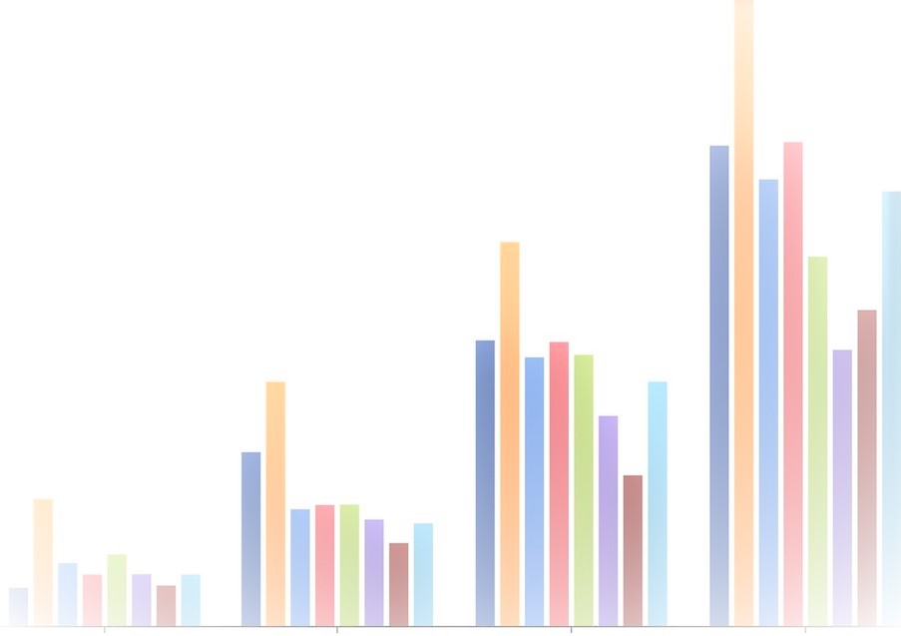



In Aotearoa New Zealand…
Background
Childhood overweight/obesity (2-14 year-olds)
Group-specific information on prevalence, trends and determinants of healthy weight
???
Māori-25%
Pacific-100%
Data on weight and height 0-19-year-olds
Which is essential to…
Fragmented
No information 0-2 year-olds
Monitor progress on reducing unhealthy weight and inequities;
Identify areas and sub-populations of higher need or which could provide exemplars of interventions;
Provide the outcome evaluation data for population interventions;
Inform, shape and catalyse regional actions to tackle unhealthy weight.
Big gaps school-aged children
Mostly aggregated at the national level

Slide 3
Aims/Methods
To map and assess diverse anthropometric datasets of 0-19-year-olds to establish what would be required and which sources would be suitable to be included in a national monitoring platform.
Datasets` assessment (last 2 decades):
Data anonymization and ethical implications;
Representativeness/coverage; frequency; year;
Measurements taken, protocols and equipment;
Potential anthropometric data quality issues and requirements for their harmonisation;
Aggregation level; sampling processes;
Data storage, availability, and access;
Options to make the platform available to end-users.
Potential of Bayesian hierarchical modelling approaches to model anthropometric variables using surrounding data in time, place and population characteristics.
Principles of Te Tiriti o Waitangi to be enacted meaningfully at all steps of this research: guidance of Associate Prof Te Morenga.
COLLABORATION
National committee (technical): stakeholders, researchers and Māori representatives.
International committee (scientific): experts in anthropometric monitoring platforms and in Bayesian hierarchical modelling statistics.
Assessment of socioeconomic and demographic variables: appropriateness and comparability.

Slide 4
Life- course
Age in years
0 | 1 | 2 | 3 | 4 | 5 | 6 | 7 | 8 | 9 | 10 | 11 | 12 | 13 | 14 | 15 | 16 | 17 | 18 | 19
Year when data was collected
National routine data: Since 2000
National routine data: Since 2000
Nationally generalizable: 2009/10
Middlemore hospital: Since 2000
Nationally generalizable: 2011/12
Nationally representative: 2006/07; 2011 to 2020
National routine data: 2010-2020
Nationally generalizable: 2013/14
Waikato region: 2013 to 2017
Nationally representative- school-based: 2002
Nationally generalizable: 2018/19
Nationallyrepresentative:1992/93 (no WC); 2002/03; 2006/07; 2011 to 2020
Nationally representative- school-based: 2007;2012
National, school-based: since 2012-yearly basis
WCTO-Plunket
LMCs
GUiNZ- Cohort
Pacific Islands Family Study-Cohort
GUiNZ
National Health Surveys- children :2-14 years
WCTO-B4SC
Contact:
Teresa Castro
t.castro@auckland.ac.nzc
GUiNZ
Under 5 Energize
Children`s Nutrition Survey: 5-14 years
GUiNZ
National Health Surveys: 15+ years
The Youth Series-secondary schools
Nurses` collection at schools- deciles 1-4
Measurements Age in years | 0 | 1 | 2 | 3 | 4-5 | 6 | 7 | 8 | 9 | 10 | 11 | 12 | 13 | 14 | 15 | 16 | 17 | 18 | 19
Birth weight | XXX
Birth length | XX
Weight | XX | XX | XXXX | XX | XXXXXX | XXX | XX | XXX | XXX | XX | XXX | XX | XXXX | XXXXX | XX | XX | XXX | XX | XX
Height/Length | X | XX | XXX | XX | XXXXXX | XXX | XX | XXX | XXX | XX | XXX | XX | XXXX | XXXXX | XX | XX | XXX | XX | XX
Waist circumference |  |  |  |  | XXX |  | X | XX | XX | X | X | X | XX | XXX | XX | XX | XX | X | X

