Slide 1


USING CELL PHONE DATA TO MONITOR POPULATION MOBILITY AND TOURISM RECOVERY.
Hattie Plant

Slide 2

WHAT WE DO
We get device counts from telecommunications providers
We convert the counts into population estimates, by
Hour
SA2 (neighbourhood-sized area)
Segment (domestic, international, or local)
We also use these estimates to produce a mobility index
OUTPUT: near-real time, hourly estimates of population across the country and how much people are moving around.

Slide 3
COVID
Decision makers needed to know where people were and how much they were moving around
There was no timely, frequent data available
Now, stakeholders are interested in longer term strategy
MINISTRY OF HEALTH
LOCAL COUNCILS
DPMC
Informing COVID-19 Vaccine Strategy
Informing changes in resident behaviours (i.e. working from home, CBD viability, asset/infrastructure utilisation)
Informing COVID-19 Alert Level/Lockdown strategy

Slide 4
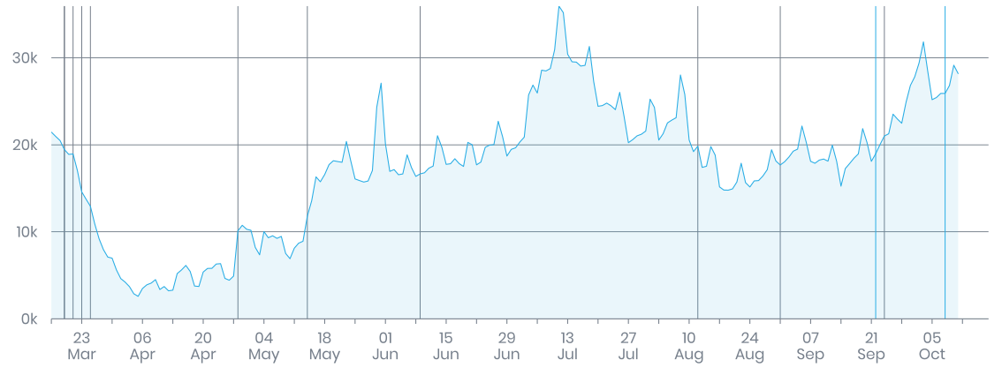
TOURISM RECOVERY
Tourism organisations wanted to understand what tourism looks like with the borders closed
New focus on domestic, not international, tourism
Trans-Tasman bubble – where are visitors going?

Slide 5
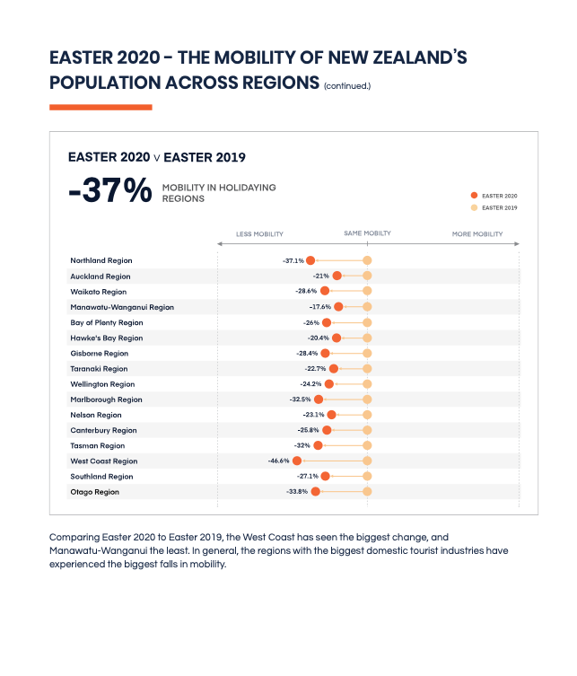
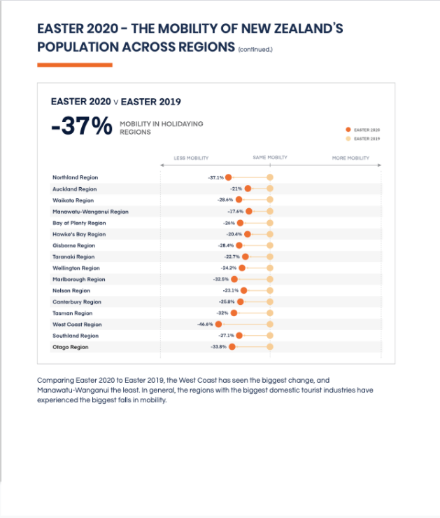
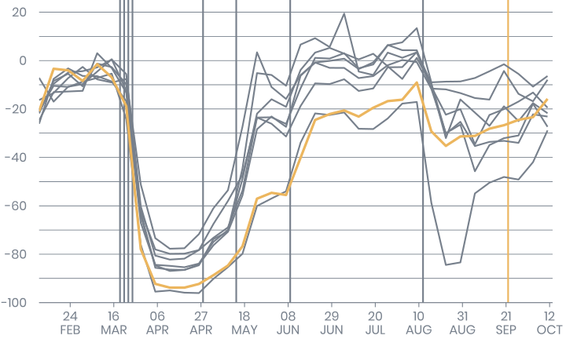

dataventures@stats.govt.nz
dataventures.nz

