Slide 1
NZ MoT VKT and fleet estimation
Purpose
Calculate the number of active motor vehicles in NZ and the distance they are driven
Current and historical
Data source
Waka Kotahi NZTA MVR (Motor Vehicle Register)
Odometer readings at Warrant/Certificate of Fitness checks
General vehicle information (vehicle type (car, truck etc.), fuel, etc.)
Importance/uses
Revenue forecasts
National Land Transport Fund/Road User Charges
Basic knowledge of current state and trends (evidence-based policy)
Input to various models
Tool used
R (currently sas)

Slide 2
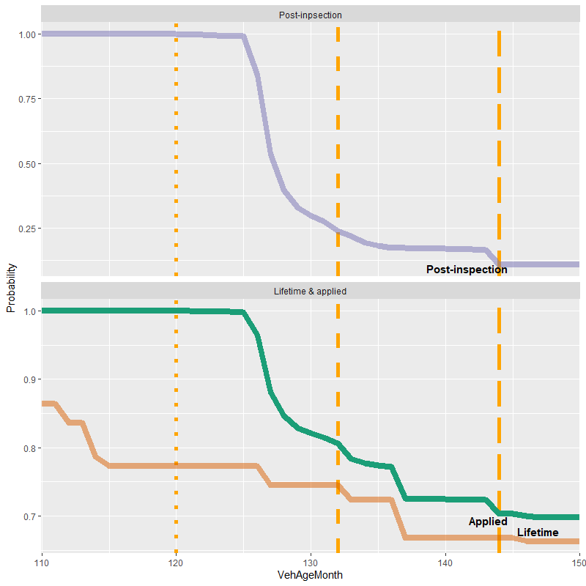
Start and end of life
Problems
No second reading for up to 3 years
Can be up to one year since any reading
Some don’t reappear at all
Assumed use between last inspection and end of life
Fleet size process
Survival rates estimated: combination of
Survival curve (overall)
Reappearance rate post inspections (proxy)
VKT process
Start of life
Older cohorts’ activity in initial 3 years (trend adjusted)
End of life
Assume previous VKT continues
Diminished proportional to survival rate

Slide 3
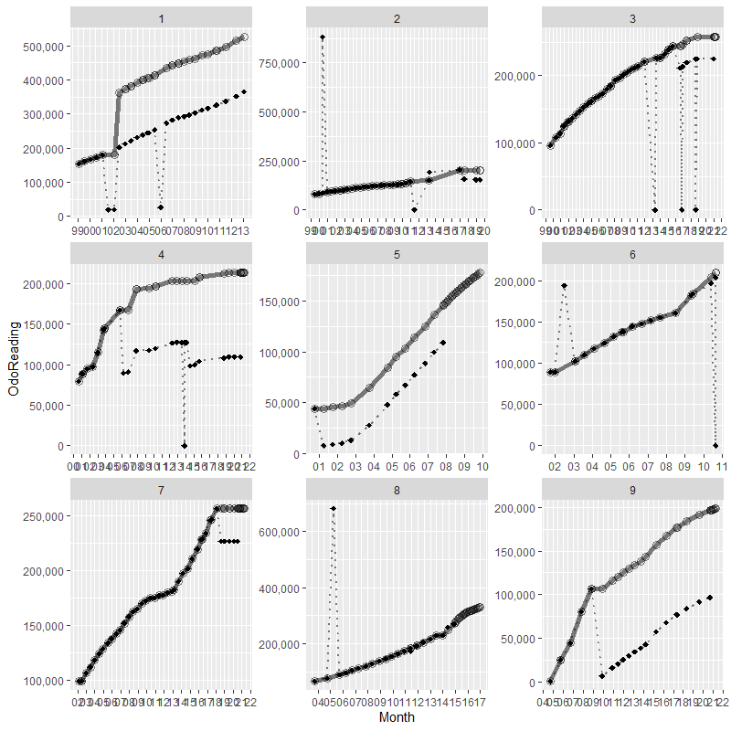
Mid-life
Problems
Erroneous high/low readings
Two (or more) readings on one day
E.g. fail then pass
Legitimate odometer roll-over/replacement
Legitimate high readings
Process
Readings → daily distance (vkt/day)
Identify (& delete) ‘suspect’ readings
Comparison with own behaviour in neighbouring readings
Comparison with cohort (> xth pctle?)
Negative values ignored
Linear interpolation monthly

Slide 4
Contact details
Kain Glensor
NZ Ministry of Transport
k.glensor@transport.govt.nz
Innovations in Applied Data Symposium, Wellington, NZ
3rd June, 2021

