Slide 1
TAWA Treasury’s microsimulation model of the New Zealand personal tax and transfer system
Michael Eglinton
Analytics and Insights Team
20/1/21

Slide 2
The TAWA (Tax and Welfare Analysis) Model
Static microsimulation model of the New Zealand Tax and Transfer System
Used by Government agencies, Tax Working Group, Welfare Expert Advisory Group, and in academic collaborations
Used for:
Estimating costs and distributional impacts of potential personal tax and welfare policies
Understanding the distribution of household incomes, net worth, and expenditure
Child poverty projections

Slide 3

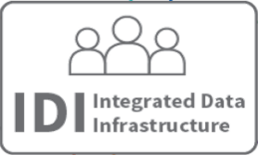




Input Data:
…
Taxable income from IR
Core benefit indicator from MSD
Household Economic Survey
Projections:
Scale so that representative of NZ population
Project up to 5 years ahead using demographic, benefit, and economic forecasts from:
TAWA Modelling:
Current legislation
Reform
…
…
Analysis:
Aggregate impacts of changes to income at national, household, family and individual levels.

Slide 4
Thanks!
Michael.Eglinton@treasury.govt.nz
The views, opinions, findings, and conclusions or recommendations expressed in this presentation are strictly those of the author(s) and do not represent policy advice. They do not necessarily reflect the views of the New Zealand Treasury or the New Zealand Government. The New Zealand Treasury and the New Zealand Government take no responsibility for any errors or omissions in, or for the correctness of, the information contained this presentation.

