Slide 1
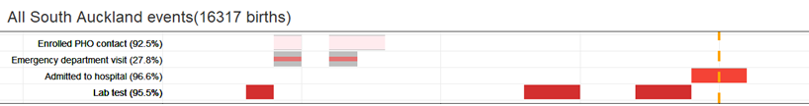
Representative Timeline Analysis
Timelines as an analytic method
Effective because it matches how we experience events
Help foster empathy
Combine science + data + lived experience
Representative timelines
Merge individual timelines to protect privacy and uphold confidentiality
Accessible to the community who can see themselves in the data

Slide 2
Demonstration of method
Person 1
Events A
Person 2
Representative timeline
Events B
Person 3

Slide 3
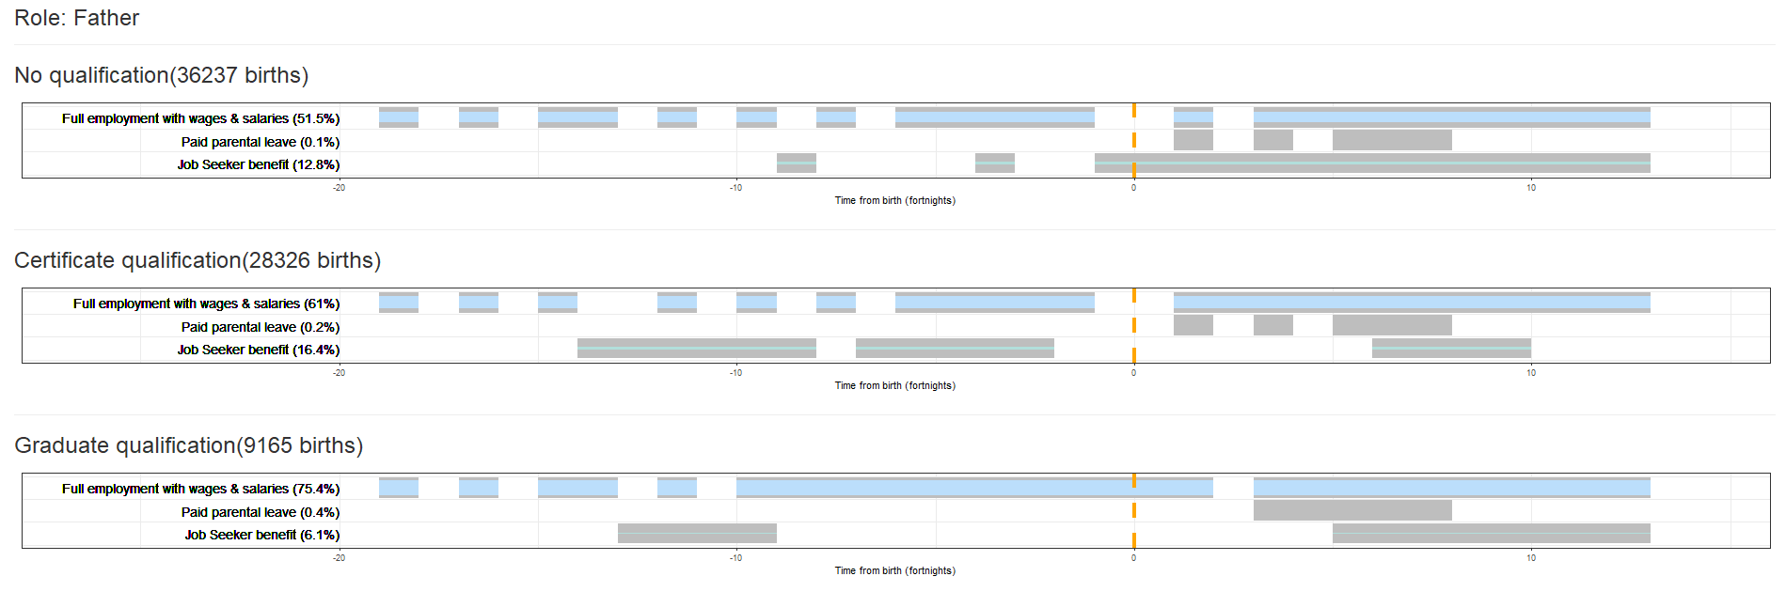
Making meaning from timelines
Fathers’ employment by level of qualification
IDI Disclaimer:
These results are not official statistics. They have been created for research purposes from the Integrated Data Infrastructure (IDI) which is carefully managed by Stats NZ. For more information about the IDI please visit https://www.stats.govt.nz/integrated-data/
Access to the data used in this study was provided by Stats NZ under conditions designed to give effect to the security and confidentiality provisions of the Statistics Act 1975. The results presented in this study are the work of the author, not Stats NZ or individual data suppliers.
The results are based in part on tax data supplied by Inland Revenue to Stats NZ under the Tax Administration Act 1994 for statistical purposes. Any discussion of data limitations or weaknesses is in the context of using the IDI for statistical purposes, and is not related to the data’s ability to support Inland Revenue’s core operational requirements.
Notes:
One row per measure
Horizontal location indicates timing for people with measure in their journey
Width of colour matches percent of people

Slide 4
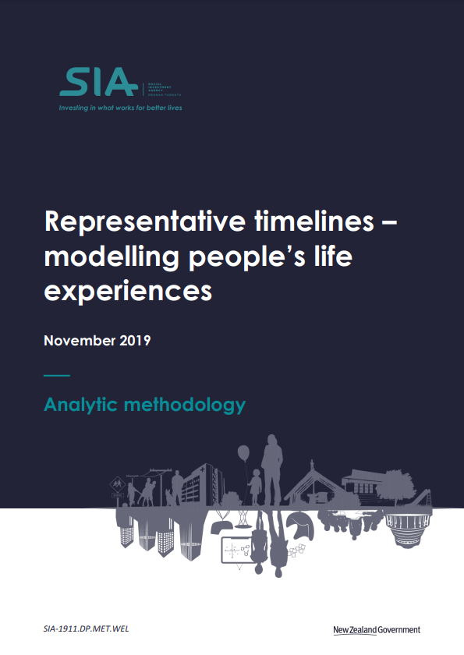


Find out more
Three reports on our website
Code from two IDI research projects using technique available
Interactive timeline visualisation app available
Simon.Anastasiadis@swa.govt.nz
swa.govt.nz
https://github.com/nz-social-wellbeing-agency

