Slide 1



























Pathway modelling to optimise long-term policy impact in New Zealand
Capitals:
Natural
Human
Financial / Physical
Social
Mike O’Sullivan, Jennifer Curtin, Suzanne Woodward, Anna Brown
Likely consequence
Likely consequence
Likely consequence
Living in cold, damp housing
Often unwell growing up
Often absent from school, education disrupted
Difficult to ﬁnd employment, limited opportunities
Less likely consequence
Less likely consequence
Less likely consequence
Less likely consequence
Less likely consequence
Less likely consequence
Likely consequence
Likely consequence
Likely consequence
Living in dry, warm housing
Mostly well growing up
Often present at school, education not disrupted
Not difficult to ﬁnd employment, many
opportunities

Slide 2






















Policy changes in the number of individuals ﬂowing between states in the system. Early intervention has effects that dissipate over time, but cumulative improvement in Four Capitals.
Capitals:
Natural
Human
Financial / Physical
Social
Likely consequence
Likely consequence
Likely consequence
Living in cold, damp housing
Often unwell growing up
Often absent from school, education disrupted
Difficult to ﬁnd employment, limited opportunities
Less likely consequence
Less likely consequence
Less likely consequence
Policy: Remedy Cold
Houses (40% effect)
Requires Natural & Financial input and provides Human and Physical output
“Knock-on” Effect:
12.5% change
“Knock-on” Effect:
3.9% change
“Knock-on” Effect:
1.2% change
Less likely consequence
Less likely consequence
Less likely consequence
Likely consequence
Likely consequence
Likely consequence
Living in dry,
warm housing
Mostly well growing up
Often present at school, education not disrupted
Not difficult to ﬁnd
employment, many
opportunities

Slide 3





















Policy changes in the number of individuals ﬂowing between states in the system. Late intervention only affects Four Capitals at the end of the pathway.
Capitals:
Natural
Human
Financial /
Physical
Social
Likely consequence
Likely consequence
Likely consequence
Living in cold, damp housing
Often unwell growing up
Often absent from school, education disrupted
Difficult to ﬁnd employment, limited opportunities
Less likely consequence
Less likely consequence
Less likely consequence
Policy: Extra Support to help Unemployed (40% effect)
Financial input, Human, Social and Financial output
Less likely consequence
Less likely consequence
Less likely consequence
Likely consequence
Likely consequence
Likely consequence
Living in dry, warm housing
Mostly well growing up
Often present at school, education not disrupted
Not difficult to ﬁnd employment, many opportunities

Slide 4
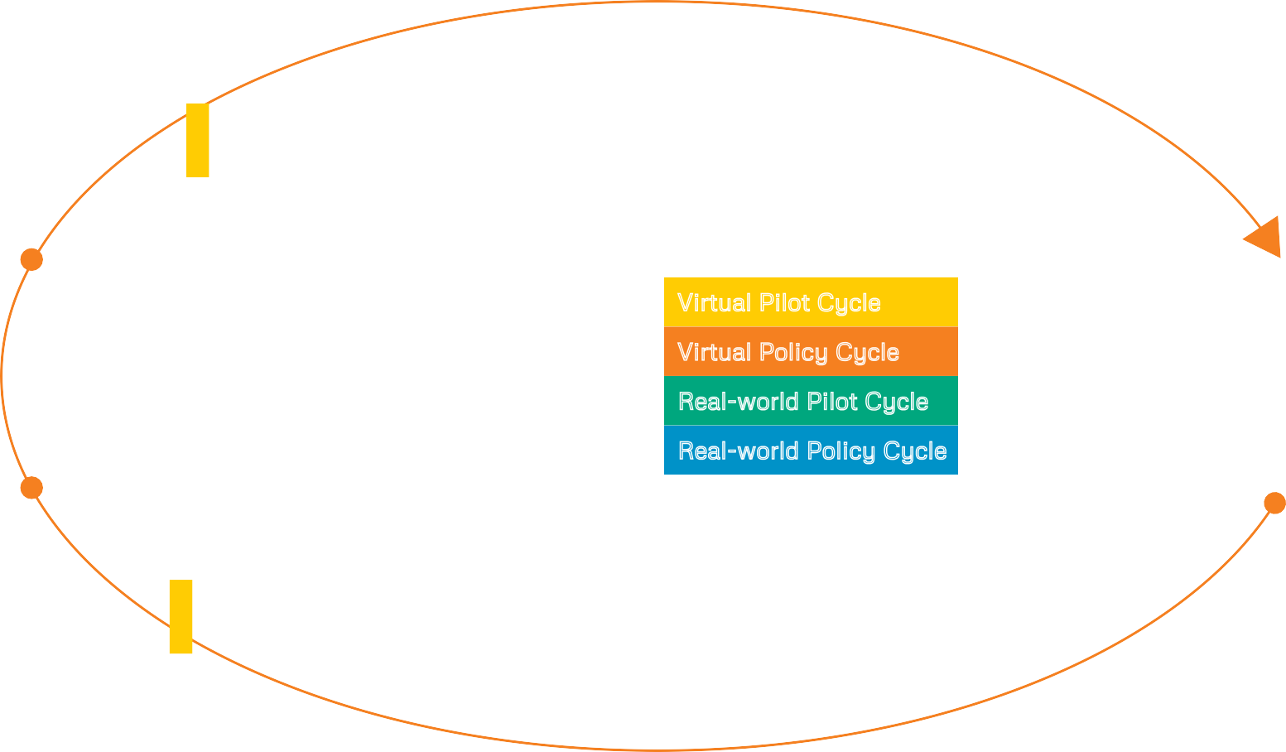
Pathway Modelling and Virtual Policy steps
* = engagement with policy partners
Pathway discovery from linked data
Pathway analysis
Pathway modelling
Data access and processing
Visualisation, representation and communication of pathway models
Narratives *
Virtual pilot evaluation
Real world
pilot evaluation *
Virtual policy evaluation *
Co-design / co-discovery *
Virtual Pilot Cycle
Validation/revision of pathway models and policy
Start of Policy Modelling Process
Virtual pilot
Real world pilot
Virtual policy implementation
Start of Cycles
Virtual policy co-design *
Process evaluation /
self-reﬂection *
Policy evaluation *
Policy implementation *
Pathway recommendation
Contact: s.woodward@auckland.ac.nz
https://orua.auckland.ac.nz/project/policy-planning/

