Slide 1


AN EVEN BETTER UNDERSTANDING OF NZ’S POPULATION DENSITY

Slide 2

QUESTION?
How would you describe an international visitor?
PREVIOUS DEFINITION
Any non-resident in New Zealand who says they will be here less than a year is an international visitor.

Slide 3
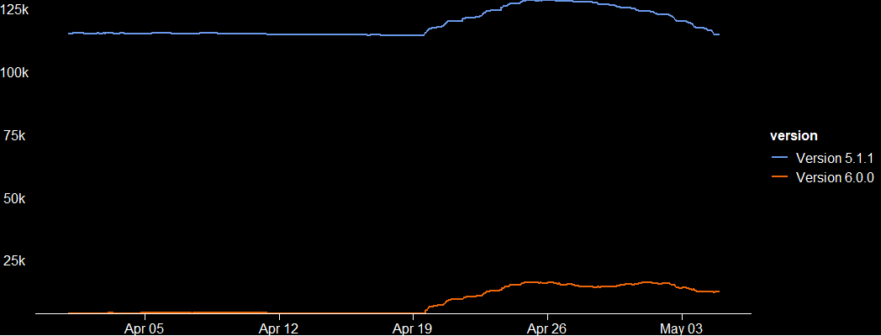
DEVELOPING THE SHORT-TERM VISITOR DEFINITION
Using travel visas and the migration at SNZ, we developed a more tourist based definition.
Determined that non-residents in New Zealand less than 90 days are almost entirely tourists.

Slide 4

DELIVERING BETTER OUTCOMES
Planning for changes in border policy
Tourism industry recovery
taylor.winter@stats.govt.nz

