Slide 1
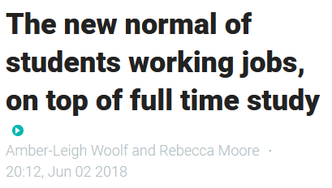
Workload of university students in Aotearoa Seasonal and longitudinal trends
Daniel Wrench (Universities New Zealand)
Dr. Sarah Randal (Universities New Zealand)
Dr. John Randal (VUW)
June 2021
Stuff, June 2018
Notes:
5 minutes
Greeting
Until now, knowledge anecdotal, like this Stuff article, or from surveys, inferences = caveats: confidence intervals, sampling bias, etc. By using the IDI, entire population, giving universities and policy-makers definitive picture of how much students work during their study, and whether it is in fact a “new normal” as claimed by this headline.

Slide 2
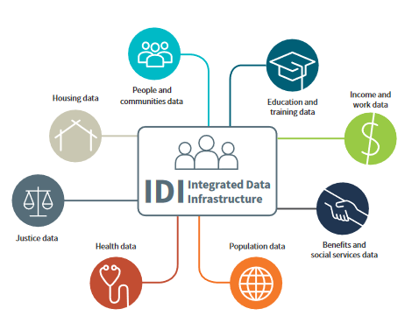
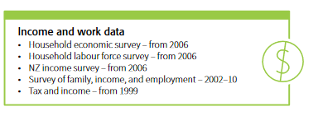
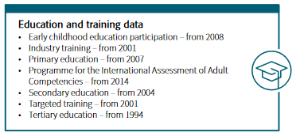
METHOD
Current limitations:
IRD datasets don’t have data on hours worked.
Census an unsatisfactory alternative.
Notes:
Key info
-Studying
-Employed
-Hours – trickier. Not in IRD, census not satisfactory (broad, quality)
-Turned to survey data to calculate average hourly rates for each industry, limiting by age group and highest qual. Not perfect- issues with sample sizes, but best, most refined estimate from data available.

Slide 3


RESULTS
Notes:
Simplify: limit to young Bachelor’s degree students. Domestic: highest rates, increasing slightly (~2000 more students working) Int: lowest rates, but rising
For those that do work, predictable high seasonality, peaking at around 18-25/week over summer for domestic and falling during the academic year to around 10-13. Marginal change between 2009 and 2019.
Int: similar seasonality but fewer hours as a whole, noting international students only allowed to work max 20 hours a week during term-time. Again, little change over the years, slight increase for some months, slight decrease for others.
Looking at the industries: retail and hospo dominate, though hospo much more common for int. Int are employed in a narrow range of industries, with low employment rate counters job-taking narrative.

Slide 4
Workload of university students in Aotearoa Seasonal and longitudinal trends
Daniel Wrench
Universities New Zealand
daniel.wrench@universitiesnz.ac.nz
IDI disclaimer
These results are not official statistics. They have been created for research purposes from the Integrated Data Infrastructure (IDI). Access to the data used in this study was provided by Stats NZ under conditions designed to give effect to the security and confidentiality provisions of the Statistics Act 1975. The results presented in this study are the work of the UNZ, not Stats NZ or individual data suppliers. The results are based in part on tax data supplied by Inland Revenue to Stats NZ under the Tax Administration Act 1994 for statistical purposes. Any discussion of data limitations or weaknesses is in the context of using the IDI for statistical purposes, and is not related to the data’s ability to support Inland Revenue’s core operational requirements.
Notes:
This study shows that the large majority of domestic students do work during the year, as well as an increasing proportion of all students. This new definitive quantitative descriptive study has potentials implications for things like the academic expectation of university students, the financial support they receive from the government, and the mental health needs for those juggling work and study.

