Slide 1

An Our-of-Order Superscalar Soft CPU
Wesley W. Terpstra
ORCONF2015

Slide 2
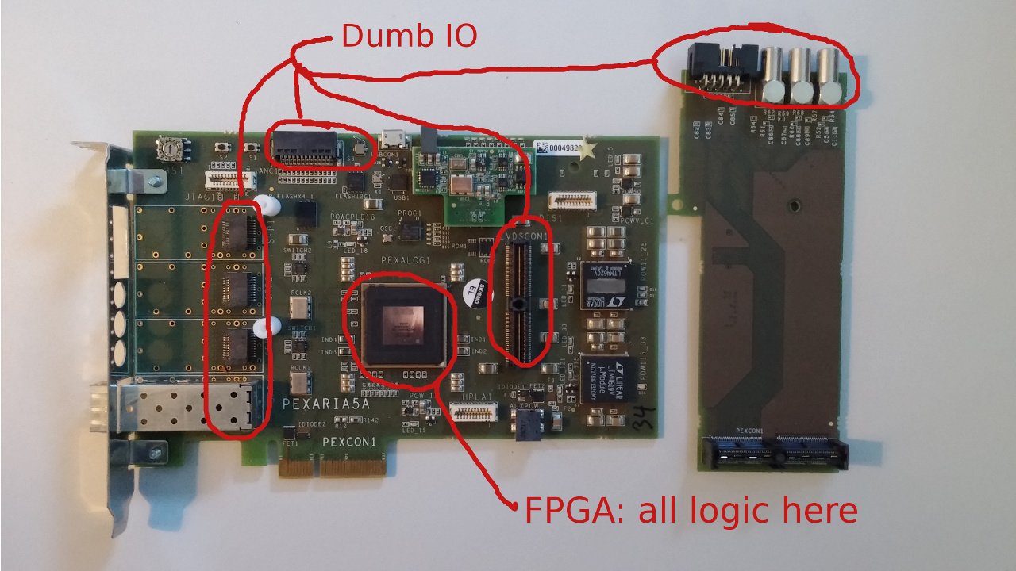
GSI – Embedded System on Chip
We build a particle accelerator
  Need custom control hardware with various form factors
All cases: an FPGA in the middle with dumb IO drivers
Sometimes we need a few microcontrollers

Slide 3
Microcontrollers: The options
“Hard-IP” - a dedicated ASIC attached to the FPGA
  Highest performance option
  Must know in advance number of cores needed
  Cannot modify behaviour or couple with in-chip logic
Closed-source soft CPUs (soft = implemented inside FPGA)
  Cannot modify behaviour
  Cannot port between FPGA vendors
Open-source soft CPUs
  Many good implementations (LM32, OR10k, LEON3)
  Highest flexibility and safe against vendor lock-in

Slide 4
FPGAs vs. ASICs
Circuits are designed in a HDL; Verilog / VHDL / etc
Both compile to registers and OR/XOR/AND/etc
  Here the similarity ends
FPGAs are reconfigurable, so less space and slower
  ASIC designs can generally hit 10* the frequency
On the other hand, FPGAs include custom RAM and DSP
  Compared to logic, on-chip and off-chip DDR RAM are fast
Content-Addressable Memory and Multiported RAMs are big
  Ok for an ASIC, but a problem for FPGAs

Slide 5
CPU Taxonomy
For sequential programs, the options are
 | In-Order | Out-of-Order
Scalar | Classic LM32, OR10k, LEON3, uRV, ... | Rare Slow memory: + Not for FPGAs
Superscalar | VLIW Itanic, DSPs | Modern ASICs Haswell, ARM OPA
Area cost
Ω(n^2)
Performance
per clock (IPC)

Slide 6

OPA: Work-in-Progress!
OPA mostly works, but is incomplete
Barely tested!
No interrupt controller
No CSRs
No division
Wishbone ERR ignored
No MMU / TLB
No ITTAGE predictor

Slide 7

The OPA core at a glance
When instantiating OPA it is connected like
LM32 | RV32
# EUs, ways, ops
Cyclone/Arria/etc
Generic
Parameters
OPA core
Instruction Bus
Data Bus
Peripheral Bus
Pipelined
Wishbone
Read-only
Out-of-Order reads
  Speculative jumps
Cached
Read-write
Out-of-Order reads
Writeback cached
  Writes never fail
Read-write
In-order reads
Uncached
All IO goes here

Slide 8
The OPA pipeline for a 2+1 issue configuration
Predict
Fetch
Decode
Rename
Issue
Prepare
Regfile
Fast0
Fast1
Slow0
Fault
L1d
Select
~9 stage pipeline
Misprediction penalty 8 or 13 cycles

Slide 9

Preliminary size and fMAX comparison
 | OPA “large” | OPA “small” | OPA “tiny” | LM32 | Units
Schedule size | 27 | 18 | 6 | 1 | Instructions
Issue width | 2+1 | 1+1 | 1+1 | 1 | Instructions
Fetch width | 4 | 2 | 1 | 1 | Instructions
Cache config | 2-way I+D | 2+1-way I+D | 1-way I+D | 1-way I+D | 4kB pages
Core-only area | 8540 | 4840 | 2470 | 1464 | ALMs
Arria 5 I3 | 150 | 175 | ? | 170 | MHz
Cyclone 5 C6 | 125 | 145 | 155 | 140 | MHz
Cyclone 5 C8 | 98 | 108 | 113 | 108 | MHz
The same top design was used, consisting of a CPU + uart + jtag RW RAM
All results from Quartus 15.0.2 compiled with “High Performance Effort”
fMAX numbers should be considered accurate only to ±3%; fitter runs vary
A bit unfair: OPA was developed on Altera FPGAs and the LM32 on Lattice

Slide 10
In-Order execution on the LM32
lbu r2,(r1+0) 1 +1 stalls sw
addi r1,r1,1 1
sw (r4+0),r2 1
bne r1,r3,-4 1 +4 taken branch
            --------
              9 cycles per iteration for LM32 without branch prediction
for (p = 0; p < e; ++p)
*o = hello[p];

Slide 11
Out-of-Order execution considers more instructions
lbu r2,(r1+0)
addi r1,r1,1
sw (r4+0),r2
bne r1,r3,-4
lbu r2,(r1+0)
addi r1,r1,1
sw (r4+0),r2
bne r1,r3,-4
lbu r2,(r1+0)
addi r1,r1,1
sw (r4+0),r2
bne r1,r3,-4
lbu r2,(r1+0)
addi r1,r1,1
sw (r4+0),r2
bne r1,r3,-4
for (p = 0; p < e; ++p)
*o = hello[p];
Cannot execute lbu until
sw completes; both use r2
Scheduler window

Slide 12
Rename registers using a small table after decode
lbu r2,(r1+0)
addi r1,r1,1
sw (r4+0),r2
bne r1,r3,-4
lbu r2,(r1+0)
addi r1,r1,1
sw (r4+0),r2
bne r1,r3,-4
lbu r2,(r1+0)
addi r1,r1,1
sw (r4+0),r2
bne r1,r3,-4
lbu r2,(r1+0)
addi r1,r1,1
sw (r4+0),r2
bne r1,r3,-4
Architecture | Physical
r1 | p0
r2 | -
r3 | e
r4 | o
lbu l0,(p0+0)
addi p1,p0,1
sw (o+0),l0
bne p1,e,-4
lbu l1,(p1+0)
addi p2,p1,1
sw (o+0),l1
bne p2,e,-4
lbu l2,(p2+0)
addi p3,p2,1
sw (o+0),l2
bne p3,e,-4
lbu l3,(p3+0)
addi p4,p3,1
sw (o+0),l3
bne p4,e,-4
gets r1
sets r2
gets r1
sets r1
Architecture | Physical
r1 | p0
r2 | l0
r3 | e
r4 | o
Look up arguments in rename table
Pick a free physical register
Replace output in table

Slide 13
Renaming decouples key inter-iteration instructions
lbu l0,(p0+0). . .
addi p1,p0,1 . . . .
sw (o+0),l0 . . .
bne p1,e,-4 . . . .
lbu l1,(p1+0). . .
addi p2,p1,1 . . . .
sw (o+0),l1 . . .
bne p2,e,-4 . . . .
lbu l2,(p2+0). . .
addi p3,p2,1 . . . .
sw (o+0),l2 . . .
bne p3,e,-4 . . . .
lbu l3,(p3+0). . .
addi p4,p3,1 . . . .
sw (o+0),l3 . . .
bne p4,e,-4 . . . .
for (p = 0; p < e; ++p)
*o = hello[p];
Each loop iteration only depends on prior add
The lbu+sw can be essentially pipelined
A 2+2 OPA executes each iteration in 1 cycle
A 1+1 OPA executes each iteration in 2 cycles
... compared to 9 cycles for a LM32

Slide 14
Out-of-Order scheduler
Ready Issued
lbu l0,(p0+0). . . 1 1
addi p1,p0,1 . . . . 1 1
sw (o+0),l0 . . . - 1
bne p1,e,-4 . . . . - 1
lbu l1,(p1+0). . . 1 1
addi p2,p1,1 . . . . 1 1
sw (o+0),l1 . . . - 0 slow0
bne p2,e,-4 . . . . - 1
lbu l2,(p2+0). . . 0 1
addi p3,p2,1 . . . . 1 1
sw (o+0),l2 . . . - 0
bne p3,e,-4 . . . . - 0 fast1
lbu l3,(p3+0). . . 0 1
addi p4,p3,1 . . . . 0 0 fast0
sw (o+0),l3 . . . - 0
bne p4,e,-4 . . . . - 0
for (p = 0; p < e; ++p)
*o = hello[p];
Issue stage selects the oldest unissued
instructions with arguments ready.
Issued instructions become ready either
next cycle (fast) or in three cycles (slow).
… even if the instruction later fails.

Slide 15
Potential mistakes in OPA
Rename Commit
lbu l0,(p0+0)
addi p1,p0,1
sw (o+0),l0
bne p1,e,-4
lbu l1,(p1+0) cache miss!
addi p2,p1,1
sw (o+0),l1
bne p2,e,-4
lbu l2,(p2+0)
addi p3,p2,1
sw (o+0),l2
bne p3,e,-4 mispredict!
lbu l3,(p3+0)
addi p4,p3,1
sw (o+0),l3
bne p4,e,-4
for (p = 0; p < e; ++p)
*o = hello[p];
Instructions shifted this way
Fault
Cache miss first detected in L1d stage, after dependent instructions issued. Handle by: reissuing load + dependents
Mispredicted bne kills all later instructions. Must also restore renamer state.
Handle by: track rename state twice
wait for bne to commit, then reload map
Rename Speculative
New instructions renamed

Slide 16
Load-store aliasing
lbu l0,(p0+0)
addi p1,p0,1
sw (o+0),l0
bne p1,e,-4
lbu l1,(p1+0)
addi p2,p1,1
sw (o+0),l1
bne p2,e,-4
lbu l2,(p2+0)
addi p3,p2,1
sw (o+0),l2
bne p3,e,-4
lbu l3,(p3+0)
addi p4,p3,1
sw (o+0),l3
bne p4,e,-4
for (p = 0; p < e; ++p)
*o = hello[p];
What if this load reads the location this store writes?
The issue stage only considers register dependencies.
It will happily execute the load first, before the store!

Slide 17
Load-Store Buffer does not work for an FPGA
The classic solution is a load-store buffer
  Stores are buffered until commit (to prevent bad speculation)
    (a big CAM)
  Loads check the store buffer and take their data from it
    (correction, a big multiported CAM)
  Stores check if any loads alias and restart them
    (another big multiported CAM for the loads)
  All this effort for uncommon, badly optimized code!

Slide 18
Some observations about load-store aliasing
The classic solution is a load-store buffer
  Stores are buffered until commit (to prevent bad speculation)
    (the target address and data already live in regfile)
  Loads check the store buffer and take their data from it
    (if loads are reissued after stores commit, unnecessary)
  Stores check if any loads alias and restart them
    (this can be imprecise; we can restart innocent loads)
  Don't pay expensive area to solve a rare problem!

Slide 19
OPA's solution to the load-store alias problem
OPA has no store-buffer, only a small load-buffer
  Stores are buffered until commit (to prevent bad speculation)
    only execute stores when they are the oldest instruction
  Loads check the store buffer and take their data from it
    do nothing
  Stores check if any loads alias and restart them
    use a small 1-port CAM to reduce restart of innocent loads
  End result: only 4% of the OPA area

Slide 20
Demo Time!
… a 2+1 OPA on the cheapest 28nm Altera FPGA

Slide 21
More fun Topics – Just ask me!
Commit policy: final, old, oldest, and complete
Prefix-Sum wakeup-select scheduler
  Calculate intra-window dependencies during rename
Register-file: 2N readers, N writers
Immediate-file: D writers, N readers
  Must contain PC to verify indirect jumps (?)
Delaying issue of ordered instructions
Loads to pbus are particularly slow... lbu r0,(x) = prefetch?

Slide 22
Conclusion
FPGAs today can fit an out-of-order superscalar CPU
The area increase is not unreasonable
  9k ALMs for a 2+1 OPA with 27-op schedule
  Cost is 6* the area of an LM32, or 3* for a 1+1 OPA
Out-of-order OPA fMAX is comparable to in-order LM32
OPA is a work in progress
  … but soon you can trade area for speed
  … add your ISA here!

Slide 23
Thank you …
… questions and suggestions are welcome!
… source at github.com/terpstra/opa

