Slide 1
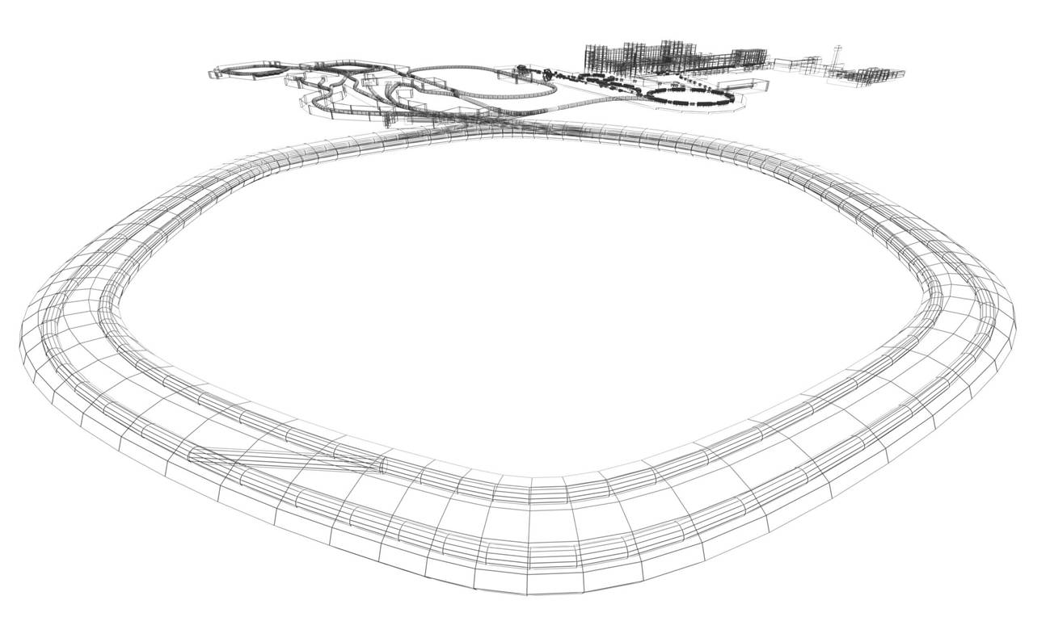

Message Signalled Interrupts in Mixed-Master Control
Wesley W. Terpstra
GSI, Germany
ICALEPS 2015

Slide 2

What is Wishbone?
  Wishbone: synchronous parallel bus
  Simple master-slave connections only

Slide 3
What is Wishbone?
  Wishbone: synchronous parallel bus
  Simple master-slave connections only
CYC
STB
STALL
ACK
Unstalled request

Slide 4
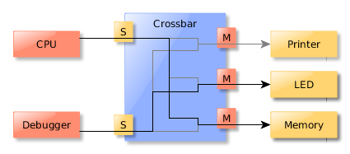
WB bus is extended using crossbars
A crossbar acts as a network switch
Slave ports for masters and master ports for slaves

Slide 5
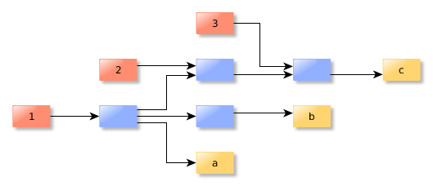
Big systems have multiple crossbars
Our timing receivers contain ~50 WB components
Nesting crossbars is a useful organizational tool

Slide 6
Slaves must be able to signal masters
In Wishbone, all communication initiated by master
Sometimes slaves must tell the master they have data
  Help! I'm on fire!

Slide 7
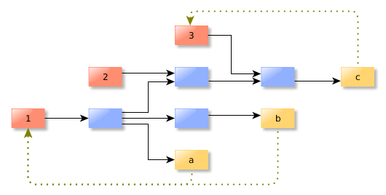
Approach: Classic interrupts
Slaves connected to a predetermined master
Master must query all slaves to find source
Interrupt priorities fixed at design-time (shared line)
Cheap, but ... Not composable

Slide 8
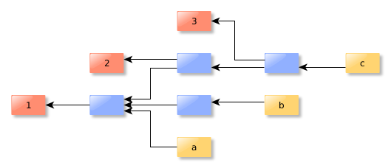
Approach: Message Signalled (MSI)
Invert Wishbone bus
  Slaves send messages to masters
  Address selects master

Slide 9
MSI is composable
Masters tell slaves their address
  Slaves can notify any master which controls them
Masters have thousands of “interrupt target addresses”
  Can immediately distinguish source of MSI
  Can prioritize MSIs by choosing destination queue
Composable: just plug two crossbars together

Slide 10
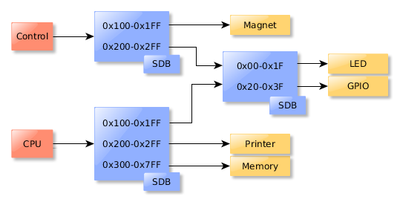
Addressing and SDB
To find slaves, masters recursively search SDB
Slaves addresses differ as seen from different masters
Addresses describe a path, not a destination

Slide 11
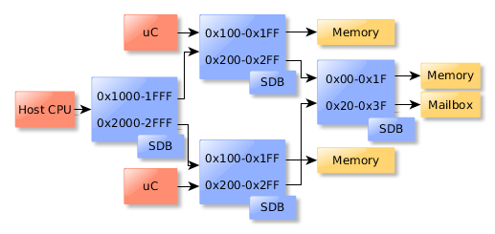
Addressing and SDB
In MSI bus, master address differs from slave PoV
When masters scan bus, also scan backwards path
  address slaves need to send master MSI
  constructed bottom-up

Slide 12
WB+MSI well suited for complex buses
Wishbone scales well, from 2- to 50-component systems
MSI expands bus composability to interrupts
SDB must be extended with master records

Slide 13

Questions?

