Slide 1
Bringing the power of synthetic data generation to the masses
NCBI FAIR hackathon – April 15-16

Slide 2
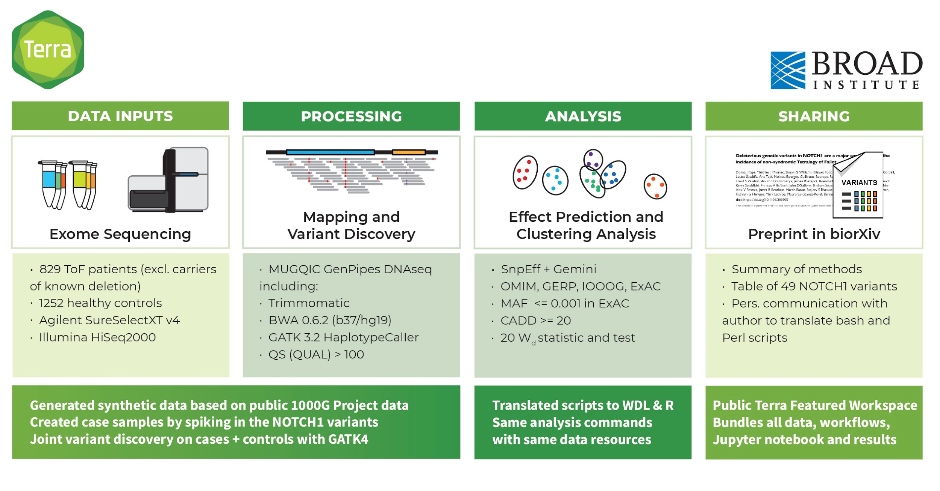
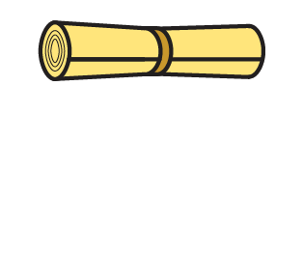
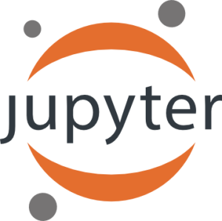
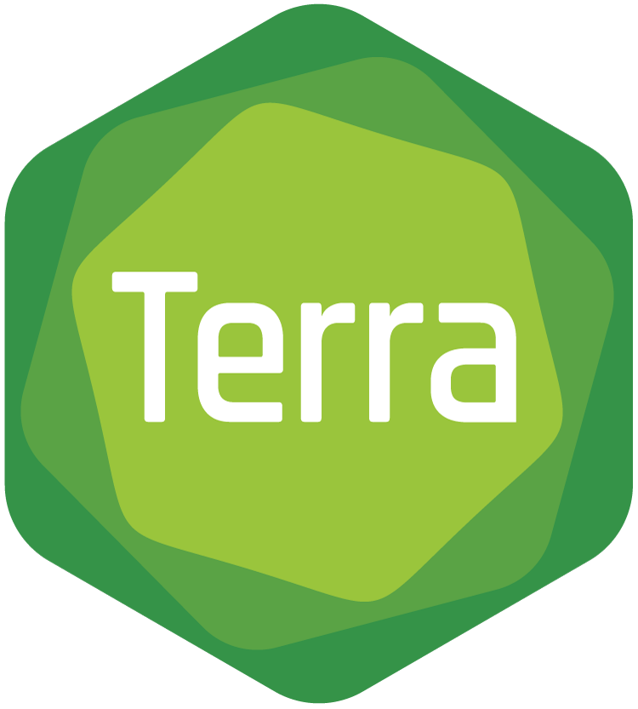

Slide 3
DATA
RESULT
ANALYSIS
A few questions we hope to answer.
“Can we confirm that this is true?”
"Is it useful for more than one case?"
“Can we repeat
the experiment?”
DATA IN DEMAND
data + resources
2. METHOD OPTIMIZATION
3. DIVERSE OPTIONS
4. QUALITY CONTROL
What kind of datasets would be useful to the community?
general, automated
specific, manual
specific, manual
Reduce cost and runtime of our portable workflows
Enable more data types and more variant types
Evaluate whether synthetic data we generate is suitable

Slide 4
What does it mean to reproduce an analysis?
OTHER
DATA
Reproduce ≠ Replicate
OTHER ANALYSIS
“Can we confirm that this is true?”
DATA
ANALYSIS
RESULT
BIOLOGICAL FINDINGS
DATA
ANALYSIS
RESULT
“Can we repeat
the experiment?”

Slide 5
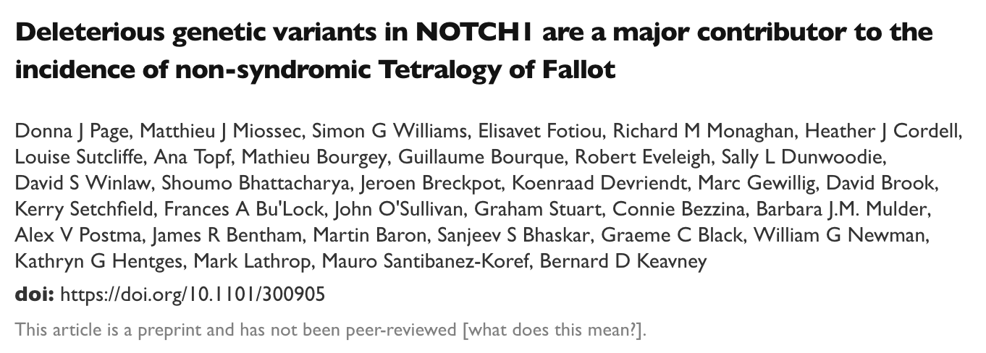
Case study
https://www.biorxiv.org/content/early/2018/04/13/300905

Slide 6
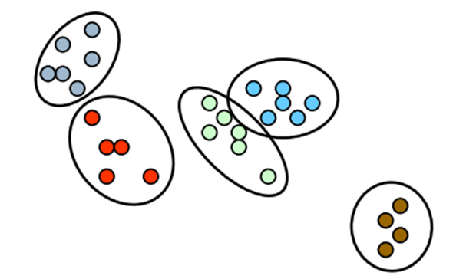
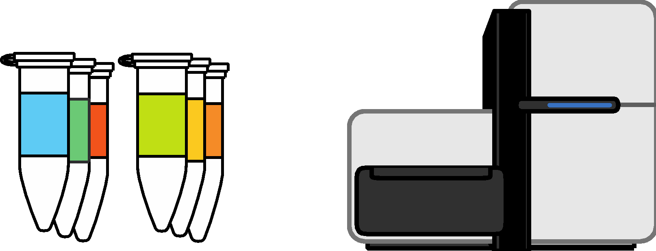
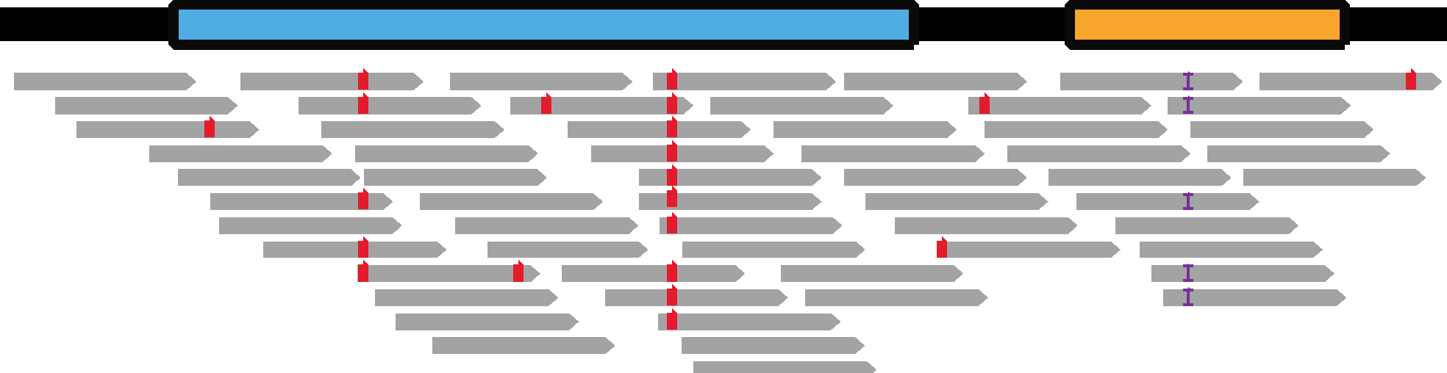
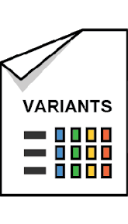
What’s in the box? Reconstructing the analysis based on the preprint
INPUT
PROCESSING
ANALYSIS
SHARING
data + resources
general, automated
specific, manual
materials & methods
Exome sequence data
Mapping &
Variant Discovery
Effect Prediction &
Clustering Analysis
Preprint in biorXiv*
829 case samples
1252 control samples
Agilent SureSelectXT v4
Illumina HiSeq2000
MUGQIC GenPipes DNAseq
Trimmomatic
BWA 0.6.2 (b37/hg19)
GATK 3.2 HaplotypeCaller
QS (QUAL) > 100
SnpEff + GEMINI
OMIM, GERP, 1000G, ExAC
MAF ≤ 0.001 in ExAC
CADD >= 20
W_{d} statistic and test
Supplemental materials
Table of 49 NOTCH1 variants
+ Summary of methods
* Page, Miossec et al., 2018. Deleterious genetic variants in NOTCH1 are a major contributor to the incidence of non-syndromic Tetralogy of Fallot
https://www.biorxiv.org/content/early/2018/04/13/300905

Slide 7
Our approach to reproducing the work
INPUT
PROCESSING
ANALYSIS
SHARING
data + resources
general, automated
specific, manual
materials & methods
Exome sequence data
Mapping &
Variant Discovery
Effect Prediction &
Clustering Analysis
Preprint in BioarXiv*
829 case samples
1252 control samples
Agilent SureSelectXT v4
Illumina HiSeq2000
MUGQIC GenPipes DNAseq
Trimmomatic
BWA 0.6.2 (b37/hg19)
GATK 3.2 HaplotypeCaller
QS (QUAL) > 100
SnpEff + Gemini
OMIM, GERP, 1000G, ExAC
MAF ≤ 0.001 in ExAC
CADD >= 20
W_{d} statistic and test
Methods summary
+ list of 49 NOTCH1 variants in supplemental materials
Generated synthetic data based on 1000G
Cases created by spiking in the NOTCH1 variants
Joint variant discovery on cases + controls with GATK4
Translated scripts Same commands
with same data resources
Terra workspace
Contains all data, workflows and notebook
* Page, Miossec et al., 2018. Deleterious genetic variants in NOTCH1 are a major contributor to the incidence of non-syndromic Tetralogy of Fallot
https://www.biorxiv.org/content/early/2018/04/13/300905

Slide 8
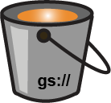

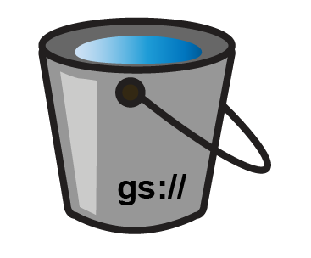

6 workflows + 1 notebook in a Terra workspace
6-Predict-variant-effects-GEMINI
1-Collect-1000G-participant
Variant
calls
Predicted
effects
2-Generate-synthetic-reads
Synthetic
exome data
ashg18-notebooks-cluster_analysis
3-Mutate-reads-with-BAMSurgeon
Mutated
exome data
Final table
of results
4-Call-single-sample-GVCF-GATK4
Sample
GVCFs
5-Joint-call-and-hard-filter-GATK4
Multisample
variant calls
gs://firecloud-workshops/181017-ashg18

Slide 9
Project objectives
1. Data in demand What kind of datasets would be useful to the community?
2. Diversifying Options Enable more data types and more variant types
3. Method optimization: Reduce cost and runtime of our workflows
4. Quality control Evaluate that the synthetic data we generate is suitable
All computational work can be done on Terra

Slide 10




Terra is a platform for Data Access & Analysis
Biomedical
Researchers
All of Us
App
Terra
App
Custom Apps & Portals
Data Generators
Tool Developers
Terra API
Data
Wrangling, Storage & Access
Data
Workspaces
Tools
Tool Generation & Maintenance
Services
Notes:
A modular platform that provides services for managing & accessing data, methods and execution. It’s pluggable so other apps/portals can live on top of it and provide complementary functionality or specialized views into data/results.
Allows data generators to deliver data to the relevant communities with minimal effort
Allows tool developers to make their tools accessible to the relevant communities with minimal effort, taking away a ton of technical obstacles (dependencies, hardware requirements etc)
Allows researchers to focus on their science!

Slide 11
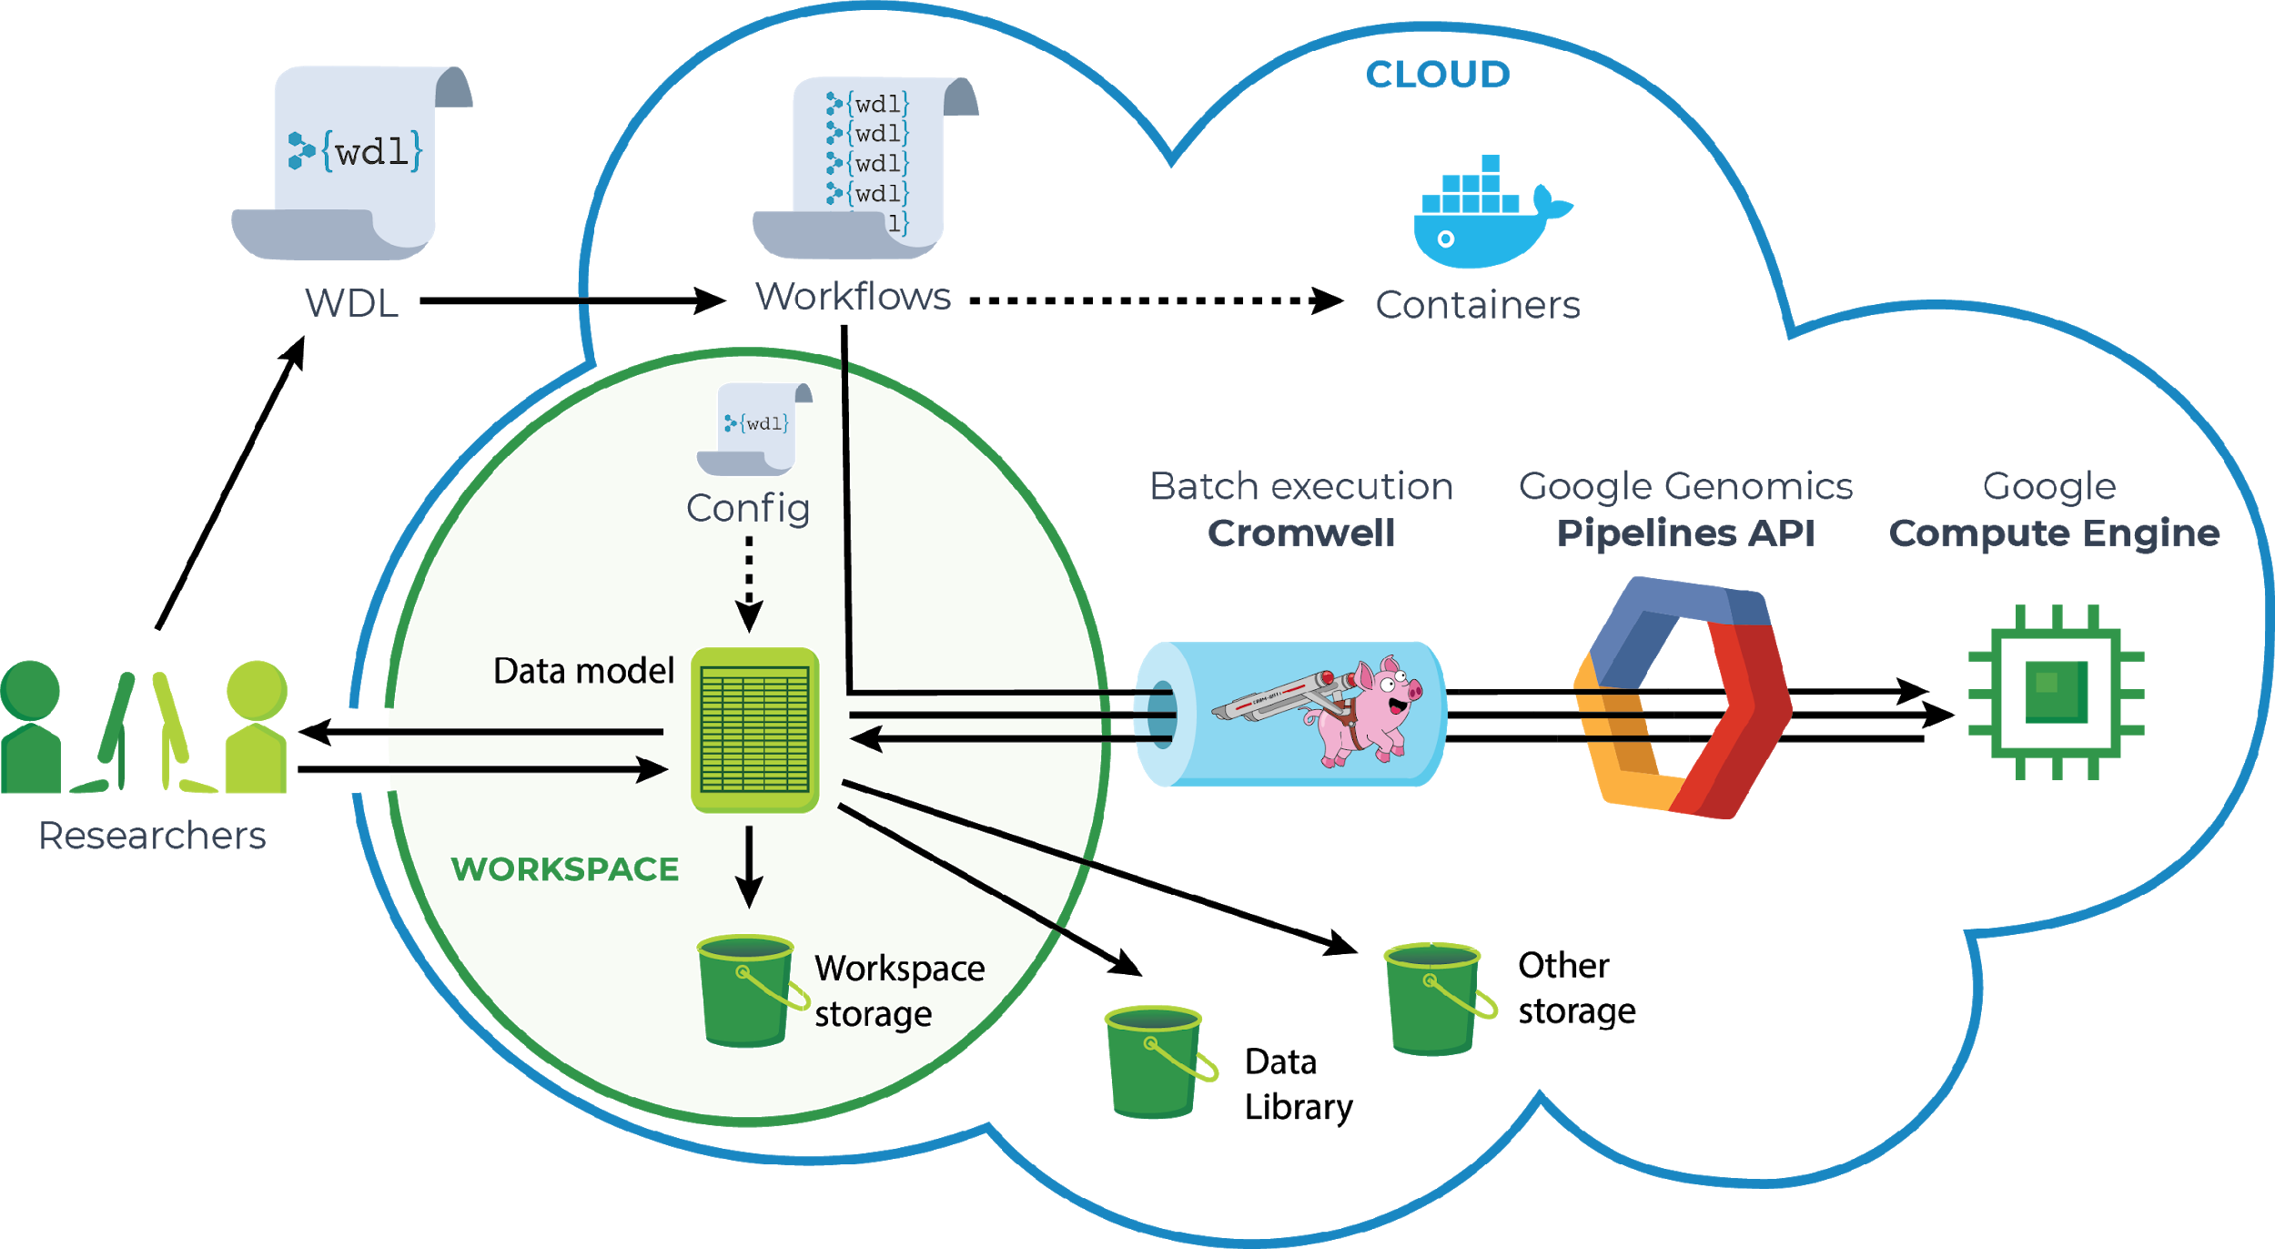
Workflow execution in Terra
Notes:
Let's say you're a researcher and you want to run a workflow on some data (aka pipeline)
Upload/import data & workflows
-> launch pipelines -> cromwell (already included under the hood)
runs pipelines on Google -- then gives the results back
Easy to give access to a collaborator
share data, methods, or share publicly
Access data in Data Library

Slide 12
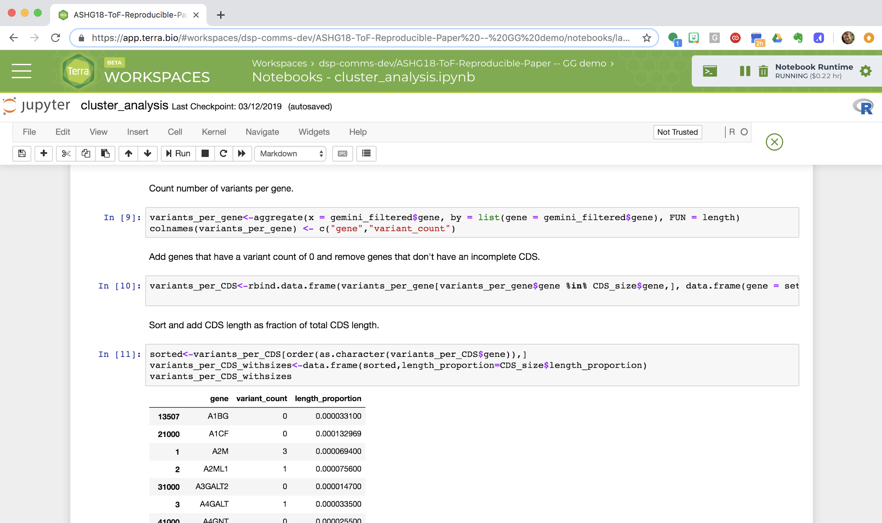
Interactive analysis with Notebooks in Terra
Notes:
After running methods on your data, you want to Interact with your data. Plot things, etc.
New feature: Jupyter notebooks; a newer, popular way of doing Interactive data analysis and providing reproducible methods
-> python and r commands on your data to do whatever analysis you want

Slide 13
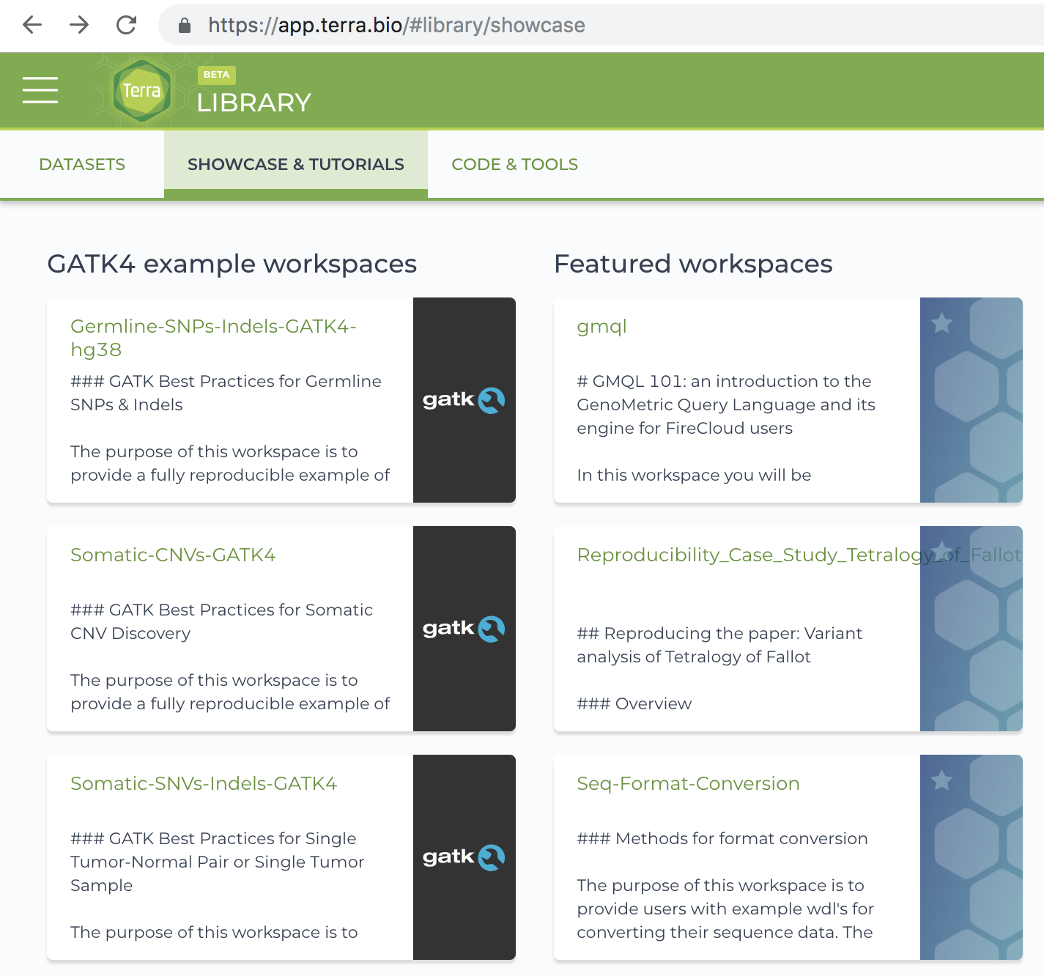
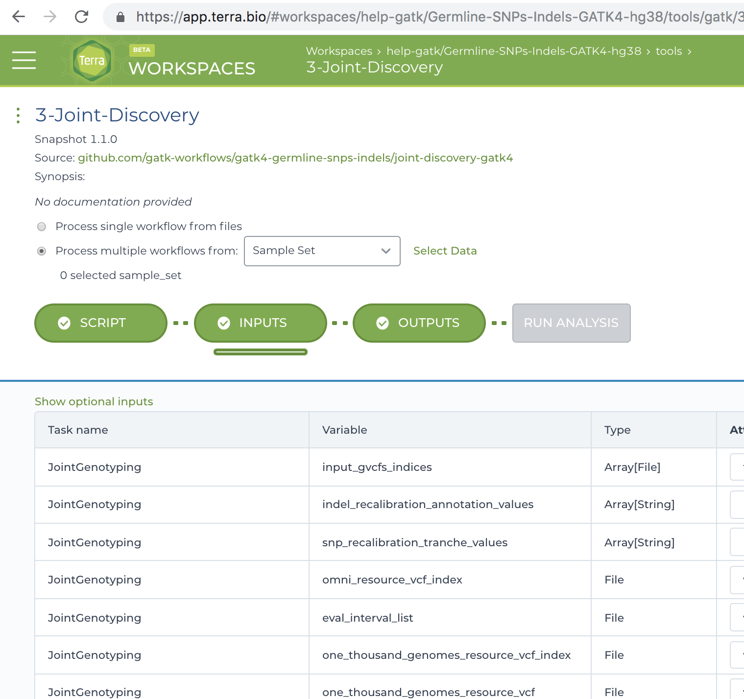
Example analysis and tool workspaces: fully loaded out of the box
Notes:
For many end users, one of the great attractions is the availability of preloaded workspaces with common analysis tools, studies or tutorials fully set up and ready to go, either to use out of the box or as a cookbook recipe to build on.

