Slide 1
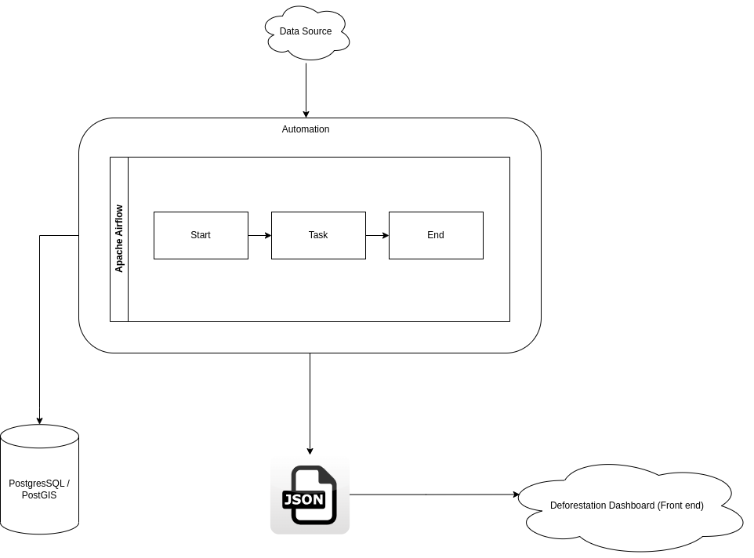
Architecture – Emphasis on Technology Stack

Slide 2
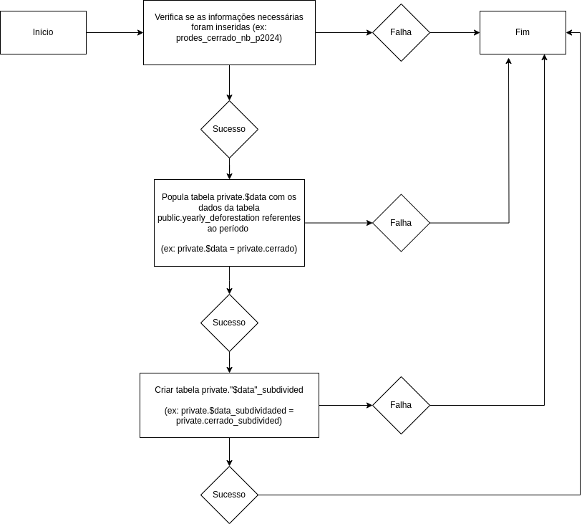
Flowchart 1

Slide 3
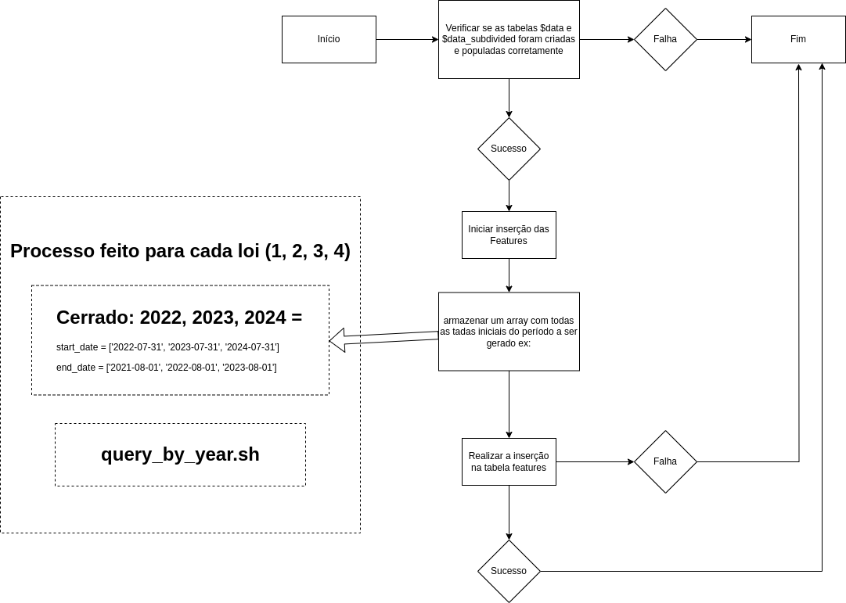
Flowchart 2

Slide 4
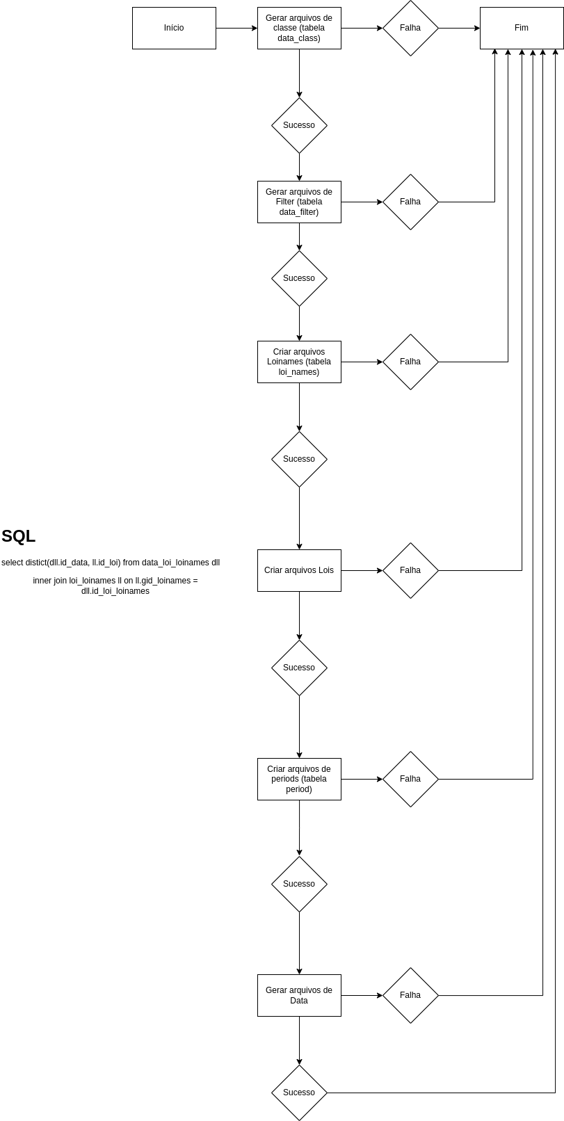
Flowchart 3

Slide 5
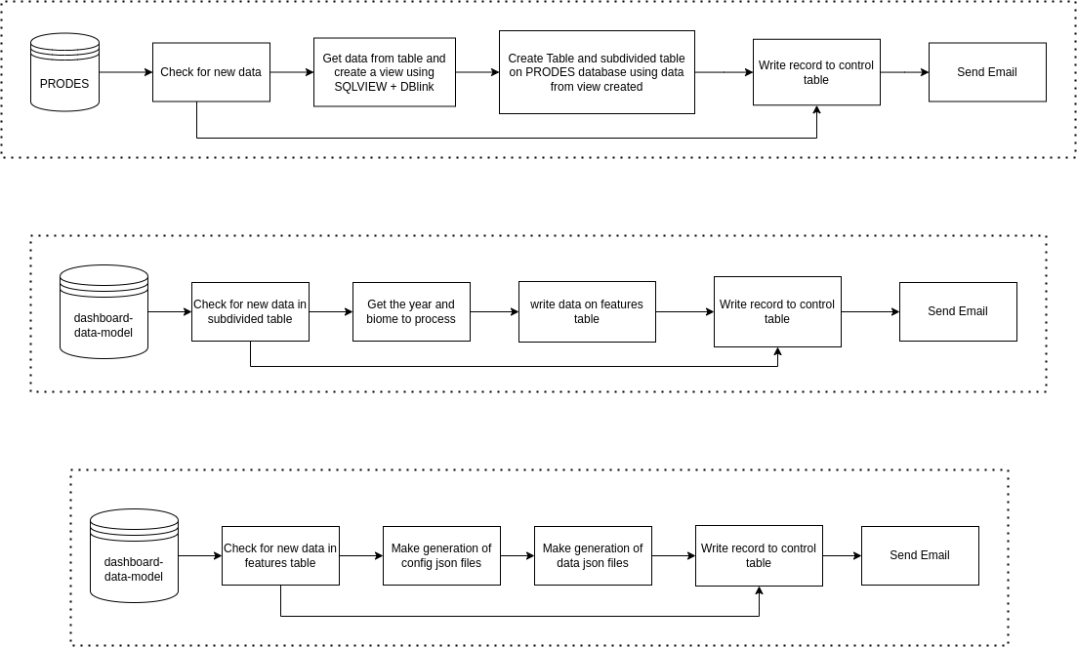
Data Flow

