Slide 1
UBC BIZTECH HELLOHACKS 2026
Lauds
The first thing you check in the morning.
Notes:
[0:00, about 15s]
Hi, I'm Terrace from Team 26. This is Lauds: sensor fusion for student life. It's the first thing you check in the morning.
---
Background: Say the name slowly: L-A-U-D-S. Lauds is the old name for the morning prayer.

Slide 2
Meet Stu.
He has a Canvas account, a Piazza account, a WeBWorK account, and several PrairieLearns with different domains. Is he keeping up with all those websites? No. In fact, he's already missed a few assignments.
Missed deadlines
A quiz posted on WeBWorK never shows up on Canvas's calendar at all.
Scattered tools
Piazza, Ed Discussion, Crowdmark, Moodle: a different app per course, sometimes per assignment.
Surprise costs
Nobody checks the Bookstore until week 2, when the required textbook is $300.
Platform isolation
Every platform is its own island. Nothing answers "what do I need to do right now?"
Notes:
[0:15, about 35s]
Meet Stu. Stu has Canvas, Piazza, WeBWorK, and a couple of PrairieLearns on different domains. Workday has his timetable. The Bookstore has his textbooks. None of them talk to each other. So a quiz posted on WeBWorK never shows up on Canvas's calendar. A three-hundred-dollar textbook turns up in week two. And nothing can answer the one question Stu has every morning: what do I need to do right now?
---
Background: Stu is the demo student on the live site.

Slide 3
WHY?
Every platform is a sensor. Lauds fuses them.
Lauds reads each system a student already uses, translates it into one shared model, and fuses it: duplicates merged, courses matched, everything ranked by what needs attention today, with a link back to where it lives.
SENSORS
Canvas, Workday, Bookstore, Piazza...
FUSION
Courses, Tasks, Announcements, Materials
ONE PICTURE
Dashboard
Notes:
[0:50, about 30s]
Here's our idea. Every one of those platforms is a sensor. Each one sees its own slice of Stu's week, and nothing more. Lauds doesn't replace any of them. It reads them all, translates them into one shared model, and fuses them: duplicates merged, courses matched, everything ranked by what needs attention today.
---
Background: The value proposition. Pause after 'fuses them'.

Slide 4
HOW THE SENSORS COME TOGETHER
Many narrow sensors, one fused picture.
SENSORS: THE SYSTEMS A STUDENT ALREADY USES
Canvas
PrairieLearn
WeBWorK
Piazza
Workday
Bookstore
THE IDEA
"Nine systems, nine logins, nine separate habits. We fuse them into one morning check."
The fusion layer is the product, not any single connector.
Adapters: one plug-in per sensor
Each turns that system's raw data into the shared model
Shared model: the ontology
Course, Item, Textbook: every source speaks the same language
Fusion: the cross-source join
Match course codes, merge duplicates, rank by urgency, flag overdue work
One operating picture
Overview, Calendar, Schedule, and a calendar feed for your phone
Notes:
[1:20, about 35s]
Here's how the sensors come together. Across the top are the systems Stu already uses: nine systems, nine logins, nine separate habits. Each one gets a small adapter that translates it into one shared model: courses, items and textbooks. Fusion only happens on that model. That's how CPSC underscore V 110 in Canvas and CPSC 110 in Piazza become one course. We fuse them into one morning check. The fusion layer is the product, not any single connector.
---
Background: The ontology is the one shared vocabulary every source is translated into. If asked: Course, Item (anything due or announced), Textbook.

Slide 5
WHY IT WORKS
A tight loop for every student's morning
See it, fuse it, rank it, act on it: a tight four-step loop, run on a student's week.
SEE
Read every sensor
Canvas, PrairieLearn, WeBWorK, Piazza, Workday, the Bookstore
FUSE
Fuse into one model
Match courses, merge duplicates: one quiz on two platforms is one item
Most student tools stop at reading.
Lauds closes the loop, every morning, before you open any other tab.
ACT
One click to do it
Open it where it lives, check it off, or send it to your calendar
DECIDE
Rank what matters
Urgency from due date and kind, weighted by what matters to you
Notes:
[1:55, about 35s]
And it runs as a tight loop, every morning. See it: read every sensor. Fuse it: one model, so one quiz on two platforms is one item. Decide: rank by urgency, weighted by what matters to you. Act: one click opens it where it lives, or checks it off. Most student tools stop at reading. Lauds closes the loop, before you open any other tab.
---
Background: Fuse is highlighted because fusion is the product.

Slide 6
LIVE DEMO
The demo in six clicks
Overview
About 25 due this week, 5 overdue. One picture before any other tab.
Top assignments
The five most urgent across every course, ranked by urgency. Each links back to its platform.
Assignments
Quiz 3 was posted on Canvas and PrairieLearn. It shows once: that's fusion.
1
2
3
Calendar, then Monday
A lecture, a lab and about 11 deadlines from four platforms, in one list.
Schedule
The weekly timetable from Workday, next to the work it's for.
Settings, Connections
Every sensor is a plug-in. A new platform or school is one adapter.
4
5
6
hello-hacks26-terraceonhigh.vercel.app · opens on a made-up demo student, week 5 of a 13-week term
Notes:
[2:30, about 75s]
Let me show you. [Switch to the browser.] This is the live site. No login: it's a made-up student in week five. [Overview] Twenty-five things due this week, five already overdue, ranked across every course. [Top assignments] The five most urgent, overdue first, and each one links straight back to the platform it came from. [Assignments tab] Here's Quiz 3. It was posted on both Canvas and PrairieLearn, and it shows up once. That's fusion. [Calendar, click Monday] Monday: a lecture, a lab and eleven deadlines from four platforms, on one screen. [Schedule tab] His timetable, straight from Workday. [Settings] And every one of these sensors is a plug-in. [Switch back to the slides.]
---
Background: Counts shift slightly by weekday. The Connections rows read 'Not connected' on purpose; don't click Connect on stage. If the site is down, go to the backup slide in the appendix.

Slide 7
HOW IT WORKS
One shared model for every sensor.
Any Sensor
Canvas · Workday · UBC Bookstore · Brightspace · WeBWorK · PrairieLearn, with 8 more coming
Adapters and Fusion
Standardized Database
Lauds Web (Next.js)
Streamlit + .ics calendar feed
Notes:
[3:45, about 15s]
Under the hood: any sensor, one adapter, one standard database, out to the web app and a calendar feed for your phone. A new platform is one adapter file.
---
Background: Every item's identity is its source plus its link; that's what lets duplicates merge.

Slide 8
14 platforms in the pipeline. 1 student who never has to think about which one.
Canvas
Workday
UBC Bookstore
PrairieLearn
WeBWorK
Brightspace
Moodle
Blackboard
Piazza
Ed Discussion
Google Classroom
Crowdmark
Macmillan Achieve
Pearson MyLab
Live on main today
Built, in review
Notes:
[4:00, about 15s]
Six platforms are merged today, and eight more are built and in review. Fourteen in the pipeline, and one student who never has to think about which one.
---
Background: Orange means merged code. With a real account today: Canvas, PrairieLearn, Workday, key dates. WeBWorK and Brightspace connect is in review.

Slide 9
Engineering discipline you can actually check.
Zero credential handling
Every login opens a real, visible browser window the student signs into themselves. Our code never sees a password.
Structured data first
Each platform's own JSON or API where one exists; a narrow page read only where none does. Never a password.
Honest about what's unverified
Every adapter's own notes state what's a cited fact versus a reasoned guess, in plain words.
Failure never cascades
One malformed course or a down server can't wipe out every other course's already-fetched data.
Verified against the real thing
Built and tested against real UBC endpoints during the hackathon, not just against documentation.
Caught before it shipped
A live test against the real Bookstore caught a bug that would have hammered an entire department with requests. Fixed before merge.
Notes:
[4:15, about 15s]
We held ourselves to rules you can check. Students log in themselves, so our code never sees a password. And a live test against the real Bookstore caught a bug before it shipped.
Timing: If you're running long, cut this slide.
---
Background: If asked 'do you scrape?': structured data first; PrairieLearn and WeBWorK have no feed, so one narrow page read.

Slide 10
TESTING PROCESS
Built fast. Verified for real.
6
platforms fully live on main today
325
automated tests, green in CI right now
3
real bugs caught by live-testing, before they ever shipped
0
student passwords ever seen, stored, or sent anywhere by our code
Notes:
[4:30, about 15s]
In numbers: six platforms, three hundred and twenty-five automated tests, three bugs caught live, and zero passwords.
Timing: If you're running long, merge this into the previous line.
---
Background: 325 is the backend test count on main; 49 web tests on top. The 3-bugs figure is the team's own count.

Slide 11
WHAT'S NEXT
Already in review, not just on a whiteboard.
Hosted, synced store
A cloud store so a student's dashboard follows them off device. In alpha now.
Zero-click capture
A browser extension that syncs signed-in tabs automatically, so it works while you work.
Key information from syllabus
An LLM reads the syllabus PDF for the exam date or assignment link a professor never put on Canvas.
Beyond UBC
The model was built with extendability in mind from day one, to work anywhere.
Notes:
[4:45, about 15s]
Next: a synced account so it follows you across devices, capture from tabs you already have open, and deadlines read straight from syllabus PDFs.
Timing: If you're running long, say only the first item.
---
Background: These are next, not shipped. Don't demo sync.

Slide 12
Lauds.
Every platform a university student already uses, fused into one shared model, ranked by what actually matters now.
CODE
github.com/terraceonhigh/helloHacks26
BUILT FOR
UBC BizTech HelloHacks 2026
BY TEAM 26
Terrace, Jacky, Samaya & Vihaan
Notes:
[5:00, about 15s]
Every platform a student already uses, fused into one picture, before you open any other tab. That's Lauds: the first thing you check in the morning. Thank you.
---
Background: Thank the team by name. Check 'Samaya' before presenting.

Slide 13
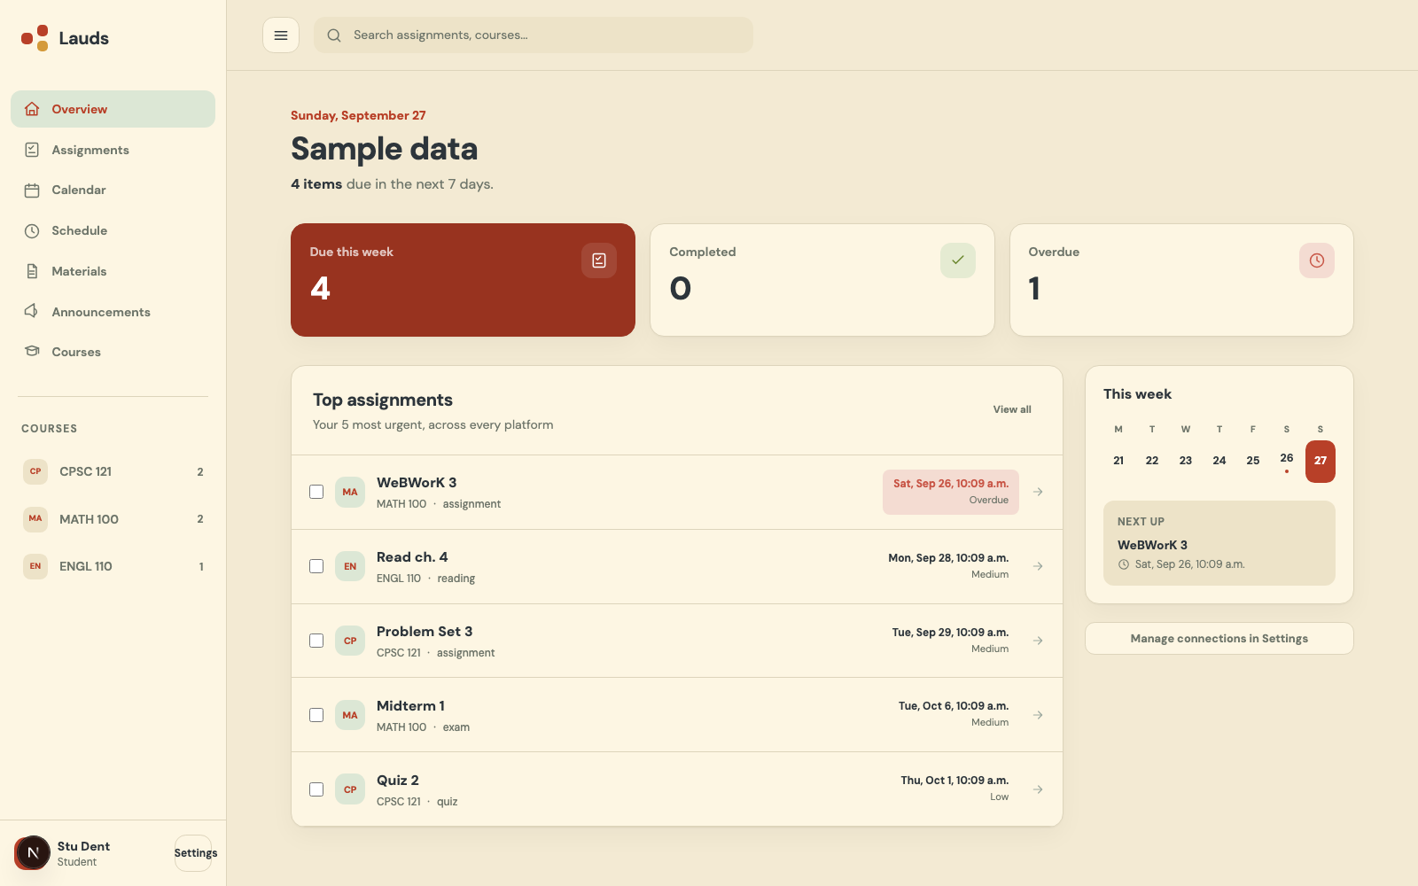
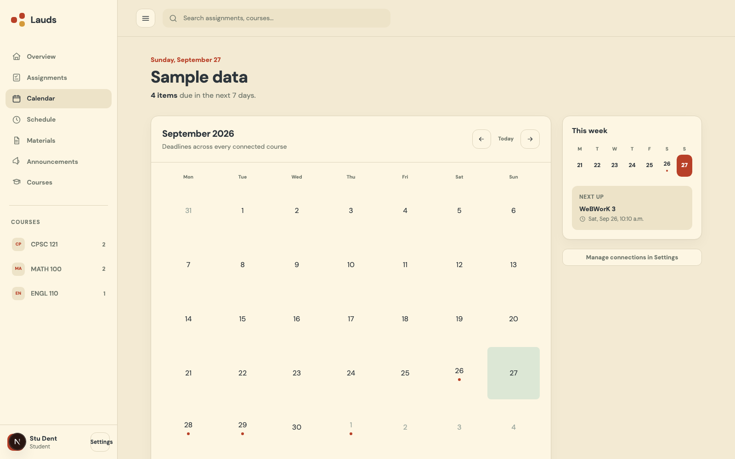
Product demo
Every deadline, one ranked list
Top assignments across every platform, ranked by real urgency, not just a due-date sort.
One calendar, every course
A real month grid, not a list, and it exports as a calendar feed for Apple, Google or Outlook.
Notes:
APPENDIX (backup). If the live demo fails, jump here and talk over the two screenshots with the same lines as the demo.
Two real screenshots of the web app. If you're doing the live demo, switch to the browser here: hello-hacks26-terraceonhigh.vercel.app. It opens on the demo student, no login.
Left: the ranked list. Top assignments across every course and platform, overdue first, ranked by urgency, not just date.
Right: the calendar. A month grid across every course, and one calendar feed that puts every deadline in Apple, Google or Outlook Calendar.

Slide 14
STATUS
What's real today
Sensor | In the live demo | With your own account today
Canvas | Yes | Yes: log in on your laptop, or paste your calendar-feed link
PrairieLearn | Yes | Yes: log in on your laptop
Workday | Yes, 9 class meetings | Yes: import the Workday .xlsx export
UBC key dates | Yes | Yes, public data
WeBWorK, Brightspace | Yes (Brightspace: courses only) | In review
Piazza | Yes, as announcements | Code exists, not yet proven on a live class
UBC Bookstore | Yes, 3 textbooks | Links to the Bookstore's own CWL book list
Moodle, Blackboard, and 5 more | No | Built or started, in review
Notes:
APPENDIX. For Q&A only: which sensors work with a real account today.
NEW SLIDE. Mostly for Q&A: have it ready, you may not need to present it.
Every sensor in the demo runs through real adapter code, but real-account use is narrower. Know which column you're talking about.
If pressed on WeBWorK or Brightspace: they're in the demo; live connect is in review. If pressed on sync across devices: that's next, the storage isn't switched on yet.

Slide 15
APPENDIX
Judge questions
Is this real data?
The demo student is fake, built in each platform's real format and run through the same code that reads a real account.
Why not Canvas's calendar?
Canvas only sees Canvas. A WeBWorK quiz never shows up there. The value is the join.
What's the moat?
The shared model and the fusion on top. One connector is easy to copy; fusing nine is the product.
How does it scale to other schools?
A new platform or school is one adapter file. Fusion, ranking and screens don't change.
Do you scrape?
Each platform's own data feed where one exists; otherwise one narrow page the student is already signed into.
What about passwords?
We never see them. You log in yourself, and the session stays on your laptop.
Why fusion, not another dashboard?
Other dashboards show one platform. Lauds joins nine, so duplicates merge and one ranked list covers everything.
What's next?
Sync across devices, capture from tabs you already have open, deadlines read from syllabus PDFs.
Notes:
APPENDIX. Keep this up during Q&A, or use it as a crib sheet.

Slide 16
APPENDIX
Keep these claims straight
Don't say | Say instead
"It connects to WeBWorK and Brightspace." | "They're in the demo; live connect is in review."
"Your dashboard syncs across devices." | "A synced account is next."
"We support 14 platforms." | "14 in the pipeline: 6 merged, 8 in review."
"Click to buy your textbooks." | "It shows your required textbooks."
"We only ever read JSON." | "Structured data first, a narrow page read where there's no feed."
"It's a Canvas tool." | "Canvas is the first sensor, not the product."
Comparisons to Palantir or military language | "Many narrow sensors, one fused picture."
Notes:
APPENDIX, for you, not the audience. Also: record the demo video in Sample mode. Real data would show your actual courses and grades.

