Slide 1

PDG – Groupe 04A
Chapuis Fabrice
Carvalheiro Heleno Gonçalo
Ferreira Silva Sven
Anthony Christen
Machraoui Badis

Slide 2

u
Current Situation
Current Situation
Our Solution
Terraform HTTP Backends exist
With Autorisation (S3)
No Existing Dedicated Product with At-Rest Encryption
No Existing Dedicated Product as HTTP Backend
Dev Workflow
Project Structure

Slide 3
u
Current Situation
Our Solution
Our Solution
HTTPS Connection
At-Rest Encryption
Teams Management
Authentication:
Bearer Tokens (Mainly for frontend)
Basic HTTP Authentication (Mainly for Terraform)
Authorization Management (roles, privileges)
Possibility to LOCK / UNLOCK States
Dev Workflow
Project Structure

Slide 4

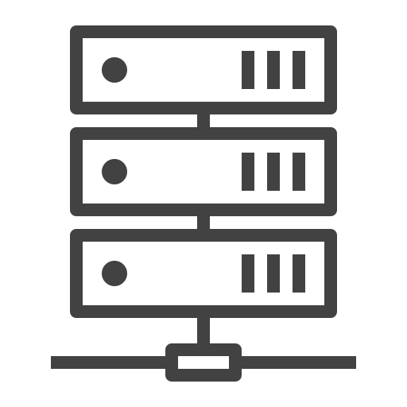

u
Current Situation
Development Workflow
Our Solution
Frontend
Backend
Dev Workflow
Christen Anthony
Badis Machraoui
Fabrice Chapuis
Sven Ferreira Silva
Project Structure
Infrastructure
Carvalheiro Heleno Gonçalo
Renovate
Renovate’s Friends

Slide 5
u
Current Situation
Development Workflow
Our Solution
Development Process: AGILE
2 Weeks Sprints
Kanban Board With Labels for Stories:
Effort (1, 2, 3, 5, 8, 13)
State (Approved, Blocked, Pending, Inactive, ...)
Type (Feature, Fix, Tests, Docs, Discussions, ...)
Priority (Now, Soon, Later, ...)
Conventional Commit Messages
Dev Workflow
Project Structure

Slide 6

u
Current Situation
Project Structure
Our Solution
Our Repositories
.github
Project-management
Github-org-management
Dev Workflow
Project Structure
Github-actions-workflow
Backend
Frontend
Infrastructure
Website

