Slide 1
Asynchronous Parallel Learning for Neural Networks and Structured Models with Dense Features
Xu SUN (孙栩)
Peking University
xusun@pku.edu.cn

Slide 2
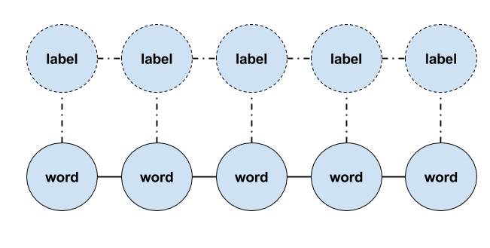
Motivation
Neural networks -> Good Performance
CNN, RNN, LSTM…
Sequence labelling, parsing, machine translation…
Neural networks -> Slow Training
Large parameter space
Dense feature
Complex computation
Faster Training ? -> Parallel Training
Synchronous
Asynchronous -> AsynGrad

Slide 3
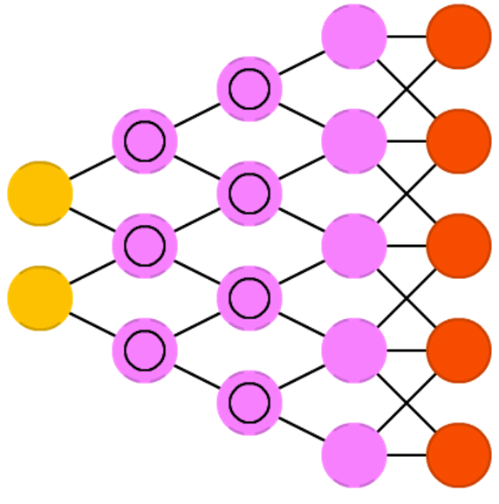
Neural Networks
Many kinds
Feed Forward Neural Networks
logistic regression
Convolutional Neural Networks
image processing
Recurrent Neural Networks
RNN, LSTM, GRU…
structured prediction

Slide 4
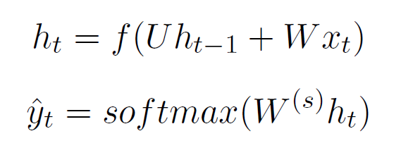

Recurrent Neural Network (RNN)
Recurrent neural network (Elman, Cognitive Science 1990)
Model time series
Predict linear-chain structures
Conditioned on all previous input
Picture from Christopher Olah

Slide 5
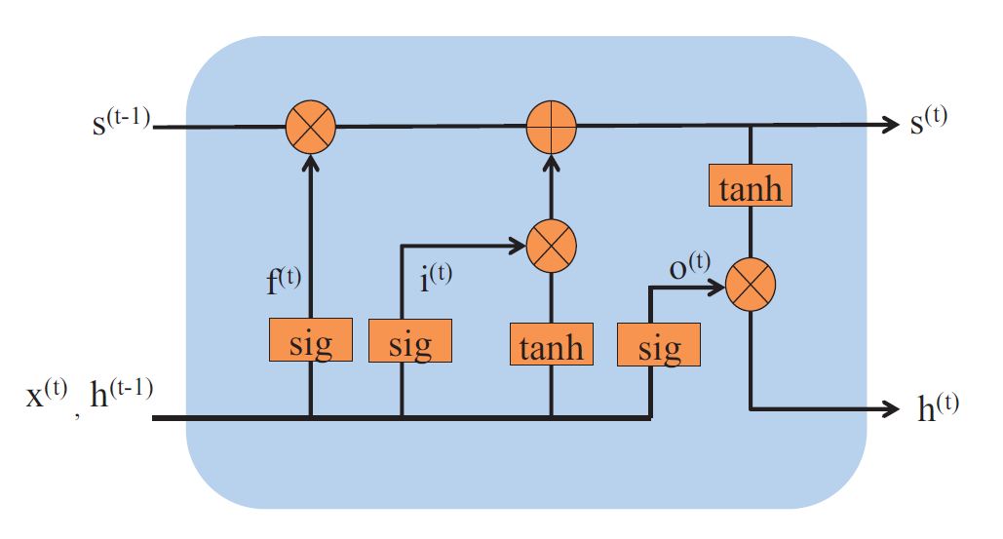
Long Short-term Memory (LSTM)
Long short-term memory (Hochreiter and Schmidhuber 1997)
A lasting linear memory
Capture long distance dependency
Three gates: input, forget and output gates
Control modification to the memory

Slide 6
Sequence-to-Sequence Model
Sequence to sequence neural network (Sutskever et al., NIPS 2014)
Encoder & Decoder
The encoder information is stored in a fixed-length vector
Popular for high-level task
Machine Translation
Summarization
…
W
X
Y
Z
<EOS>
A
B
C
<EOS>
W
X
Y
Z
Encoder
Decoder

Slide 7

For Large-Scale Structured Prediction
Training large-scale neural networks is costly
Numerous parameters
Dense Feature
Time-consuming
For example
A NMT model may take weeks
to train
Days, even if with GPU clusters
How to accelerate training speed?
Parallel training
Especially, asynchronous (lock-free) parallel training
Notes:
需要图

Slide 8
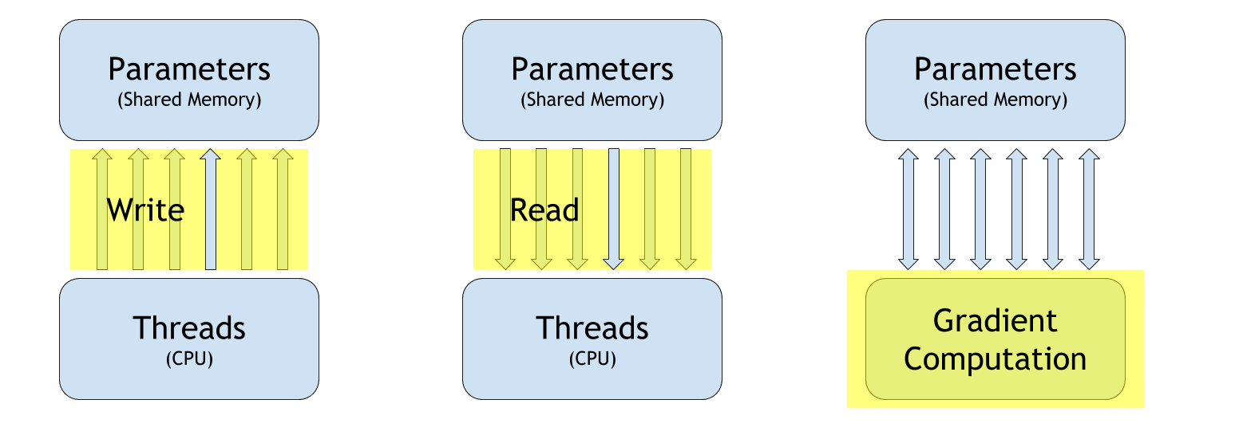
Problem Analysis
Basic operations in parallel training
Problem differs in
Online vs. Mini-batch vs. Batch
Synchronous parallel vs. Asynchronous parallel
Dense feature model vs. Sparse feature model

Slide 9
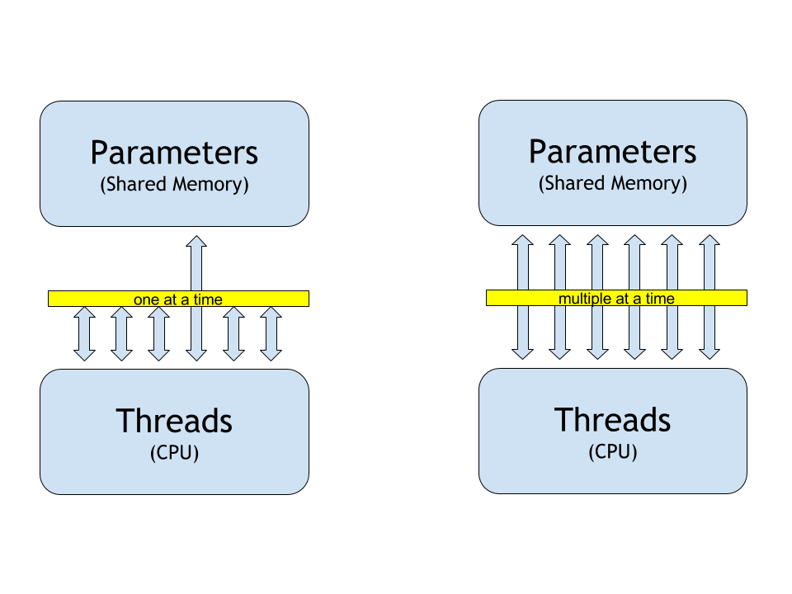
Parallel Training
Synchronous (locked)
Multiple threads
Only one can modify model parameters at the same time
Asynchronous (lock-free)
Multiple threads
Each one can modify model parameters at the same time

Slide 10
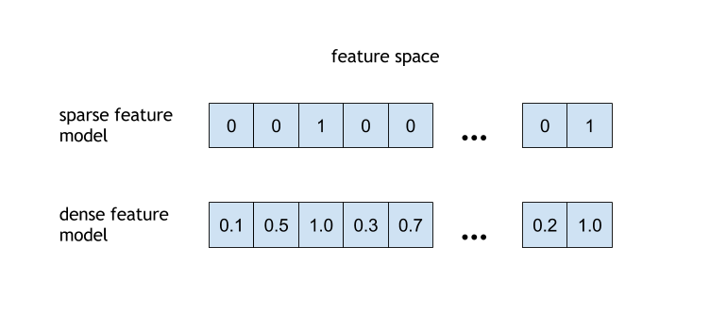
Model Types
Sparse feature model
e.g. HMM, CRF, Perceptron, MILA…
features are sparse
less read & write time
Dense feature model
e.g. RNN, LSTM, Sequence-to-Sequence…
features are dense
more read & write time

Slide 11
Problem Analysis
How threads interact with each other?
 | Sparse | Dense
Sync. | ? | ?
Async. | ? | ?

Slide 12
Problem Analysis
How threads interact with each other?
 | Sparse | Dense
Sync. | ? | ?
Async. | ? | ?

Slide 13
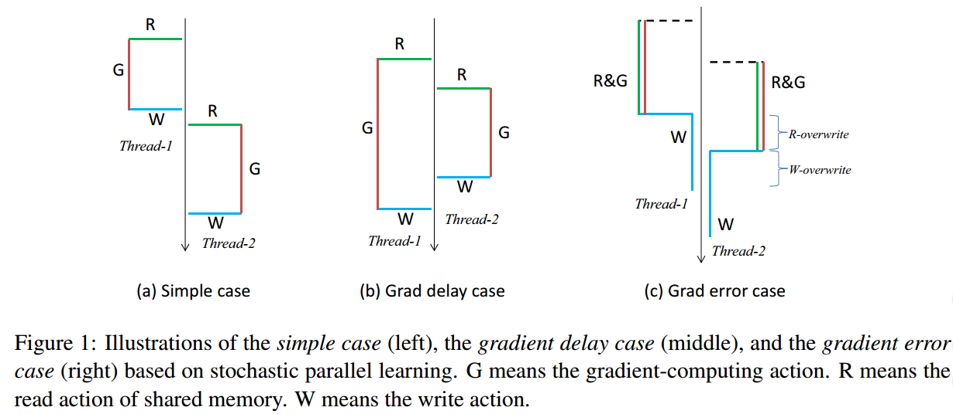
Synchronous Online Parallel Training
Correctness
Current approach: DSGD （round-robin）
Langford et al, NIPS 2009
Stochastic parallel learning by locking memory
No problem at all!
1. Simple case
Reading parameters from shared memory
Computing Gradients
Writing parameters to shared memory
Notes:
现有的同步方法

Slide 14
Synchronous Online Parallel Training
Correctness
Current approach:
mini-batch based method
Computing gradients in parallel
such as: parallel matrix operations via GPU
No problem at all!
1. Simple case
Reading parameters from shared memory
Computing Gradients
Writing parameters to shared memory
Notes:
现有的同步方法

Slide 15

Problem Analysis
How threads interact with each other?
 | Sparse | Dense
Sync.
Async. | ? | ?

Slide 16

Problem Analysis
How threads interact with each other?
 | Sparse | Dense
Sync.
Async. | ? | ?

Slide 17
Problem Analysis
How threads interact with each other?
 | Sparse | Dense
Sync.
Async. | ? | ?

Slide 18
Asynchronous Online Parallel Training
Asynchronous parallel learning is very popular for traditional sparse feature models
2. This case is called Gradient Delay case
→ More complicated, but problem solved for sparse feature models (Niu et al. NIPS 2011)

Slide 19
Asynchronous Online Parallel Training
Current approach: HogWild! and variants
Multiple threads updating parameters at the same time
For sparse feature models
Advantage
Actual parallel training
Fast training speed with no performance loss
Problem also solved (for sparse feature models)!

Slide 20
Problem Analysis
How threads interact with each other?
 | Sparse | Dense
Sync.
Async. |  | ?

Slide 21
Problem Analysis
How threads interact with each other?
 | Sparse | Dense
Sync.
Async. |  | ?

Slide 22
Problem Analysis
How threads interact with each other?
 | Sparse | Dense
Sync. | √ | √
Async. | √ | ?

Slide 23
Asynchronous Online Parallel Learning
3. Even more difficult case: Gradient Error Case
Happens for dense feature models, like neural networks
Actions (R, G & W) are time-consuming
Read-overwrite and write-overwrite problems
→Not well studied before, how to deal with this problem?
√

Slide 24
Problem Analysis
How threads interact with each other?
 | Sparse | Dense
Sync. | √ | √
Async. | √ | ?

Slide 25
Problem Analysis
How threads interact with each other?
 | Sparse | Dense
Sync. | √ | √
Async. | √
AsynGrad aims to
solve
gradient error case
AsynGrad

Slide 26
Problem Analysis
How threads interact with each other?
 | Sparse | Dense
Sync. | √ | √
Async. | √
This is our proposal
AsynGrad

Slide 27
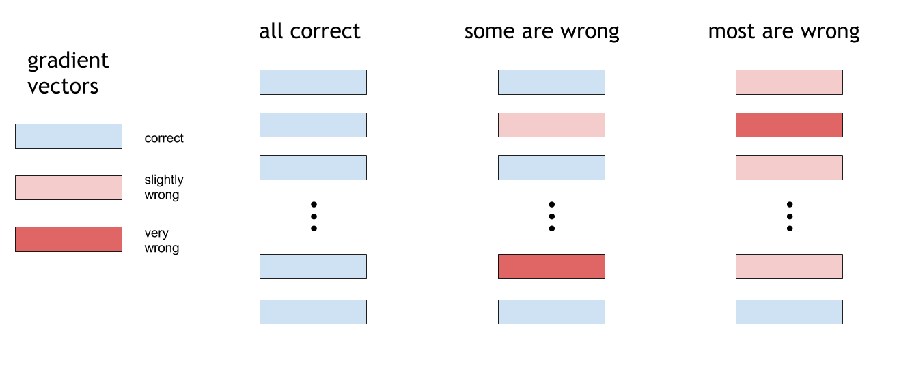
Review of Gradient Error Case
Gradient error has two aspects
How many of the gradients are wrong?
How wrong are they?

Slide 28
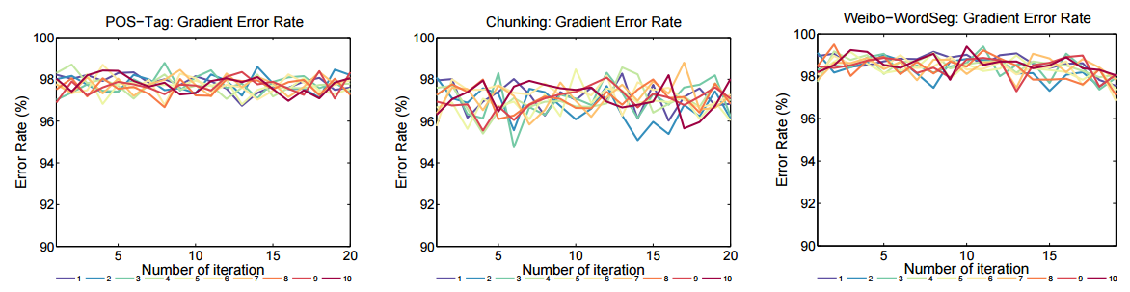
Experimental Observations
Gradient error is very common in asynchronous training of neural networks in real-world tasks

Slide 29
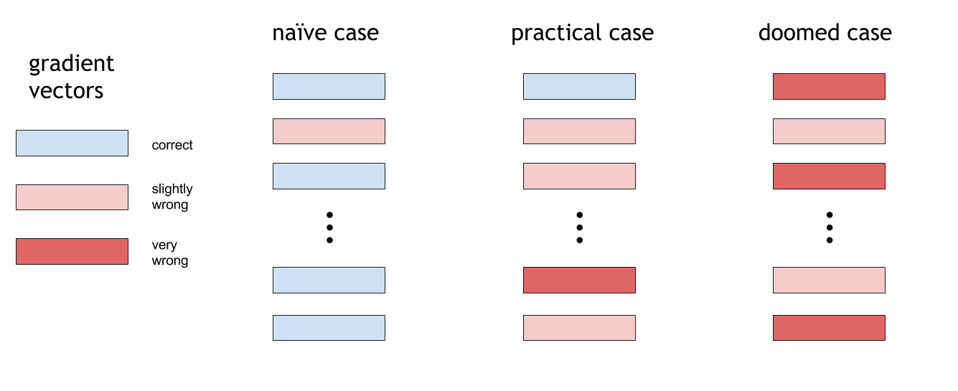
Experimental Observations
Gradient error is moderate in asynchronous training of neural networks in real-world tasks

Slide 30
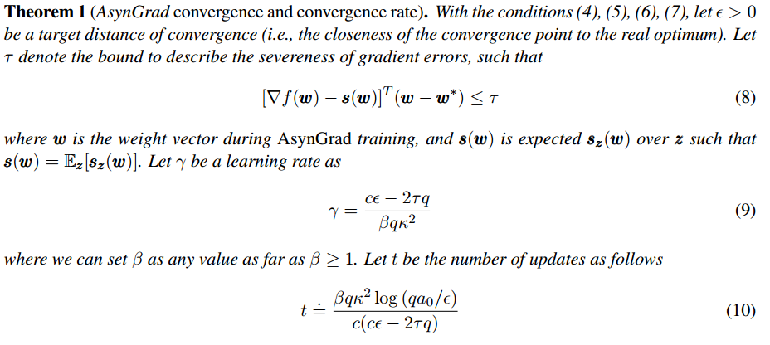
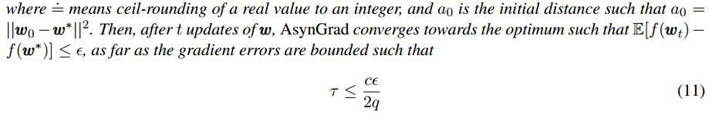
Our Theoretical Analysis
Can training still converge with gradient errors?
Even though there are gradient errors, training still converges towards the optimum, when the gradient errors are bounded.
bounded gradient errors

Slide 31
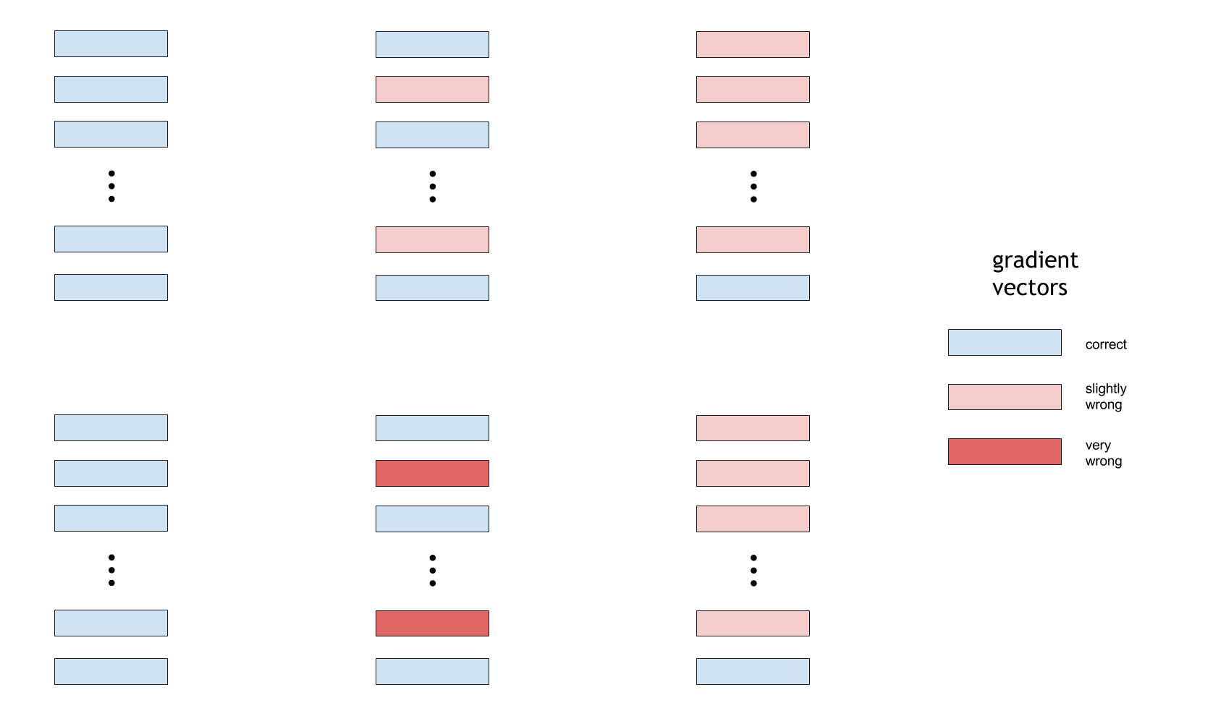
Our Theoretical Analysis
Even if most of the gradients are wrong
With their errors bounded, training still converge

Slide 32
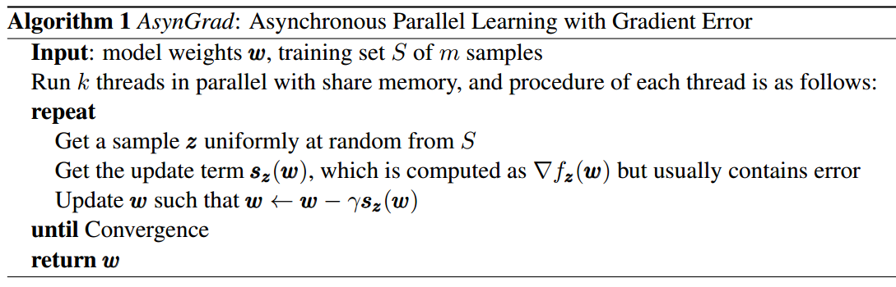
AsynGrad
An asynchronous parallel learning solution for fast training of neural networks
Asynchronous Parallel Learning with Gradient Error (AsynGrad)
Algorithm
X. Sun. Asynchronous Parallel Learning for Neural Networks and Structured Models with Dense Features. COLING 2016.

Slide 33
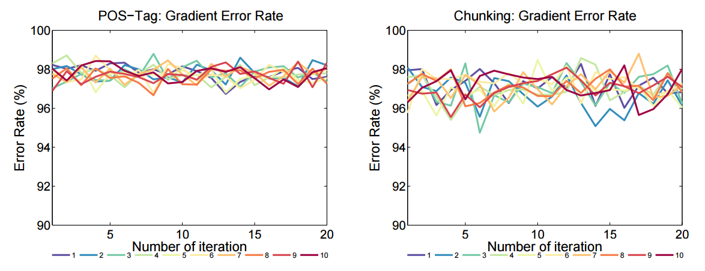
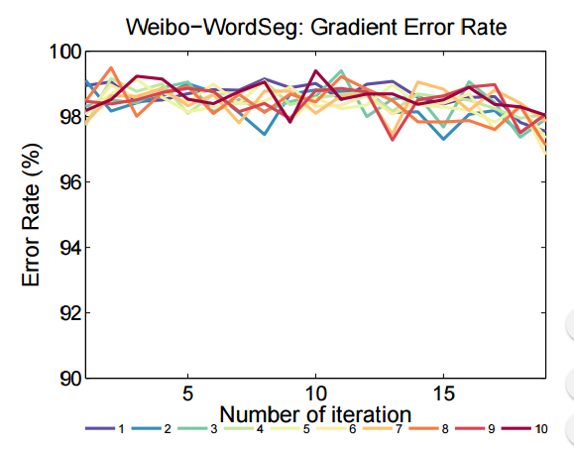
Experiments on LSTM
Experiments show a high gradient error rate

Slide 34
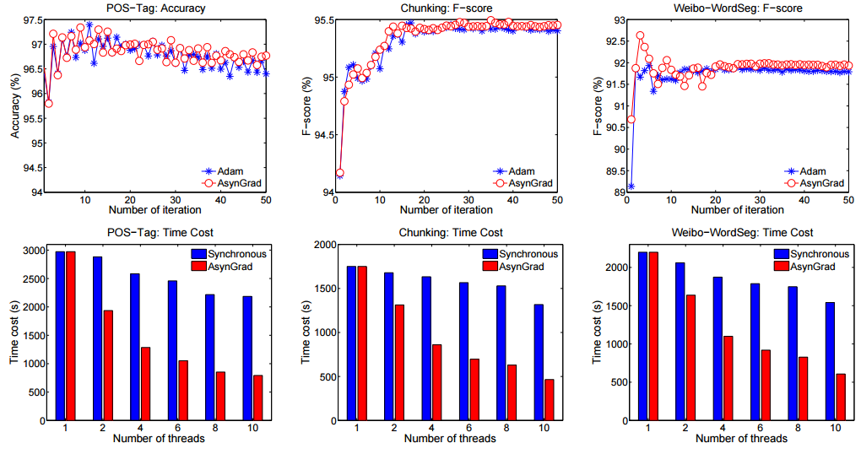
Experiments on LSTM
Experiments show that AsynGrad still converge even with a high gradient error rate

Slide 35
Experiments on LSTM
No loss on accuracy/F-score
With substantially faster training speed
AsynGrad

Slide 36
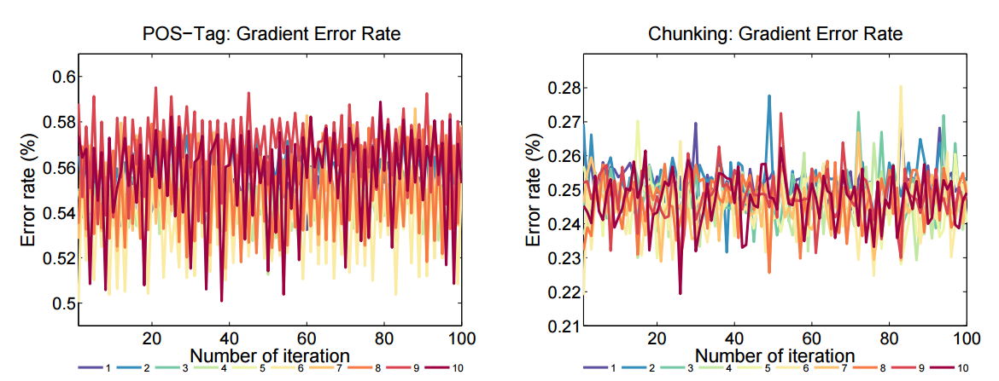
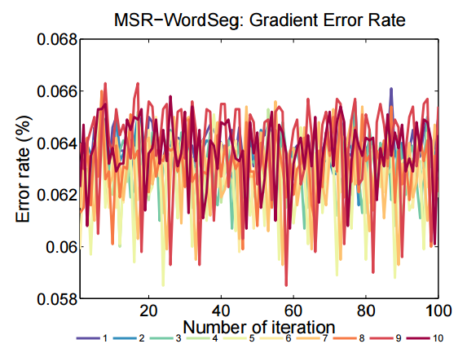
AsynGrad: A General-Purpose Solution
Also suitable for other dense feature models
Dense CRF -> moderate error rate

Slide 37
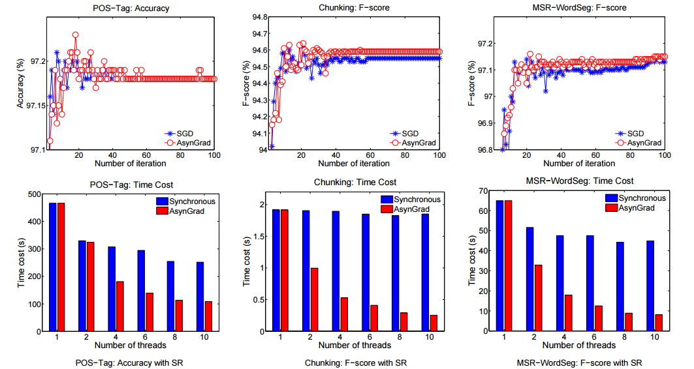
Experiments on Dense-CRF
No loss on accuracy/F-score
With substantially faster training speed
AsynGrad

Slide 38
Problem Analysis
How threads interact with each other?
 | Sparse | Dense
Sync. | √ | √
Async. | √ | ?

Slide 39
AsynGrad
Gradient errors are common and inevitable in asynchronous training of dense feature models
Such as neural networks
AsynGrad survives with gradient errors
With substantial faster training speed
No loss at all on test accuracy
Theoretical justification

Slide 40
Thanks!

