Slide 1
CS A203 - AVL Trees
Data Structures and Algorithms

Slide 2
Announcements
Reading
  Today: Chapter 9.2 G-T (AVL trees)

Slide 3
Overview
Motivation
AVLs
Implementing AVLs
Summary

Slide 4
AVL Trees: Motivation
Recall the purpose of using binary trees is that they provide the benefits of a linked list, ease of insertion and deletion, with the speed of a binary search, i.e. logarithmic time.
Consider the standard BST "search" algorithm. It starts at the tree's root node and then travels along the tree's edges until the node in question is reached.
  Each step the algorithm takes, that is, each link it follows, takes it one step further away from the root node.
  The algorithm never needs to look back and reexamine a node it has already seen.
Thus, the time it takes to find any given node in a BST cannot exceed c+nd, where n is the maximum distance, in terms of link path length, of any node from the root node, and c and d are some finite constants.
In other words, finding a node in a BST takes O(tree depth) time.

Slide 5
Depth of Balanced Trees
We've seen that the worst case is a linear tree, where depth is O(n).
It can be shown that in a balanced tree, a tree in which all leaf nodes have the same depth, the maximum depth of any node is proportional to log₂ n, where n is the total number of nodes in the tree.

Slide 6
BSTs Not Balanced
Unfortunately, the average BST is not balanced.
  For example, if a BST is constructed from the sequence (1, 2, 3, ..., n), we end up with a tree that basically looks like a simple linked list.
    the nodes corresponding to the numbers 1, 2, 3, ... n-1 all have exactly one outgoing link, and the node corresponding to n is the tree's only leaf.
  Obviously, the leaf's depth is n-1.
  In other words, there are number patterns for which the maximum leaf depth of the corresponding BST is linearly proportional to n.
  The worst-case complexity of the node finding algorithm therefore is c+nd, or O(n).

Slide 7
Maintaining Balance
Clearly, the BST becomes more efficient if the item insertion and removal algorithms are modified in such way that a certain amount of balancing is guaranteed.
BSTs with a guarantee of balance are commonly referred to as balanced search trees.
The most widely known balanced search tree is the AVL (Adelson-Velskii and Landis) tree.

Slide 8
A Balance Condition
The difference between the longest and shortest paths from the root to any null pointer in a tree is either zero for trees whose number of nodes = 2^{k}-1 (where k is a positive integer) or at most one for all other trees.
Problem: this balance condition is expensive to maintain.

Slide 9
AVL Trees: Modified Balance Condition
An AVL tree is a BST that obeys the following rule on its structure: the height of the left and right subtrees of any node differs by at most one.
In other words, if the height of a given node's left subtree is m, then the height of this node's right subtree must be neither lower than m-1 nor higher than m+1.

Slide 10
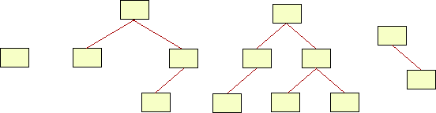
AVL Trees

Slide 11
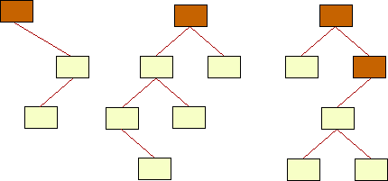
Unbalanced Trees

Slide 12
How To Create AVL Trees
We must modify our insert and delete methods for BSTs so that the balance condition is always maintained.
If we are to gain anything from this, the process must not take more than O(log n) time for insert or delete.

Slide 13
AVL Tree Implementation
An AVL tree node has an additional data element to keep track of the height of each subtree.
  Some use a balance factor variable that stores whether the left and right subtrees of a node are of equal height, left is higher than the right, or right is higher than the left.
  Another method stores the actual height of the subtree extending from each node.
To implement an AVL tree, we will use two classes. The first is for the individual tree nodes, called AvlNode.

Slide 14

Class AvlNode
class AvlNode {
AvlNode(Comparable theElement) {
this(theElement,null,null);
}
AvlNode(Comparable theElement,AvlNode lt,AvlNode rt) {
element = theElement;
left = lt;
right = rt;
height = 0;
}
//
Comparable element;
int height;
AvlNode left; AvlNode right;
}

Slide 15
Class AvlTree
The public interface is the same as for the Binary Search Tree.
The differences are all in the private methods that implement the public operations.
In addition to the methods of the BST, we need methods for maintaining balance on insertion and deletion.

Slide 16
AvlTree.java Public interface
public class AvlTree {
public AvlTree( ) { ... }
public void insert(Comparable x) { ... }
public void remove(Comparable x) { ... }
public Comparable findMin( ) { ... }
public Comparable findMax( ) { ... }
public Comparable find(Comparable x) { ... }
public void makeEmpty( ) { ... }
public boolean isEmpty( ) { ... }
public void printTree( ) { ... }

Slide 17
AvlTree.java: Private methods
  private Comparable elementAt(AvlNode t) { ... }
  private AvlNode insert(Comparable x,AvlNode t) { ... }
  private AvlNode remove(Comparable x,AvlNode t) { ... }
  private AvlNode findMin(AvlNode t) { ... }
  private AvlNode findMax(AvlNode t) { ... }
  private AvlNode find(Comparable x,AvlNode t) { ... }
  private AvlNode findParent(Comparable x,AvlNode t) { ... }
  private void printTree(AvlNode t) { ... }
  private static int height(AvlNode t) { ... }
  private static int max(int lhs,int rhs) { ... }
  private static AvlNode rotateWithLeftChild(AvlNode k2) { ... }
  private static AvlNode rotateWithRightChild(AvlNode k1) { ... }
  private static AvlNode doubleWithLeftChild(AvlNode k3) { ... }
  private static AvlNode doubleWithRightChild(AvlNode k1) { ... }
  //
  private AvlNode root;
}

Slide 18
Imbalance: Cases
There are four cases we need to handle
  Imbalance in the left subtree of the left child of root.
  Imbalance in the right subtree of the left child of root.
  Imbalance in the left subtree of the right child of root.
  Imbalance in the right subtree of the right child of root.
We'll consider each of these cases.

Slide 19
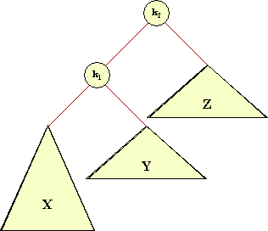
Imbalance in the left subtree of the left child of root.

Slide 20
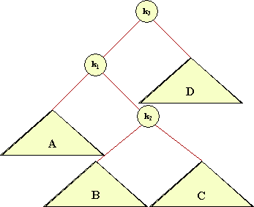
Imbalance in the right subtree of the left child of root.

Slide 21
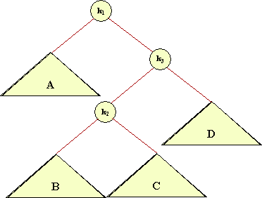
Imbalance in the left subtree of the right child of root.

Slide 22
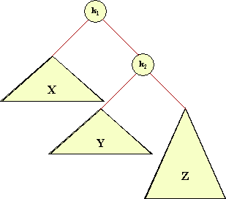
Imbalance in the right subtree of the right child of root.

Slide 23
Rotations
Notice that cases 1 and 4 are mirror images.
Notice also that cases 2 and 3 are mirror images.
Thus we have two basic situations:
  Imbalance is on the outside.
  Imbalance is on the inside.
We fix imbalance by performing a rotation on the tree.

Slide 24
What is a Rotation?
A rotation replaces the root node with one of its child nodes, placing the original root node as one of the children of the new root node.
The subtree from the original child node that is replaced by the original root node becomes a subtree of the original root node.
Time for a picture.

Slide 25
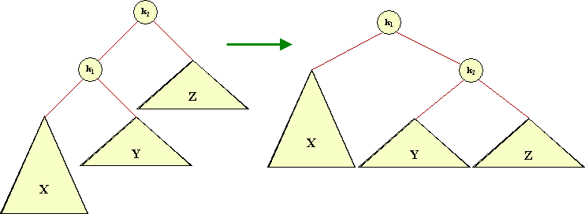
Rotation Picture

Slide 26
The Effects of Rotation
Notice that the rotation shown changes the heights of the subtrees by increasing the depth of subtree Z by 1 and decreasing the depth of subtree X by 1.
  The length of any path from new root to a node in Z is increased by 1 over what it was before the rotation.
  The length of any path from the new root to a node in X is decreased by 1 from what it was before rotation.
  The length of any path from the new root to a node in Y is unchanged.

Slide 27
Rotations Require O(log n) Time
Notice that to implement the rearrangement we need to change three pointers.
  The original parent of the root of the rotation needs to point to the new root.
  The new root's appropriate child pointer needs to point to the old root.
  The old root's appropriate child pointer needs to point to the appropriate subtree of the original child.
We also need to update the height information.
  Since height is measured from the bottom, we only need to change the height for the two nodes that were rotated.
  And we need to update the height of all ancestors along the path from the new root of the rotated subtree to the global root of the AVL tree.

Slide 28
Maintaining Balance Using Rotations
The key idea is that we can use a small number of rotations to restore balance after an insertion or deletion.
We've seen 4 cases that we need to consider.
A key question is: How many rotations are needed?

Slide 29
Single Rotations
We'll consider cases 1 and 4 since they are symmetric and require the same basic process to restore balance.
Both cases can be balanced by using a single rotation.

Slide 30
Case 1: use rotateWithLeftChild

Slide 31
Case 1
Left and right subtrees are out of balance by 2 (left deeper).
The leftmost subtree of the left child is the deeper of the two.
The effect of rotation restores balance.
This is called a right rotation because the root node moves to become the right subtree of the new root.

Slide 32
Code
private static AvlNode rotateWithLeftChild(AvlNode k2) {
AvlNode k1 = k2.left;
k2.left = k1.right;
k1.right = k2;
k2.height = max(height(k2.left),
height(k2.right))+1;
k1.height = max(height(k1.left),
k2.height)+1;
return k1;
}

Slide 33
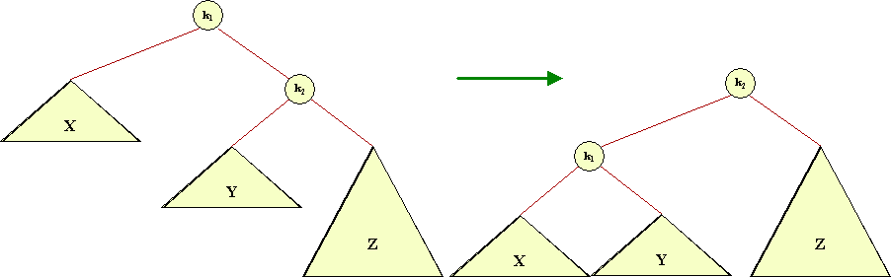
Case 4: rotateWithRightChild

Slide 34
Case 4
Left and right subtrees are out of balance by 2 (right deeper).
The rightmost subtree of the right child is the deeper of the two.
The effect of rotation restores balance.
This is called a left rotation because the root node moves to become the left subtree of the new root.

Slide 35
Code
private static AvlNode rotateWithRightChild(AvlNode k1) {
AvlNode k2 = k1.right;
k1.right = k2.left;
k2.left = k1;
k1.height = max(height(k1.left),
height(k1.right))+1;
k2.height = max(height(k2.right),
k1.height)+1;
return k2;
}

Slide 36
Is One Rotation Sufficient?
We've examined cases 1 and 4 and found that we only needed one rotation to restore balance.
What about cases 2 and 3?
Can we find a single rotation to restore balance from those situations?

Slide 37
Case 3

Slide 38
Case 3
A single rotation involving k1 and k3 would not change the imbalance.
It merely results in Case 2.

Slide 39
Case 2

Slide 40
Case 3
We need to do something different.
The only other option that makes any sense is a rotation involving k2 and k3.
That results in the situation of Case 4
We can balance using a left rotation involving k1 and k2.

Slide 41
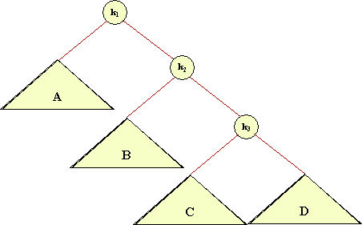
Case 4: Expanded Version

Slide 42
Double Rotations
Cases 2 and 3 requre two rotations
We can get from case 2 or 3 to case 1 or 4 in one rotation.
Cases 1 and 4 are balancable using one rotation.
Both of the rotations use the rotation code we've already seen.

Slide 43
Code
private static AvlNode doubleWithRightChild(AvlNode k1) {
k1.right = rotateWithLeftChild(k1.right);
return rotateWithRightChild(k1);
}
Reversing the order of the rotations handles Case 2.

Slide 44
insert
The basic insert procedure is the same as the simple insert method from BST class.
If the insertion causes the left and right subtrees of any node to differ by more than 1 then this needs to be fixed using the rotation technique.

Slide 45
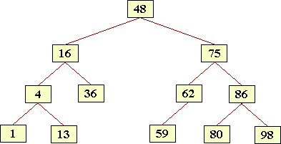
Insert 5
5

Slide 46
Insert 5
13
4
1
5

Slide 47
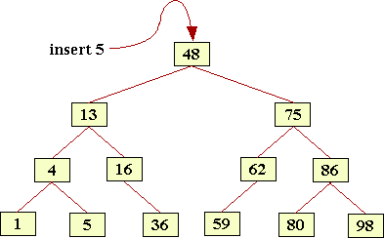
Final Result

Slide 48
Code for insert
private AvlNode insert(Comparable x,AvlNode t) {
if (t == null)
t = new AvlNode(x,null,null);
else if (x.compareTo(t.element)<0) {
t.left = insert(x,t.left);
if ((height(t.left)-height(t.right))>1) {
if (x.compareTo(t.left.element)<0)
t = rotateWithLeftChild(t);
else t = doubleWithLeftChild(t); }
}
else if (x.compareTo(t.element)>0) {
t.right = insert(x,t.right);
if ((height(t.right)-height(t.left))>1) {
if (x.compareTo(t.right.element)>0)
t = rotateWithRightChild(t);
else t = doubleWithRightChild(t); }
}
t.height = max(height(t.left),height(t.right))+1;
return t;
}
public void insert(Comparable x){ root = insert(x,root); }

Slide 49
Analysis
We've figured out a way to do insertion in O(log n) time while maintaining the balance condition at all nodes.
The key observation was that inserting only affects balance at nodes along the path to the root.
Imagine keeping track of the height of the left and right subtrees at each node.
When you insert, you only have to update these values along the path to the root.
If the update is constant time, then the total operation is O(log n).

Slide 50
remove
Removing a node from an AVL tree involves a slight modification to the BST remove algorithm and then we test and rebalance the tree in the same way as for insert.
The modification involves only removing nodes with a single child.
What happens when a node has two children?
  We find the immediate predecessor of that node (inorder traversal).
  This means going left from our original node and then moving all the way to the right of that subtree.
  By definition the predecessor node cannot have a right child or it would not be the largest value in the subtree.
  Therefore we can remove the predecessor node without dramatically changing the shape of the tree.
  Recall the remove algorithm from the BST.

Slide 51
Remove 13: Predecessor = 5

Slide 52
Remove 13: Copy predecessor to current.
5

Slide 53
Remove 13: Delete predecessor, rebalance if necessary
5

Slide 54
Code Part 1
private AvlNode remove(Comparable x,AvlNode t) {
AvlNode parent = null;
if (t == null) return t; // Not Found
if (x.compareTo(t.element)<0)
t.left = remove(x,t.left);
else if (x.compareTo(t.element)>0)
t.right = remove(x,t.right);
else
{
parent=findParent(t.element,root);
if (t.left!=null && t.right!= null)
{ // Two children
t.element = findMin(t.right).element;
t.right = remove(t.element,t.right);
}
else t = (t.left!=null) ? t.left : t.right;
}

Slide 55
Code Part 2
if ((height(parent.right)-height(parent.left))==2)
{
  if(height(parent.right.left)>
  height(parent.right.right))
  parent = doubleWithRightChild(parent);
  else parent = rotateWithRightChild(parent);
}
if ((height(parent.left)-height(parent.right))==2)
{
if(height(parent.left.right)>
height(parent.left.left))
parent = doubleWithLeftChild(parent);
else parent = rotateWithLeftChild(parent);
}
t.height = max(height(t.left),height(t.right))+1; return t;
}
public void remove(Comparable x){ root = remove(x,root); }

Slide 56
Analysis
There is extra work in doing rotations for an AVL tree in comparison to a BST.
Because the tree is kept in a balanced state we would expect the average path length for a remove to be shorter, and this is the case in practice.
Many remove operations do not require any rotation, so the only extra work is in updating the height of each subtree.
Empirical and theoretical studies have shown that as the size of the tree grows the average times for the remove operation in an AVL tree are better than for a BST.
This means the effect of having a more balanced tree outweighs the extra work of keeping it balanced.

Slide 57
Summary
Tree operations are insert, delete, find.
Normal BSTs can become unbalanced, leading to O(n) worst-case times for all three operations.
The AVL tree requires more coding work than a simple random binary tree, but provides better and better performance as n gets larger.
  Therefore, where performance is important and n is large, the AVL tree would be the preferred data structure.
  Worst-case time for AVL tree operations is O(log n).
  Balance condition: At every node, difference between height of left and right subtrees is at most 1.
  Find is identical.
  Insert and delete are complicated and require rotation operations.

