Slide 1

Cardio-Vascular Disease prediction using Machine Learning Algorithm
Submitted by:
Terrance Thomas 18184928

Slide 2
Points of the presentation
Motivation
Dataset
Algorithm & Result
Visualization

Slide 3
Motivation
CVD
#1 cause of death globally
1/3rd of deaths occur to people below the age of 70 years
By 2030, 60% death to be in the age group below 60

Slide 4
Dataset
Kaggle
consists of 70,000 rows and 14 columns
data is nonbiased

Slide 5
Algorithm & Result
KDD
Data Pre-Processing
Random forest
Accuracy of 72%
Over Fitted Data

Slide 6
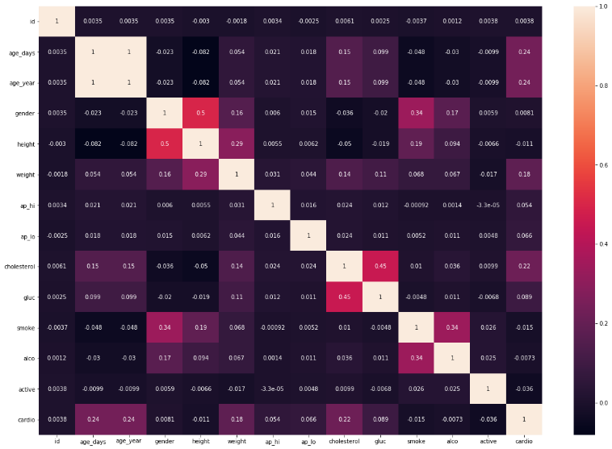
Visualization

Slide 7
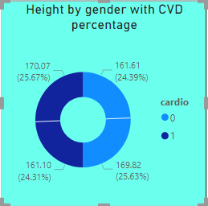
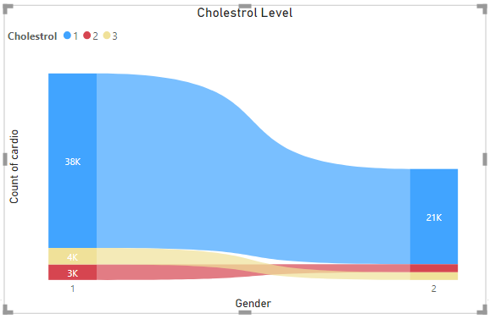
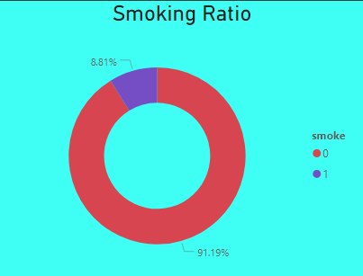
Visualization

Slide 8
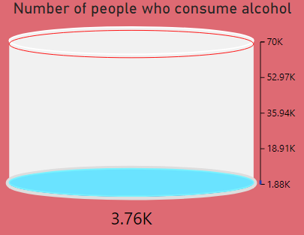
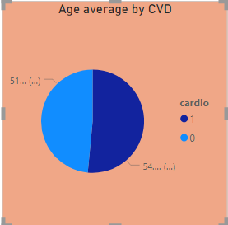
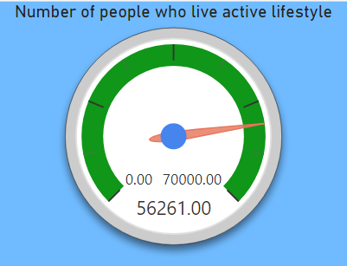
Visualization

Slide 9
Thank You

