Slide 1

Sentiment analysis on Yelp Reviews
Terrance Xia

Slide 2




Business Problems & Data
Why do people like/dislike certain restaurants?
Predict star ratings based on the sentiment
2.1M Restaurant Review Comments
Predict the continuity of business based on the sentiment

Slide 3
Modeling Process
Cleaning
Transform
Modeling
Prediction
Remove stop words, symbols, punctuation, non-English language
Oversampling
Train / test split
Sentiment ratings
Number of reviews
Number of check ins
Review length
Logistic regression
Random forest
XGBoost
Model optimization
Star rating (Accuracy: 51%)
Business continuity (Accuracy: 89%)

Slide 4
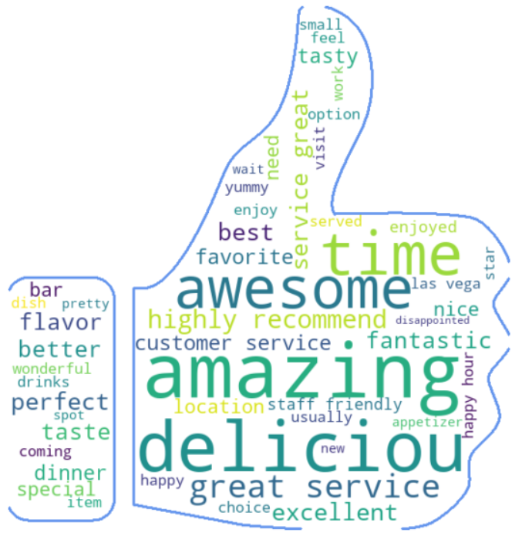
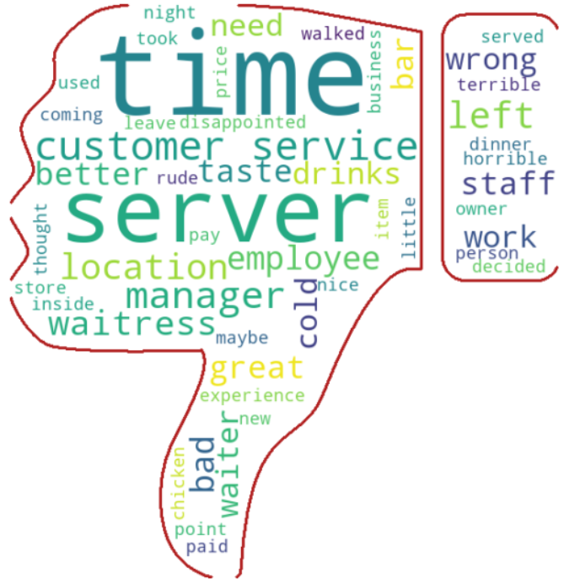
Common Words Star 5 vs Star 1
Common Words Star 5 Rating Restaurant
Common Words Star 1 Rating Restaurant

Slide 5
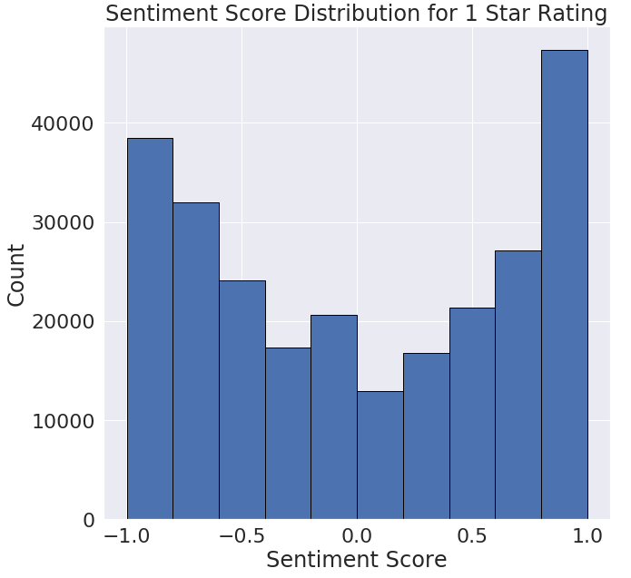
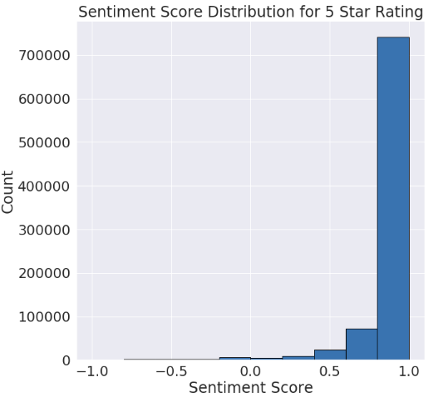
Review Comments Sentiment Distribution Star 1 vs Star 5

Slide 6
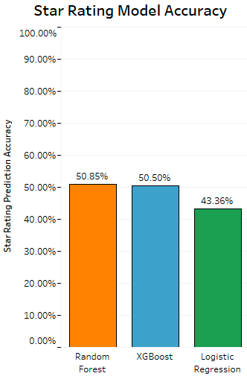
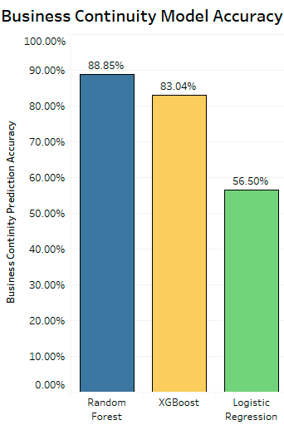
Model Accuracy Comparison

Slide 7
Model Application
Star
Rating
Business
Continuity
Improve star rating on Yelp for restaurant owners
Change reputation for restaurants on Yelp
Attract more customers
Insights to potential investors
Additional evaluation criteria for goodwill

