Slide 1


Neo4j Basic Training

Slide 2
Welcome everyone
Please say hi to each other.
We'll spend the rest of the day together.

Slide 3
What are we going to learn today?
Querying graph patterns with Cypher,
Designing and implementing a graph database model
Evolving an existing graph to support new or changed requirements.

Slide 4
What are we going to do today?
Intro to graphs and graph modeling
Evolving the graph model
Missing domain concept
Relationship bundling
Modeling guidelines

Slide 5
Optional Modules
Further evolving the graph model
Specific relationship types
Refactoring large graphs
Multiple models
Your turn

Slide 6
Thank you for your time
Any other questions?
Feedback form: bit.ly/neo-survey gives a discount

Slide 7
Intro to graph modeling

Slide 8
What are we going to do?
Intro to the property graph model
The airport dataset
The modeling workﬂow
Load CSV data

Slide 9






The labelled property graph
name: “Dan” born: May 29, 1970
twitter: “@dan”
name: “Ann” born: Dec 5, 1975
Nodes
LOVES
LOVES LIVES WITH
Relationships
PERSON
PERSON
Properties
Labels
since: Jan 10, 2011
brand: “Volvo” model: “V70”
CAR

Slide 10
Property Graph Model Components
Nodes
Represent the objects in the graph
Can be labeled
PERSON
PERSON
CAR

Slide 11
Property Graph Model Components
Nodes
Represent the objects in the graph
Can be labeled
LOVES
LOVES LIVES WITH
Relationships
Relate nodes by type and direction
PERSON
PERSON
CAR

Slide 12
Property Graph Model Components
name: “Dan”
Nodes
Represent the objects in the graph
Can be labeled
Relationships
Relate nodes by type and
direction
Properties
Name-value pairs that can go on nodes and relationships.
born: May 29, 1970 twitter: “@dan”
name: “Ann” born: Dec 5, 1975
LOVES
LOVES LIVES WITH
PERSON
PERSON
since: Jan 10, 2011
brand: “Volvo” model: “V70”
CAR

Slide 13





The modeling workﬂow
1. Derive the question
2. Obtain the data
3. Develop a model
4. Ingest the data
5. Query/Prove our model

Slide 14
The modeling workﬂow
1. Derive the question
2. Obtain the data
3. Develop a model
4. Ingest the data
5. Query/Prove our model

Slide 15
The Modeling Workﬂow

Slide 16
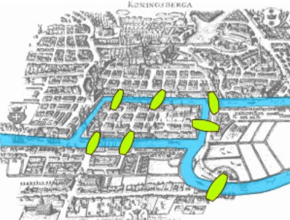
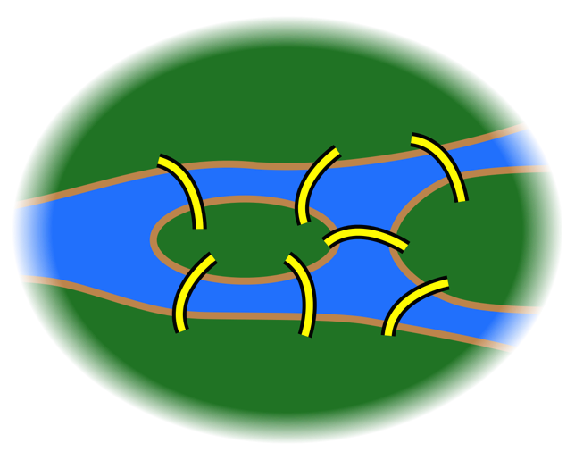
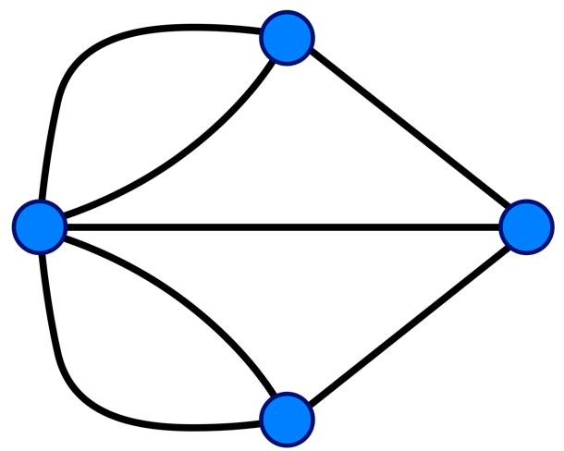
Models

Slide 17
Find the most popular airports
As an air travel enthusiast
I want to know how airports are con_{nected}
So that I can find the busiest ones

Slide 18
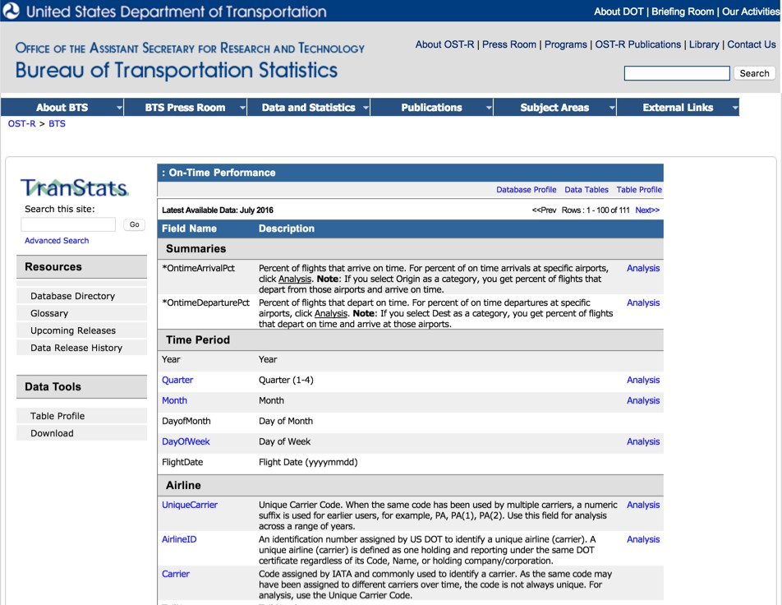
The ﬂights dataset

Slide 19
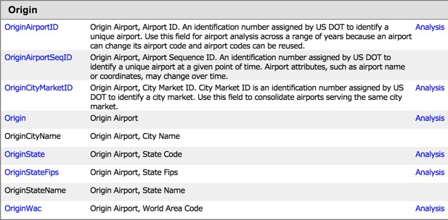
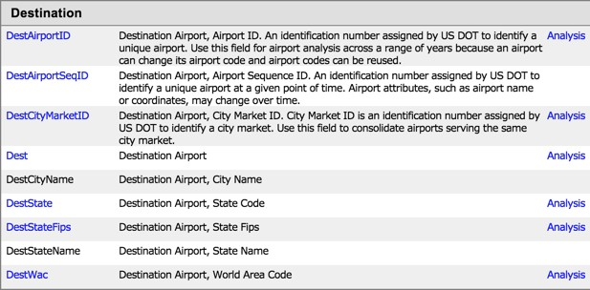
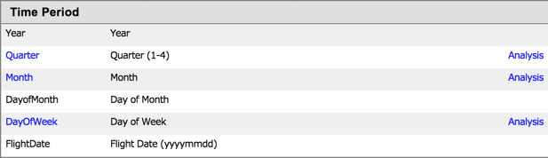
What data do we have?

Slide 20
Derive questions
As an air travel enthusiast
I want to know how airports are connected
^{So} that I can find the busiest ones
Is Airport A connected to Airport B?

Slide 21
Identity entities
Is Airport A connected to Airport B?
airport

Slide 22
Identify relationships between entities
Is Airport A connected to Airport B?
airport CONNECTED_TO airport

Slide 23
It’s a graph!
Is Airport A connected to Airport B?
(airport)-[:CONNECTED_TO]->(airport)

Slide 24

It’s a graph!
Is Airport A connected to Airport B?
(airport)-[:CONNECTED_TO]->(airport)

Slide 25

Labels
Labels are for categorizing nodes.

Slide 26
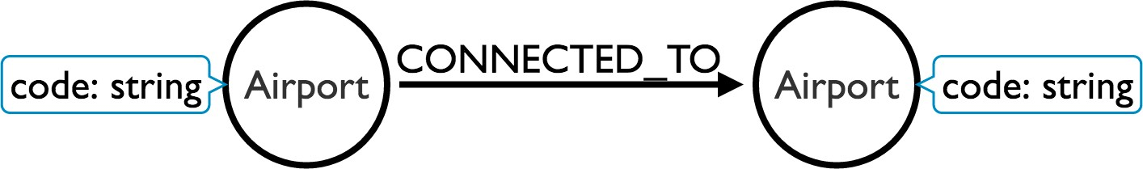
Properties
Properties are for defining attributes of nodes or relationships. We need an airport code to uniquely identify each airport.

Slide 27
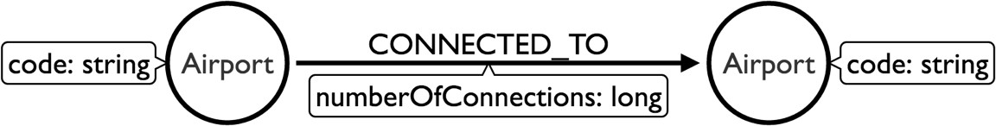
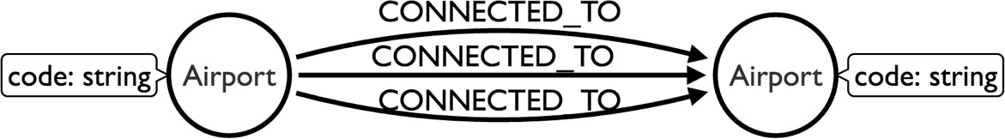
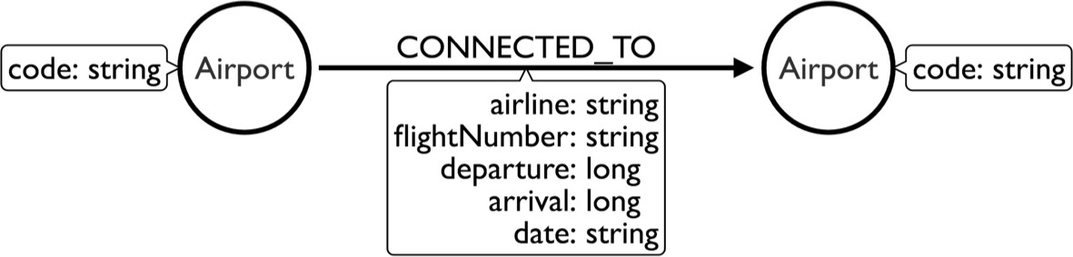
Modeling diﬀerent connections
Busy airports will have multiple connections between them. We can model this in diﬀerent ways:
As an air travel enthusiast
I want to know how airports are connected
^{So} that I can find the busiest ones

Slide 28
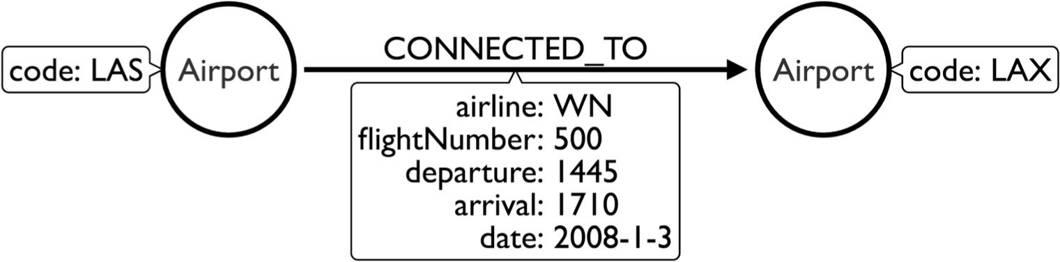
Sample data

Slide 29
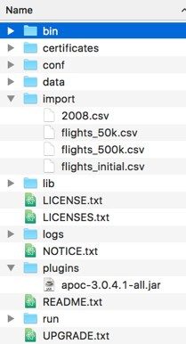
Prepare your Neo4j graph.db directory
Copy folders
import
plugins
from USB Stick
to the default.graphdb folder (or $NEO4J_HOME)
bit.ly/neo4j-modeling-data

Slide 30
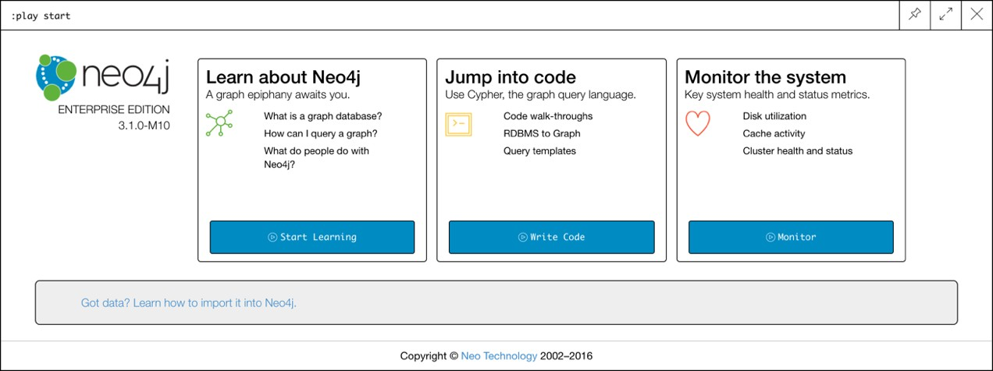
Make sure you’ve got Neo4j running
Start the server.
It should be running on: http://localhost:7474
Log-in with default credentials user: neo4j password: neo4j
Choose a new password
We’re good to go!

Slide 31
Find the most popular airports
Open your browser to http://localhost:7474 and execute the following command:
:play https://guides.neo4j.com/modeling_airports

Slide 32

Play the guides in your browser until you see...

Slide 33
The MERGE command

Slide 34
MERGE
The MERGE command is a combination of MATCH and CREATE. If the pattern already exists then it will return it; if not it will create it.
en.wikipedia.org/wiki/Idempotence

Slide 35
We can MERGE nodes...
MERGE (las:Airport {code: "LAS"}) RETURN las

Slide 36
...or relationships...
MATCH | (las:Airport {code: | "LAS"})
MATCH | (lax:Airport {code: | "LAX"})
MERGE (las)-[:CONNECTED_TO]->(lax)

Slide 37
...or both
MERGE | (las:Airport | {code: "LAS"})
MERGE | (lax:Airport | {code: "LAX"})
MERGE (las)-[:CONNECTED_TO]->(lax)
MERGE (las:Airport {code: "LAS"})-[:CONNECTED_TO]->(lax:Airport
{code: "LAX"})

Slide 38
Continue playing the guide
Continue the guide in your browser

Slide 39
The modeling workﬂow

Slide 40




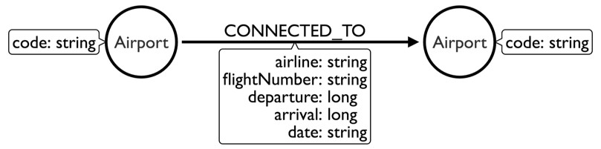


The modeling workﬂow
MATCH (origin:Airport {code: "LAX"})
-[flight:CONNECTED_TO]->
(destination:Airport {code: "LAS"}) RETURN origin, destination, flight
LIMIT 10
As an air travel enthusiast
^{I want to know} how airports are connected
^{So that} I can find the busiest ones
CREATE (lax:Airport {code: "LAX"}) CREATE (las:Airport {code: "LAS"}) CREATE (las)-[connection:CONNECTED_TO {
airline: "WN",
flightNumber: "82",
date: "2008-1-3",
departure: 1715,
arrival: 1820}]->(lax)
Is Airport A connected to Airport B?
|---------+------+------------|
| Origin | Dest | FlightNum |
|---------+------+------------|
| IAD
| IAD
| IND
| IND
| TPA
| TPA
| BWI
| BWI
| 335
| 3231
| 448
| 3920
|
|
|
|
(airport)-[:CONNECTED_TO]->(airport)
|---------+------+------------|

Slide 41

Modeling airports
As an air travel enthusiast
I want to know how airports are connected
^{So} that I can find the busiest ones

Slide 42
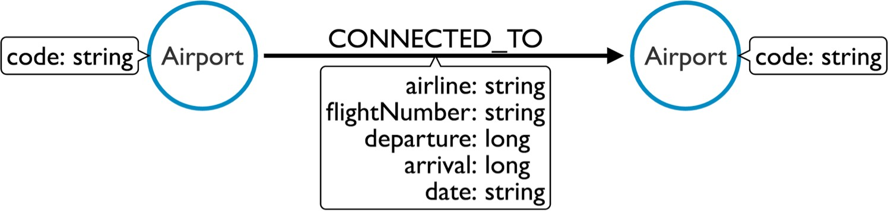
Nodes
As an air travel enthusiast
I want to know how airports are connected
^{So} that I can find the busiest ones

Slide 43
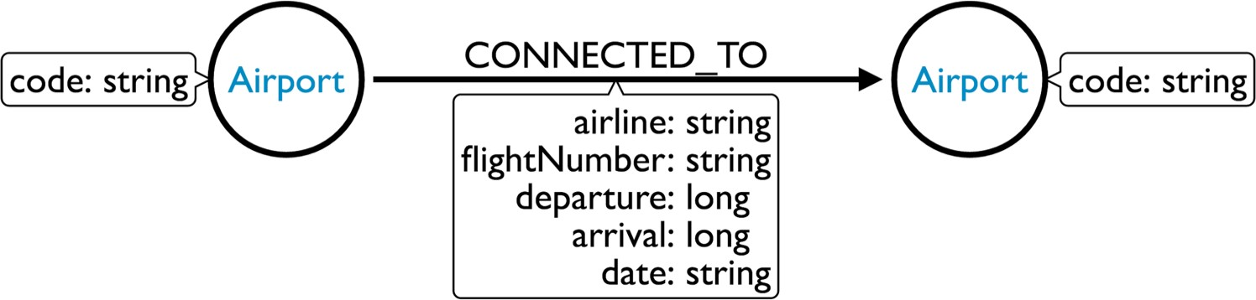
Labels
As an air travel enthusiast
I want to know how airports are connected
^{So} that I can find the busiest ones

Slide 44
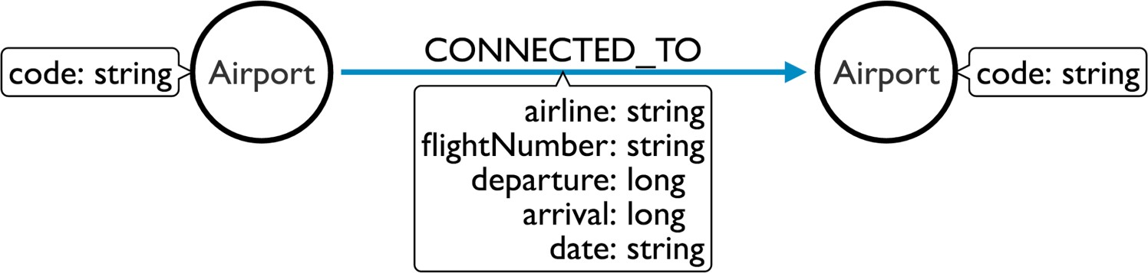
Relationships
As an air travel enthusiast
I want to know how airports are connected
^{So} that I can find the busiest ones

Slide 45
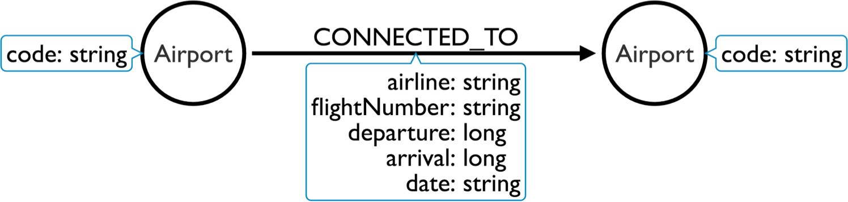
Properties
As an air travel enthusiast
I want to know how airports are connected
^{So} that I can find the busiest ones

Slide 46
Loading CSV data

Slide 47
Load CSV
A clause in the Cypher query language that lets us iterate over CSV files and create graph structures based on the data contained in each row.

Slide 48
Load CSV
LOAD CSV // load csv data
WITH HEADERS // optionally use first header row as keys in "row" map FROM "url" // file:// URL relative to $NEO4J_HOME/import or http:// AS row // return each row of the CSV as list of strings or map
// ... rest of the Cypher statement ...

Slide 49
Load CSV
[USING PERIODIC COMMIT] // optionally batch transactions
LOAD CSV // load csv data
WITH HEADERS // optionally use first header row as keys in "row" map FROM "url" // file:// URL relative to $NEO4J_HOME/import or http:// AS row // return each row of the CSV as list of strings or map [FIELDTERMINATOR ";"] // optionally alt. delimiter
// ... rest of the Cypher statement ...

Slide 50
Consider this CSV ﬁle
|---------+------+------------|
| Origin | Dest | FlightNum |
|---------+------+------------|
| | IAD | | | TPA | | | 335 | |
| | IAD | | | TPA | | | 3231 | |
| | IND | | | BWI | | | 448 | |
| | IND | | | BWI | | | 3920 | |
|---------+------+------------|

Slide 51
Create nodes
LOAD CSV WITH HEADERS FROM "file:///flights.csv" AS row
CREATE | (:Airport | {code: | row.Origin})
CREATE | (:Airport | {code: | row.Dest})
|---------+------+------------|
| Origin | Dest | FlightNum |
|---------+------+------------|
| | IAD | | | TPA | | | 335 | |
| | IAD | | | TPA | | | 3231 | |
| | IND | | | BWI | | | 448 | |
| | IND | | | BWI | | | 3920 | |
|---------+------+------------|

Slide 52
Create relationships
LOAD CSV WITH HEADERS FROM "file:///flights.csv" AS row
CREATE (origin:Airport {code: row.Origin})
CREATE (destination:Airport {code: row.Dest})
CREATE (origin)-[:CONNECTED_TO {flightNumber: row.FlightNum}]->(destination)
|---------+------+------------|
| Origin | Dest | FlightNum |
|---------+------+------------|
| | IAD | | | TPA | | | 335 | |
| | IAD | | | TPA | | | 3231 | |
| | IND | | | BWI | | | 448 | |
| | IND | | | BWI | | | 3920 | |
|---------+------+------------|

Slide 53
Find existing nodes and relationships
LOAD CSV WITH HEADERS FROM "file:///flights.csv" AS row
MATCH (origin:Airport {code: row.Origin})
MATCH (destination:Airport {code: row.Dest})
MATCH (origin)-[:CONNECTED_TO {flightNumber: row.FlightNum}]->(destination)
...
|---------+------+------------|
| Origin | Dest | FlightNum |
|---------+------+------------|
| | IAD | | | TPA | | | 335 | |
| | IAD | | | TPA | | | 3231 | |
| | IND | | | BWI | | | 448 | |
| | IND | | | BWI | | | 3920 | |
|---------+------+------------|

Slide 54
Update existing nodes and relationships
LOAD CSV WITH HEADERS FROM "file:///flights.csv" AS row
MATCH (origin:Airport {code: row.Origin})
MATCH (destination:Airport {code: row.Dest})
MATCH (origin)-[c:CONNECTED_TO {flightNumber:row.FlightNum}]->(destination)
SET c.airline = row.UniqueCarrier
|---------+------+-----------+----------------|
| Origin | Dest | FlightNum | UniqueCarrier |
|---------+------+-----------+----------------|
| | IAD | | | TPA | | | 335 | | | WN | |
| | IAD | | | TPA | | | 3231 | | | WN | |
| | IND | | | BWI | | | 448 | | | WN | |
| | IND | | | BWI | | | 3920 | | | WN | |
|---------+------+-----------+----------------|

Slide 55
Idempotently create nodes and relationships
LOAD CSV WITH HEADERS FROM "file:///flights.csv" AS row
MERGE (origin:Airport {code: row.Origin})
MERGE (destination:Airport {code: row.Dest})
MERGE (origin)-[:CONNECTED_TO {flightNumber: row.FlightNum}]-
>(destination)
|---------+------+------------|
| Origin | Dest | FlightNum |
|---------+------+------------|
| | IAD | | | TPA | | | 335 | |
| | IAD | | | TPA | | | 3231 | |
| | IND | | | BWI | | | 448 | |
| | IND | | | BWI | | | 3920 | |
|---------+------+------------|

Slide 56
Let’s give it a try
Continue the guide in your browser

Slide 57
End of Module Intro to Graph Modeling
Questions ?

Slide 58
Missing domain concept

Slide 59
What are we going to do?
Profile queries
Introduce a missing concept in the domain
Constraints and indexes
Write our first refactoring query

Slide 60
Start playing the next guide….
...if you aren’t playing it already
:play http://guides.neo4j.com/modeling_airports/02_flight.html

Slide 61
Proﬁling queries

Slide 62
How do I proﬁle a query?
By prefixing the query with:
EXPLAIN
shows the execution plan without actually executing it or returning any results.

Slide 63
How do I proﬁle a query?
By prefixing the query with:
EXPLAIN
shows the execution plan without actually executing it or returning any results.
PROFILE
executes the statement and returns the results along with profiling information.

Slide 64
How do I proﬁle a query?
EXPLAIN
MATCH (origin:Airport)-[c:CONNECTED_TO]
->(destination:Airport) WHERE destination.code = "LAS" RETURN origin, destination, c LIMIT 10

Slide 65
How do I proﬁle a query?
PROFILE
MATCH (origin:Airport)-[c:CONNECTED_TO]
->(destination:Airport) WHERE destination.code = "LAS" RETURN origin, destination, c LIMIT 10

Slide 66
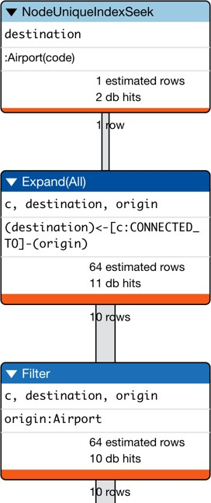
Anatomy of an execution plan
PROFILE
MATCH (origin:Airport)-[c:CONNECTED_TO]
->(destination:Airport) WHERE destination.code = "LAS" RETURN origin, destination, c LIMIT 10

Slide 67
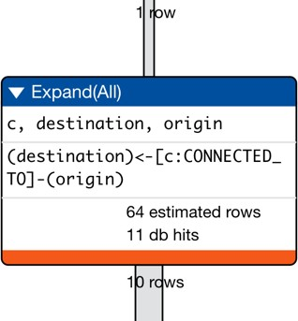
Operations
Rows come in
Do some work
Rows go out

Slide 68
What’s our goal?
At a high level, the goal is simple: get the number of db hits down.

Slide 69
“an abstract unit of storage
What is a database hit?
”
engine work.

Slide 70
Let’s proﬁle some queries
Continue playing the guide in your browser

Slide 71
Introducing a missing domain concept

Slide 72
Introducing a missing domain concept
Sometimes we design a model and after working with it for a bit we realise that we’ve missed an important domain concept.

Slide 73
Introducing a missing domain concept
Sometimes we design a model and after working with it for a bit we realise that we’ve missed an important domain concept.
In our case we’re missing nodes to represent Flights

Slide 74
Introducing a missing domain concept

Slide 75
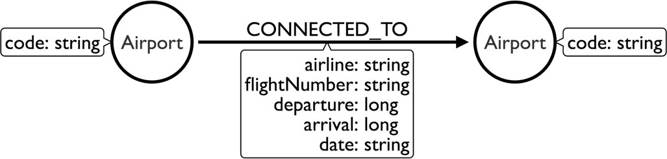
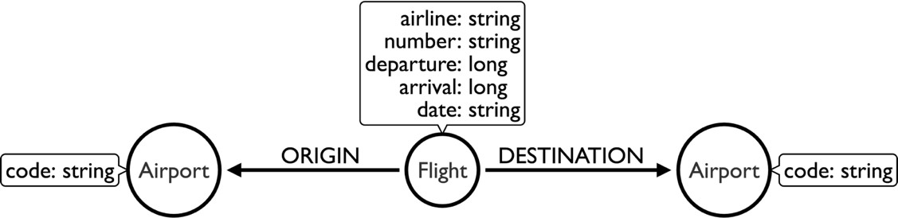
Flight as a ﬁrst class citizen
???

Slide 76
Flight as a ﬁrst class citizen
MATCH (o:Airport)-[:CONNECTED_TO]->(d:Airport) MERGE...

Slide 77
Constraints and indexes

Slide 78
Unique Constraints
We create unique constraints to:
ensure uniqueness
allow fast lookup of nodes which match label-property pairs.

Slide 79
Unique Constraints
We create unique constraints to:
ensure uniqueness
allow fast lookup of nodes which match label-property pairs.
CREATE CONSTRAINT ON (identifier:Label)
ASSERT identifier.property IS UNIQUE

Slide 80
Refactoring: Derive node from relationship
This is the first of the refactoring patterns that we’ll encounter today. We have this pattern:
(origin)-[:CONNECTED_TO]->(destination)
And we’ll create a new node using the properties of the CONNECTED_TO
relationship:
(origin)<-[:ORIGIN]-(flight)-[:DESTINATION]->(destination)

Slide 81
Indexes
We create indexes to:
allow fast lookup of nodes which match label-property pairs.

Slide 82
Indexes
We create indexes to:
allow fast lookup of nodes which match label-property pairs.
CREATE INDEX ON :Label(property)

Slide 83
What gets indexed?
The following are index backed:
Equality
STARTS WITH
CONTAINS
ENDS WITH
Range searches
(Non-) existence checks

Slide 84







How are indexes used in neo4j?
Indexes are only used to find the starting point for queries.
Graph
Relational
Use index scans to look up rows in tables and join them with rows from other tables
Use indexes to find the starting points for a query.

Slide 85
Let’s get on with the refactoring
Continue playing the guide in your browser

Slide 86
End of Module Missing Concept
Questions?

