Slide 1

Сase #1 Well Pump Review
Almaty 2018

Slide 2
Methodology
Calculate bottomhole flowing pressure on existing wells
Generate inflow performance relationship
Predict flowrate with higher drawdown and reduced bottomhole pressure
Evaluate practicality of artificial lift methods for three wells
Recommend a lift method

Slide 3
PVT
PVT
WELL NAME & NUMBER |  | Well #205 | Well #206 | Well #201
Solution GOR | sm3/sm3 | 51.1 | 26 | 30
Oil Gravity | kg/m3 | 792.2 | 790.9 | 790.5
Gas Gravity | SG(air) | 1.034 | 0.991 | 0.925
Water Specific Gravity | SG(water) | 1.11 | 1.11 | 1.11
Temperature | ºC | 87.3 | 83.3 | 80
Bubble Point Pressure | bara | 66.8 | 38.2 | 44.3
Oil FVF | m3/m3 | 1.224 | 1.15 | 1.149
Oil Viscosity | Cp | 0.42 | 0.46 | 0.49

Slide 4
Completion
Completion
WELL NAME & NUMBER |  | Well #205 | Well #206 | Well #201
MD pump depth | m | 1200 | 900 | n/a
TVD pump depth | m | 2165 | 900 | n/a
MD Tubing Depth | m | 1200 | 900 | 2148.1
Tubing Inside Diameter | Inches | 2.441 | 2.992 | 2.441
Tubing Outside Diameter | inches | 2.8675 | 3.5 | 2.875
Liner Top | m | n/a | 1246 | n/a
Liner Inside Diameter | inches | 6.184 | 6.184 | 6.184
Casing Inside Diameter | Inches | 7" to surface | 8.535 | 7" to surface
Formation Measured Depth | m | 2353 | 2165 | 2172.6
Formation Temperature | ºC | 87.3 | 83.3 | 80

Slide 5
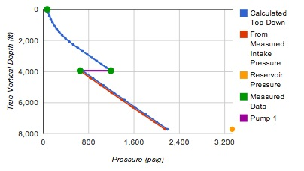
Well #205
Well Test Date 2018
Assumed intake pressure of 664 psi (600m fluid above pump)
Pwf = 2146 psig
Test Date |  | 2018
Tubing Head Pressure | psig | 58
Tubing Head Temperature | ºC | 60
Water Cut | % | 50
Liquid Rate | sm3/d | 106.7
RPM | m | 208
Displacement | m3/day/RPM | 0.513
GOR | sm3/sm3 | 22.2

Slide 6
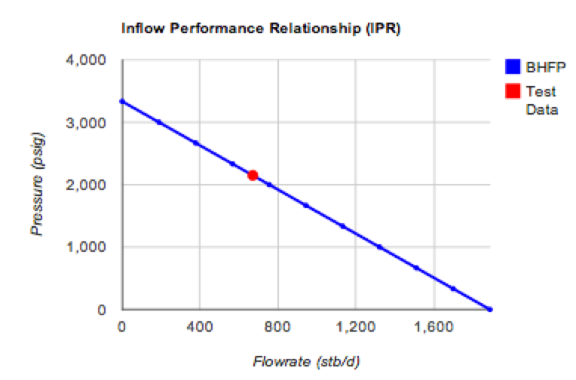

Well #205
Very little drawdown
Provided no concerns about channeling / coning water, can increase offtake.
Suggest target pwf of 70 bar (1015psi) -maintains above bubble point
Target rate of 210 m3 /day (1323 blpd)
Approximately 70HP motor required
Target

Slide 7
Well #205
Lift Requirements
210 m3/day (1323 BPD)
Pump at 2000 m (6561 ft)
Requires pump differential pressure rating of 1601 m (5252ft)
Approximately 70HP motor required
Well Head Pressure | 100 | (psig)
Flowing Bottomhole Pressure | 1051.17 | (psig)
Water Cut | 90 | (percent)
Pump Intake Pressure | 804.41 | (psig)
Pump Intake Rate | 13181.3 | (RB/day)
Pump Discharge Pressure | 3181.37 | (psig)
Head Required | 1601.32 | (m)

Slide 8
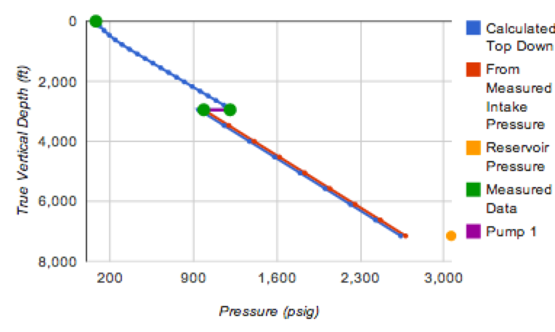
Well #206
Well Test Date 2018
Assumed intake pressure of 1000 psi
Pwf = 2679 psig
Test Date |  | 2018
Tubing Head Pressure | psig | 80
Tubing Head Temperature | ºC | 60
Water Cut | % | 55
Liquid Rate | sm3/d | 377.9
RPM | m | 400
Calculated m3/dayRPM | m3/day/RPM | 0.945

Slide 9
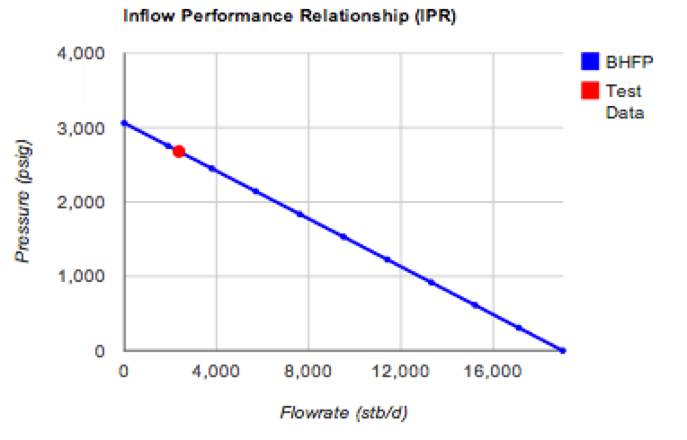

Well #206
Very little drawdown
Provided no concerns about channeling / coning water, can increase offtake.
Suggest target pwf of 70 bar (1015psi) -maintains above bubble point
Target rate of 2015 m3 /day (12700 blpd)
Target

Slide 10
Well #206
Lift Requirements
2015 m3/day (12700 BPD)
Pump at 2000 m (6561 ft)
Requires pump differential pressure rating of 907 m (2975ft)
Approximately 350HP motor required
Well Head Pressure | 100 | (psig)
Flowing Bottomhole Pressure | 1440.39 | (psig)
Water Cut | 50 | (percent)
Pump Intake Pressure | 1235.38 | (psig)
Pump Intake Rate | 11450.9 | (RB/day)
Pump Discharge Pressure | 2352.75 | (psig)
Head Required | 907.531 | (m)

Slide 11
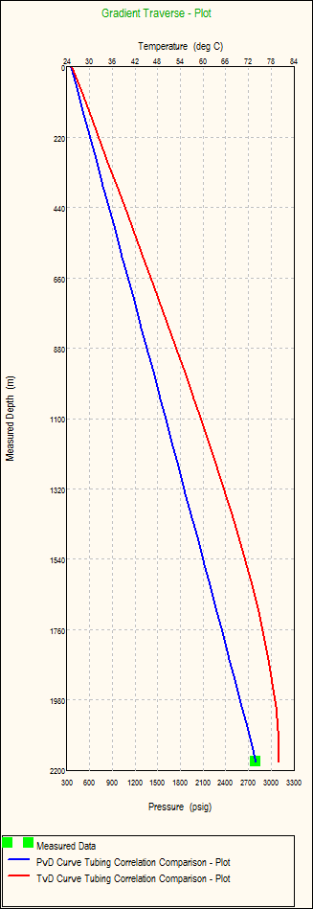
Well #201
Well Test Date 2018
Calculated Pwf
Pwf = 2797.9 psig
Test Date |  | 2018
Tubing Head Pressure | psig | 353
Tubing Head Temperature | ºC
Water Cut | % | 16
Liquid Rate | sm3/d | 276
RPM | m | n/a
Calculated m3/dayRPM | m3/day/RPM | n/a

Slide 12
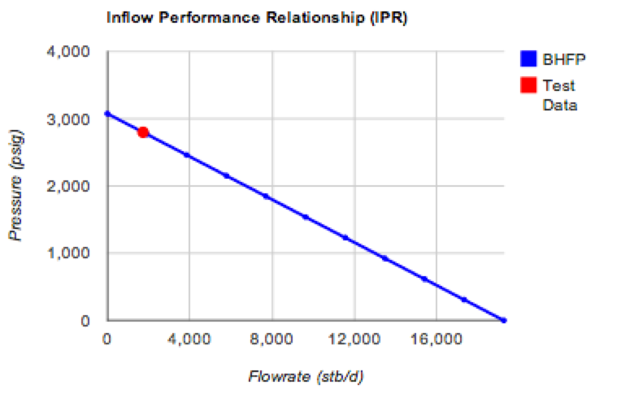

Well #201
Very little drawdown
Provided no concerns about channelling / coning water, can increase offtake.
Suggest target pwf of 70 bar (1015psi) -maintains above bubble point
Target rate of 2015 m3 /day (12700 blpd)
ESP going to be similar to Well #206 design
Target

Slide 13
Lift Requirements
Two wells produce 2015 m3/day
One well produce 210 m3/day
Prefer use same lift method for all three wells

Slide 14
TASK: The rates on all three wells can be significantly increased. Please, based on provided tech data, recommend viable and highest rates options.
Pump Selection
Lift Method | Where Applicable | Why not!
Rod Pump | ? | ?
Jet Pump | ? | ?
Progressing Cavity Pump | ? | ?
Gaslift | ? | ?
ESP | ? | ?

