Slide 1
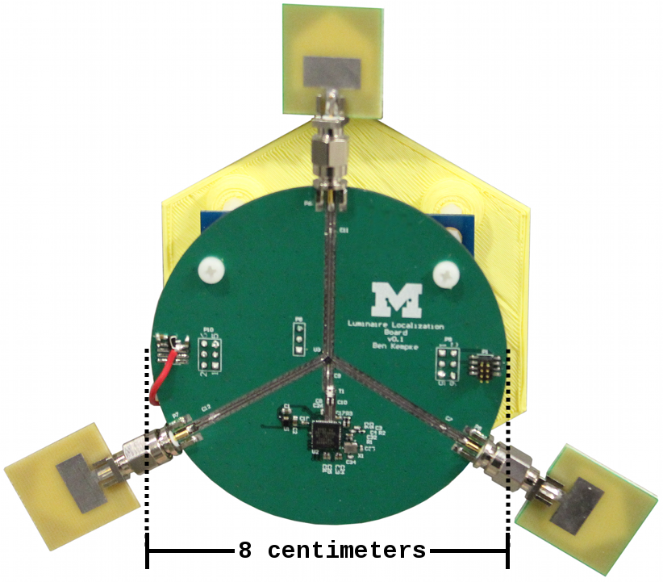
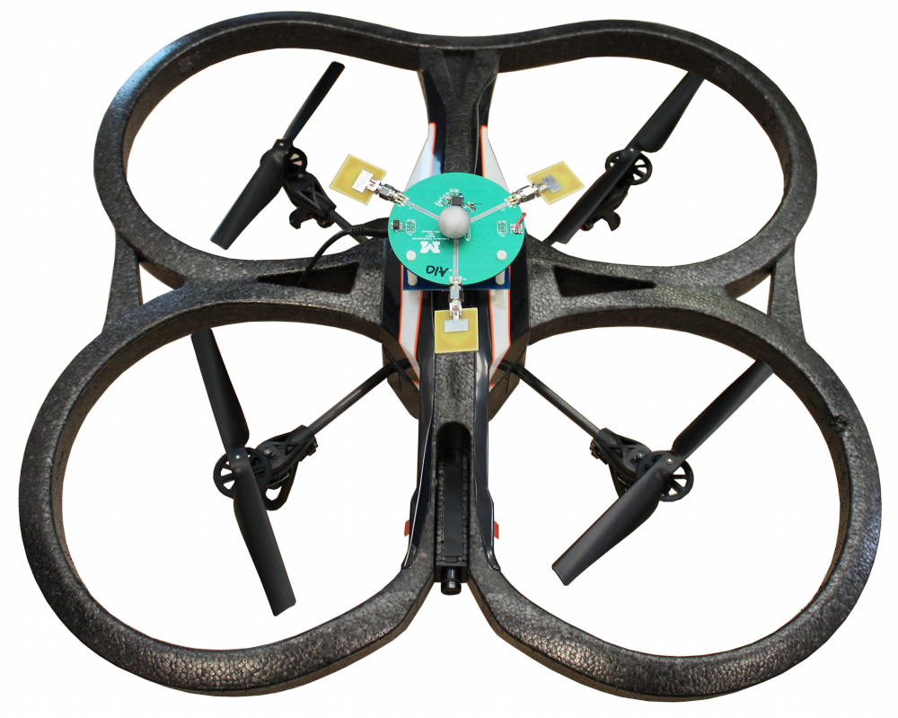
PolyPoint UWB Localization
Wait, What? Demo
The Importance of Indoor Localization
High-fidelity indoor localization enables a bevy of applications, powering today’s Robot Café demo and empowering tomorrow’s swarms of autonomous flying robots. The TerraSwarm project is exploring localization on multiple thrusts including PolyPoint with ultra-wideband RF, ALPS with ultrasonic, and Luaxpose with visible light.
Teaser Pics
Challenges of RF-based Indoor Localization
Multipath sucks, text text
End Text
Multipath Pics
The PolyPoint Ultra-wideband Localization System
Accessors
Swarmlet
Navigation
Smartphone App
Reconfigurability
Using Accessors and a Swarmlet provides a GUI based editor for easily reconfiguring how the application runs. Adding status indications or alternate localization services is simply a matter of dropping in new Accessors, connecting the ports, and re-running the Swarmlet.

