Slide 1
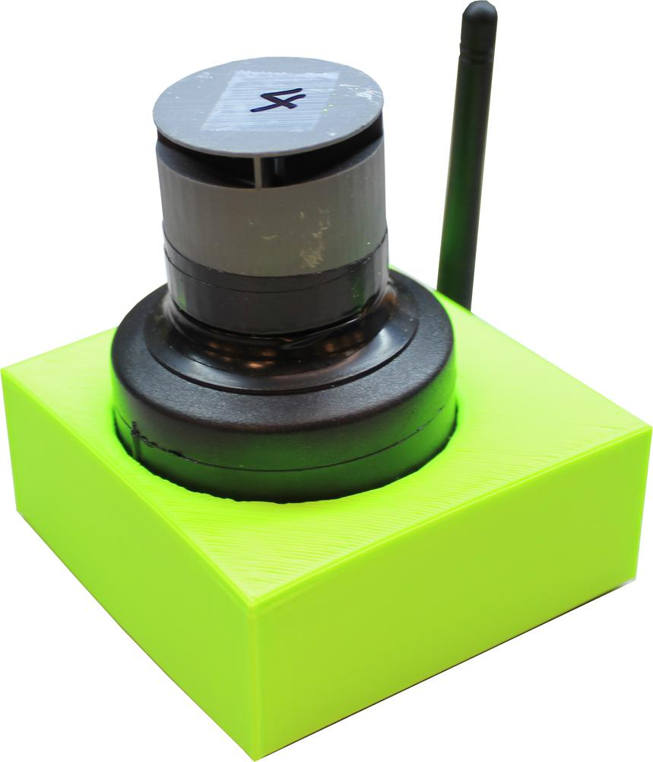

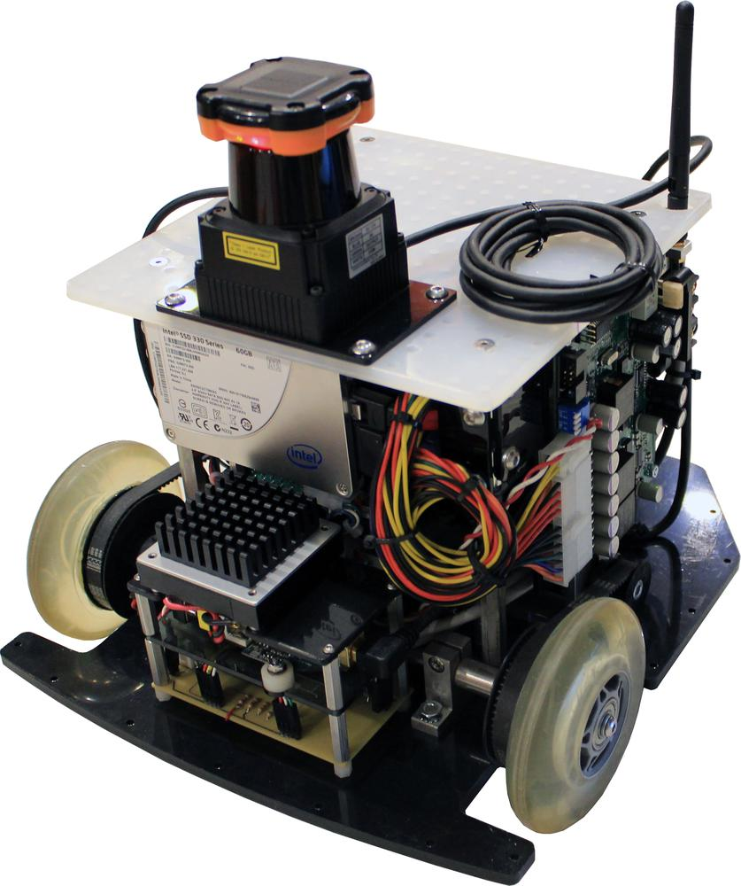
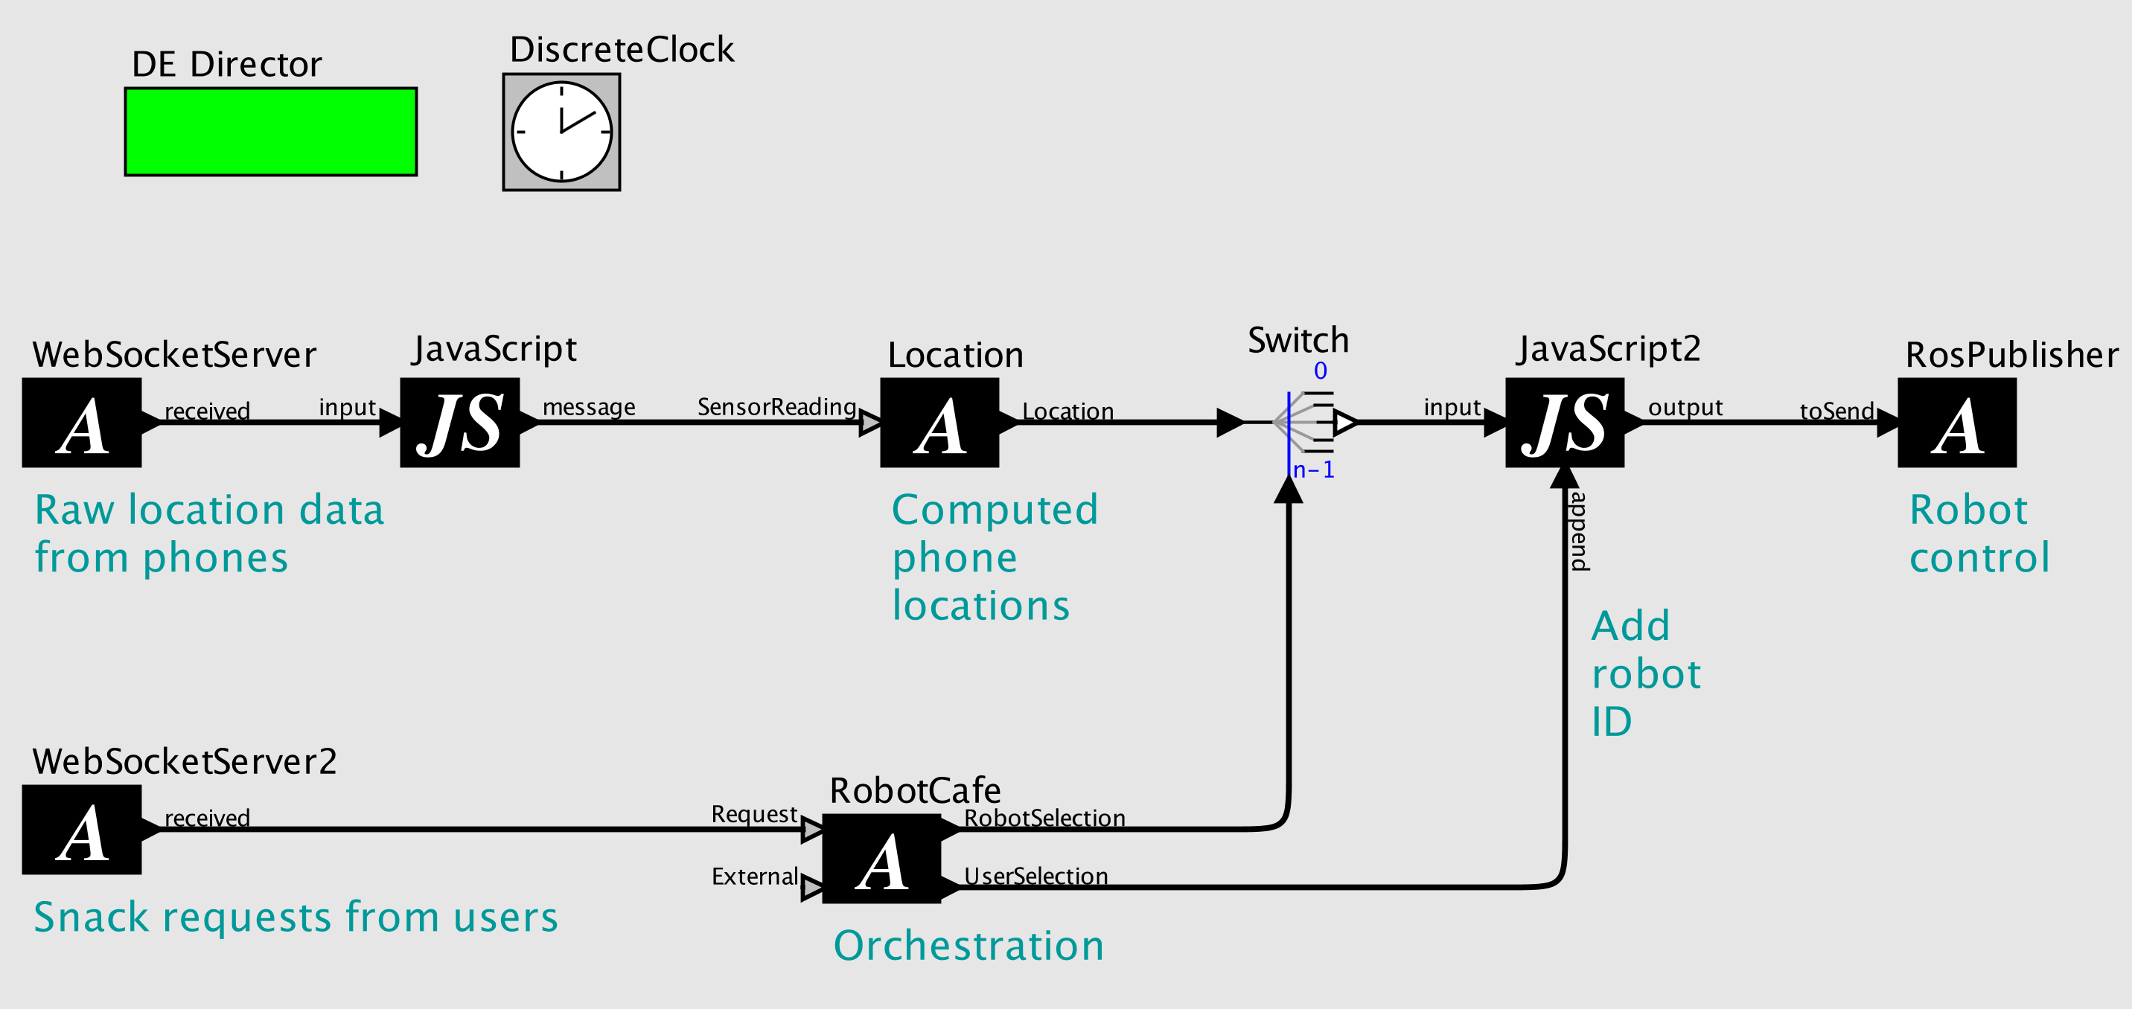
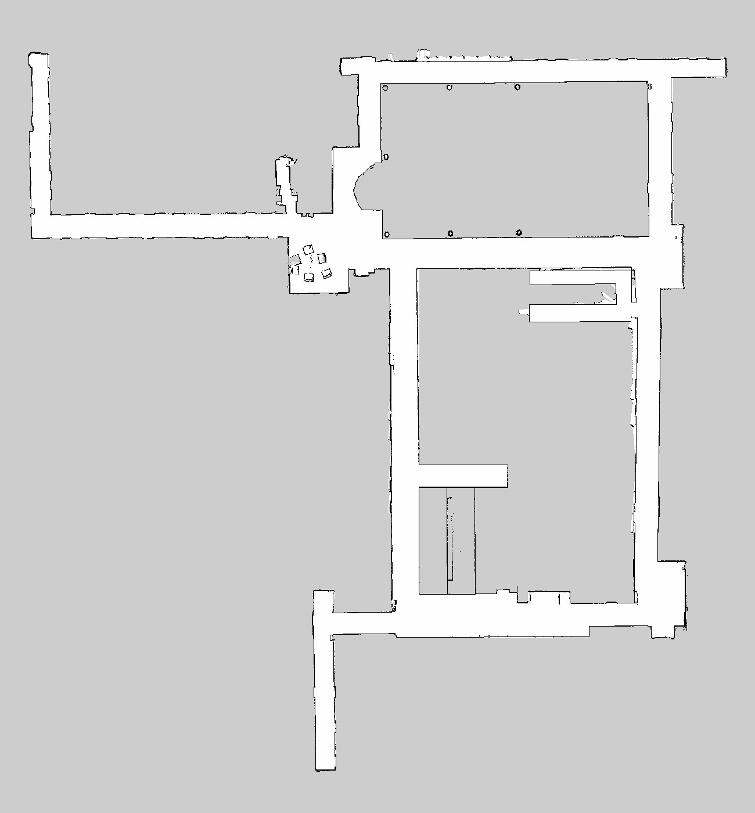

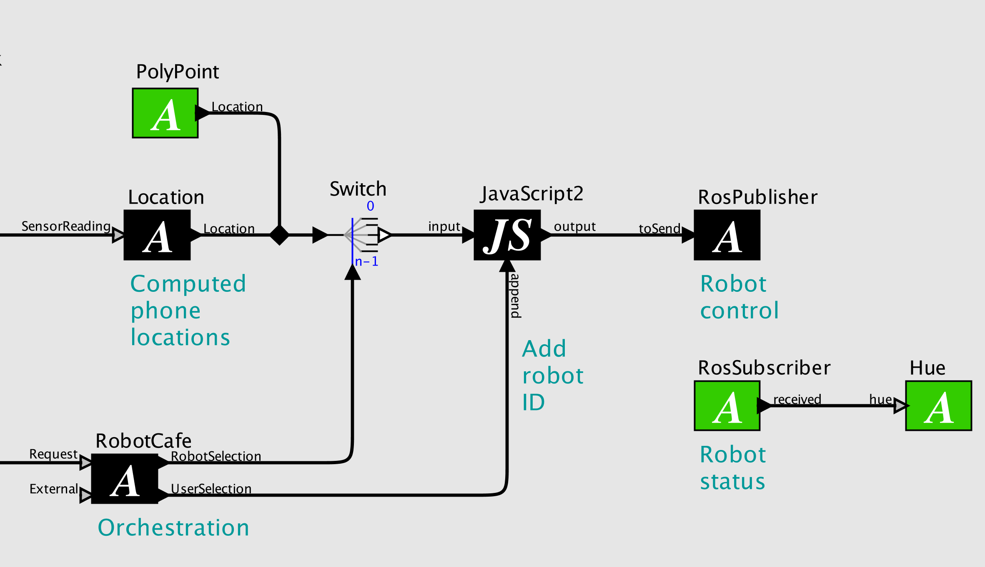
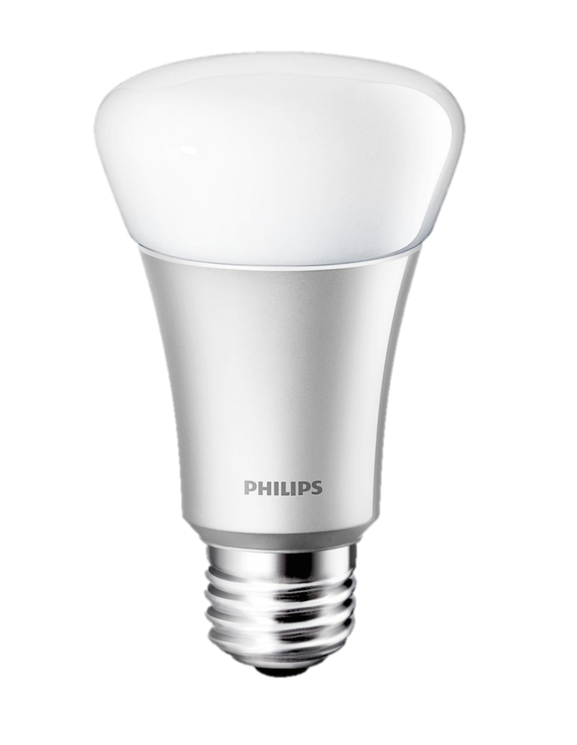
RoboCafé
Wait, What? Demo
Robot Delivery Service at the Push of a Button
Indoor localization and autonomous robots combine to provide a seamless experience for on-demand snack delivery. A smartphone app provides a food and drink menu, and one click has the item delivered to you.
The ALPS ultrasonic indoor localization system provides precise location data of the smartphone while the user makes a selection. The location data and snack choice are fed to a nearby Swarmlet that processes the incoming data and dispatches a robot to the user’s location. The robot uses a human-friendly navigation algorithm to find a path to the user and complete the delivery.
Localization
Scarab Robots
Accessors
E
Smartphone App
S
Swarmlet
Navigation
Technology
ALPS Localization
Accessors/Ptolemy II
Scarab & Navigation
ALPS is an ultrasonic localization system that localizes unmodified smartphones to with 30 cm error. ALPS anchors can self-localize by walking a smartphone around a new space, lessening the burden of installing the system.
Accessors provide a sandboxed JavaScript environment for interacting with physical devices, including robots, smart devices, and other networked devices. They execute inside of the Ptolemy II modeling and simulation tool.
Scarab robots are relatively low-cost ground robots that run the open-source ROS operating system for robots. They use “human-friendly” navigation to follow a path while avoiding people in the same space.
Reconfigurability
Using Accessors and a Swarmlet provides a GUI based editor for easily reconfiguring how the application runs. Adding status indications or alternate localization services is simply a matter of dropping in new Accessors, connecting the ports, and re-running the Swarmlet.

