Slide 1
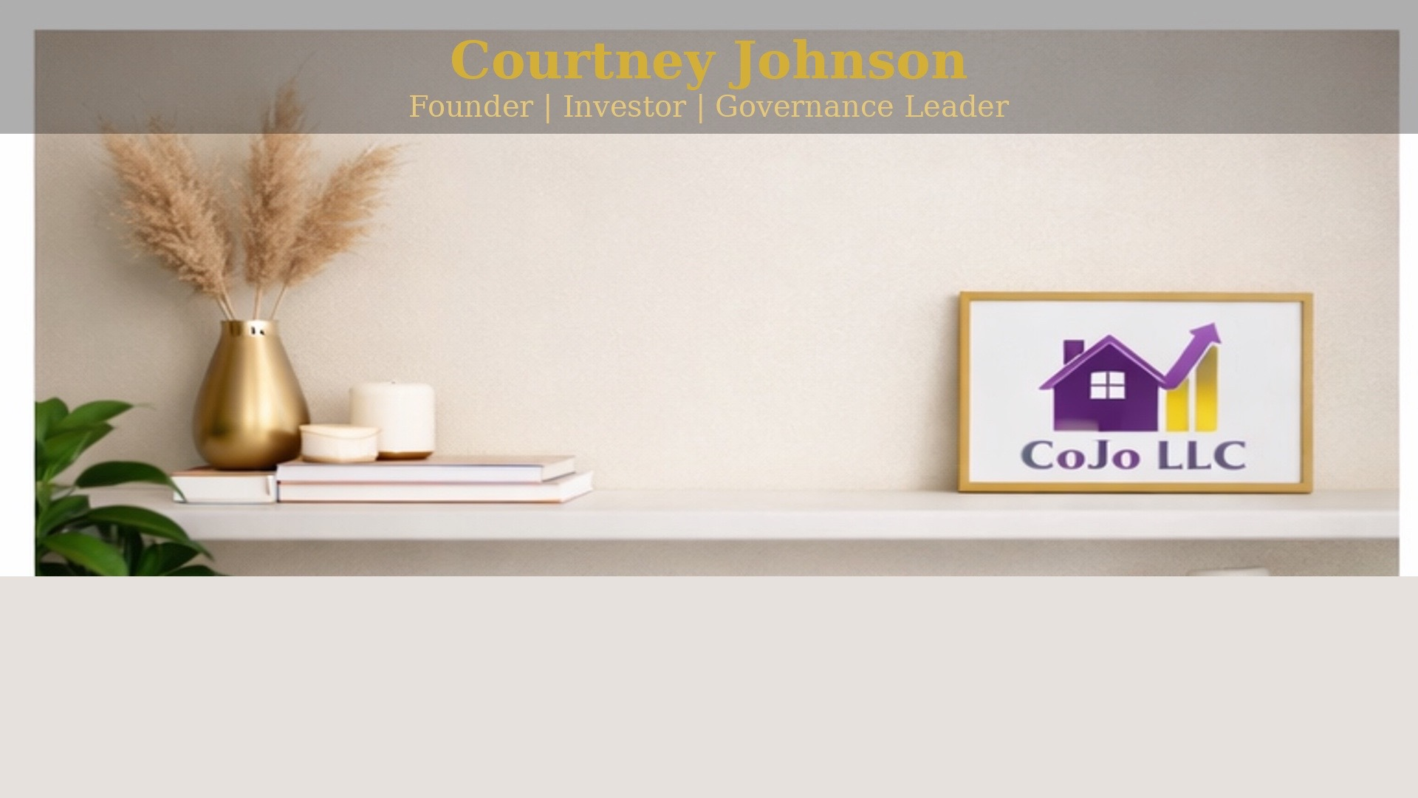
Building High-Impact Teams From Scratch
Courtney Johnson
Founder | Investor | Governance Leader

Slide 2
You don’t build great teams by accident.
You build them intentionally.

Slide 3
Let’s Start Here
Who has built a team from scratch?
Who inherited a team they didn’t choose?
Keep your hand up if it was harder than expected.

Slide 4
What You’ll Get Today
How to build teams from nothing
How to lead people you didn’t hire
How to set culture early
What NOT to do
Everything I’m sharing—I’ve lived.

Slide 5
Where It Started
Built first TPA Auditing Unit
Promoted from within
No blueprint
Leading From Within
Peers → Direct reports
Friends → Accountability
Comfort → Authority
The role changed overnight. Relationships didn’t.

Slide 6
What Would You Do?
Your closest work friend is now your direct report…
And they’re underperforming.
Do you address it immediately—or give them grace?

Slide 7
Creating Structure
Defined roles
Built workflows
Established accountability
If it doesn’t exist—you create it.

Slide 8
Redefining Relationships
Not everyone adjusted
Not everyone stayed
Clarity over comfort

Slide 9
Leadership is not a title.
It’s a shift in behavior others can feel.

Slide 10
Building Again
Built a National Accounts – Insurance Customer Unit
Larger scale
Higher visibility

Slide 11
The Challenge
Different personalities
Different expectations
No shared culture
You’re building alignment
Strategy Shift
Culture first
Then performance
Then structure

Slide 12
Be Honest
Who has joined a team with no clear culture?
How did that feel?

Slide 13
Culture is not what you say.
It’s what you tolerate.

Slide 14
National Leadership
Led client relationship management across national accounts
Influencing without direct authority
First person in this new created role
Leading across all the United States

Slide 15
The Challenge
No direct control
High expectations
Cross-functional complexity
Influence Over Authority
Relationships are currency
Credibility over title

Slide 16
Quick Reflection
Where do you rely too much on authority…
instead of influence?

Slide 17
The higher you go, the less control you have—
and the more influence you need.

Slide 18
Now: 120-Year-Old Startup
Rebuilding from scratch
Creating structure + vision
Building team + strategy simultaneously

Slide 19
The Reality
No clean systems
No legacy structure
Everything is intentional

Slide 20
Building While Leading
Hiring while executing
Structuring while scaling
Leading while defining direction

Slide 21
True leadership is building while everything is still unclear.

Slide 22
My Team-Building Framework
Start with clarity
Define roles early
Set expectations fast
Build culture intentionally
Hold accountability consistently

Slide 23
If people don’t know what success looks like—
they will create their own version.

Slide 24
What you allow…
becomes your culture.

Slide 25
You cannot lead effectively
if you are trying to be liked.

Slide 26
Hiring Insight
Hire for ownership
Hire for adaptability
Hire for mindset
Not just experience

Slide 27
Self Check
Rate yourself: Clarity
Rate yourself: Accountability
Rate yourself: Boundaries
Where are you weakest?

Slide 28
NOT EVERYONE WILL COME WITH YOU.
And that’s okay.

Slide 29
Leadership Reality
Some people resist growth
Some relationships shift
Some people opt out
That’s leadership

Slide 30
What This Means For You
You don’t need perfect conditions
You don’t need the perfect team
You need clarity and courage

Slide 31
Where Trust & Inclusion Show Up
- Clear expectations for everyone
- Consistent accountability
- Psychological safety to perform
Inclusion is not just who is in the room.
It’s how you lead once they’re there.

Slide 32
Your Action
One boundary
One conversation
One leadership shift

Slide 33
You are not just leading people.
You are building something that outlasts you.

Slide 34
My Leadership Balance
VISION
  Clarity
  Direction
  Expectations
COLLABORATION
  Trust
  Influence
  Alignment
ADAPTABILITY
  Build in ambiguity
  Adjust in real time
  Lead through change

Slide 35
Final Reflection
Effective team leadership requires
more than execution.
It requires balance.
Vision
Collaboration
Adaptability

Slide 36
Thank You
Courtney Johnson
Founder | Investor | Governance Leader
Feel free to reach out to me at cojo.dreamhomes@gmail.com
Or via LinkedIn: https://www.linkedin.com/in/courtney-johnson-cojollc/

