Slide 1
CSDA1050 Advanced Analytics Capstone Course
Improving student’s graduation in Education
Sylvain Kamto
Student ID: 11060

Slide 2
1- Introduction/ Background
Currently less than 65% of the students complete their studies as planned. Part of the students will move to work without graduation or change the branch of studies to another institute, but too many have either delayed in their studies (12.3%) or will completely discontinue (8.5%)
The delayed and dropout students pose significant direct costs to cities and schools due to reduced funding from government. Dropouts especially have challenges in finding a job and this problem is causing serious impacts on society in the long run.
To alleviate this problem, we are here by initiating a concept project on how to apply analytics to improve graduation in schools. The core of the idea is the following: utilize advanced analytics and machine learning to identify students who have elevated risk to dropout or delay in studies, so that interventions and support actions can be initiated early enough.

Slide 3
2- Research Question
1
Predicts which students have elevated risk of delayed studies or even dropping out
2
Predict student academic outcomes to better guidance and support

Slide 4
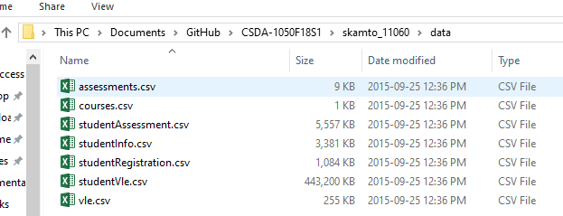
3- Dataset
Data were collected from the anonymised Open University Learning Analytics Dataset (OULAD). It contains data about courses, students and their interactions with Virtual Learning Environment (VLE) for seven selected courses (called modules)
The dataset consists of tables connected using unique identifiers. All tables are stored in the csv format.

Slide 5
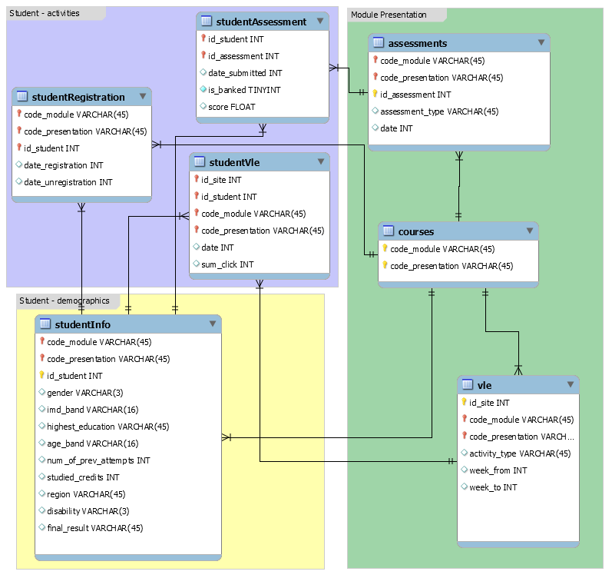
4- Dataset Description
This dataset offers two of the elements in the framework: behavior and performance. It contains information about 22 courses, 32,593 students, their assessment results, and logs of their interactions with the VLE represented by daily summaries of student clicks (10,655,280 entries).

Slide 6
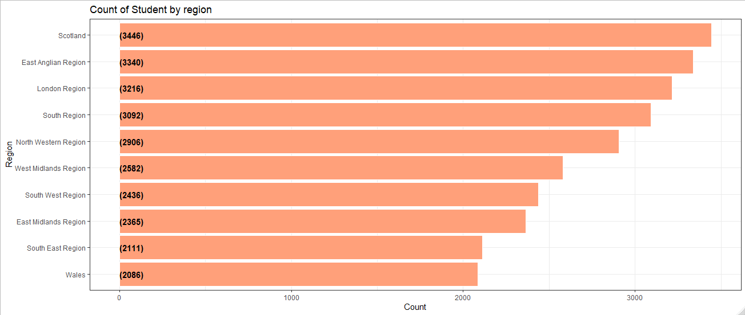
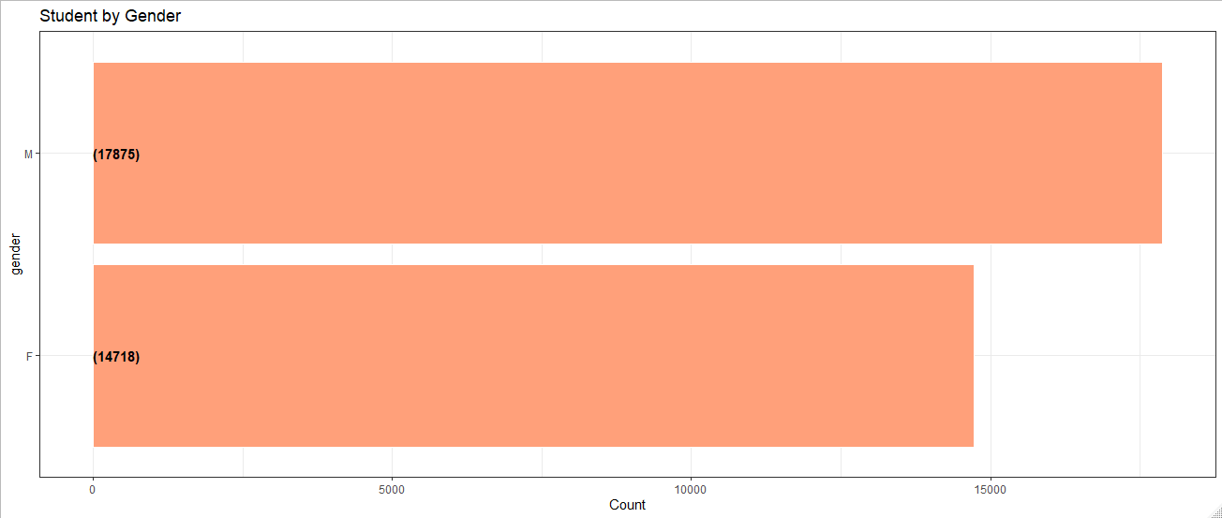
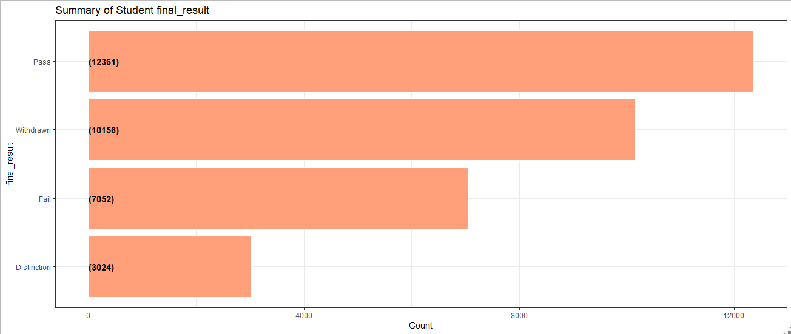
Data exploration

Slide 7
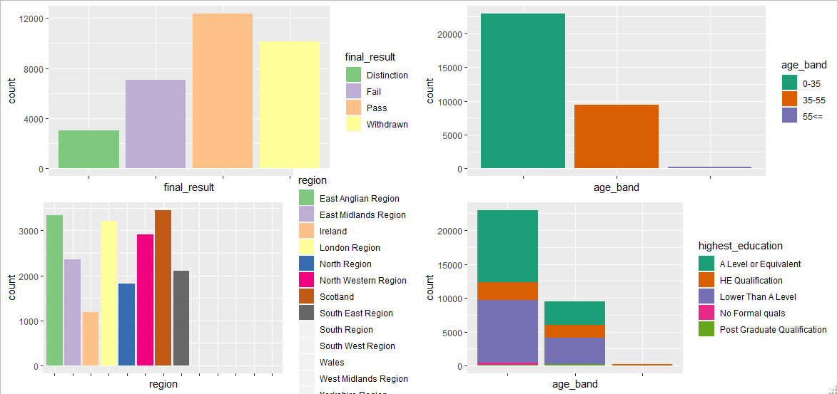
Data exploration

Slide 8
Analytics
Target Variable :
Fail or Pass

Slide 9
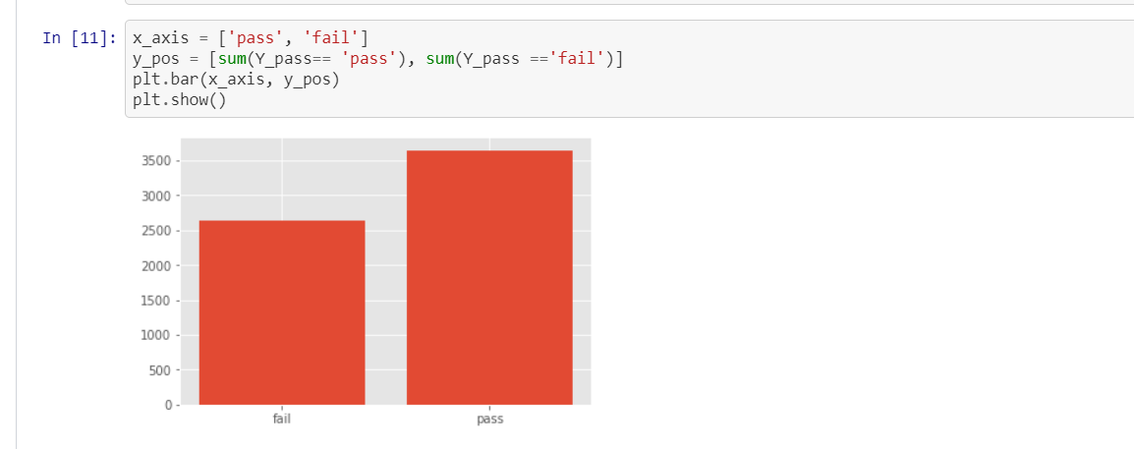
Bar Chart of distribution of students who failed and passed

Slide 10
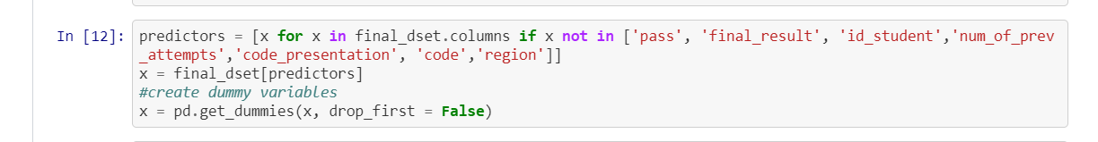
Predictor variable

Slide 11
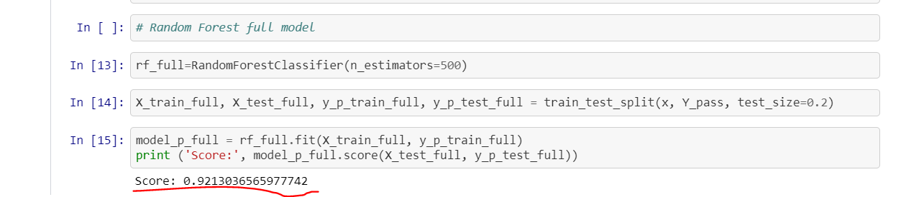
Random Forest full Model
The full model with all of the students assessment scores, weekly virtual interaction scores, etc. Is fairly robust at predicting student failure. But this prediction is made with all data available. Or over 30 weeks of data.
Can student success of failure be predicted earlier?

Slide 12
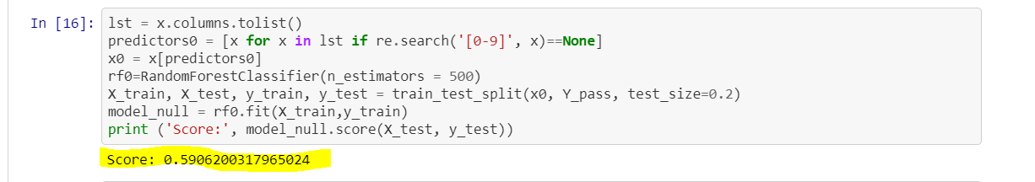
Model with only demographic data
this is data of only student demographic data. So the model does not use any course information
now with only demographic data, the model can predict success of failure with about 60% accuracy

Slide 13
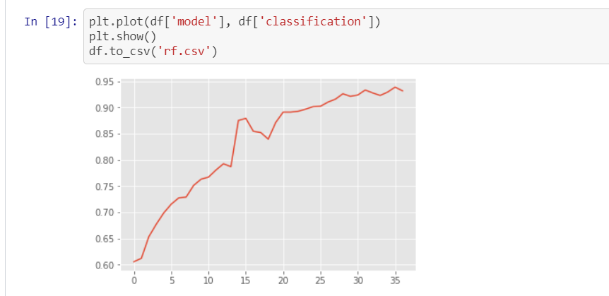
Steady increase in model prediction accuracy with every additional week of data. However, we see jumps at certain weeks. This coincides with weeks where student had tests
by week 8, the model could predict with 75% accuracy student failure. Over 85% accuracy by week 13. And after week 24, there seems to be marginal gains, suggesting that additional student information does not add to model predictive power

Slide 14
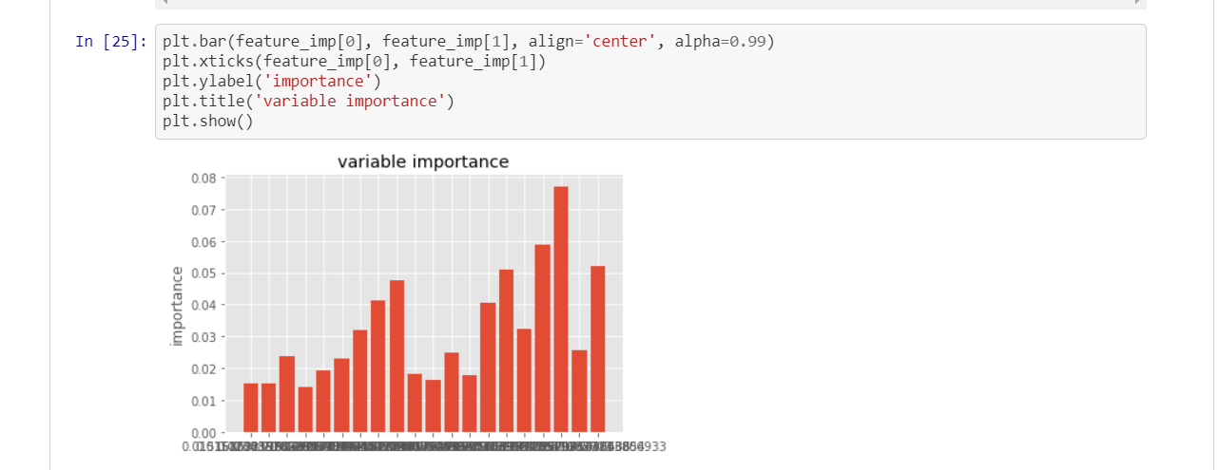
Feature importance
The model can predict with confidence student success and failure, but what features does the model identify as important for its prediction?
As expected, the strongest indicators of success and failure were tests (TMA), especially the tests taken towards the end of the course. Important online interactions mainly centered on overall activity and content activity.

Slide 15
Conclusion
As online learning continues to grow as a platform to educate students, it is important to consider how we can use the data associated with these programs to best identify students who are at risk for failure.
I use random forests to see how early student failure can be predicted. The models showed that with demographic information alone, student failure can be predicted with 60% accuracy. As weekly information on student online interactions and assessments are added, predictions for students at risk for failure greatly increase. By week 8, the model improves to 75% accurcacy, and has over 85% accuracy by week 13.
As educators continue to seek ways to identify students at risk for failure, this model provides a robust way to do so. However, it is not enough to find students at risk for failure. Intervention needs to be implemented to best understand how to improve the outcomes of these students.

