Slide 1
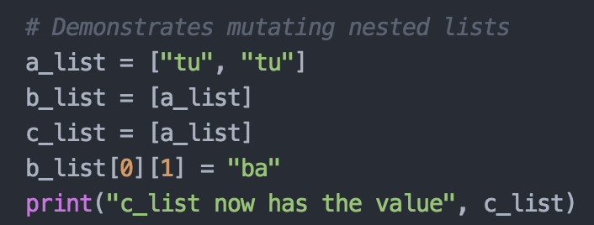
Nested Lists Example
Name Space
Object Space
a_list
[ , ]
list
tu
tu
srt
srt

Slide 2
Nested Lists Example
Name Space
Object Space
a_list
[ , ]
list
b_list
[ ]
list
tu
tu
srt
srt

Slide 3
Nested Lists Example
Name Space
Object Space
a_list
[ , ]
list
b_list
[ ]
list
c_list
[ ]
tu
tu
list
srt
srt

Slide 4
Nested Lists Example
Name Space
Object Space
a_list
[ , ]
list
b_list
[ ]
ba
list
c_list
[ ]
tu
tu
srt
list
srt
srt

