Slide 1
LazerBlast
An Improvement on Pylaga

Slide 2
Project Objectives
Create a video game in the same spirit as arcade top-down shooters like Galaga.
Add challenge of multiple enemy types that require color matching laser hits to destroy. Specifically, we aimed to improve upon the open-source game, Pylaga.
Follow standard practices for Python modules, and make the game extensible for later developers.

Slide 3
Implementation Language
Written in Python using the PyGame library.
Python was chosen because of its widespread use, the availability of open-source components on PyPI, and the ease with which modules can be packaged and released.

Slide 4
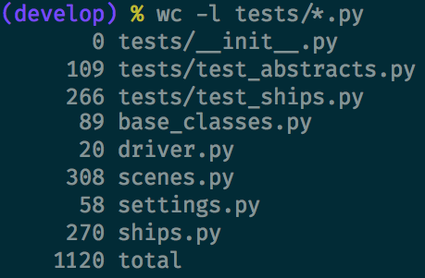
Lines of Code
In total, we had 1120 lines of code. (Including internal documentation and tests.)

Slide 5
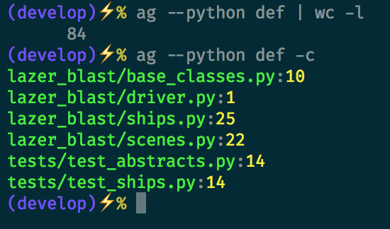
Number of Functions
There were a total of 84 functions. When considering lines of code (including documentation) that makes each function/method around 13 lines long.

Slide 6
Specific Methods Used
We made use of the Spiral Method to implement LazerBlast.
For example, when developing the graphics, we first rendered each player as a simple box, then in the next go around added color, and finally added actual images.
In addition, we used Test Driven Development for each arm of the spiral.

Slide 7
Results of Project
Do we have a finished game?
Yes. The finished product satisfies all of the functional requirements specified in the Planning phase.
Did the project expand upon Pylaga by adding color, increasing difficulty?
Yes. There are colors, and difficulty can be controlled through the settings module.
Did the project follow standard practices for Python modules, and make the game extensible for later developers?
Yes. The module can be installed using pip. Logic is encapsulated in classes and has a clear hierarchy. Tests also exist to prevent regression.

