Slide 1
LazerBlast
An Improvement on Pylaga

Slide 2
Project Objectives
We had two main improvements that we wanted to make:
Add a color changing-component to arcade-like shooters.
Follow standard practices for Python modules, and make the game extensible for later developers.*
*This improvement will be the topic of this presentation.

Slide 3
Implementation Language
Written in Python using the PyGame library.
Python was chosen because of its widespread use, the availability of open-source components on PyPI, and the ease with which modules can be packaged and released.
Pylaga did not take advantage of PyPI, or the python’s setup_utils module.

Slide 4
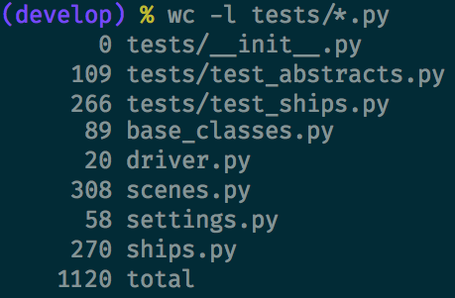
Lines of Code
In total, we had 1120 lines of code. (Including internal documentation and tests.) Pylaga had 1445 lines total.

Slide 5
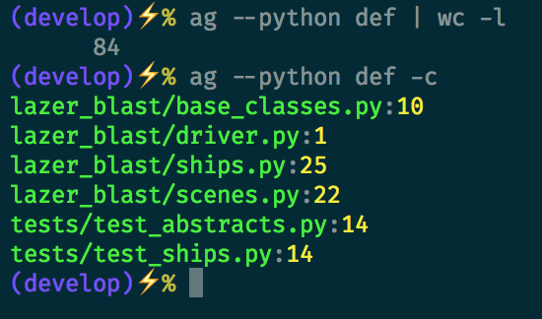
Number of Functions
There were a total of 84 functions. When considering lines of code (including documentation) that makes each function/method around 13 lines long. Pylaga had a total of 106 (so, also around 13 lines per function.)

Slide 6
Specific Methods Used
We made use of the Spiral Method to implement LazerBlast.
In the first iteration, we created base classes for objects which are rendered and in motion. This gave the game more structure.
In addition, we used Test Driven Development for each arm of the spiral.
Tests are primarily on the base classes and models.

Slide 7
Results of Project
Do we have a finished game?
Yes. The finished product satisfies all of the functional requirements specified in the Planning phase.
Did the project expand upon Pylaga by adding color, increasing difficulty?
Yes. There are colors, and difficulty can be controlled through the settings module.
Did the project follow standard practices for Python modules, and make the game extensible for later developers?
Yes. The module can be installed using pip. Logic is encapsulated in classes and has a clear hierarchy. Tests also exist to prevent regression.

