Slide 1
Milestone I
Terrence Reilly

Slide 2
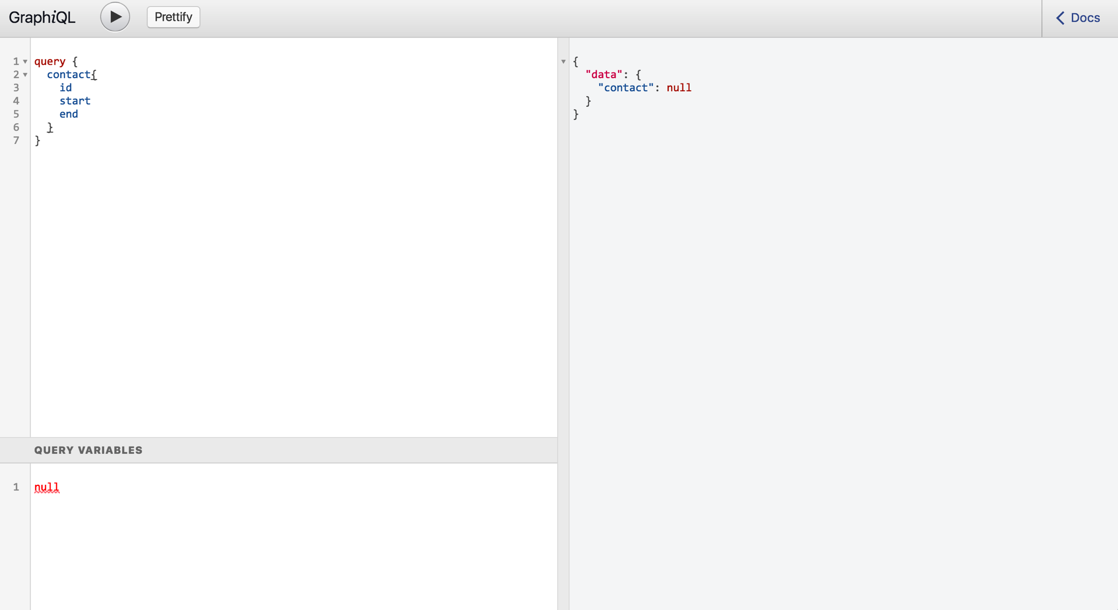
GraphQL Endpoints
I’ve got the GraphQL endpoint up, so that I can make live requests.

Slide 3
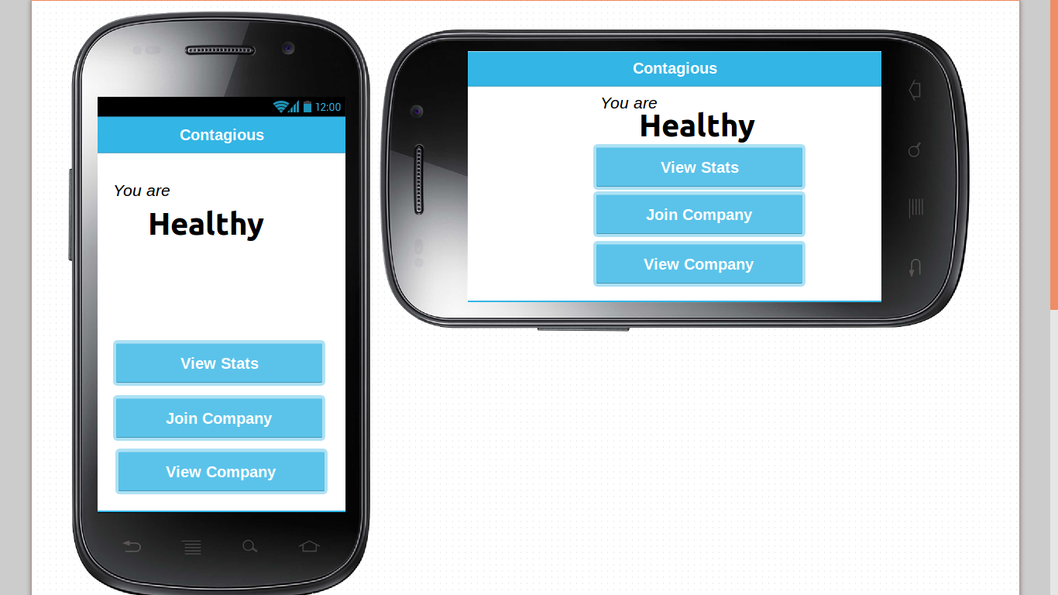
Basic App Layout
The basic layout of the app in Android is completed

Slide 4
Backend Models, Authentication
The necessary backend models are completed. (There is a Contact Model, and a Profile.)
Authentication needs to be done. Then, requests need to be made.
I’ve attempted using django-graph-auth module for authentication, but it wasn’t working.

Slide 5
To-Do Next
Requests from app to backend
Posting to backend
Building statistics
User authentication

