Slide 1
Final Project Presentation
Terrence Reilly

Slide 2
Completed Items
A backend with JSON authentication
Deployment to AWS
Graphql endpoints
HTTP requests through app with OKHttp
App layout, buttons, etc.

Slide 3
Not Completed
I failed to get LEBluetooth working in time

Slide 4
Features Implemenetd
The ability to post a "contact" (when two phones are near one another)
The ability to get a list of contacts.
The ability to create a new user or group.
The ability to authenticate the user

Slide 5
Features Cont.
The ability to add a user to a group
The ability to return statistics on users or groups
The ability to display statistics for a particular user or the user's groups

Slide 6
Features Unimplemented
The ability to determine if another phone running the app is nearby (using LE bluetooth)

Slide 7
Problems Encountered
The LEBluetooth libraries I found didn’t have very good documentation
The EC2 instance did not have Python3 installed
So, I just had to install Python3 and the dev dependencies

Slide 8
What I’d Have Done differently
I probably wouldn’t have used GraphQL, just because of the paucity of documentation
I’d have gone with the AndroidBeaconLibrary to begin with

Slide 9
To-Do In the Future
If there is enough time, I would like to test the Android Beacon Library
If there is an abundance of time, I would like to get graphs showing up, and perhaps have a sign-up page.

Slide 10
Libraries Used
OkHttp
AndroidBeaconLibrary

Slide 11
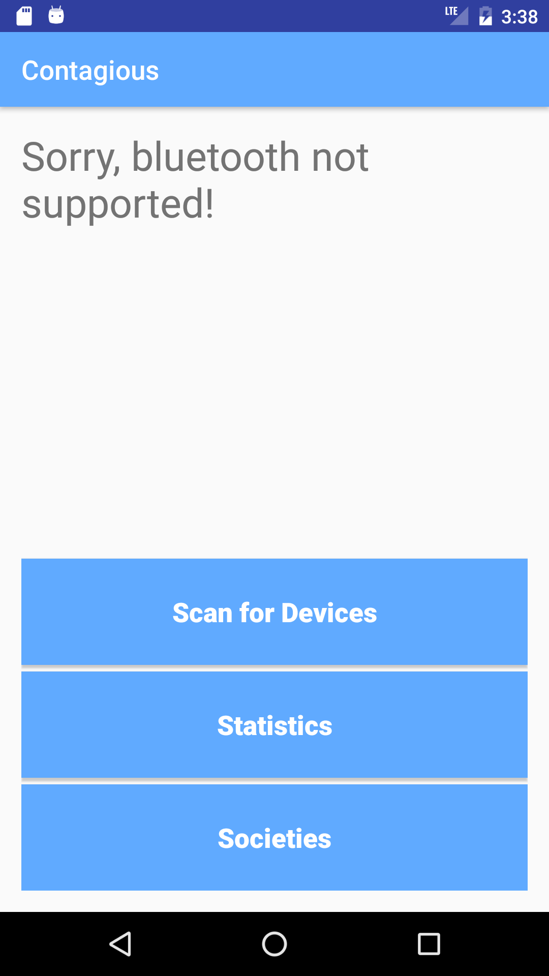
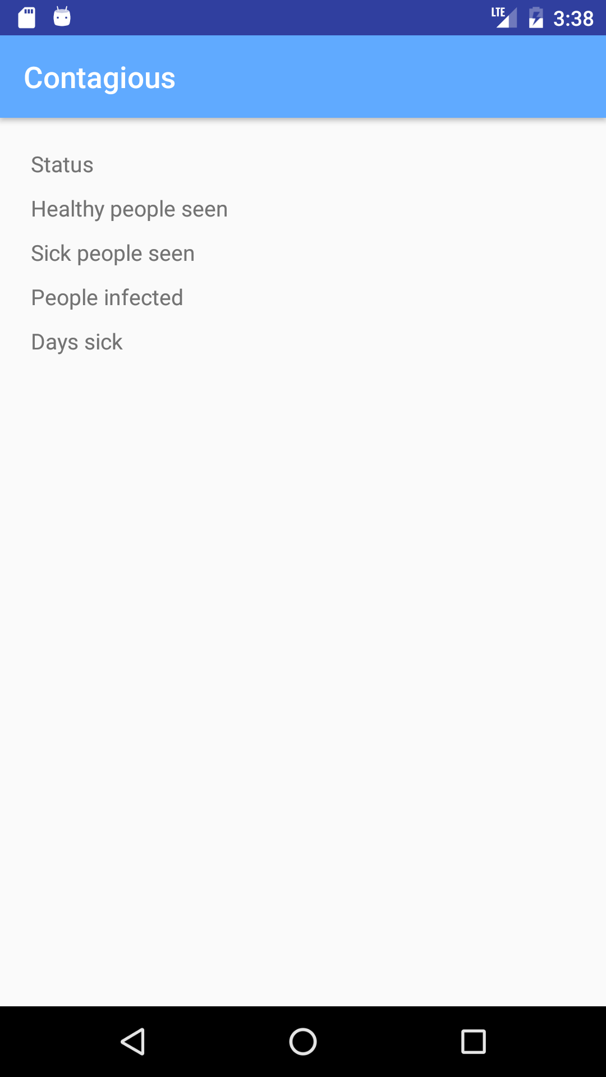
Screenshots

