Slide 1

Plane Vision
Terrence turner | tsturner24@gmail.com | Linkedin | github

Slide 2
Outline
Project Background
Mission Statement
Problem Statement
Dataset
Data Wrangling
Exploratory Data Analysis

Slide 3

Project Background

Slide 4
Mission Statement
Being able to track and identify potential threats would be beneficial to the military. The goal of this project is to detect an aircraft given a satellite image.
Data wrangling
Performing Exploratory Data Analysis (EDA)
Developing a Convolutional Neural Networks (CNN) using VGG16

Slide 5
Problem Statement
How well can the model detect an aircraft given a satellite image?

Slide 6
Dataset
Plane
https://www.kaggle.com/rhammell/planesnet
No Plane

Slide 7
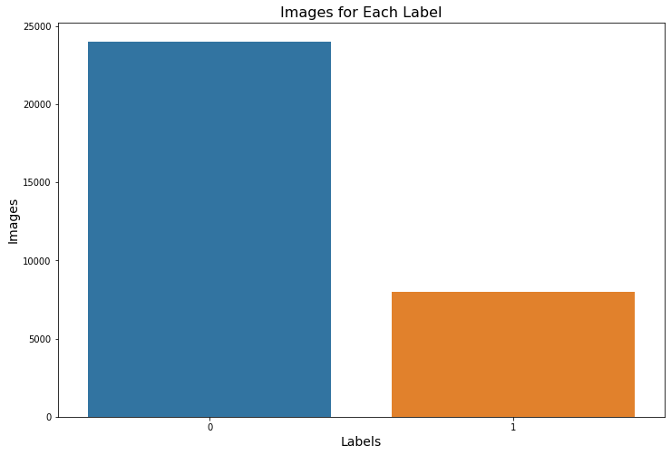
Data Wrangling

Slide 8
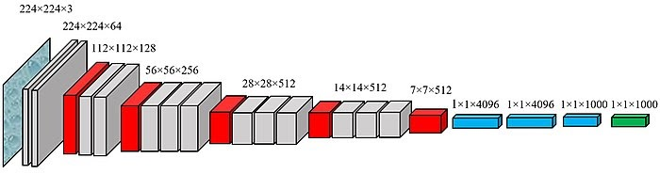
Transfer Learning
Transfer learning is a deep learning method for taking a model used for a task and reusing for another task.
VGG Net is the name of a convolutional neural network model proposed by K. Simonyan and A. Zisserman.
VGG Net was invented to enhance classification accuracy by increasing the depth of the CNNs.

Slide 9
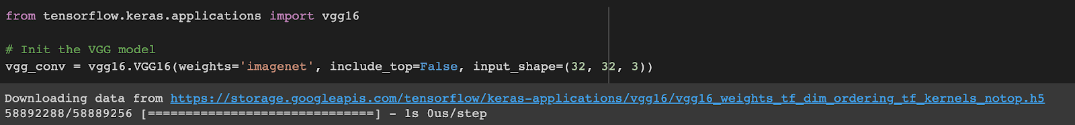
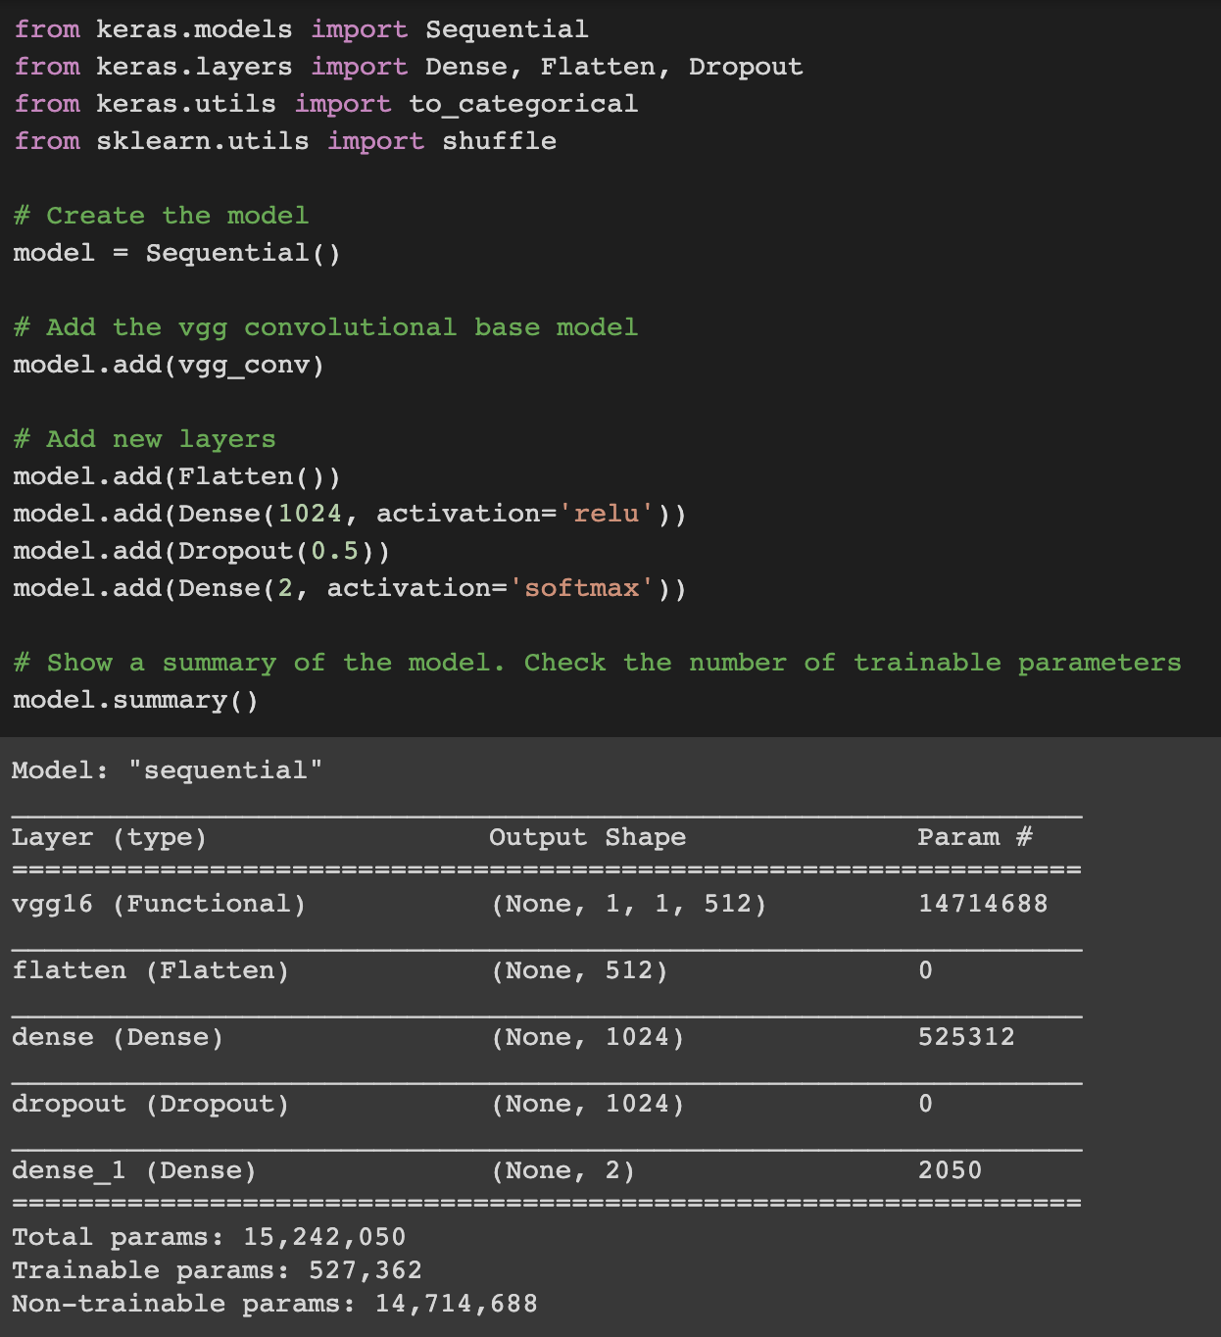
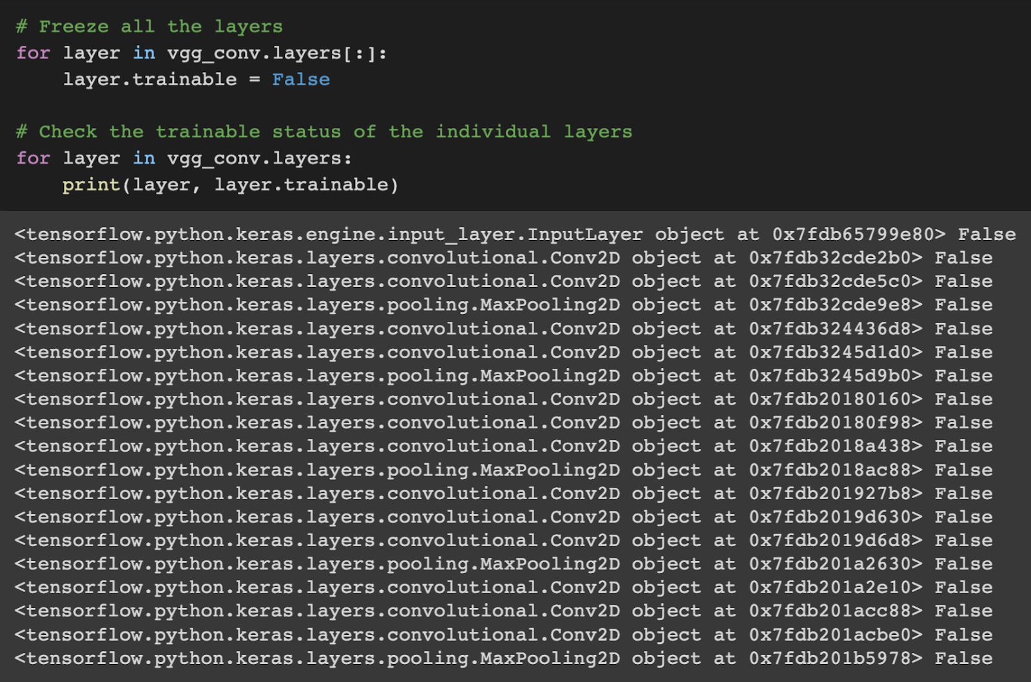
VGG16 Model

Slide 10
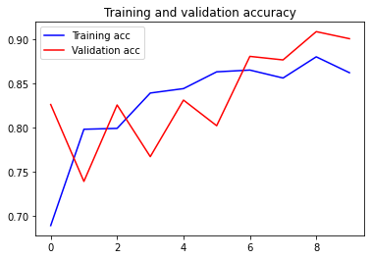
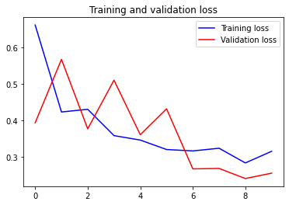
Exploratory Data Analysis (EDA)

Slide 11
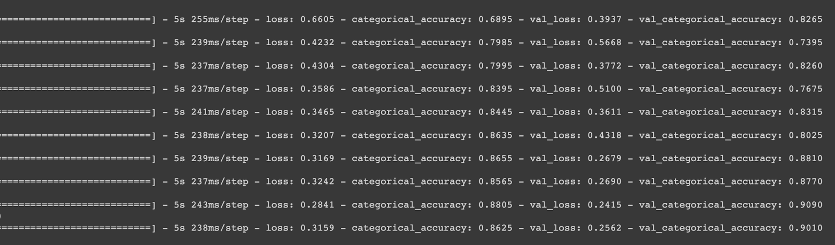
Results
The model performed well with 90% accuracy. The model made 198 out of 2000 errors.

Slide 12
Conclusion
I recommend this model because it was able to detect whether an image was a plane or not accurately.
This will greatly benefit the military and any other federal agencies.
Uses: AI planes detecting and targeting enemy planes
The only thing I would change is trying to get to use all 32000 images.
This may have increased the accuracy even more.

