Slide 1
Predicting NBA Players’ salary
Terrence turner | tsturner24@gmail.com | Linkedin | github

Slide 2
Outline
Project Background
Mission Statement
Datasets
Data Wrangling
Exploratory Data Analysis
In-Depth Data Analysis

Slide 3
Project Background

Slide 4
Mission Statement
Assist NBA General Mangers with deciding how much to pay NBA players based off their stats.
Data wrangling
Performing exploratory data analysis
Developing machine learning model using RandomForestRegressor and GridSearchCV

Slide 5
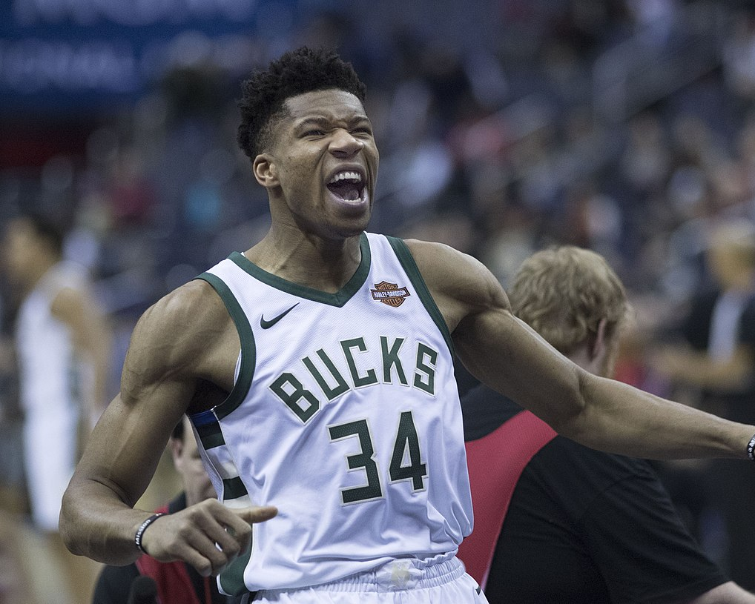
datasets
NBA Season Stats from 1950-2019 dataset
24.7K rows
50 columns
NBA Contracts
428 rows
10 columns
2019-2020 NBA Player Stats
624 rows
31 columns
This Photo by Unknown Author is licensed under CC BY-SA

Slide 6
Data wrangling
Contracts dataset
Dropped any null columns. Split the player column into Player, Year and Contract ends.
Removed all parentheses, commas, percent signs, and dollar signs from the table.
NBA Stats dataset
Filtered to years 2014 - 2019 because the earliest contract signed was 2015.
Renamed columns to show stats per game rather than in total and choose columns names that were easier to understand.
Dropped total columns and reordered columns to match the 2020 stats columns
2019-20 NBA Stats
there was extra value in the name column, so I split the column and dropped the extra value and dropped the old player and rank column.
Missing Values
I left missing values alone because I plan on using SimpleImputer when using Machine Learning Model

Slide 7
Exploratory data analysis
Descriptive Data Analysis & Statistical Data Analysis

Slide 8
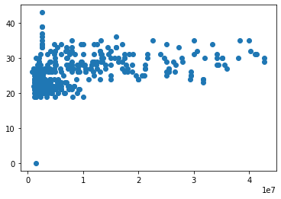
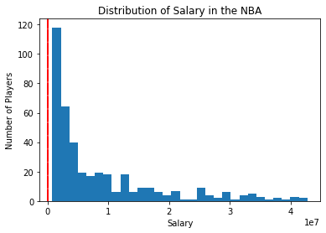
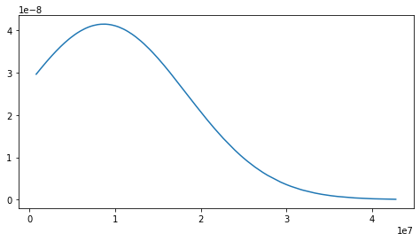
Avg. Salary & Age Correlation
Probability Density Function

Slide 9
In-depth data analysis
Random Forest Regressor & Grid Search CV

Slide 10
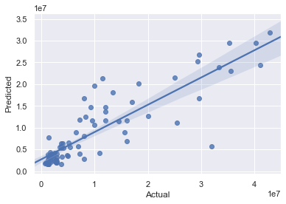
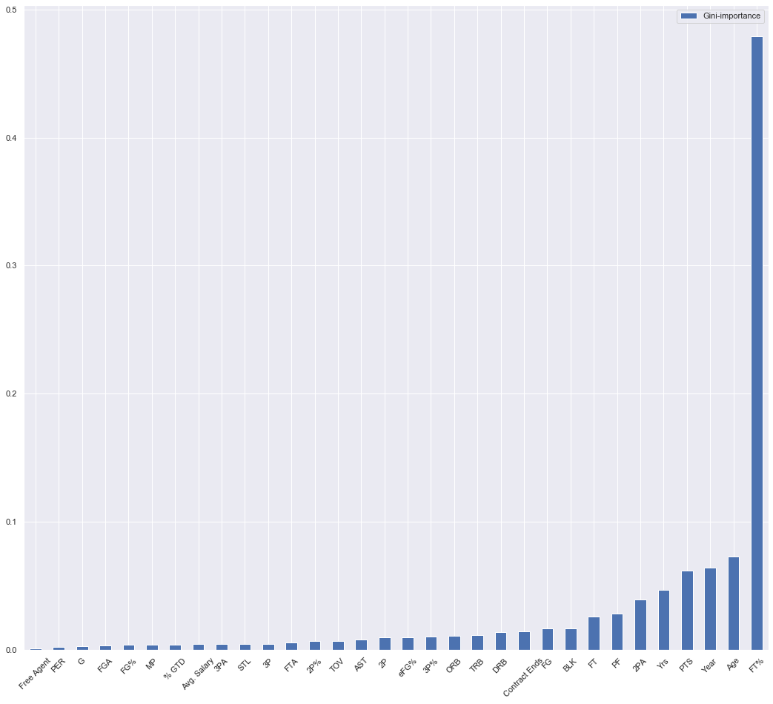
Actual Salary vs Predicted Salary
Feature Importance

Slide 11
Recommendations on improvement
MAPE = 49.92%
Using more advance stats which will give the model more data

