Slide 1

TERRESTRIAL PLATFORM | TERRA3RDEYE | ENTERPRISE SPECIFICATION
Terra3rdEye: AI-Powered Visual Intelligence System for All Industrial Applications
Autonomous Industrial Intelligence Suite · Tier-1 Plant Architecture
““Your AI-powered industrial watchdog that never blinks, ensuring unmatched safety, quality, and operational efficiency across every sector, every shift, every second.””
— — THE OUTCOME-BASED REVOLUTION
EXECUTIVE OPERATIONAL SYNOPSIS
In fast-paced manufacturing and process environments, continuous monitoring is essential. Terra 3rd Eye acts as a 24/7 digital watchdog, leveraging computer vision and neural networks to observe, analyze, and respond to shop-floor events—from workplace PPE compliance and worker fall detection to inline product quality control and intruder security.
INFERENCE LATENCY
< 45 ms Edge
PPE COMPLIANCE
99.4% Verified
CAMERA PIPELINE
64x RTSP Streams
SAFETY RATING
Class 1 / Div 2
TERRESTRIAL PLATFORM CORE
Edge-to-Cloud Cognitive Nervous System
Physics-informed mathematical twin running sub-25ms closed-loop supervisory control with full ISA-95/101 conformity.
Notes:
Terra3rdEye - Enterprise Product Specification
Tagline: AI-Powered Visual Intelligence System for All Industrial Applications
Outcome Quote:
“Your AI-powered industrial watchdog that never blinks, ensuring unmatched safety, quality, and operational efficiency across every sector, every shift, every second.” (— THE OUTCOME-BASED REVOLUTION)
Executive Overview:
In fast-paced manufacturing and process environments, continuous monitoring is essential. Terra 3rd Eye acts as a 24/7 digital watchdog, leveraging computer vision and neural networks to observe, analyze, and respond to shop-floor events—from workplace PPE compliance and worker fall detection to inline product quality control and intruder security.
Key Telemetry Metrics:
- INFERENCE LATENCY:: < 45 ms Edge
- PPE COMPLIANCE:: 99.4% Verified
- CAMERA PIPELINE:: 64x RTSP Streams
- SAFETY RATING:: Class 1 / Div 2

Slide 2
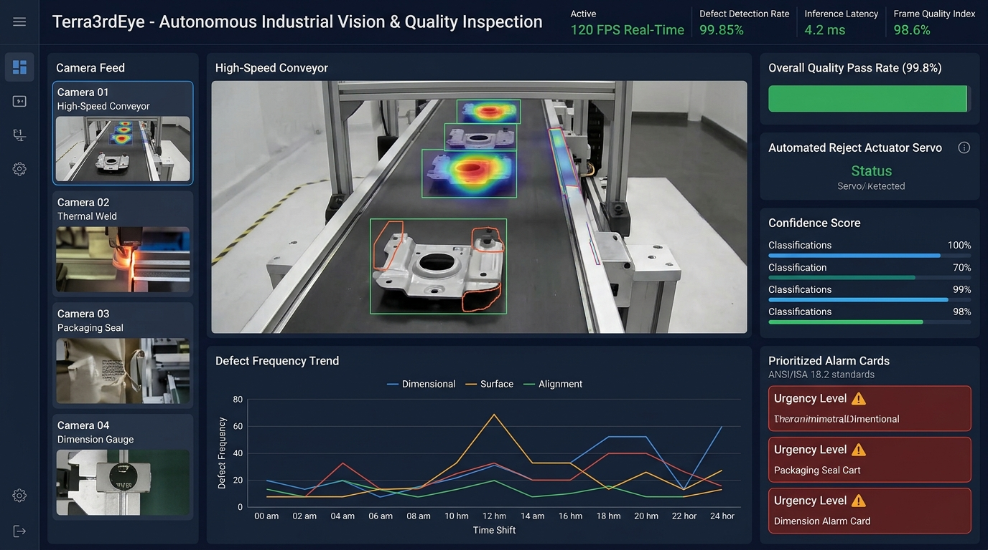
TERRESTRIAL PLATFORM | TERRA3RDEYE | OPERATIONAL INTERFACE
Terra3rdEye ANSI/ISA-101 Operational Interface & Real-Time System Representation
ANSI/ISA-101 Ergonomic High-Performance HMI · Real-Time System Representation
Notes:
Terra3rdEye - ANSI/ISA-101 Verified Operational Interface
Representation: Terra3rdEye ANSI/ISA-101 Operational Interface & Real-Time System Representation
Compliance: ANSI/ISA-101 Verified HMI
Asset File: terra_3rdeye_isa101_showcase.jpg

Slide 3
TERRESTRIAL PLATFORM | TERRA3RDEYE | CORE CAPABILITIES
What Terra3rdEye Will Do
Specific operational functions and engineering capabilities directly sourced from technical documentation.
PILLAR 01 | ENGINEERING CAPABILITY
Workplace Safety & Compliance Monitoring
Detects missing PPE kits (helmets, gloves, vests, goggles), unsafe behaviors, social distancing, and person down emergencies.
PILLAR 02 | ENGINEERING CAPABILITY
Production Quality Control AI
Identifies deformed products, broken packaging, label orientation errors, and color deviations directly on the conveyor.
PILLAR 03 | ENGINEERING CAPABILITY
AI-Driven Security & Surveillance
Detects unauthorized access, intruders, after-hours activity, facial recognition access control, and vehicle license plate tracking.
PILLAR 04 | ENGINEERING CAPABILITY
24/7 Fire & Leakage Surveillance
Monitors visual and thermal feeds for smoke, open flames, and fluid leakages in raw material and chemical storage warehouses.
Notes:
What Terra3rdEye Will Do:
[1] Workplace Safety & Compliance Monitoring:
Detects missing PPE kits (helmets, gloves, vests, goggles), unsafe behaviors, social distancing, and person down emergencies.
[2] Production Quality Control AI:
Identifies deformed products, broken packaging, label orientation errors, and color deviations directly on the conveyor.
[3] AI-Driven Security & Surveillance:
Detects unauthorized access, intruders, after-hours activity, facial recognition access control, and vehicle license plate tracking.
[4] 24/7 Fire & Leakage Surveillance:
Monitors visual and thermal feeds for smoke, open flames, and fluid leakages in raw material and chemical storage warehouses.

Slide 4
TERRESTRIAL PLATFORM | TERRA3RDEYE | FIELD USE CASES
Operational Use Cases & Field Impact
Actual documented use cases across Quality Assurance, Reduced Manpower, Efficiency, and Asset Productivity.
CASE 01 | QA & INLINE PRODUCTION QUALITY CONTROL
QA & Inline Production Quality Control
Detects damaged, deformed, or defective products on assembly lines; verifies labeling accuracy, packaging integrity, color mismatch, and alignment errors.
CASE 02 | SAFETY & WORKPLACE PPE COMPLIANCE
Safety & Workplace PPE Compliance
Detects workers without PPE kits (helmets, gloves, safety vests, goggles) and triggers instant alerts when personnel enter hazardous restricted zones.
CASE 03 | REDUCED MANPOWER
Reduced Manpower (Facial Recognition & Access Tracking)
Automated facial recognition for employee access control, attendance tracking, and vehicle tracking for plant material shipments, replacing manual security registers.
CASE 04 | PRODUCTIVITY & LIFE-SAFETY
Productivity & Life-Safety (Fall & Emergency Detection)
Real-time worker fall detection, person down alerts, and thermal smoke/fire detection trigger instant evacuation alarms and management notifications.
Notes:
Terra3rdEye - Operational Use Cases & Field Impact:
[QA & Inline Production Quality Control] QA & Inline Production Quality Control:
Detects damaged, deformed, or defective products on assembly lines; verifies labeling accuracy, packaging integrity, color mismatch, and alignment errors.
[Safety & Workplace PPE Compliance] Safety & Workplace PPE Compliance:
Detects workers without PPE kits (helmets, gloves, safety vests, goggles) and triggers instant alerts when personnel enter hazardous restricted zones.
[Reduced Manpower] Reduced Manpower (Facial Recognition & Access Tracking):
Automated facial recognition for employee access control, attendance tracking, and vehicle tracking for plant material shipments, replacing manual security registers.
[Productivity & Life-Safety] Productivity & Life-Safety (Fall & Emergency Detection):
Real-time worker fall detection, person down alerts, and thermal smoke/fire detection trigger instant evacuation alarms and management notifications.

Slide 5
TERRESTRIAL PLATFORM | TERRA3RDEYE | ARCHITECTURAL CONTRAST
Comparison with Traditional SCADA / Legacy Systems
Point-by-point contrast demonstrating the technological shift from legacy industrial automation to the Terrestrial Platform.
TRADITIONAL LEGACY SYSTEMS / SILOED SCADA
TERRA3RDEYE TERRESTRIAL PLATFORM ADVANTAGE
Security and safety personnel passively monitor dozens of CCTV screens, missing critical PPE violations and safety breaches.
Automated neural networks inspect every camera frame in real time, alerting instantly when safety helmets, gloves, or vests are missing.
Product quality inspection relies on manual spot-checks, allowing deformed items and misaligned labels to ship to clients.
100% inline visual quality control detecting damaged, deformed, or defective products, color mismatches, and packaging flaws.
Streaming heavy high-definition video feeds across plant networks causes severe IT bandwidth congestion.
Local edge inference: lightweight event metadata and bounding boxes transmitted via WebSockets without network overload.
Notes:
Terra3rdEye - Architectural Contrast (Legacy SCADA vs Terrestrial Platform):
LEGACY:
Security and safety personnel passively monitor dozens of CCTV screens, missing critical PPE violations and safety breaches.
TERRESTRIAL ADVANTAGE:
Automated neural networks inspect every camera frame in real time, alerting instantly when safety helmets, gloves, or vests are missing.
LEGACY:
Product quality inspection relies on manual spot-checks, allowing deformed items and misaligned labels to ship to clients.
TERRESTRIAL ADVANTAGE:
100% inline visual quality control detecting damaged, deformed, or defective products, color mismatches, and packaging flaws.
LEGACY:
Streaming heavy high-definition video feeds across plant networks causes severe IT bandwidth congestion.
TERRESTRIAL ADVANTAGE:
Local edge inference: lightweight event metadata and bounding boxes transmitted via WebSockets without network overload.

Slide 6
TERRESTRIAL PLATFORM | TERRA3RDEYE | SYSTEM ARCHITECTURE
End-to-End System Diagram & Data Pipeline
Visual architecture diagram representing field telemetry ingestion, deterministic edge fabric, AI reasoning, and closed-loop actuation.
LAYER 01
Optical & Thermal Ingestion
Multi-camera visual acquisition aggregating high-speed GigE Vision, RTSP video streams, line-scan sensors, and thermal infrared cameras.
PROTOCOLS & STANDARDS:
• GigE Vision
• RTSP Video Stream
• ONVIF Profile S/T
LAYER 02
Hardware Edge Preprocessing
Zero-copy frame ingestion, hardware-accelerated image normalization, spatial distortion correction, and sub-10ms frame dispatch.
PROTOCOLS & STANDARDS:
• Hardware Video Pipeline
• Frame Normalization
• Sub-10ms Vision Bus
LAYER 03
Defect Segmentation Core
Ultra-fast neural defect detection, micron-level dimensional tolerance verification, surface anomaly classification, and OCR label parsing.
PROTOCOLS & STANDARDS:
• Real-Time Defect AI
• Sub-Micron Gauging
• Surface Anomaly Model
LAYER 04
Automated Reject Cockpit
High-speed pneumatic reject gate actuation, robotic sorter guidance, QA traceability archiving, and ANSI/ISA-101 defect inspection consoles.
PROTOCOLS & STANDARDS:
• Pneumatic Reject Gate
• Robotic Sorter Link
• ISA-101 Vision HMI
UNIFIED DATA PIPELINE FLOW
Optical & Thermal Video Streams ➔ Hardware Frame Preprocessing ➔ Real-Time Defect Segmentation ➔ High-Speed Reject Gate Actuation (< 10ms Latency)
Notes:
Terra3rdEye - End-to-End System Diagram & Data Pipeline:
Layer 01: Optical & Thermal Ingestion
Multi-camera visual acquisition aggregating high-speed GigE Vision, RTSP video streams, line-scan sensors, and thermal infrared cameras.
Protocols: GigE Vision, RTSP Video Stream, ONVIF Profile S/T
Layer 02: Hardware Edge Preprocessing
Zero-copy frame ingestion, hardware-accelerated image normalization, spatial distortion correction, and sub-10ms frame dispatch.
Protocols: Hardware Video Pipeline, Frame Normalization, Sub-10ms Vision Bus
Layer 03: Defect Segmentation Core
Ultra-fast neural defect detection, micron-level dimensional tolerance verification, surface anomaly classification, and OCR label parsing.
Protocols: Real-Time Defect AI, Sub-Micron Gauging, Surface Anomaly Model
Layer 04: Automated Reject Cockpit
High-speed pneumatic reject gate actuation, robotic sorter guidance, QA traceability archiving, and ANSI/ISA-101 defect inspection consoles.
Protocols: Pneumatic Reject Gate, Robotic Sorter Link, ISA-101 Vision HMI
Pipeline Flow:
DATA PIPELINE FLOW: Optical & Thermal Video Streams ➔ Hardware Frame Preprocessing ➔ Real-Time Defect Segmentation ➔ High-Speed Reject Gate Actuation (< 10ms Latency)

Slide 7
TERRESTRIAL PLATFORM | TERRA3RDEYE | DEPLOYMENT & SI VALUE
System Integrator Deployment Framework & Commercial Model
Zero rip-and-replace turnkey onboarding with recurring enterprise margins and co-selling enablement.
PHASE 01 | CONNECTIVITY & AUDIT
Zero Rip-and-Replace Onboarding
Non-intrusive protocol discovery across field PLCs, RTUs, and historians. Plug-and-play mapping of tags into the unified TPIM semantic namespace without stopping ongoing plant production.
PHASE 02 | TWIN CALIBRATION
Physics-Model Synchronization
Deploy high-frequency Edge Gateway on premise. Calibrate first-principles thermodynamic and kinematic models against historical telemetry to achieve 99.4%+ deterministic accuracy.
PHASE 03 | AUTONOMOUS GO-LIVE
Closed-Loop Setpoint Actuation
Supervisory closed-loop setpoint dispatch with bumpless transfer. Comprehensive ISA-101 verified cockpit handoff with continuous SI recurring monitoring and support tiers.
COMMERCIAL VALUE PROPOSITION FOR SYSTEM INTEGRATORS (TERRA3RDEYE)
• High-Margin Software Recurring Revenue: Earn 25%–35% continuous recurring margin on every Terra3rdEye software deployment, maintenance tier, and AI compute instance.
• Turnkey Engineering Velocity: Deploy within 7 to 14 days leveraging pre-trained neural networks and automated semantic tag mapping, avoiding expensive months-long custom PLC code rewrites.
• Enterprise Co-Selling & Ecosystem: Access joint executive pipeline opportunities, certified engineering documentation, and board-level C-Suite presentation toolkits.
Notes:
Terra3rdEye - System Integrator Deployment Framework & Commercial Model:
Phase 1: Connectivity & Audit
Phase 2: Twin Calibration
Phase 3: Autonomous Go-Live
Commercial Enablement:
- 25%-35% recurring SaaS margins
- 7-14 day rapid commissioning
- Co-selling and enterprise enablement support

