Slide 1

TERRESTRIAL PLATFORM | TERRAASSETS | ENTERPRISE SPECIFICATION
TerraAssets: AI-Driven Predictive Health Indexing & Prescriptive Asset Lifecycle Management
Autonomous Industrial Intelligence Suite · Tier-1 Plant Architecture
““Comprehensive asset management: preventive and predictive AI-led health indexing with proprietary multi-physics degradation models.””
— — THE OUTCOME-BASED REVOLUTION
EXECUTIVE OPERATIONAL SYNOPSIS
Heavy batch and continuous processes expose substations and mechanical components to massive strains. TerraAssets deploys predictive maintenance AI engines that continually scan telemetry from critical chillers, compressors, relays, breaker panels, and transformers to uncover micro-anomalies and trigger prioritized work orders under ISA 18.2 compliance.
ISO CONFORMANCE
ISO 55000 / 14224
RUL PREDICTION
Weibull / AI Hybrid
ASSET DOSSIER
100% Tree Hierarchy
MTBF GAIN
+28% Measured
TERRESTRIAL PLATFORM CORE
Edge-to-Cloud Cognitive Nervous System
Physics-informed mathematical twin running sub-25ms closed-loop supervisory control with full ISA-95/101 conformity.
Notes:
TerraAssets - Enterprise Product Specification
Tagline: AI-Driven Predictive Health Indexing & Prescriptive Asset Lifecycle Management
Outcome Quote:
“Comprehensive asset management: preventive and predictive AI-led health indexing with proprietary multi-physics degradation models.” (— THE OUTCOME-BASED REVOLUTION)
Executive Overview:
Heavy batch and continuous processes expose substations and mechanical components to massive strains. TerraAssets deploys predictive maintenance AI engines that continually scan telemetry from critical chillers, compressors, relays, breaker panels, and transformers to uncover micro-anomalies and trigger prioritized work orders under ISA 18.2 compliance.
Key Telemetry Metrics:
- ISO CONFORMANCE:: ISO 55000 / 14224
- RUL PREDICTION:: Weibull / AI Hybrid
- ASSET DOSSIER:: 100% Tree Hierarchy
- MTBF GAIN:: +28% Measured

Slide 2
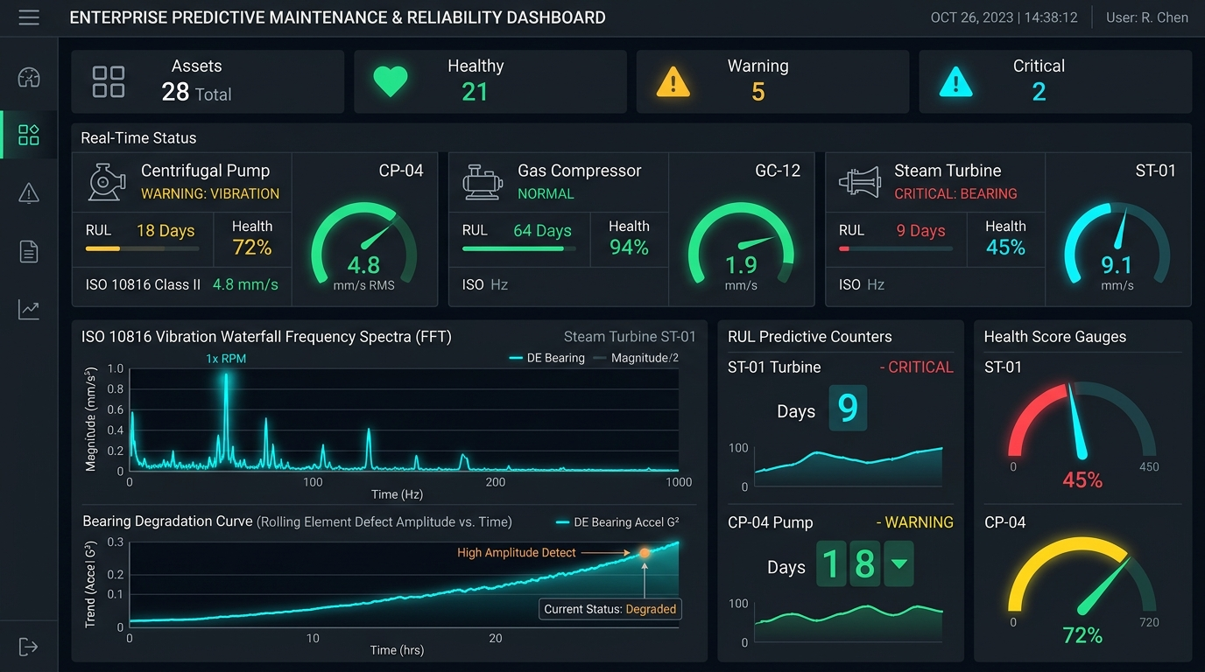
TERRESTRIAL PLATFORM | TERRAASSETS | OPERATIONAL INTERFACE
TerraAssets ANSI/ISA-101 Operational Interface & Real-Time System Representation
ANSI/ISA-101 Ergonomic High-Performance HMI · Real-Time System Representation
Notes:
TerraAssets - ANSI/ISA-101 Verified Operational Interface
Representation: TerraAssets ANSI/ISA-101 Operational Interface & Real-Time System Representation
Compliance: ANSI/ISA-101 Verified HMI
Asset File: terra_assets_showcase.jpg

Slide 3
TERRESTRIAL PLATFORM | TERRAASSETS | CORE CAPABILITIES
What TerraAssets Will Do
Specific operational functions and engineering capabilities directly sourced from technical documentation.
PILLAR 01 | ENGINEERING CAPABILITY
Multi-Tier Topological Asset Hierarchy
Organizes complex plant asset hierarchies, relationships, and electrical connections using an enterprise graph topology engine.
PILLAR 02 | ENGINEERING CAPABILITY
Continuous Transformer Health Analytics
Monitors transformer thermal stresses, winding temperature, and oil degradation parameters continuously.
PILLAR 03 | ENGINEERING CAPABILITY
Vibration & Rotating Machine Prognostics
Tracks vibration signatures, harmonics, and run-hours across chillers, compressors, and high-pressure pumps.
PILLAR 04 | ENGINEERING CAPABILITY
Native SAP / CMMS Bidirectional Integration
Automated creation of maintenance tickets and spare parts reservation in enterprise ERP.
Notes:
What TerraAssets Will Do:
[1] Multi-Tier Topological Asset Hierarchy:
Organizes complex plant asset hierarchies, relationships, and electrical connections using an enterprise graph topology engine.
[2] Continuous Transformer Health Analytics:
Monitors transformer thermal stresses, winding temperature, and oil degradation parameters continuously.
[3] Vibration & Rotating Machine Prognostics:
Tracks vibration signatures, harmonics, and run-hours across chillers, compressors, and high-pressure pumps.
[4] Native SAP / CMMS Bidirectional Integration:
Automated creation of maintenance tickets and spare parts reservation in enterprise ERP.

Slide 4
TERRESTRIAL PLATFORM | TERRAASSETS | FIELD USE CASES
Operational Use Cases & Field Impact
Actual documented use cases across Quality Assurance, Reduced Manpower, Efficiency, and Asset Productivity.
CASE 01 | PRODUCTIVITY & DOWNTIME MITIGATION
Productivity & Downtime Mitigation
Unplanned production downtime suppressed from legacy baseline of 490 hours/year down to just 180 hours in 2022, courtesy of immediate predictive maintenance alerts.
CASE 02 | ASSET PROTECTION
Asset Protection (Substation Transformer Load Tracking)
Continually monitors transformer thermal stresses, phase imbalances, and harmonic distortion to prevent catastrophic insulation failure.
CASE 03 | REDUCED MANPOWER
Reduced Manpower (Automated SAP Work Order Dispatch)
Autonomously calculates run-hours and triggers maintenance tickets with required spare parts in SAP ERP, eliminating manual inspections.
CASE 04 | QA & ROTATING MACHINE LONGEVITY
QA & Rotating Machine Longevity
Detects early bearing flaking and unbalance on critical chillers and compressors months before vibration crosses destructive trip limits.
Notes:
TerraAssets - Operational Use Cases & Field Impact:
[Productivity & Downtime Mitigation] Productivity & Downtime Mitigation:
Unplanned production downtime suppressed from legacy baseline of 490 hours/year down to just 180 hours in 2022, courtesy of immediate predictive maintenance alerts.
[Asset Protection] Asset Protection (Substation Transformer Load Tracking):
Continually monitors transformer thermal stresses, phase imbalances, and harmonic distortion to prevent catastrophic insulation failure.
[Reduced Manpower] Reduced Manpower (Automated SAP Work Order Dispatch):
Autonomously calculates run-hours and triggers maintenance tickets with required spare parts in SAP ERP, eliminating manual inspections.
[QA & Rotating Machine Longevity] QA & Rotating Machine Longevity:
Detects early bearing flaking and unbalance on critical chillers and compressors months before vibration crosses destructive trip limits.

Slide 5
TERRESTRIAL PLATFORM | TERRAASSETS | ARCHITECTURAL CONTRAST
Comparison with Traditional SCADA / Legacy Systems
Point-by-point contrast demonstrating the technological shift from legacy industrial automation to the Terrestrial Platform.
TRADITIONAL LEGACY SYSTEMS / SILOED SCADA
TERRAASSETS TERRESTRIAL PLATFORM ADVANTAGE
Routine maintenance done on fixed calendar dates, replacing healthy components or missing sudden breakdowns.
Condition-based maintenance driven by continuous multi-modal vibration, thermal, and electrical telemetry.
Generic threshold alarms that go off only when bearing raceways or windings have already been destroyed.
Prognostic multi-physics models that detect micro-degradations months before failure occurs.
Manual creation of work orders and paperwork slowing down critical maintenance responses.
Closed-loop automated creation of work orders in SAP/Maximo with recommended toolkits and spare parts.
Notes:
TerraAssets - Architectural Contrast (Legacy SCADA vs Terrestrial Platform):
LEGACY:
Routine maintenance done on fixed calendar dates, replacing healthy components or missing sudden breakdowns.
TERRESTRIAL ADVANTAGE:
Condition-based maintenance driven by continuous multi-modal vibration, thermal, and electrical telemetry.
LEGACY:
Generic threshold alarms that go off only when bearing raceways or windings have already been destroyed.
TERRESTRIAL ADVANTAGE:
Prognostic multi-physics models that detect micro-degradations months before failure occurs.
LEGACY:
Manual creation of work orders and paperwork slowing down critical maintenance responses.
TERRESTRIAL ADVANTAGE:
Closed-loop automated creation of work orders in SAP/Maximo with recommended toolkits and spare parts.

Slide 6
TERRESTRIAL PLATFORM | TERRAASSETS | SYSTEM ARCHITECTURE
End-to-End System Diagram & Data Pipeline
Visual architecture diagram representing field telemetry ingestion, deterministic edge fabric, AI reasoning, and closed-loop actuation.
LAYER 01
Vibration & Condition Ingestion
High-frequency telemetry acquisition from triaxial accelerometers, eddy current proximity probes, oil condition sensors, and thermography.
PROTOCOLS & STANDARDS:
• ISO 10816 Vibration
• High-Frequency IEPE
• OPC UA Part 100
LAYER 02
Spectral Waveform Buffering
Raw vibration waveform capture, edge FFT spectrum extraction, circular bearing telemetry buffering, and acoustic transient streaming.
PROTOCOLS & STANDARDS:
• Vibration FFT Stream
• Transient Waveform Bus
• Edge Spectral Engine
LAYER 03
RUL Predictive Engine
Physics-based bearing degradation models, spectral peak trending (1x/2x/harmonics), rotor unbalance detection, and RUL time-to-failure forecasting.
PROTOCOLS & STANDARDS:
• RUL Prognostics AI
• Bearing Fault Models
• Spectral Trend AI
LAYER 04
Reliability Dispatch Cockpit
Automated prescriptive work order generation in SAP PM / IBM Maximo, equipment health gauges, and ANSI/ISA-101 reliability dashboards.
PROTOCOLS & STANDARDS:
• SAP PM / Maximo
• Prescriptive Orders
• ISA-101 APM Cockpit
UNIFIED DATA PIPELINE FLOW
Triaxial Vibration & Oil Telemetry ➔ Edge FFT Spectral Waveform Bus ➔ Physics-Based RUL Prognostics ➔ Automated Maintenance Dispatch
Notes:
TerraAssets - End-to-End System Diagram & Data Pipeline:
Layer 01: Vibration & Condition Ingestion
High-frequency telemetry acquisition from triaxial accelerometers, eddy current proximity probes, oil condition sensors, and thermography.
Protocols: ISO 10816 Vibration, High-Frequency IEPE, OPC UA Part 100
Layer 02: Spectral Waveform Buffering
Raw vibration waveform capture, edge FFT spectrum extraction, circular bearing telemetry buffering, and acoustic transient streaming.
Protocols: Vibration FFT Stream, Transient Waveform Bus, Edge Spectral Engine
Layer 03: RUL Predictive Engine
Physics-based bearing degradation models, spectral peak trending (1x/2x/harmonics), rotor unbalance detection, and RUL time-to-failure forecasting.
Protocols: RUL Prognostics AI, Bearing Fault Models, Spectral Trend AI
Layer 04: Reliability Dispatch Cockpit
Automated prescriptive work order generation in SAP PM / IBM Maximo, equipment health gauges, and ANSI/ISA-101 reliability dashboards.
Protocols: SAP PM / Maximo, Prescriptive Orders, ISA-101 APM Cockpit
Pipeline Flow:
DATA PIPELINE FLOW: Triaxial Vibration & Oil Telemetry ➔ Edge FFT Spectral Waveform Bus ➔ Physics-Based RUL Prognostics ➔ Automated Maintenance Dispatch

Slide 7
TERRESTRIAL PLATFORM | TERRAASSETS | DEPLOYMENT & SI VALUE
System Integrator Deployment Framework & Commercial Model
Zero rip-and-replace turnkey onboarding with recurring enterprise margins and co-selling enablement.
PHASE 01 | CONNECTIVITY & AUDIT
Zero Rip-and-Replace Onboarding
Non-intrusive protocol discovery across field PLCs, RTUs, and historians. Plug-and-play mapping of tags into the unified TPIM semantic namespace without stopping ongoing plant production.
PHASE 02 | TWIN CALIBRATION
Physics-Model Synchronization
Deploy high-frequency Edge Gateway on premise. Calibrate first-principles thermodynamic and kinematic models against historical telemetry to achieve 99.4%+ deterministic accuracy.
PHASE 03 | AUTONOMOUS GO-LIVE
Closed-Loop Setpoint Actuation
Supervisory closed-loop setpoint dispatch with bumpless transfer. Comprehensive ISA-101 verified cockpit handoff with continuous SI recurring monitoring and support tiers.
COMMERCIAL VALUE PROPOSITION FOR SYSTEM INTEGRATORS (TERRAASSETS)
• High-Margin Software Recurring Revenue: Earn 25%–35% continuous recurring margin on every TerraAssets software deployment, maintenance tier, and AI compute instance.
• Turnkey Engineering Velocity: Deploy within 7 to 14 days leveraging pre-trained neural networks and automated semantic tag mapping, avoiding expensive months-long custom PLC code rewrites.
• Enterprise Co-Selling & Ecosystem: Access joint executive pipeline opportunities, certified engineering documentation, and board-level C-Suite presentation toolkits.
Notes:
TerraAssets - System Integrator Deployment Framework & Commercial Model:
Phase 1: Connectivity & Audit
Phase 2: Twin Calibration
Phase 3: Autonomous Go-Live
Commercial Enablement:
- 25%-35% recurring SaaS margins
- 7-14 day rapid commissioning
- Co-selling and enterprise enablement support

