Slide 1

TERRESTRIAL PLATFORM | TERRACORROGUARD | ENTERPRISE SPECIFICATION
TerraCorroGuard: Cathodic Protection (CP) & Electrochemical Corrosion Telemetry Platform
Autonomous Industrial Intelligence Suite · Tier-1 Plant Architecture
““Cathodic protection and corrosion telemetry — automating instant-off PSP surveys and extending pipeline lifespans by decades.””
— — THE OUTCOME-BASED REVOLUTION
EXECUTIVE OPERATIONAL SYNOPSIS
TerraCorroGuard provides comprehensive remote monitoring of buried pipelines and critical structural assets to prevent electrochemical metal corrosion. It automates Pipe-to-Soil Potential (PSP) logging, synchronous GPS instant-off surveys, transformer rectifier (TR) tracking, and AC/DC stray current interference mitigation.
CORROSION RATE
mils/year Real-Time
ER / LPR SENSORS
Dual-Channel Probes
CATHODIC POTENTIAL
-850mV CSE Nominal
ASSET LIFESPAN
+35% Extended
TERRESTRIAL PLATFORM CORE
Edge-to-Cloud Cognitive Nervous System
Physics-informed mathematical twin running sub-25ms closed-loop supervisory control with full ISA-95/101 conformity.
Notes:
TerraCorroGuard - Enterprise Product Specification
Tagline: Cathodic Protection (CP) & Electrochemical Corrosion Telemetry Platform
Outcome Quote:
“Cathodic protection and corrosion telemetry — automating instant-off PSP surveys and extending pipeline lifespans by decades.” (— THE OUTCOME-BASED REVOLUTION)
Executive Overview:
TerraCorroGuard provides comprehensive remote monitoring of buried pipelines and critical structural assets to prevent electrochemical metal corrosion. It automates Pipe-to-Soil Potential (PSP) logging, synchronous GPS instant-off surveys, transformer rectifier (TR) tracking, and AC/DC stray current interference mitigation.
Key Telemetry Metrics:
- CORROSION RATE:: mils/year Real-Time
- ER / LPR SENSORS:: Dual-Channel Probes
- CATHODIC POTENTIAL:: -850mV CSE Nominal
- ASSET LIFESPAN:: +35% Extended

Slide 2
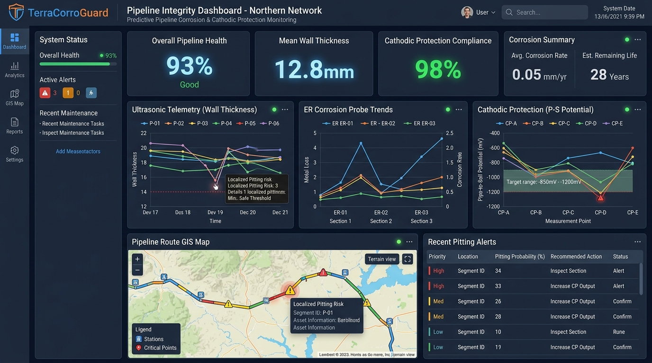
TERRESTRIAL PLATFORM | TERRACORROGUARD | OPERATIONAL INTERFACE
TerraCorroGuard ANSI/ISA-101 Operational Interface & Real-Time System Representation
ANSI/ISA-101 Ergonomic High-Performance HMI · Real-Time System Representation
Notes:
TerraCorroGuard - ANSI/ISA-101 Verified Operational Interface
Representation: TerraCorroGuard ANSI/ISA-101 Operational Interface & Real-Time System Representation
Compliance: ANSI/ISA-101 Verified HMI
Asset File: terra_corroguard_showcase.jpg

Slide 3
TERRESTRIAL PLATFORM | TERRACORROGUARD | CORE CAPABILITIES
What TerraCorroGuard Will Do
Specific operational functions and engineering capabilities directly sourced from technical documentation.
PILLAR 01 | ENGINEERING CAPABILITY
PSP & Instant-Off Telemetry
Automated pipe-to-soil potential logging and transformer rectifier (TR) tracking via satellite/cellular.
PILLAR 02 | ENGINEERING CAPABILITY
AC/DC Interference Mitigation
Rapid identification of AC induced currents from overhead power lines and stray DC currents.
PILLAR 03 | ENGINEERING CAPABILITY
NACE Compliance Analytics
Automated polarization audit logs and sacrificial anode consumption tracking adhering to NACE SP0169.
PILLAR 04 | ENGINEERING CAPABILITY
GIS Route Mapping
Visualizes color-coded cathodic protection status directly on high-resolution GIS maps.
Notes:
What TerraCorroGuard Will Do:
[1] PSP & Instant-Off Telemetry:
Automated pipe-to-soil potential logging and transformer rectifier (TR) tracking via satellite/cellular.
[2] AC/DC Interference Mitigation:
Rapid identification of AC induced currents from overhead power lines and stray DC currents.
[3] NACE Compliance Analytics:
Automated polarization audit logs and sacrificial anode consumption tracking adhering to NACE SP0169.
[4] GIS Route Mapping:
Visualizes color-coded cathodic protection status directly on high-resolution GIS maps.

Slide 4
TERRESTRIAL PLATFORM | TERRACORROGUARD | FIELD USE CASES
Operational Use Cases & Field Impact
Actual documented use cases across Quality Assurance, Reduced Manpower, Efficiency, and Asset Productivity.
CASE 01 | PRODUCTIVITY & ASSET LIFESPAN EXTENSION
Productivity & Asset Lifespan Extension
Extends buried cross-country pipeline lifespans by decades and prevents environmental spills through continuous cathodic protection monitoring.
CASE 02 | REDUCED MANPOWER
Reduced Manpower (PSP & Instant-Off Telemetry)
Automated pipe-to-soil potential logging and transformer rectifier (TR) tracking eliminates manual survey trips.
CASE 03 | QA & SAFETY
QA & Safety (Interference Mitigation)
Rapid identification of AC induced currents from overhead power lines and stray DC mitigation.
CASE 04 | COMPLIANCE
Compliance (NACE Compliance Analytics)
Automated polarization audit logs and sacrificial anode consumption tracking conforming to NACE standards.
Notes:
TerraCorroGuard - Operational Use Cases & Field Impact:
[Productivity & Asset Lifespan Extension] Productivity & Asset Lifespan Extension:
Extends buried cross-country pipeline lifespans by decades and prevents environmental spills through continuous cathodic protection monitoring.
[Reduced Manpower] Reduced Manpower (PSP & Instant-Off Telemetry):
Automated pipe-to-soil potential logging and transformer rectifier (TR) tracking eliminates manual survey trips.
[QA & Safety] QA & Safety (Interference Mitigation):
Rapid identification of AC induced currents from overhead power lines and stray DC mitigation.
[Compliance] Compliance (NACE Compliance Analytics):
Automated polarization audit logs and sacrificial anode consumption tracking conforming to NACE standards.

Slide 5
TERRESTRIAL PLATFORM | TERRACORROGUARD | ARCHITECTURAL CONTRAST
Comparison with Traditional SCADA / Legacy Systems
Point-by-point contrast demonstrating the technological shift from legacy industrial automation to the Terrestrial Platform.
TRADITIONAL LEGACY SYSTEMS / SILOED SCADA
TERRACORROGUARD TERRESTRIAL PLATFORM ADVANTAGE
CP technicians spend months driving along thousands of kilometers of rough terrain to manually measure test coupons.
Automated remote test posts transmitting synchronized PSP readings daily over satellite or cellular networks.
Manual voltage readings contain IR drop errors, giving false confidence in pipeline protection.
Synchronized GPS current interruption measuring true polarized instant-off potentials with zero IR error.
Stray AC currents from parallel high-voltage transmission lines go unnoticed until pipe walls perforate.
High-speed AC voltage and current density logging with automated mitigation switchgear triggers.
Notes:
TerraCorroGuard - Architectural Contrast (Legacy SCADA vs Terrestrial Platform):
LEGACY:
CP technicians spend months driving along thousands of kilometers of rough terrain to manually measure test coupons.
TERRESTRIAL ADVANTAGE:
Automated remote test posts transmitting synchronized PSP readings daily over satellite or cellular networks.
LEGACY:
Manual voltage readings contain IR drop errors, giving false confidence in pipeline protection.
TERRESTRIAL ADVANTAGE:
Synchronized GPS current interruption measuring true polarized instant-off potentials with zero IR error.
LEGACY:
Stray AC currents from parallel high-voltage transmission lines go unnoticed until pipe walls perforate.
TERRESTRIAL ADVANTAGE:
High-speed AC voltage and current density logging with automated mitigation switchgear triggers.

Slide 6
TERRESTRIAL PLATFORM | TERRACORROGUARD | SYSTEM ARCHITECTURE
End-to-End System Diagram & Data Pipeline
Visual architecture diagram representing field telemetry ingestion, deterministic edge fabric, AI reasoning, and closed-loop actuation.
LAYER 01
Cathodic Protection Ingestion
Distributed acquisition from cathodic protection (CP) rectifiers, electrical resistance (ER) corrosion probes, and ultrasonic wall thickness sensors.
PROTOCOLS & STANDARDS:
• NACE SP0169 / ISO 15589-1
• Cellular / Satellite IoT
• Modbus over Radio
LAYER 02
Georeferenced Pipeline Stream
Low-power telemetry buffering, GPS-synchronized pipe-to-soil potential sampling, and high-impedance polarization curve buffering.
PROTOCOLS & STANDARDS:
• Georeferenced Stream
• Pipe-to-Soil Potential Bus
• Low-Power Buffer
LAYER 03
Electrochemical Corrosion AI
Dynamic soil resistivity modeling, localized pitting corrosion rate estimation, coupon polarization decay analysis, and remaining pipeline life forecasting.
PROTOCOLS & STANDARDS:
• Electrochemical AI
• Pitting Risk Model
• Pipeline RUL Forecasting
LAYER 04
Rectifier & GIS Cockpit
Closed-loop cathodic rectifier voltage adjustments, automated pipeline dig verification work orders, and ANSI/ISA-101 GIS corrosion dashboards.
PROTOCOLS & STANDARDS:
• Rectifier Voltage Control
• Pipeline Dig Work Orders
• ISA-101 GIS Cockpit
UNIFIED DATA PIPELINE FLOW
CP Rectifier & Ultrasonic Sensors ➔ Georeferenced Potential Stream ➔ Electrochemical Corrosion Modeling ➔ Automated Rectifier Voltage Actuation
Notes:
TerraCorroGuard - End-to-End System Diagram & Data Pipeline:
Layer 01: Cathodic Protection Ingestion
Distributed acquisition from cathodic protection (CP) rectifiers, electrical resistance (ER) corrosion probes, and ultrasonic wall thickness sensors.
Protocols: NACE SP0169 / ISO 15589-1, Cellular / Satellite IoT, Modbus over Radio
Layer 02: Georeferenced Pipeline Stream
Low-power telemetry buffering, GPS-synchronized pipe-to-soil potential sampling, and high-impedance polarization curve buffering.
Protocols: Georeferenced Stream, Pipe-to-Soil Potential Bus, Low-Power Buffer
Layer 03: Electrochemical Corrosion AI
Dynamic soil resistivity modeling, localized pitting corrosion rate estimation, coupon polarization decay analysis, and remaining pipeline life forecasting.
Protocols: Electrochemical AI, Pitting Risk Model, Pipeline RUL Forecasting
Layer 04: Rectifier & GIS Cockpit
Closed-loop cathodic rectifier voltage adjustments, automated pipeline dig verification work orders, and ANSI/ISA-101 GIS corrosion dashboards.
Protocols: Rectifier Voltage Control, Pipeline Dig Work Orders, ISA-101 GIS Cockpit
Pipeline Flow:
DATA PIPELINE FLOW: CP Rectifier & Ultrasonic Sensors ➔ Georeferenced Potential Stream ➔ Electrochemical Corrosion Modeling ➔ Automated Rectifier Voltage Actuation

Slide 7
TERRESTRIAL PLATFORM | TERRACORROGUARD | DEPLOYMENT & SI VALUE
System Integrator Deployment Framework & Commercial Model
Zero rip-and-replace turnkey onboarding with recurring enterprise margins and co-selling enablement.
PHASE 01 | CONNECTIVITY & AUDIT
Zero Rip-and-Replace Onboarding
Non-intrusive protocol discovery across field PLCs, RTUs, and historians. Plug-and-play mapping of tags into the unified TPIM semantic namespace without stopping ongoing plant production.
PHASE 02 | TWIN CALIBRATION
Physics-Model Synchronization
Deploy high-frequency Edge Gateway on premise. Calibrate first-principles thermodynamic and kinematic models against historical telemetry to achieve 99.4%+ deterministic accuracy.
PHASE 03 | AUTONOMOUS GO-LIVE
Closed-Loop Setpoint Actuation
Supervisory closed-loop setpoint dispatch with bumpless transfer. Comprehensive ISA-101 verified cockpit handoff with continuous SI recurring monitoring and support tiers.
COMMERCIAL VALUE PROPOSITION FOR SYSTEM INTEGRATORS (TERRACORROGUARD)
• High-Margin Software Recurring Revenue: Earn 25%–35% continuous recurring margin on every TerraCorroGuard software deployment, maintenance tier, and AI compute instance.
• Turnkey Engineering Velocity: Deploy within 7 to 14 days leveraging pre-trained neural networks and automated semantic tag mapping, avoiding expensive months-long custom PLC code rewrites.
• Enterprise Co-Selling & Ecosystem: Access joint executive pipeline opportunities, certified engineering documentation, and board-level C-Suite presentation toolkits.
Notes:
TerraCorroGuard - System Integrator Deployment Framework & Commercial Model:
Phase 1: Connectivity & Audit
Phase 2: Twin Calibration
Phase 3: Autonomous Go-Live
Commercial Enablement:
- 25%-35% recurring SaaS margins
- 7-14 day rapid commissioning
- Co-selling and enterprise enablement support

