Slide 1

TERRESTRIAL PLATFORM | TERRAEMS | ENTERPRISE SPECIFICATION
TerraEMS: Army of AI Agents Managing Entire Energy Ecosystems
Autonomous Industrial Intelligence Suite · Tier-1 Plant Architecture
““24x7 conscious AI being analyzing your energy and taking action — not static utility bills, but predictive load balancing that eliminates peak demand penalties.””
— — THE OUTCOME-BASED REVOLUTION
EXECUTIVE OPERATIONAL SYNOPSIS
Whether managing a factory floor, a commercial complex, or an airport navigation grid, TerraEMS brings the entire energy infrastructure into one intelligent platform. Ingesting data across Modbus, DLMS, MQTT, and LoRaWAN, it combines deep harmonics analysis, predictive peak demand management, and 24/7 GenAI energy awareness.
MFM CONFORMANCE
Class 0.2S
HARMONIC SCOPE
Up to 63rd Order
SLD ACCURACY
99.8% Nominal
BILLING CYCLE
15-Min Block Sync
TERRESTRIAL PLATFORM CORE
Edge-to-Cloud Cognitive Nervous System
Physics-informed mathematical twin running sub-25ms closed-loop supervisory control with full ISA-95/101 conformity.
Notes:
TerraEMS - Enterprise Product Specification
Tagline: Army of AI Agents Managing Entire Energy Ecosystems
Outcome Quote:
“24x7 conscious AI being analyzing your energy and taking action — not static utility bills, but predictive load balancing that eliminates peak demand penalties.” (— THE OUTCOME-BASED REVOLUTION)
Executive Overview:
Whether managing a factory floor, a commercial complex, or an airport navigation grid, TerraEMS brings the entire energy infrastructure into one intelligent platform. Ingesting data across Modbus, DLMS, MQTT, and LoRaWAN, it combines deep harmonics analysis, predictive peak demand management, and 24/7 GenAI energy awareness.
Key Telemetry Metrics:
- MFM CONFORMANCE:: Class 0.2S
- HARMONIC SCOPE:: Up to 63rd Order
- SLD ACCURACY:: 99.8% Nominal
- BILLING CYCLE:: 15-Min Block Sync

Slide 2
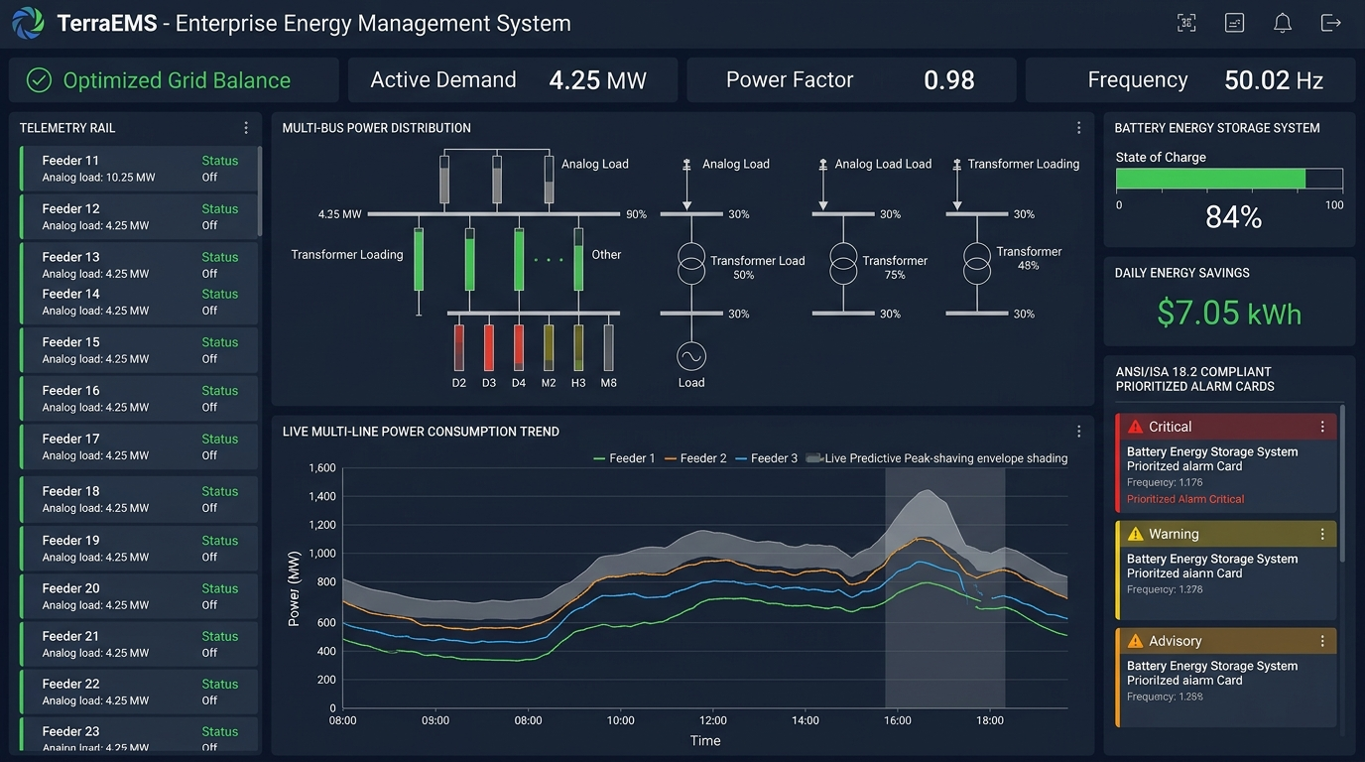
TERRESTRIAL PLATFORM | TERRAEMS | OPERATIONAL INTERFACE
TerraEMS ANSI/ISA-101 Operational Interface & Real-Time System Representation
ANSI/ISA-101 Ergonomic High-Performance HMI · Real-Time System Representation
Notes:
TerraEMS - ANSI/ISA-101 Verified Operational Interface
Representation: TerraEMS ANSI/ISA-101 Operational Interface & Real-Time System Representation
Compliance: ANSI/ISA-101 Verified HMI
Asset File: terra_ems_isa101_showcase.jpg

Slide 3
TERRESTRIAL PLATFORM | TERRAEMS | CORE CAPABILITIES
What TerraEMS Will Do
Specific operational functions and engineering capabilities directly sourced from technical documentation.
PILLAR 01 | ENGINEERING CAPABILITY
Multifunction Meter (MFM) & Harmonics Engine
Captures fundamental parameters (kWh, voltage, current) alongside in-depth electrical harmonics analysis.
PILLAR 02 | ENGINEERING CAPABILITY
Substation Equipment Monitoring
Monitors relays, breaker panels, switchgear, and transformers with timely alerts adhering to ISA 18.2 compliance.
PILLAR 03 | ENGINEERING CAPABILITY
Self-Learning AI Optimization
AI models continuously learn from energy consumption patterns to adjust optimization strategies and adapt to seasonal shifts.
PILLAR 04 | ENGINEERING CAPABILITY
Mobile App & Payment Gateway
Monitor energy consumption and securely pay bills using mobile application (Android, iOS, Windows) with instant receipts.
Notes:
What TerraEMS Will Do:
[1] Multifunction Meter (MFM) & Harmonics Engine:
Captures fundamental parameters (kWh, voltage, current) alongside in-depth electrical harmonics analysis.
[2] Substation Equipment Monitoring:
Monitors relays, breaker panels, switchgear, and transformers with timely alerts adhering to ISA 18.2 compliance.
[3] Self-Learning AI Optimization:
AI models continuously learn from energy consumption patterns to adjust optimization strategies and adapt to seasonal shifts.
[4] Mobile App & Payment Gateway:
Monitor energy consumption and securely pay bills using mobile application (Android, iOS, Windows) with instant receipts.

Slide 4
TERRESTRIAL PLATFORM | TERRAEMS | FIELD USE CASES
Operational Use Cases & Field Impact
Actual documented use cases across Quality Assurance, Reduced Manpower, Efficiency, and Asset Productivity.
CASE 01 | EFFICIENCY
Efficiency (Airport Peak Hour Surcharge Elimination)
Demand management algorithms reduced peak hour utility surcharges, delivering direct financial savings of ₹2,40,000 (2022) and ₹3,10,000 (2023) at Airport of India.
CASE 02 | QA & POWER FACTOR PENALTY AVOIDANCE
QA & Power Factor Penalty Avoidance
Real-time Power Factor alerts successfully maintained levels above 0.95, capturing PF penalty avoidance savings of ₹1,15,000 (2022) and ₹1,25,000 (2023).
CASE 03 | EFFICIENCY
Efficiency (Untraced Utility Loss Slashed in Process Plant)
Driven by automated meter visibility, untraced utility losses plummeted from 19.5% down to just 6.5%, saving ₹8,50,000 in direct utility costs in chemical manufacturing.
CASE 04 | REDUCED MANPOWER
Reduced Manpower (Automated Billing & Administrative Savings)
Automating bill generation and payment processing structurally yielded cash-flow savings of ₹25,000/month (₹3,00,000 per annum) in administrative overhead.
CASE 05 | ASSET PROTECTION
Asset Protection (Phase Load Imbalance & Harmonics Tracking)
Identified and corrected a 12% phase load imbalance at the Localizer site, restoring transformer efficiency and protecting CNS room navigation hardware from premature electrical burnout.
Notes:
TerraEMS - Operational Use Cases & Field Impact:
[Efficiency] Efficiency (Airport Peak Hour Surcharge Elimination):
Demand management algorithms reduced peak hour utility surcharges, delivering direct financial savings of ₹2,40,000 (2022) and ₹3,10,000 (2023) at Airport of India.
[QA & Power Factor Penalty Avoidance] QA & Power Factor Penalty Avoidance:
Real-time Power Factor alerts successfully maintained levels above 0.95, capturing PF penalty avoidance savings of ₹1,15,000 (2022) and ₹1,25,000 (2023).
[Efficiency] Efficiency (Untraced Utility Loss Slashed in Process Plant):
Driven by automated meter visibility, untraced utility losses plummeted from 19.5% down to just 6.5%, saving ₹8,50,000 in direct utility costs in chemical manufacturing.
[Reduced Manpower] Reduced Manpower (Automated Billing & Administrative Savings):
Automating bill generation and payment processing structurally yielded cash-flow savings of ₹25,000/month (₹3,00,000 per annum) in administrative overhead.
[Asset Protection] Asset Protection (Phase Load Imbalance & Harmonics Tracking):
Identified and corrected a 12% phase load imbalance at the Localizer site, restoring transformer efficiency and protecting CNS room navigation hardware from premature electrical burnout.

Slide 5
TERRESTRIAL PLATFORM | TERRAEMS | ARCHITECTURAL CONTRAST
Comparison with Traditional SCADA / Legacy Systems
Point-by-point contrast demonstrating the technological shift from legacy industrial automation to the Terrestrial Platform.
TRADITIONAL LEGACY SYSTEMS / SILOED SCADA
TERRAEMS TERRESTRIAL PLATFORM ADVANTAGE
Reviewing monthly utility bills after the money is spent; zero granular visibility into where waste occurs.
Real-time sub-metering across feeders, panels, and transformers with instant cost attribution and harmonic profiling.
Incurring heavy contract demand penalties and power factor surcharges during sudden factory or facility ramp-ups.
Continuous automated load balancing and predictive peak demand management to prevent all utility penalty conditions.
Manual meter reading and fragmented paper billing leading to delayed cash flow and billing disputes.
Integrated mobile application with in-built payment gateway, instant payment confirmations, and automated billing workflows.
Notes:
TerraEMS - Architectural Contrast (Legacy SCADA vs Terrestrial Platform):
LEGACY:
Reviewing monthly utility bills after the money is spent; zero granular visibility into where waste occurs.
TERRESTRIAL ADVANTAGE:
Real-time sub-metering across feeders, panels, and transformers with instant cost attribution and harmonic profiling.
LEGACY:
Incurring heavy contract demand penalties and power factor surcharges during sudden factory or facility ramp-ups.
TERRESTRIAL ADVANTAGE:
Continuous automated load balancing and predictive peak demand management to prevent all utility penalty conditions.
LEGACY:
Manual meter reading and fragmented paper billing leading to delayed cash flow and billing disputes.
TERRESTRIAL ADVANTAGE:
Integrated mobile application with in-built payment gateway, instant payment confirmations, and automated billing workflows.

Slide 6
TERRESTRIAL PLATFORM | TERRAEMS | SYSTEM ARCHITECTURE
End-to-End System Diagram & Data Pipeline
Visual architecture diagram representing field telemetry ingestion, deterministic edge fabric, AI reasoning, and closed-loop actuation.
LAYER 01
Multi-Feeder Power Ingestion
Sub-second electrical telemetry acquisition from smart power meters, digital protection relays, and transformer monitoring units.
PROTOCOLS & STANDARDS:
• DLMS/COSEM (IEC 62056)
• Modbus RTU/TCP
• IEC 61850 MMS
LAYER 02
High-Frequency Power Stream
Continuous 3-phase power telemetry buffering, harmonic distortion FFT computation, and sub-cycle power quality event capture.
PROTOCOLS & STANDARDS:
• Power Quality Stream
• Harmonic FFT Buffer
• Sub-Cycle Event Bus
LAYER 03
Peak Demand Optimizer
Multi-horizon energy demand forecasting, dynamic tariff arbitrage algorithms, power factor correction, and transformer load balancing.
PROTOCOLS & STANDARDS:
• Demand Forecasting
• Tariff Arbitrage AI
• Power Factor Optimizer
LAYER 04
Microgrid Dispatch Cockpit
Autonomous BESS battery charge/discharge dispatch, automated non-critical load shedding, and ANSI/ISA-101 energy supervisory displays.
PROTOCOLS & STANDARDS:
• BESS Inverter Dispatch
• Automated Load Shedding
• ISA-101 Energy HMI
UNIFIED DATA PIPELINE FLOW
3-Phase Meter Telemetry ➔ High-Frequency Power Streaming ➔ Peak Demand & Tariff Optimization ➔ Automated BESS & Load Actuation
Notes:
TerraEMS - End-to-End System Diagram & Data Pipeline:
Layer 01: Multi-Feeder Power Ingestion
Sub-second electrical telemetry acquisition from smart power meters, digital protection relays, and transformer monitoring units.
Protocols: DLMS/COSEM (IEC 62056), Modbus RTU/TCP, IEC 61850 MMS
Layer 02: High-Frequency Power Stream
Continuous 3-phase power telemetry buffering, harmonic distortion FFT computation, and sub-cycle power quality event capture.
Protocols: Power Quality Stream, Harmonic FFT Buffer, Sub-Cycle Event Bus
Layer 03: Peak Demand Optimizer
Multi-horizon energy demand forecasting, dynamic tariff arbitrage algorithms, power factor correction, and transformer load balancing.
Protocols: Demand Forecasting, Tariff Arbitrage AI, Power Factor Optimizer
Layer 04: Microgrid Dispatch Cockpit
Autonomous BESS battery charge/discharge dispatch, automated non-critical load shedding, and ANSI/ISA-101 energy supervisory displays.
Protocols: BESS Inverter Dispatch, Automated Load Shedding, ISA-101 Energy HMI
Pipeline Flow:
DATA PIPELINE FLOW: 3-Phase Meter Telemetry ➔ High-Frequency Power Streaming ➔ Peak Demand & Tariff Optimization ➔ Automated BESS & Load Actuation

Slide 7
TERRESTRIAL PLATFORM | TERRAEMS | DEPLOYMENT & SI VALUE
System Integrator Deployment Framework & Commercial Model
Zero rip-and-replace turnkey onboarding with recurring enterprise margins and co-selling enablement.
PHASE 01 | CONNECTIVITY & AUDIT
Zero Rip-and-Replace Onboarding
Non-intrusive protocol discovery across field PLCs, RTUs, and historians. Plug-and-play mapping of tags into the unified TPIM semantic namespace without stopping ongoing plant production.
PHASE 02 | TWIN CALIBRATION
Physics-Model Synchronization
Deploy high-frequency Edge Gateway on premise. Calibrate first-principles thermodynamic and kinematic models against historical telemetry to achieve 99.4%+ deterministic accuracy.
PHASE 03 | AUTONOMOUS GO-LIVE
Closed-Loop Setpoint Actuation
Supervisory closed-loop setpoint dispatch with bumpless transfer. Comprehensive ISA-101 verified cockpit handoff with continuous SI recurring monitoring and support tiers.
COMMERCIAL VALUE PROPOSITION FOR SYSTEM INTEGRATORS (TERRAEMS)
• High-Margin Software Recurring Revenue: Earn 25%–35% continuous recurring margin on every TerraEMS software deployment, maintenance tier, and AI compute instance.
• Turnkey Engineering Velocity: Deploy within 7 to 14 days leveraging pre-trained neural networks and automated semantic tag mapping, avoiding expensive months-long custom PLC code rewrites.
• Enterprise Co-Selling & Ecosystem: Access joint executive pipeline opportunities, certified engineering documentation, and board-level C-Suite presentation toolkits.
Notes:
TerraEMS - System Integrator Deployment Framework & Commercial Model:
Phase 1: Connectivity & Audit
Phase 2: Twin Calibration
Phase 3: Autonomous Go-Live
Commercial Enablement:
- 25%-35% recurring SaaS margins
- 7-14 day rapid commissioning
- Co-selling and enterprise enablement support

