Slide 1

TERRESTRIAL PLATFORM | TERRAGRIDW | ENTERPRISE SPECIFICATION
TerraGridW: Smart Water Grid, Pumping Energy Optimization & Custody Telemetry
Autonomous Industrial Intelligence Suite · Tier-1 Plant Architecture
““Pumping station energy optimization, transient wave leak detection, and smart custody metering eliminating unbilled water loss.””
— — THE OUTCOME-BASED REVOLUTION
EXECUTIVE OPERATIONAL SYNOPSIS
TerraGridW delivers intelligent management of bulk water transmission networks, regional canals, and pumping stations. It optimizes pumping station energy via dynamic multi-pump sequencing, detects pipeline bursts using high-speed transient wave analysis, and integrates DLMS/LoRa smart meters with automated billing.
REVERSE OSMOSIS
82.5% Recovery
WATER QUALITY
TDS / pH Online
SPECIFIC ENERGY
2.8 kWh/m³
LEAK PINPOINTING
Acoustic + Mass
TERRESTRIAL PLATFORM CORE
Edge-to-Cloud Cognitive Nervous System
Physics-informed mathematical twin running sub-25ms closed-loop supervisory control with full ISA-95/101 conformity.
Notes:
TerraGridW - Enterprise Product Specification
Tagline: Smart Water Grid, Pumping Energy Optimization & Custody Telemetry
Outcome Quote:
“Pumping station energy optimization, transient wave leak detection, and smart custody metering eliminating unbilled water loss.” (— THE OUTCOME-BASED REVOLUTION)
Executive Overview:
TerraGridW delivers intelligent management of bulk water transmission networks, regional canals, and pumping stations. It optimizes pumping station energy via dynamic multi-pump sequencing, detects pipeline bursts using high-speed transient wave analysis, and integrates DLMS/LoRa smart meters with automated billing.
Key Telemetry Metrics:
- REVERSE OSMOSIS:: 82.5% Recovery
- WATER QUALITY:: TDS / pH Online
- SPECIFIC ENERGY:: 2.8 kWh/m³
- LEAK PINPOINTING:: Acoustic + Mass

Slide 2
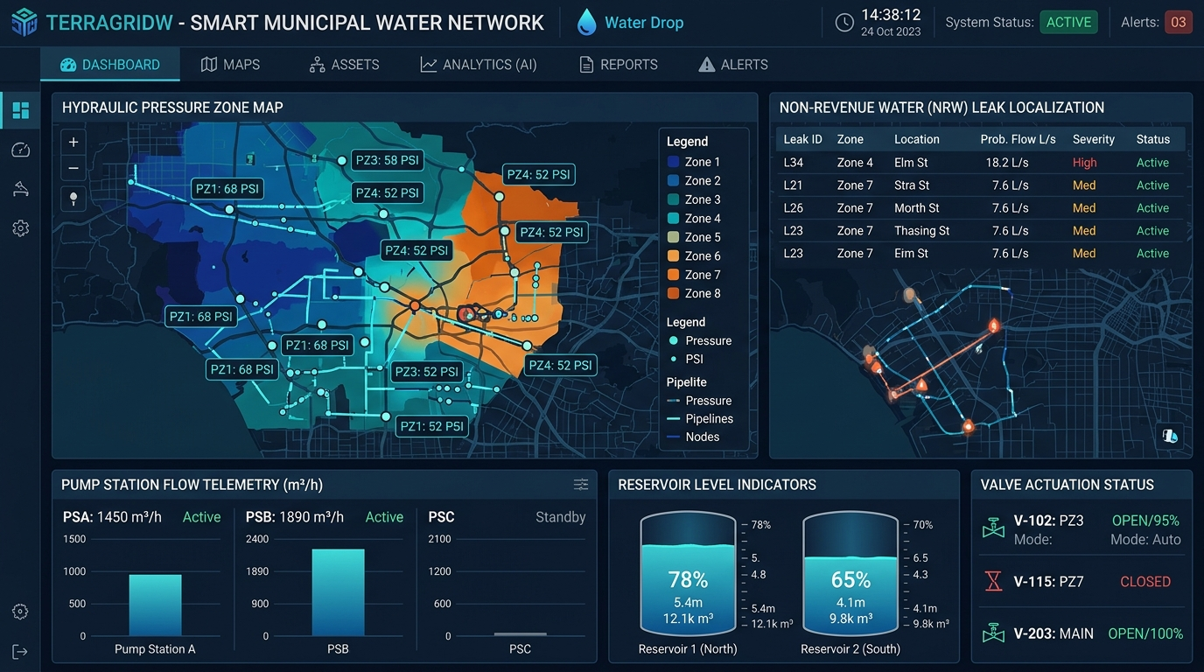
TERRESTRIAL PLATFORM | TERRAGRIDW | OPERATIONAL INTERFACE
TerraGridW ANSI/ISA-101 Operational Interface & Real-Time System Representation
ANSI/ISA-101 Ergonomic High-Performance HMI · Real-Time System Representation
Notes:
TerraGridW - ANSI/ISA-101 Verified Operational Interface
Representation: TerraGridW ANSI/ISA-101 Operational Interface & Real-Time System Representation
Compliance: ANSI/ISA-101 Verified HMI
Asset File: terra_gridw_showcase.jpg

Slide 3
TERRESTRIAL PLATFORM | TERRAGRIDW | CORE CAPABILITIES
What TerraGridW Will Do
Specific operational functions and engineering capabilities directly sourced from technical documentation.
PILLAR 01 | ENGINEERING CAPABILITY
Pumping Energy Optimization
Dynamic multi-pump sequencing and VFD coordination based on hydraulic head and Best Efficiency Point (BEP).
PILLAR 02 | ENGINEERING CAPABILITY
Transient Wave Leak Detection
Real-time pressure burst localization capturing acoustic reflections to find pipe ruptures immediately.
PILLAR 03 | ENGINEERING CAPABILITY
Integrated AMI / Billing Gateway
DLMS/COSEM and LoRa smart meter ingestion with built-in consumer billing and payment gateways.
PILLAR 04 | ENGINEERING CAPABILITY
Non-Revenue Water (NRW) Analytics
Continuous mass balance algorithms quantifying unbilled distribution losses across regional pipeline networks.
Notes:
What TerraGridW Will Do:
[1] Pumping Energy Optimization:
Dynamic multi-pump sequencing and VFD coordination based on hydraulic head and Best Efficiency Point (BEP).
[2] Transient Wave Leak Detection:
Real-time pressure burst localization capturing acoustic reflections to find pipe ruptures immediately.
[3] Integrated AMI / Billing Gateway:
DLMS/COSEM and LoRa smart meter ingestion with built-in consumer billing and payment gateways.
[4] Non-Revenue Water (NRW) Analytics:
Continuous mass balance algorithms quantifying unbilled distribution losses across regional pipeline networks.

Slide 4
TERRESTRIAL PLATFORM | TERRAGRIDW | FIELD USE CASES
Operational Use Cases & Field Impact
Actual documented use cases across Quality Assurance, Reduced Manpower, Efficiency, and Asset Productivity.
CASE 01 | EFFICIENCY
Efficiency (Pumping Station Energy Optimization)
Dynamic multi-pump sequencing and VFD coordination based on hydraulic head reduces water pumping power by up to 22%.
CASE 02 | QA & PIPELINE SAFETY
QA & Pipeline Safety (Transient Wave Leak Detection)
Real-time pressure burst localization and non-revenue water (NRW) analytics pinpoint leaks within 60 seconds.
CASE 03 | REDUCED MANPOWER
Reduced Manpower (Integrated AMI & Billing Gateway)
DLMS/COSEM and LoRa smart meter ingestion with built-in consumer payment gateways eliminates manual meter reading.
CASE 04 | PRODUCTIVITY
Productivity (District Metering Area Balancing)
Balances bulk water delivery across municipal sectors to eradicate commercial water theft and unbilled losses.
Notes:
TerraGridW - Operational Use Cases & Field Impact:
[Efficiency] Efficiency (Pumping Station Energy Optimization):
Dynamic multi-pump sequencing and VFD coordination based on hydraulic head reduces water pumping power by up to 22%.
[QA & Pipeline Safety] QA & Pipeline Safety (Transient Wave Leak Detection):
Real-time pressure burst localization and non-revenue water (NRW) analytics pinpoint leaks within 60 seconds.
[Reduced Manpower] Reduced Manpower (Integrated AMI & Billing Gateway):
DLMS/COSEM and LoRa smart meter ingestion with built-in consumer payment gateways eliminates manual meter reading.
[Productivity] Productivity (District Metering Area Balancing):
Balances bulk water delivery across municipal sectors to eradicate commercial water theft and unbilled losses.

Slide 5
TERRESTRIAL PLATFORM | TERRAGRIDW | ARCHITECTURAL CONTRAST
Comparison with Traditional SCADA / Legacy Systems
Point-by-point contrast demonstrating the technological shift from legacy industrial automation to the Terrestrial Platform.
TRADITIONAL LEGACY SYSTEMS / SILOED SCADA
TERRAGRIDW TERRESTRIAL PLATFORM ADVANTAGE
Pumps operated manually at fixed speeds regardless of hydraulic head or fluctuating electricity tariffs.
AI-driven pump sequencing and dynamic VFD speed optimization based on time-of-day power tariffs and reservoir levels.
Pipeline leaks detected only when water pools on the surface or consumers complain of dry taps.
High-frequency pressure transient wave algorithms pinpointing pipe bursts and micro-leaks within seconds.
Manual meter reading prone to billing disputes, estimated bills, and heavy non-revenue water (NRW) loss.
Automated Metering Infrastructure (AMI) with LoRa/DLMS meters and integrated consumer billing portals.
Notes:
TerraGridW - Architectural Contrast (Legacy SCADA vs Terrestrial Platform):
LEGACY:
Pumps operated manually at fixed speeds regardless of hydraulic head or fluctuating electricity tariffs.
TERRESTRIAL ADVANTAGE:
AI-driven pump sequencing and dynamic VFD speed optimization based on time-of-day power tariffs and reservoir levels.
LEGACY:
Pipeline leaks detected only when water pools on the surface or consumers complain of dry taps.
TERRESTRIAL ADVANTAGE:
High-frequency pressure transient wave algorithms pinpointing pipe bursts and micro-leaks within seconds.
LEGACY:
Manual meter reading prone to billing disputes, estimated bills, and heavy non-revenue water (NRW) loss.
TERRESTRIAL ADVANTAGE:
Automated Metering Infrastructure (AMI) with LoRa/DLMS meters and integrated consumer billing portals.

Slide 6
TERRESTRIAL PLATFORM | TERRAGRIDW | SYSTEM ARCHITECTURE
End-to-End System Diagram & Data Pipeline
Visual architecture diagram representing field telemetry ingestion, deterministic edge fabric, AI reasoning, and closed-loop actuation.
LAYER 01
DMA & Pressure Ingestion
Telemetry acquisition from electromagnetic flowmeters, district metered area (DMA) pressure loggers, and reservoir level transmitters.
PROTOCOLS & STANDARDS:
• DLMS/COSEM (IEC 62056)
• LoRaWAN / NB-IoT
• Modbus RTU
LAYER 02
Hydraulic Zone Stream
Low-power edge data buffering, water hammer transient capture, and diurnal flow pattern normalization across pressure management zones.
PROTOCOLS & STANDARDS:
• Hydraulic Telemetry Bus
• Diurnal Flow Stream
• Transient Pressure Buffer
LAYER 03
NRW Leak Localization Core
EPANET hydraulic simulation, acoustic leak cross-correlation, night-flow anomaly detection, and pipe burst localization algorithms.
PROTOCOLS & STANDARDS:
• EPANET Hydraulic Model
• Acoustic Cross-Correlator
• NRW Leak AI
LAYER 04
PRV & Pump Actuation Cockpit
Closed-loop PRV modulating setpoints, pump station variable speed drive dispatch, and ANSI/ISA-101 municipal water distribution dashboards.
PROTOCOLS & STANDARDS:
• PRV Modulation
• Pump VFD Dispatch
• ISA-101 Water HMI
UNIFIED DATA PIPELINE FLOW
DMA Flow & Pressure Telemetry ➔ Hydraulic Zone Stream ➔ EPANET Simulation & NRW Leak AI ➔ Automated PRV & Pump Actuation
Notes:
TerraGridW - End-to-End System Diagram & Data Pipeline:
Layer 01: DMA & Pressure Ingestion
Telemetry acquisition from electromagnetic flowmeters, district metered area (DMA) pressure loggers, and reservoir level transmitters.
Protocols: DLMS/COSEM (IEC 62056), LoRaWAN / NB-IoT, Modbus RTU
Layer 02: Hydraulic Zone Stream
Low-power edge data buffering, water hammer transient capture, and diurnal flow pattern normalization across pressure management zones.
Protocols: Hydraulic Telemetry Bus, Diurnal Flow Stream, Transient Pressure Buffer
Layer 03: NRW Leak Localization Core
EPANET hydraulic simulation, acoustic leak cross-correlation, night-flow anomaly detection, and pipe burst localization algorithms.
Protocols: EPANET Hydraulic Model, Acoustic Cross-Correlator, NRW Leak AI
Layer 04: PRV & Pump Actuation Cockpit
Closed-loop PRV modulating setpoints, pump station variable speed drive dispatch, and ANSI/ISA-101 municipal water distribution dashboards.
Protocols: PRV Modulation, Pump VFD Dispatch, ISA-101 Water HMI
Pipeline Flow:
DATA PIPELINE FLOW: DMA Flow & Pressure Telemetry ➔ Hydraulic Zone Stream ➔ EPANET Simulation & NRW Leak AI ➔ Automated PRV & Pump Actuation

Slide 7
TERRESTRIAL PLATFORM | TERRAGRIDW | DEPLOYMENT & SI VALUE
System Integrator Deployment Framework & Commercial Model
Zero rip-and-replace turnkey onboarding with recurring enterprise margins and co-selling enablement.
PHASE 01 | CONNECTIVITY & AUDIT
Zero Rip-and-Replace Onboarding
Non-intrusive protocol discovery across field PLCs, RTUs, and historians. Plug-and-play mapping of tags into the unified TPIM semantic namespace without stopping ongoing plant production.
PHASE 02 | TWIN CALIBRATION
Physics-Model Synchronization
Deploy high-frequency Edge Gateway on premise. Calibrate first-principles thermodynamic and kinematic models against historical telemetry to achieve 99.4%+ deterministic accuracy.
PHASE 03 | AUTONOMOUS GO-LIVE
Closed-Loop Setpoint Actuation
Supervisory closed-loop setpoint dispatch with bumpless transfer. Comprehensive ISA-101 verified cockpit handoff with continuous SI recurring monitoring and support tiers.
COMMERCIAL VALUE PROPOSITION FOR SYSTEM INTEGRATORS (TERRAGRIDW)
• High-Margin Software Recurring Revenue: Earn 25%–35% continuous recurring margin on every TerraGridW software deployment, maintenance tier, and AI compute instance.
• Turnkey Engineering Velocity: Deploy within 7 to 14 days leveraging pre-trained neural networks and automated semantic tag mapping, avoiding expensive months-long custom PLC code rewrites.
• Enterprise Co-Selling & Ecosystem: Access joint executive pipeline opportunities, certified engineering documentation, and board-level C-Suite presentation toolkits.
Notes:
TerraGridW - System Integrator Deployment Framework & Commercial Model:
Phase 1: Connectivity & Audit
Phase 2: Twin Calibration
Phase 3: Autonomous Go-Live
Commercial Enablement:
- 25%-35% recurring SaaS margins
- 7-14 day rapid commissioning
- Co-selling and enterprise enablement support

