Slide 1

TERRESTRIAL PLATFORM | TERRAHIVE | ENTERPRISE SPECIFICATION
TerraHive: Enterprise-Grade Multi-Agent Swarm Orchestration System
Autonomous Industrial Intelligence Suite · Tier-1 Plant Architecture
““Creating multi agent enterprise grade systems to run enterprise with AI — replacing departmental silos with autonomous collaborative swarms.””
— — THE OUTCOME-BASED REVOLUTION
EXECUTIVE OPERATIONAL SYNOPSIS
TerraHive establishes a coordinated ecosystem of autonomous software agents collaborating seamlessly to orchestrate production, asset health, and dispatch pipelines. Engineered with an autonomous agent orchestration engine and distributed state persistence, it conducts real-time consensus rounds to resolve cross-departmental bottlenecks.
DECENTRALIZED MESH
Zero Single-Point
CONSENSUS PROTOCOL
Raft / Industrial
FAILOVER WINDOW
< 200 ms Edge
ACTIVE NODES
256 Auto-Synced
TERRESTRIAL PLATFORM CORE
Edge-to-Cloud Cognitive Nervous System
Physics-informed mathematical twin running sub-25ms closed-loop supervisory control with full ISA-95/101 conformity.
Notes:
TerraHive - Enterprise Product Specification
Tagline: Enterprise-Grade Multi-Agent Swarm Orchestration System
Outcome Quote:
“Creating multi agent enterprise grade systems to run enterprise with AI — replacing departmental silos with autonomous collaborative swarms.” (— THE OUTCOME-BASED REVOLUTION)
Executive Overview:
TerraHive establishes a coordinated ecosystem of autonomous software agents collaborating seamlessly to orchestrate production, asset health, and dispatch pipelines. Engineered with an autonomous agent orchestration engine and distributed state persistence, it conducts real-time consensus rounds to resolve cross-departmental bottlenecks.
Key Telemetry Metrics:
- DECENTRALIZED MESH:: Zero Single-Point
- CONSENSUS PROTOCOL:: Raft / Industrial
- FAILOVER WINDOW:: < 200 ms Edge
- ACTIVE NODES:: 256 Auto-Synced

Slide 2
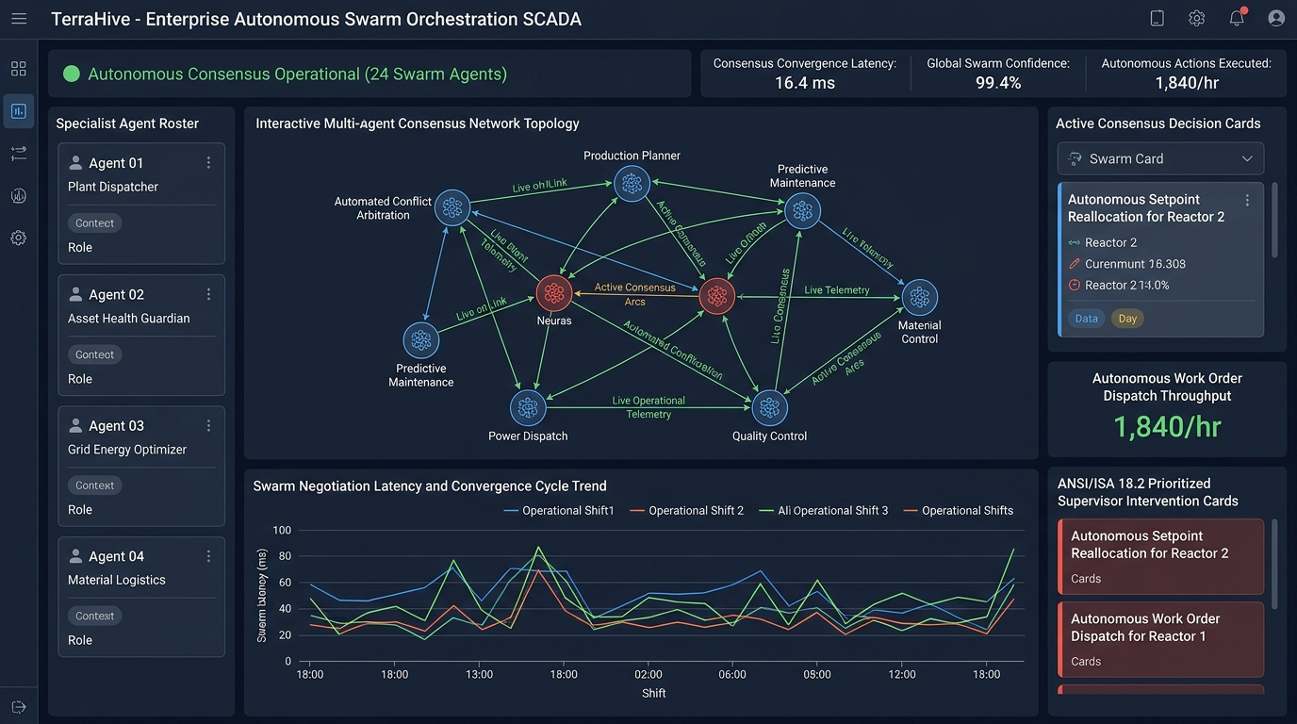
TERRESTRIAL PLATFORM | TERRAHIVE | OPERATIONAL INTERFACE
TerraHive ANSI/ISA-101 Operational Interface & Real-Time System Representation
ANSI/ISA-101 Ergonomic High-Performance HMI · Real-Time System Representation
Notes:
TerraHive - ANSI/ISA-101 Verified Operational Interface
Representation: TerraHive ANSI/ISA-101 Operational Interface & Real-Time System Representation
Compliance: ANSI/ISA-101 Verified HMI
Asset File: terra_hive_isa101_showcase.jpg

Slide 3
TERRESTRIAL PLATFORM | TERRAHIVE | CORE CAPABILITIES
What TerraHive Will Do
Specific operational functions and engineering capabilities directly sourced from technical documentation.
PILLAR 01 | ENGINEERING CAPABILITY
Decentralized Swarm Architecture
Specialized autonomous agents for diagnostics, maintenance coordination, and dispatch optimization.
PILLAR 02 | ENGINEERING CAPABILITY
Dynamic Consensus Engine
AI-driven cross-departmental negotiation based on real-time operational constraints.
PILLAR 03 | ENGINEERING CAPABILITY
Audited Governance & Traceability
Comprehensive action logging, deterministic execution tracing, and human-in-the-loop permission gates.
PILLAR 04 | ENGINEERING CAPABILITY
Deterministic Swarm State Machine
Autonomous state engine managing agent goals, collaborative sessions, tools, operational memories, and reflection loops.
Notes:
What TerraHive Will Do:
[1] Decentralized Swarm Architecture:
Specialized autonomous agents for diagnostics, maintenance coordination, and dispatch optimization.
[2] Dynamic Consensus Engine:
AI-driven cross-departmental negotiation based on real-time operational constraints.
[3] Audited Governance & Traceability:
Comprehensive action logging, deterministic execution tracing, and human-in-the-loop permission gates.
[4] Deterministic Swarm State Machine:
Autonomous state engine managing agent goals, collaborative sessions, tools, operational memories, and reflection loops.

Slide 4
TERRESTRIAL PLATFORM | TERRAHIVE | FIELD USE CASES
Operational Use Cases & Field Impact
Actual documented use cases across Quality Assurance, Reduced Manpower, Efficiency, and Asset Productivity.
CASE 01 | REDUCED MANPOWER
Reduced Manpower (Decentralized Swarm Coordination)
Specialized agents for diagnostics, maintenance coordination, and dispatch optimization collaborate automatically.
CASE 02 | EFFICIENCY
Efficiency (Dynamic Consensus Negotiation)
AI-driven cross-departmental negotiation resolves trade-offs between production throughput and power tariffs.
CASE 03 | QA & COMPLIANCE
QA & Compliance (Audited Governance)
Comprehensive action logging and human-in-the-loop permission gates with complete state tracing.
CASE 04 | PRODUCTIVITY
Productivity (Automated ERP Spare Parts Cycle)
When asset wear is detected, inventory agents check ERP stock, book procurement, and reserve maintenance downtime.
Notes:
TerraHive - Operational Use Cases & Field Impact:
[Reduced Manpower] Reduced Manpower (Decentralized Swarm Coordination):
Specialized agents for diagnostics, maintenance coordination, and dispatch optimization collaborate automatically.
[Efficiency] Efficiency (Dynamic Consensus Negotiation):
AI-driven cross-departmental negotiation resolves trade-offs between production throughput and power tariffs.
[QA & Compliance] QA & Compliance (Audited Governance):
Comprehensive action logging and human-in-the-loop permission gates with complete state tracing.
[Productivity] Productivity (Automated ERP Spare Parts Cycle):
When asset wear is detected, inventory agents check ERP stock, book procurement, and reserve maintenance downtime.

Slide 5
TERRESTRIAL PLATFORM | TERRAHIVE | ARCHITECTURAL CONTRAST
Comparison with Traditional SCADA / Legacy Systems
Point-by-point contrast demonstrating the technological shift from legacy industrial automation to the Terrestrial Platform.
TRADITIONAL LEGACY SYSTEMS / SILOED SCADA
TERRAHIVE TERRESTRIAL PLATFORM ADVANTAGE
Maintenance, operations, and procurement teams communicate via emails, spreadsheets, and delayed meetings.
Autonomous agents negotiate constraints instantly across departments in real-time consensus rounds.
Static maintenance schedules that either over-service assets or miss sudden accelerated wear.
Dynamic dispatch balancing asset wear, fuel costs, market prices, and inventory availability.
Black-box decisions with no traceability or compliance record.
Audited cryptographic consensus log with configurable human-in-the-loop authorization gates.
Notes:
TerraHive - Architectural Contrast (Legacy SCADA vs Terrestrial Platform):
LEGACY:
Maintenance, operations, and procurement teams communicate via emails, spreadsheets, and delayed meetings.
TERRESTRIAL ADVANTAGE:
Autonomous agents negotiate constraints instantly across departments in real-time consensus rounds.
LEGACY:
Static maintenance schedules that either over-service assets or miss sudden accelerated wear.
TERRESTRIAL ADVANTAGE:
Dynamic dispatch balancing asset wear, fuel costs, market prices, and inventory availability.
LEGACY:
Black-box decisions with no traceability or compliance record.
TERRESTRIAL ADVANTAGE:
Audited cryptographic consensus log with configurable human-in-the-loop authorization gates.

Slide 6
TERRESTRIAL PLATFORM | TERRAHIVE | SYSTEM ARCHITECTURE
End-to-End System Diagram & Data Pipeline
Visual architecture diagram representing field telemetry ingestion, deterministic edge fabric, AI reasoning, and closed-loop actuation.
LAYER 01
Distributed Agent Ingestion
High-throughput ingestion connecting autonomous departmental agent streams, ERP transactions, operational event queues, and SCADA state tags.
PROTOCOLS & STANDARDS:
• Agent Swarm Protocol
• Real-Time State Stream
• Enterprise Messaging
LAYER 02
Swarm State Convergence Bus
Low-latency consensus broadcast fabric, distributed memory synchronization, and deterministic state-machine transaction sequencing.
PROTOCOLS & STANDARDS:
• Consensus Broadcast Bus
• Distributed Vector Memory
• Sub-20ms State Sync
LAYER 03
Swarm Consensus Core
Game-theoretic multi-agent negotiation, cross-departmental constraint arbitration, dynamic goal decomposition, and autonomous policy synthesis.
PROTOCOLS & STANDARDS:
• Game-Theoretic Arbitration
• Constraint Resolver AI
• Swarm Consensus Engine
LAYER 04
Autonomous Dispatch Cockpit
Automated cross-system work order dispatch, autonomous operational setpoint execution, and ANSI/ISA-101 human-in-the-loop supervisor consoles.
PROTOCOLS & STANDARDS:
• Autonomous Work Orders
• Cross-System Setpoints
• ISA-101 Swarm HMI
UNIFIED DATA PIPELINE FLOW
Enterprise Agent Event Ingestion ➔ Swarm Consensus Convergence Bus ➔ Multi-Agent Constraint Arbitration ➔ Autonomous Cross-System Execution
Notes:
TerraHive - End-to-End System Diagram & Data Pipeline:
Layer 01: Distributed Agent Ingestion
High-throughput ingestion connecting autonomous departmental agent streams, ERP transactions, operational event queues, and SCADA state tags.
Protocols: Agent Swarm Protocol, Real-Time State Stream, Enterprise Messaging
Layer 02: Swarm State Convergence Bus
Low-latency consensus broadcast fabric, distributed memory synchronization, and deterministic state-machine transaction sequencing.
Protocols: Consensus Broadcast Bus, Distributed Vector Memory, Sub-20ms State Sync
Layer 03: Swarm Consensus Core
Game-theoretic multi-agent negotiation, cross-departmental constraint arbitration, dynamic goal decomposition, and autonomous policy synthesis.
Protocols: Game-Theoretic Arbitration, Constraint Resolver AI, Swarm Consensus Engine
Layer 04: Autonomous Dispatch Cockpit
Automated cross-system work order dispatch, autonomous operational setpoint execution, and ANSI/ISA-101 human-in-the-loop supervisor consoles.
Protocols: Autonomous Work Orders, Cross-System Setpoints, ISA-101 Swarm HMI
Pipeline Flow:
DATA PIPELINE FLOW: Enterprise Agent Event Ingestion ➔ Swarm Consensus Convergence Bus ➔ Multi-Agent Constraint Arbitration ➔ Autonomous Cross-System Execution

Slide 7
TERRESTRIAL PLATFORM | TERRAHIVE | DEPLOYMENT & SI VALUE
System Integrator Deployment Framework & Commercial Model
Zero rip-and-replace turnkey onboarding with recurring enterprise margins and co-selling enablement.
PHASE 01 | CONNECTIVITY & AUDIT
Zero Rip-and-Replace Onboarding
Non-intrusive protocol discovery across field PLCs, RTUs, and historians. Plug-and-play mapping of tags into the unified TPIM semantic namespace without stopping ongoing plant production.
PHASE 02 | TWIN CALIBRATION
Physics-Model Synchronization
Deploy high-frequency Edge Gateway on premise. Calibrate first-principles thermodynamic and kinematic models against historical telemetry to achieve 99.4%+ deterministic accuracy.
PHASE 03 | AUTONOMOUS GO-LIVE
Closed-Loop Setpoint Actuation
Supervisory closed-loop setpoint dispatch with bumpless transfer. Comprehensive ISA-101 verified cockpit handoff with continuous SI recurring monitoring and support tiers.
COMMERCIAL VALUE PROPOSITION FOR SYSTEM INTEGRATORS (TERRAHIVE)
• High-Margin Software Recurring Revenue: Earn 25%–35% continuous recurring margin on every TerraHive software deployment, maintenance tier, and AI compute instance.
• Turnkey Engineering Velocity: Deploy within 7 to 14 days leveraging pre-trained neural networks and automated semantic tag mapping, avoiding expensive months-long custom PLC code rewrites.
• Enterprise Co-Selling & Ecosystem: Access joint executive pipeline opportunities, certified engineering documentation, and board-level C-Suite presentation toolkits.
Notes:
TerraHive - System Integrator Deployment Framework & Commercial Model:
Phase 1: Connectivity & Audit
Phase 2: Twin Calibration
Phase 3: Autonomous Go-Live
Commercial Enablement:
- 25%-35% recurring SaaS margins
- 7-14 day rapid commissioning
- Co-selling and enterprise enablement support

