Slide 1

TERRESTRIAL PLATFORM | TERRAPFD | ENTERPRISE SPECIFICATION
TerraPFD: First-Principles Science-Grounded Process Flow Diagrams & Balance Engine
Autonomous Industrial Intelligence Suite · Tier-1 Plant Architecture
““Creation of plants science model culminating into PFD ready for plug and play with actual physical plant.””
— — THE OUTCOME-BASED REVOLUTION
EXECUTIVE OPERATIONAL SYNOPSIS
TerraPFD bridges process engineering science with real-time operations. It transforms static 2D drawings into living Process Flow Diagrams calibrated with real thermodynamic and hydraulic first principles, mass & energy balances, and pre-built controller I/O bindings ready for deployment.
REACTOR-01 MEB
100.0% Closed
CONSERVATION C/H2/O2
Nominal
ASME V&V 20
Code V • Verified
EDGE SYNC
0.42 ms Jitter
TERRESTRIAL PLATFORM CORE
Edge-to-Cloud Cognitive Nervous System
Physics-informed mathematical twin running sub-25ms closed-loop supervisory control with full ISA-95/101 conformity.
Notes:
TerraPFD - Enterprise Product Specification
Tagline: First-Principles Science-Grounded Process Flow Diagrams & Balance Engine
Outcome Quote:
“Creation of plants science model culminating into PFD ready for plug and play with actual physical plant.” (— THE OUTCOME-BASED REVOLUTION)
Executive Overview:
TerraPFD bridges process engineering science with real-time operations. It transforms static 2D drawings into living Process Flow Diagrams calibrated with real thermodynamic and hydraulic first principles, mass & energy balances, and pre-built controller I/O bindings ready for deployment.
Key Telemetry Metrics:
- REACTOR-01 MEB:: 100.0% Closed
- CONSERVATION C/H2/O2:: Nominal
- ASME V&V 20:: Code V • Verified
- EDGE SYNC:: 0.42 ms Jitter

Slide 2
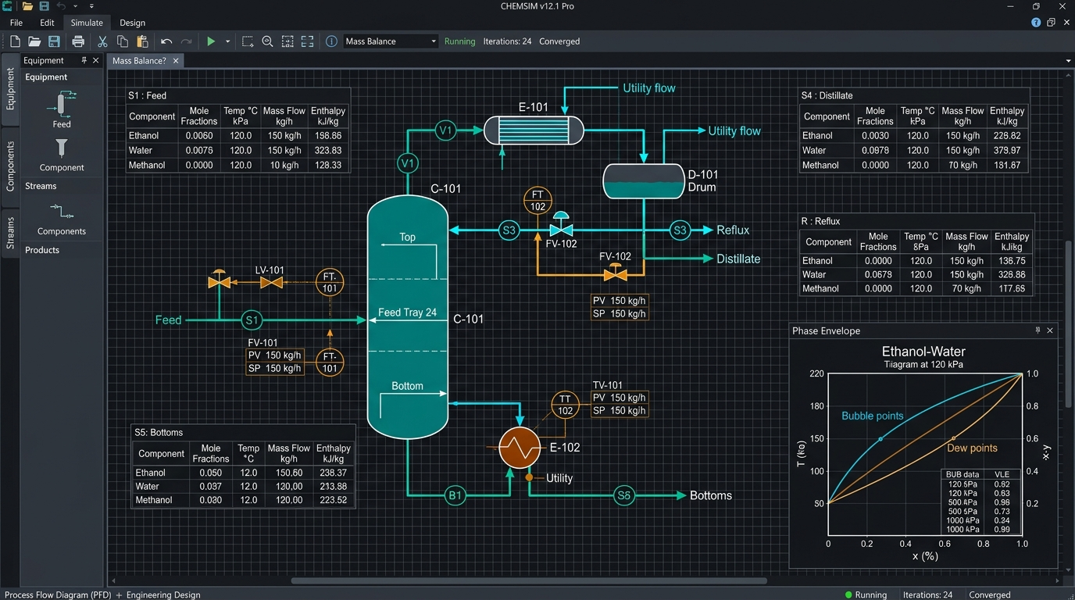
TERRESTRIAL PLATFORM | TERRAPFD | OPERATIONAL INTERFACE
TerraPFD ANSI/ISA-101 Operational Interface & Real-Time System Representation
ANSI/ISA-101 Ergonomic High-Performance HMI · Real-Time System Representation
Notes:
TerraPFD - ANSI/ISA-101 Verified Operational Interface
Representation: TerraPFD ANSI/ISA-101 Operational Interface & Real-Time System Representation
Compliance: ANSI/ISA-101 Verified HMI
Asset File: terra_pfd_showcase.jpg

Slide 3
TERRESTRIAL PLATFORM | TERRAPFD | CORE CAPABILITIES
What TerraPFD Will Do
Specific operational functions and engineering capabilities directly sourced from technical documentation.
PILLAR 01 | ENGINEERING CAPABILITY
Thermodynamic Balance Engine
Embedded thermodynamic property libraries for accurate real-time enthalpy, entropy, and vapor fraction calculations.
PILLAR 02 | ENGINEERING CAPABILITY
Mass & Energy Balance Dossiers
Continuous tracking of mass and thermal balances across every branch of the plant network.
PILLAR 03 | ENGINEERING CAPABILITY
Direct Controller Mapping
Pre-built I/O bindings for seamless deployment to physical plant equipment and PLCs.
PILLAR 04 | ENGINEERING CAPABILITY
Fouling & Degradation Tracking
Tracks heat transfer coefficients (U-values) over time to alert operators when heat exchanger tubes require cleaning.
Notes:
What TerraPFD Will Do:
[1] Thermodynamic Balance Engine:
Embedded thermodynamic property libraries for accurate real-time enthalpy, entropy, and vapor fraction calculations.
[2] Mass & Energy Balance Dossiers:
Continuous tracking of mass and thermal balances across every branch of the plant network.
[3] Direct Controller Mapping:
Pre-built I/O bindings for seamless deployment to physical plant equipment and PLCs.
[4] Fouling & Degradation Tracking:
Tracks heat transfer coefficients (U-values) over time to alert operators when heat exchanger tubes require cleaning.

Slide 4
TERRESTRIAL PLATFORM | TERRAPFD | FIELD USE CASES
Operational Use Cases & Field Impact
Actual documented use cases across Quality Assurance, Reduced Manpower, Efficiency, and Asset Productivity.
CASE 01 | EFFICIENCY
Efficiency (Mass & Energy Balance Calculations)
Calculates real-time mass and thermal balances across condensers, heat exchangers, and distillation columns, uncovering energy losses. (Terra Aavtar Mass & Energy Balance).
CASE 02 | QA
QA (Thermodynamic Bottleneck Detection)
Detects hydraulic and thermal bottlenecks before physical equipment is fabricated, preventing cavitation and vapor-lock. (Terra Aavtar Thermodynamics).
CASE 03 | PRODUCTIVITY
Productivity (Pre-Built Controller I/O Bindings)
Pre-mapped I/O tags allow process engineers to deploy validated setpoints straight to plant controllers with zero re-tagging.
CASE 04 | REDUCED MANPOWER
Reduced Manpower (Virtual Metering of Unmetered Streams)
First-principles virtual metering calculates flow rates and enthalpies of intermediate streams without costly physical sensor installations.
Notes:
TerraPFD - Operational Use Cases & Field Impact:
[Efficiency] Efficiency (Mass & Energy Balance Calculations):
Calculates real-time mass and thermal balances across condensers, heat exchangers, and distillation columns, uncovering energy losses. (Terra Aavtar Mass & Energy Balance).
[QA] QA (Thermodynamic Bottleneck Detection):
Detects hydraulic and thermal bottlenecks before physical equipment is fabricated, preventing cavitation and vapor-lock. (Terra Aavtar Thermodynamics).
[Productivity] Productivity (Pre-Built Controller I/O Bindings):
Pre-mapped I/O tags allow process engineers to deploy validated setpoints straight to plant controllers with zero re-tagging.
[Reduced Manpower] Reduced Manpower (Virtual Metering of Unmetered Streams):
First-principles virtual metering calculates flow rates and enthalpies of intermediate streams without costly physical sensor installations.

Slide 5
TERRESTRIAL PLATFORM | TERRAPFD | ARCHITECTURAL CONTRAST
Comparison with Traditional SCADA / Legacy Systems
Point-by-point contrast demonstrating the technological shift from legacy industrial automation to the Terrestrial Platform.
TRADITIONAL LEGACY SYSTEMS / SILOED SCADA
TERRAPFD TERRESTRIAL PLATFORM ADVANTAGE
Static PDF or AutoCAD drawings filed away in binders, disconnected from live operating conditions.
Living, interactive diagrams where stream temperatures, pressures, and enthalpies recalculate in real time.
Process bottlenecks only discovered after expensive equipment is fabricated and run on site.
Predictive hydraulic and thermal simulation discovering vapor-lock and pressure drop bottlenecks beforehand.
Operators lack visibility into unmetered streams and internal energy losses.
First-principles virtual metering calculating flow rates and enthalpies of unmetered intermediate streams.
Notes:
TerraPFD - Architectural Contrast (Legacy SCADA vs Terrestrial Platform):
LEGACY:
Static PDF or AutoCAD drawings filed away in binders, disconnected from live operating conditions.
TERRESTRIAL ADVANTAGE:
Living, interactive diagrams where stream temperatures, pressures, and enthalpies recalculate in real time.
LEGACY:
Process bottlenecks only discovered after expensive equipment is fabricated and run on site.
TERRESTRIAL ADVANTAGE:
Predictive hydraulic and thermal simulation discovering vapor-lock and pressure drop bottlenecks beforehand.
LEGACY:
Operators lack visibility into unmetered streams and internal energy losses.
TERRESTRIAL ADVANTAGE:
First-principles virtual metering calculating flow rates and enthalpies of unmetered intermediate streams.

Slide 6
TERRESTRIAL PLATFORM | TERRAPFD | SYSTEM ARCHITECTURE
End-to-End System Diagram & Data Pipeline
Visual architecture diagram representing field telemetry ingestion, deterministic edge fabric, AI reasoning, and closed-loop actuation.
LAYER 01
P&ID Instrument Ingestion
Real-time acquisition connecting process transmitters (FT, PT, TT, LT), control valves, and process stream analyzer instrumentation across plant units.
PROTOCOLS & STANDARDS:
• OPC UA DA
• HART / Fieldbus
• Modbus TCP
LAYER 02
Flowsheet Topology Stream
High-throughput flowsheet topology streaming, unit operation boundary condition buffering, and mass conservation balance tracking.
PROTOCOLS & STANDARDS:
• Flowsheet Topology Bus
• Mass Conservation Stream
• Unit Operation Buffer
LAYER 03
Rigorous Simulation Core
Equation-oriented flash distillation solvers, heat exchanger LMTD rating, control valve Cv sizing validation, and vapor-liquid equilibrium (VLE) curves.
PROTOCOLS & STANDARDS:
• VLE Phase Envelope AI
• LMTD Rating Model
• Mass Balance Solver
LAYER 04
Interactive PFD Cockpit
Real-time flowsheet topology navigation, control valve setpoint trim dispatch, and ANSI/ISA-101 interactive process flow diagram cockpits.
PROTOCOLS & STANDARDS:
• Valve Trim Dispatch
• Topology Navigation
• ISA-101 PFD Cockpit
UNIFIED DATA PIPELINE FLOW
P&ID Instrument Field Ingestion ➔ Dynamic Flowsheet Topology Stream ➔ Rigorous VLE & Mass Balance Solver ➔ Interactive Closed-Loop PFD Cockpit
Notes:
TerraPFD - End-to-End System Diagram & Data Pipeline:
Layer 01: P&ID Instrument Ingestion
Real-time acquisition connecting process transmitters (FT, PT, TT, LT), control valves, and process stream analyzer instrumentation across plant units.
Protocols: OPC UA DA, HART / Fieldbus, Modbus TCP
Layer 02: Flowsheet Topology Stream
High-throughput flowsheet topology streaming, unit operation boundary condition buffering, and mass conservation balance tracking.
Protocols: Flowsheet Topology Bus, Mass Conservation Stream, Unit Operation Buffer
Layer 03: Rigorous Simulation Core
Equation-oriented flash distillation solvers, heat exchanger LMTD rating, control valve Cv sizing validation, and vapor-liquid equilibrium (VLE) curves.
Protocols: VLE Phase Envelope AI, LMTD Rating Model, Mass Balance Solver
Layer 04: Interactive PFD Cockpit
Real-time flowsheet topology navigation, control valve setpoint trim dispatch, and ANSI/ISA-101 interactive process flow diagram cockpits.
Protocols: Valve Trim Dispatch, Topology Navigation, ISA-101 PFD Cockpit
Pipeline Flow:
DATA PIPELINE FLOW: P&ID Instrument Field Ingestion ➔ Dynamic Flowsheet Topology Stream ➔ Rigorous VLE & Mass Balance Solver ➔ Interactive Closed-Loop PFD Cockpit

Slide 7
TERRESTRIAL PLATFORM | TERRAPFD | DEPLOYMENT & SI VALUE
System Integrator Deployment Framework & Commercial Model
Zero rip-and-replace turnkey onboarding with recurring enterprise margins and co-selling enablement.
PHASE 01 | CONNECTIVITY & AUDIT
Zero Rip-and-Replace Onboarding
Non-intrusive protocol discovery across field PLCs, RTUs, and historians. Plug-and-play mapping of tags into the unified TPIM semantic namespace without stopping ongoing plant production.
PHASE 02 | TWIN CALIBRATION
Physics-Model Synchronization
Deploy high-frequency Edge Gateway on premise. Calibrate first-principles thermodynamic and kinematic models against historical telemetry to achieve 99.4%+ deterministic accuracy.
PHASE 03 | AUTONOMOUS GO-LIVE
Closed-Loop Setpoint Actuation
Supervisory closed-loop setpoint dispatch with bumpless transfer. Comprehensive ISA-101 verified cockpit handoff with continuous SI recurring monitoring and support tiers.
COMMERCIAL VALUE PROPOSITION FOR SYSTEM INTEGRATORS (TERRAPFD)
• High-Margin Software Recurring Revenue: Earn 25%–35% continuous recurring margin on every TerraPFD software deployment, maintenance tier, and AI compute instance.
• Turnkey Engineering Velocity: Deploy within 7 to 14 days leveraging pre-trained neural networks and automated semantic tag mapping, avoiding expensive months-long custom PLC code rewrites.
• Enterprise Co-Selling & Ecosystem: Access joint executive pipeline opportunities, certified engineering documentation, and board-level C-Suite presentation toolkits.
Notes:
TerraPFD - System Integrator Deployment Framework & Commercial Model:
Phase 1: Connectivity & Audit
Phase 2: Twin Calibration
Phase 3: Autonomous Go-Live
Commercial Enablement:
- 25%-35% recurring SaaS margins
- 7-14 day rapid commissioning
- Co-selling and enterprise enablement support

