Slide 1

TERRESTRIAL PLATFORM | TERRASCADA | ENTERPRISE SPECIFICATION
TerraSCADA: Physics-Aware AI SCADA Platform & Living Operational Mimic
Autonomous Industrial Intelligence Suite · Tier-1 Plant Architecture
““SCADA should not be an animated image, but a real world working AI avatar of plant.””
— — THE OUTCOME-BASED REVOLUTION
EXECUTIVE OPERATIONAL SYNOPSIS
TerraSCADA replaces legacy static visual graphics with an intelligent supervisory platform that understands the underlying science, reaction kinetics, and thermal flows of industrial processes. Featuring vector-sharp dynamic SVGs strictly compliant with ISA-101 standards, native IEC 61850 integration, and built-in predictive warnings, it acts as a true real-time AI avatar of the physical facility.
ISA-101 MIMIC
Level 1-4 Vector
TAG SCAN RATE
100 ms Real-Time
ALARM FLOOD
ISA-18.2 Suppressed
REDUNDANCY
Hot-Standby 0ms
TERRESTRIAL PLATFORM CORE
Edge-to-Cloud Cognitive Nervous System
Physics-informed mathematical twin running sub-25ms closed-loop supervisory control with full ISA-95/101 conformity.
Notes:
TerraSCADA - Enterprise Product Specification
Tagline: Physics-Aware AI SCADA Platform & Living Operational Mimic
Outcome Quote:
“SCADA should not be an animated image, but a real world working AI avatar of plant.” (— THE OUTCOME-BASED REVOLUTION)
Executive Overview:
TerraSCADA replaces legacy static visual graphics with an intelligent supervisory platform that understands the underlying science, reaction kinetics, and thermal flows of industrial processes. Featuring vector-sharp dynamic SVGs strictly compliant with ISA-101 standards, native IEC 61850 integration, and built-in predictive warnings, it acts as a true real-time AI avatar of the physical facility.
Key Telemetry Metrics:
- ISA-101 MIMIC:: Level 1-4 Vector
- TAG SCAN RATE:: 100 ms Real-Time
- ALARM FLOOD:: ISA-18.2 Suppressed
- REDUNDANCY:: Hot-Standby 0ms

Slide 2
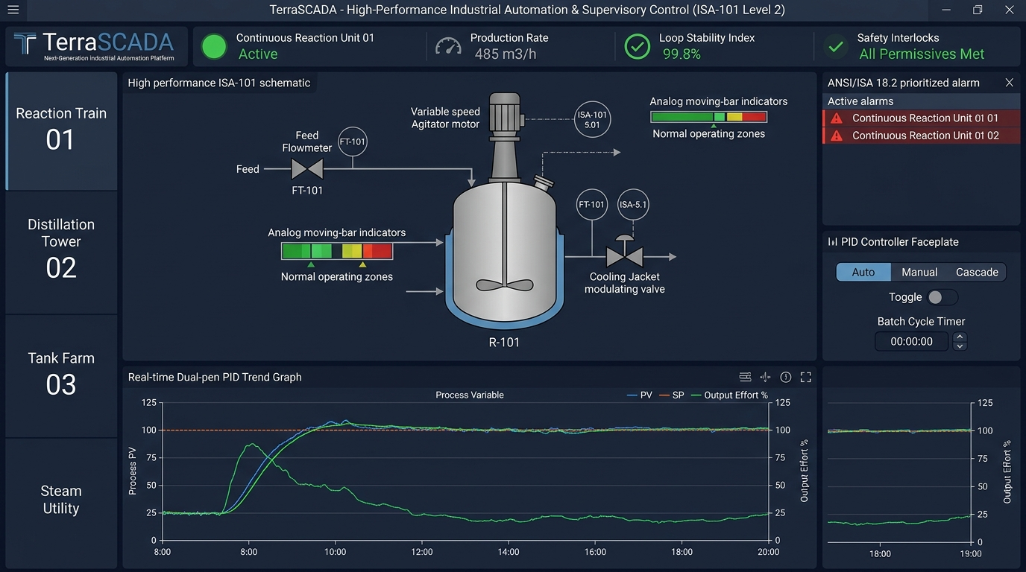
TERRESTRIAL PLATFORM | TERRASCADA | OPERATIONAL INTERFACE
TerraSCADA ANSI/ISA-101 Operational Interface & Real-Time System Representation
ANSI/ISA-101 Ergonomic High-Performance HMI · Real-Time System Representation
Notes:
TerraSCADA - ANSI/ISA-101 Verified Operational Interface
Representation: TerraSCADA ANSI/ISA-101 Operational Interface & Real-Time System Representation
Compliance: ANSI/ISA-101 Verified HMI
Asset File: terra_scada_isa101_showcase.jpg

Slide 3
TERRESTRIAL PLATFORM | TERRASCADA | CORE CAPABILITIES
What TerraSCADA Will Do
Specific operational functions and engineering capabilities directly sourced from technical documentation.
PILLAR 01 | ENGINEERING CAPABILITY
Vector Dynamic Single Line Diagrams (SLDs)
Resolution-independent electrical mimics with automatic line coloring based on bus voltage and breaker states.
PILLAR 02 | ENGINEERING CAPABILITY
Native IEC 61850 / Modbus Gateway
Direct protocol drivers eliminate third-party OPC middleware, cutting network hops and point failure risk.
PILLAR 03 | ENGINEERING CAPABILITY
Built-in High-Speed Historian
Sub-millisecond data logging with high-efficiency columnar compression and instant trend playback.
PILLAR 04 | ENGINEERING CAPABILITY
21 CFR Part 11 Audit Trail
Immutable chronological digital signatures and audit records for all operator actions and setpoint modifications.
Notes:
What TerraSCADA Will Do:
[1] Vector Dynamic Single Line Diagrams (SLDs):
Resolution-independent electrical mimics with automatic line coloring based on bus voltage and breaker states.
[2] Native IEC 61850 / Modbus Gateway:
Direct protocol drivers eliminate third-party OPC middleware, cutting network hops and point failure risk.
[3] Built-in High-Speed Historian:
Sub-millisecond data logging with high-efficiency columnar compression and instant trend playback.
[4] 21 CFR Part 11 Audit Trail:
Immutable chronological digital signatures and audit records for all operator actions and setpoint modifications.

Slide 4
TERRESTRIAL PLATFORM | TERRASCADA | FIELD USE CASES
Operational Use Cases & Field Impact
Actual documented use cases across Quality Assurance, Reduced Manpower, Efficiency, and Asset Productivity.
CASE 01 | QA & QUALITY PASS RATES
QA & Quality Pass Rates (Chemical Transformation)
Quality pass rates (OOS) optimized instantly from legacy baseline of 93.8% up to 99.5% via total elimination of manual recipe dosing errors through automated SCADA controls.
CASE 02 | PRODUCTIVITY
Productivity (Batch Cycle Time Reduction)
Manufacturing batch cycle times reduced by over 34%, dropping from legacy baseline of 9.8 hours down to 6.4 hours through automated multi-screen sequencing.
CASE 03 | REDUCED MANPOWER
Reduced Manpower (Consolidated Control Architecture)
Consolidated 5 separate control centers across utility solar blocks into a single centralized SCADA interface, removing redundant field technician staffing.
CASE 04 | EFFICIENCY
Efficiency (Real-Time Energy & Harmonics Telemetry)
Overlays live power harmonics, line currents, and transformer thermal stresses directly onto process mimics, preventing grid-side overloads.
Notes:
TerraSCADA - Operational Use Cases & Field Impact:
[QA & Quality Pass Rates] QA & Quality Pass Rates (Chemical Transformation):
Quality pass rates (OOS) optimized instantly from legacy baseline of 93.8% up to 99.5% via total elimination of manual recipe dosing errors through automated SCADA controls.
[Productivity] Productivity (Batch Cycle Time Reduction):
Manufacturing batch cycle times reduced by over 34%, dropping from legacy baseline of 9.8 hours down to 6.4 hours through automated multi-screen sequencing.
[Reduced Manpower] Reduced Manpower (Consolidated Control Architecture):
Consolidated 5 separate control centers across utility solar blocks into a single centralized SCADA interface, removing redundant field technician staffing.
[Efficiency] Efficiency (Real-Time Energy & Harmonics Telemetry):
Overlays live power harmonics, line currents, and transformer thermal stresses directly onto process mimics, preventing grid-side overloads.

Slide 5
TERRESTRIAL PLATFORM | TERRASCADA | ARCHITECTURAL CONTRAST
Comparison with Traditional SCADA / Legacy Systems
Point-by-point contrast demonstrating the technological shift from legacy industrial automation to the Terrestrial Platform.
TRADITIONAL LEGACY SYSTEMS / SILOED SCADA
TERRASCADA TERRESTRIAL PLATFORM ADVANTAGE
Clunky bitmap graphics that distort on modern 4K monitors and require months of tedious drawing revisions.
Clean, responsive dynamic SVG Single Line Diagrams and process mimics compliant with ISA-101 human-machine interface standards.
Dumb indicators that only turn red when a parameter has already exceeded catastrophic limits.
Physics-aware predictive indicators that alert operators 20 minutes before temperature or pressure breaches limits.
Heavy proprietary workstation clients with steep per-seat licensing fees and vendor lock-in.
Web-native HTML5/WebGL cloud-native architecture supporting unlimited simultaneous concurrent enterprise users with 21 CFR Part 11 audit trails.
Notes:
TerraSCADA - Architectural Contrast (Legacy SCADA vs Terrestrial Platform):
LEGACY:
Clunky bitmap graphics that distort on modern 4K monitors and require months of tedious drawing revisions.
TERRESTRIAL ADVANTAGE:
Clean, responsive dynamic SVG Single Line Diagrams and process mimics compliant with ISA-101 human-machine interface standards.
LEGACY:
Dumb indicators that only turn red when a parameter has already exceeded catastrophic limits.
TERRESTRIAL ADVANTAGE:
Physics-aware predictive indicators that alert operators 20 minutes before temperature or pressure breaches limits.
LEGACY:
Heavy proprietary workstation clients with steep per-seat licensing fees and vendor lock-in.
TERRESTRIAL ADVANTAGE:
Web-native HTML5/WebGL cloud-native architecture supporting unlimited simultaneous concurrent enterprise users with 21 CFR Part 11 audit trails.

Slide 6
TERRESTRIAL PLATFORM | TERRASCADA | SYSTEM ARCHITECTURE
End-to-End System Diagram & Data Pipeline
Visual architecture diagram representing field telemetry ingestion, deterministic edge fabric, AI reasoning, and closed-loop actuation.
LAYER 01
Field I/O & PLC Ingestion
Deterministic signal acquisition connecting plant PLCs, RTUs, digital controllers, and safety instrumented field transducers.
PROTOCOLS & STANDARDS:
• OPC UA Pub/Sub
• Modbus TCP/RTU
• Profinet / EtherCAT
LAYER 02
Deterministic Process Bus
Deterministic millisecond-level telemetry streaming, high-speed tag buffering, and lossless industrial time-series archival.
PROTOCOLS & STANDARDS:
• Process Event Bus
• Millisecond Telemetry
• Sub-10ms Determinism
LAYER 03
Advanced Process Control (APC)
Multi-loop PID auto-tuning, state-space multivariable control, feedforward decoupling models, and process disturbance rejection.
PROTOCOLS & STANDARDS:
• Model Predictive Control
• PID Auto-Tuning
• Disturbance Rejection
LAYER 04
ISA-101 Unit Cockpit
Deterministic setpoint adjustments, analog profile moving-bar indicators, emergency trip sequences, and Level 2 process mimics.
PROTOCOLS & STANDARDS:
• Closed-Loop Setpoints
• Analog Moving Bars
• ISA-101 Level 2 HMI
UNIFIED DATA PIPELINE FLOW
High-Speed PLC Field I/O ➔ Deterministic Process Event Bus ➔ Model Predictive Control & PID ➔ Closed-Loop Actuation (< 10ms Determinism)
Notes:
TerraSCADA - End-to-End System Diagram & Data Pipeline:
Layer 01: Field I/O & PLC Ingestion
Deterministic signal acquisition connecting plant PLCs, RTUs, digital controllers, and safety instrumented field transducers.
Protocols: OPC UA Pub/Sub, Modbus TCP/RTU, Profinet / EtherCAT
Layer 02: Deterministic Process Bus
Deterministic millisecond-level telemetry streaming, high-speed tag buffering, and lossless industrial time-series archival.
Protocols: Process Event Bus, Millisecond Telemetry, Sub-10ms Determinism
Layer 03: Advanced Process Control (APC)
Multi-loop PID auto-tuning, state-space multivariable control, feedforward decoupling models, and process disturbance rejection.
Protocols: Model Predictive Control, PID Auto-Tuning, Disturbance Rejection
Layer 04: ISA-101 Unit Cockpit
Deterministic setpoint adjustments, analog profile moving-bar indicators, emergency trip sequences, and Level 2 process mimics.
Protocols: Closed-Loop Setpoints, Analog Moving Bars, ISA-101 Level 2 HMI
Pipeline Flow:
DATA PIPELINE FLOW: High-Speed PLC Field I/O ➔ Deterministic Process Event Bus ➔ Model Predictive Control & PID ➔ Closed-Loop Actuation (< 10ms Determinism)

Slide 7
TERRESTRIAL PLATFORM | TERRASCADA | DEPLOYMENT & SI VALUE
System Integrator Deployment Framework & Commercial Model
Zero rip-and-replace turnkey onboarding with recurring enterprise margins and co-selling enablement.
PHASE 01 | CONNECTIVITY & AUDIT
Zero Rip-and-Replace Onboarding
Non-intrusive protocol discovery across field PLCs, RTUs, and historians. Plug-and-play mapping of tags into the unified TPIM semantic namespace without stopping ongoing plant production.
PHASE 02 | TWIN CALIBRATION
Physics-Model Synchronization
Deploy high-frequency Edge Gateway on premise. Calibrate first-principles thermodynamic and kinematic models against historical telemetry to achieve 99.4%+ deterministic accuracy.
PHASE 03 | AUTONOMOUS GO-LIVE
Closed-Loop Setpoint Actuation
Supervisory closed-loop setpoint dispatch with bumpless transfer. Comprehensive ISA-101 verified cockpit handoff with continuous SI recurring monitoring and support tiers.
COMMERCIAL VALUE PROPOSITION FOR SYSTEM INTEGRATORS (TERRASCADA)
• High-Margin Software Recurring Revenue: Earn 25%–35% continuous recurring margin on every TerraSCADA software deployment, maintenance tier, and AI compute instance.
• Turnkey Engineering Velocity: Deploy within 7 to 14 days leveraging pre-trained neural networks and automated semantic tag mapping, avoiding expensive months-long custom PLC code rewrites.
• Enterprise Co-Selling & Ecosystem: Access joint executive pipeline opportunities, certified engineering documentation, and board-level C-Suite presentation toolkits.
Notes:
TerraSCADA - System Integrator Deployment Framework & Commercial Model:
Phase 1: Connectivity & Audit
Phase 2: Twin Calibration
Phase 3: Autonomous Go-Live
Commercial Enablement:
- 25%-35% recurring SaaS margins
- 7-14 day rapid commissioning
- Co-selling and enterprise enablement support

