Slide 1

TERRESTRIAL PLATFORM | TERRASOLAR | ENTERPRISE SPECIFICATION
TerraSolar: Utility-Scale Solar Fleet Performance Optimization & Yield Management
Autonomous Industrial Intelligence Suite · Tier-1 Plant Architecture
““Solar management should not be blind daily manual logging, but autonomous gigawatt-scale optimization delivering 96.5% plant availability and eliminating string-level downtime.””
— — THE OUTCOME-BASED REVOLUTION
EXECUTIVE OPERATIONAL SYNOPSIS
Deployed across massive 250MW utility footprints, TerraSolar unifies distributed solar infrastructure into a central Common Monitoring and Control Station (CMCS). Featuring LoRaWAN wireless tracking for String Monitoring Boxes (SMB), DLMS/COSEM energy meter integration, and real-time CUF/PR calculations, it drives generation efficiency and eliminates data blind spots.
FLEET PR RATIO
82.4% Optimal
PLANT AVAILABILITY
96.5% Target
SMB TELEMETRY
LoRaWAN 868MHz
STRING JITTER
< 1.2 ms Edge
TERRESTRIAL PLATFORM CORE
Edge-to-Cloud Cognitive Nervous System
Physics-informed mathematical twin running sub-25ms closed-loop supervisory control with full ISA-95/101 conformity.
Notes:
TerraSolar - Enterprise Product Specification
Tagline: Utility-Scale Solar Fleet Performance Optimization & Yield Management
Outcome Quote:
“Solar management should not be blind daily manual logging, but autonomous gigawatt-scale optimization delivering 96.5% plant availability and eliminating string-level downtime.” (— THE OUTCOME-BASED REVOLUTION)
Executive Overview:
Deployed across massive 250MW utility footprints, TerraSolar unifies distributed solar infrastructure into a central Common Monitoring and Control Station (CMCS). Featuring LoRaWAN wireless tracking for String Monitoring Boxes (SMB), DLMS/COSEM energy meter integration, and real-time CUF/PR calculations, it drives generation efficiency and eliminates data blind spots.
Key Telemetry Metrics:
- FLEET PR RATIO:: 82.4% Optimal
- PLANT AVAILABILITY:: 96.5% Target
- SMB TELEMETRY:: LoRaWAN 868MHz
- STRING JITTER:: < 1.2 ms Edge

Slide 2
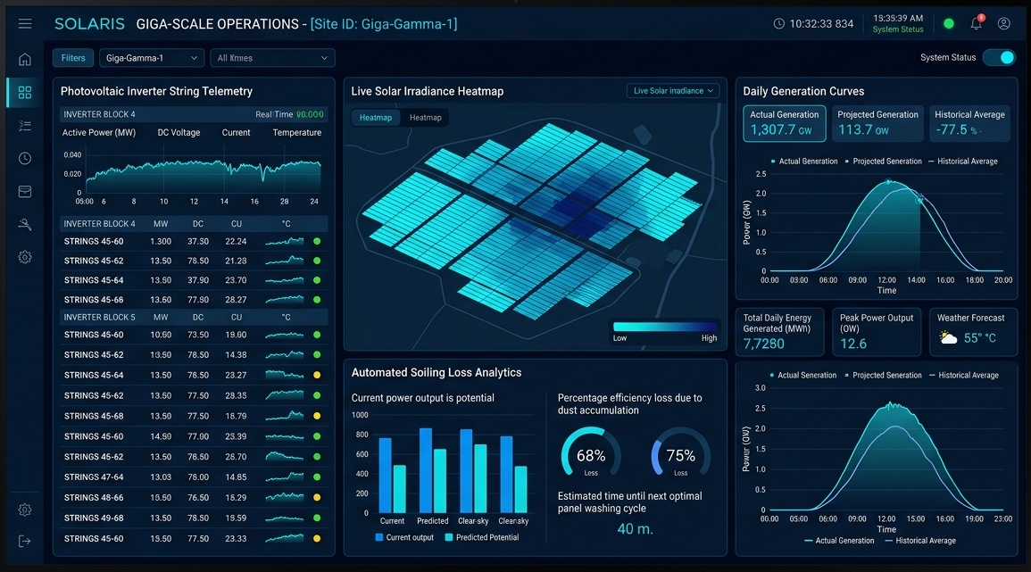
TERRESTRIAL PLATFORM | TERRASOLAR | OPERATIONAL INTERFACE
TerraSolar ANSI/ISA-101 Operational Interface & Real-Time System Representation
ANSI/ISA-101 Ergonomic High-Performance HMI · Real-Time System Representation
Notes:
TerraSolar - ANSI/ISA-101 Verified Operational Interface
Representation: TerraSolar ANSI/ISA-101 Operational Interface & Real-Time System Representation
Compliance: ANSI/ISA-101 Verified HMI
Asset File: terra_solar_showcase.jpg

Slide 3
TERRESTRIAL PLATFORM | TERRASOLAR | CORE CAPABILITIES
What TerraSolar Will Do
Specific operational functions and engineering capabilities directly sourced from technical documentation.
PILLAR 01 | ENGINEERING CAPABILITY
Solar RMS Electrical Parameters
Monitors Grid Status, Inverter Status, Line Energy, Runtime, Power, Frequency, Line Voltage/Current, DC Voltage/Current, Irradiation, Ambient/Inverter Temp.
PILLAR 02 | ENGINEERING CAPABILITY
Capacity Utilization Factor (CUF) & PR Engine
Continuous weather-corrected Performance Ratio (PR) and CUF benchmarking against theoretical irradiance curves.
PILLAR 03 | ENGINEERING CAPABILITY
ISA-18.2 Compliance Alarm Handling
Filters secondary nuisance alerts during grid disruptions, focusing operator attention strictly on critical inverter or transformer trips.
PILLAR 04 | ENGINEERING CAPABILITY
Attribute-Based Access Control (ABAC)
Dynamic access permissions evaluated by user role, structural attributes, and device location with encrypted audit trails.
Notes:
What TerraSolar Will Do:
[1] Solar RMS Electrical Parameters:
Monitors Grid Status, Inverter Status, Line Energy, Runtime, Power, Frequency, Line Voltage/Current, DC Voltage/Current, Irradiation, Ambient/Inverter Temp.
[2] Capacity Utilization Factor (CUF) & PR Engine:
Continuous weather-corrected Performance Ratio (PR) and CUF benchmarking against theoretical irradiance curves.
[3] ISA-18.2 Compliance Alarm Handling:
Filters secondary nuisance alerts during grid disruptions, focusing operator attention strictly on critical inverter or transformer trips.
[4] Attribute-Based Access Control (ABAC):
Dynamic access permissions evaluated by user role, structural attributes, and device location with encrypted audit trails.

Slide 4
TERRESTRIAL PLATFORM | TERRASOLAR | FIELD USE CASES
Operational Use Cases & Field Impact
Actual documented use cases across Quality Assurance, Reduced Manpower, Efficiency, and Asset Productivity.
CASE 01 | PRODUCTIVITY
Productivity (96.5% Plant Availability Milestone)
Achieved a 96.5% availability benchmark on a 250MW utility solar footprint by continuously scanning inverters and step-up transformers, eliminating generation field blind spots.
CASE 02 | QA & STRING-LEVEL ANOMALY DETECTION
QA & String-Level Anomaly Detection
Continuous LoRaWAN monitoring paired with automated anomaly detection identifies minor string current drops instantly, eliminating string-level downtime.
CASE 03 | REDUCED MANPOWER
Reduced Manpower (Workforce Multiplier Effect)
Consolidated 5 separate block control centers into 1 CMCS, removing redundant field staffing requirements and centralizing operations under a core engineering team.
CASE 04 | EFFICIENCY
Efficiency (Continuous Power Quality Auditing)
Continuous electrical diagnostics identify early-stage power harmonics and insulation resistance issues, protecting multi-crore transformers from grid-side thermal stress.
CASE 05 | NATURAL LANGUAGE ENERGY QUERYING
Natural Language Energy Querying
Engineers query live solar telemetry using natural language (e.g. 'Show me chart for voltage of all phases in March' or 'What was peak harmonic distortion on Block P3 yesterday?').
Notes:
TerraSolar - Operational Use Cases & Field Impact:
[Productivity] Productivity (96.5% Plant Availability Milestone):
Achieved a 96.5% availability benchmark on a 250MW utility solar footprint by continuously scanning inverters and step-up transformers, eliminating generation field blind spots.
[QA & String-Level Anomaly Detection] QA & String-Level Anomaly Detection:
Continuous LoRaWAN monitoring paired with automated anomaly detection identifies minor string current drops instantly, eliminating string-level downtime.
[Reduced Manpower] Reduced Manpower (Workforce Multiplier Effect):
Consolidated 5 separate block control centers into 1 CMCS, removing redundant field staffing requirements and centralizing operations under a core engineering team.
[Efficiency] Efficiency (Continuous Power Quality Auditing):
Continuous electrical diagnostics identify early-stage power harmonics and insulation resistance issues, protecting multi-crore transformers from grid-side thermal stress.
[Natural Language Energy Querying] Natural Language Energy Querying:
Engineers query live solar telemetry using natural language (e.g. 'Show me chart for voltage of all phases in March' or 'What was peak harmonic distortion on Block P3 yesterday?').

Slide 5
TERRESTRIAL PLATFORM | TERRASOLAR | ARCHITECTURAL CONTRAST
Comparison with Traditional SCADA / Legacy Systems
Point-by-point contrast demonstrating the technological shift from legacy industrial automation to the Terrestrial Platform.
TRADITIONAL LEGACY SYSTEMS / SILOED SCADA
TERRASOLAR TERRESTRIAL PLATFORM ADVANTAGE
Decentralized silos: five separate control rooms across blocks requiring redundant 24/7 technician shifts and manual paper log entries.
Consolidated single Common Monitoring and Control Station (CMCS) with centralized domain expertise monitoring the entire 250MW footprint.
String-level blown fuses or dirt-induced dropouts go unnoticed for days until periodic manual testing is conducted.
Continuous LoRaWAN wireless tracking down to discrete DC string currents with automated anomaly detection triggering immediate tickets.
Fragmented communication networks unable to bridge field inverters, DLMS meters, and high-voltage grid substations.
Unified multi-protocol fabric combining OPC UA, Modbus, LoRaWAN, DLMS/COSEM, and IEC 61850 into ISA-101 compliant mimics.
Notes:
TerraSolar - Architectural Contrast (Legacy SCADA vs Terrestrial Platform):
LEGACY:
Decentralized silos: five separate control rooms across blocks requiring redundant 24/7 technician shifts and manual paper log entries.
TERRESTRIAL ADVANTAGE:
Consolidated single Common Monitoring and Control Station (CMCS) with centralized domain expertise monitoring the entire 250MW footprint.
LEGACY:
String-level blown fuses or dirt-induced dropouts go unnoticed for days until periodic manual testing is conducted.
TERRESTRIAL ADVANTAGE:
Continuous LoRaWAN wireless tracking down to discrete DC string currents with automated anomaly detection triggering immediate tickets.
LEGACY:
Fragmented communication networks unable to bridge field inverters, DLMS meters, and high-voltage grid substations.
TERRESTRIAL ADVANTAGE:
Unified multi-protocol fabric combining OPC UA, Modbus, LoRaWAN, DLMS/COSEM, and IEC 61850 into ISA-101 compliant mimics.

Slide 6
TERRESTRIAL PLATFORM | TERRASOLAR | SYSTEM ARCHITECTURE
End-to-End System Diagram & Data Pipeline
Visual architecture diagram representing field telemetry ingestion, deterministic edge fabric, AI reasoning, and closed-loop actuation.
LAYER 01
Inverter & Met Ingestion
Multi-string telemetry acquisition connecting central inverters, tracker inclinometers, pyranometers, and meteorological weather stations.
PROTOCOLS & STANDARDS:
• SunSpec Modbus RS485
• LoRaWAN Field Mesh
• IEC 60870-5-104
LAYER 02
Solar Edge Aggregation
Lossless high-frequency solar irradiance streaming, MPPT curve normalization, and sub-second tracker telemetry aggregation.
PROTOCOLS & STANDARDS:
• Solar Telemetry Bus
• MPPT Data Pipeline
• Lossless Edge Stream
LAYER 03
Yield & Soiling Forecaster
Machine learning solar irradiance forecasting, drone thermography string degradation modeling, and dynamic soiling loss calculations.
PROTOCOLS & STANDARDS:
• Irradiance Forecasting
• Soiling Loss Model
• String Health AI
LAYER 04
Tracker & Dispatch Cockpit
Autonomous single-axis tracker backtracking angles, grid curtailment setpoint execution, and ANSI/ISA-101 solar plant cockpits.
PROTOCOLS & STANDARDS:
• Tracker Tilt Actuation
• Curtailment Dispatch
• ISA-101 Solar HMI
UNIFIED DATA PIPELINE FLOW
Inverter & Pyranometer Telemetry ➔ High-Speed Solar Edge Stream ➔ ML Yield & Soiling Forecasting ➔ Automated Tracker & Grid Dispatch
Notes:
TerraSolar - End-to-End System Diagram & Data Pipeline:
Layer 01: Inverter & Met Ingestion
Multi-string telemetry acquisition connecting central inverters, tracker inclinometers, pyranometers, and meteorological weather stations.
Protocols: SunSpec Modbus RS485, LoRaWAN Field Mesh, IEC 60870-5-104
Layer 02: Solar Edge Aggregation
Lossless high-frequency solar irradiance streaming, MPPT curve normalization, and sub-second tracker telemetry aggregation.
Protocols: Solar Telemetry Bus, MPPT Data Pipeline, Lossless Edge Stream
Layer 03: Yield & Soiling Forecaster
Machine learning solar irradiance forecasting, drone thermography string degradation modeling, and dynamic soiling loss calculations.
Protocols: Irradiance Forecasting, Soiling Loss Model, String Health AI
Layer 04: Tracker & Dispatch Cockpit
Autonomous single-axis tracker backtracking angles, grid curtailment setpoint execution, and ANSI/ISA-101 solar plant cockpits.
Protocols: Tracker Tilt Actuation, Curtailment Dispatch, ISA-101 Solar HMI
Pipeline Flow:
DATA PIPELINE FLOW: Inverter & Pyranometer Telemetry ➔ High-Speed Solar Edge Stream ➔ ML Yield & Soiling Forecasting ➔ Automated Tracker & Grid Dispatch

Slide 7
TERRESTRIAL PLATFORM | TERRASOLAR | DEPLOYMENT & SI VALUE
System Integrator Deployment Framework & Commercial Model
Zero rip-and-replace turnkey onboarding with recurring enterprise margins and co-selling enablement.
PHASE 01 | CONNECTIVITY & AUDIT
Zero Rip-and-Replace Onboarding
Non-intrusive protocol discovery across field PLCs, RTUs, and historians. Plug-and-play mapping of tags into the unified TPIM semantic namespace without stopping ongoing plant production.
PHASE 02 | TWIN CALIBRATION
Physics-Model Synchronization
Deploy high-frequency Edge Gateway on premise. Calibrate first-principles thermodynamic and kinematic models against historical telemetry to achieve 99.4%+ deterministic accuracy.
PHASE 03 | AUTONOMOUS GO-LIVE
Closed-Loop Setpoint Actuation
Supervisory closed-loop setpoint dispatch with bumpless transfer. Comprehensive ISA-101 verified cockpit handoff with continuous SI recurring monitoring and support tiers.
COMMERCIAL VALUE PROPOSITION FOR SYSTEM INTEGRATORS (TERRASOLAR)
• High-Margin Software Recurring Revenue: Earn 25%–35% continuous recurring margin on every TerraSolar software deployment, maintenance tier, and AI compute instance.
• Turnkey Engineering Velocity: Deploy within 7 to 14 days leveraging pre-trained neural networks and automated semantic tag mapping, avoiding expensive months-long custom PLC code rewrites.
• Enterprise Co-Selling & Ecosystem: Access joint executive pipeline opportunities, certified engineering documentation, and board-level C-Suite presentation toolkits.
Notes:
TerraSolar - System Integrator Deployment Framework & Commercial Model:
Phase 1: Connectivity & Audit
Phase 2: Twin Calibration
Phase 3: Autonomous Go-Live
Commercial Enablement:
- 25%-35% recurring SaaS margins
- 7-14 day rapid commissioning
- Co-selling and enterprise enablement support

