Slide 1

TERRESTRIAL PLATFORM | TERRAALARM | ENTERPRISE SPECIFICATION
TerraAlarm: ISA 18.2 Enterprise Alarm Lifecycle & Chattering Suppression Engine
Autonomous Industrial Intelligence Suite · Tier-1 Plant Architecture
““ISA 18.2 based alarm system eradicating nuisance alarm floods and guiding operators to instant root-cause resolution.””
— — THE OUTCOME-BASED REVOLUTION
EXECUTIVE OPERATIONAL SYNOPSIS
TerraAlarm provides an enterprise-grade alarm management system built strictly to ANSI/ISA 18.2 and EEMUA 191 standards. Engineered with an enterprise event streaming core, it manages the complete alarm lifecycle, suppresses chattering alarms, and correlates Sequence of Events (SOE) across distributed substations and industrial plants.
ALARM MANAGEMENT
EEMUA 191 / ISA-18.2
CHATTERING SUPPRESSION
99.2% Cleansed
ROOT CAUSE TRACE
Bayesian Directed Graph
OPERATOR LOAD
< 1 Alarm / 10 Min
TERRESTRIAL PLATFORM CORE
Edge-to-Cloud Cognitive Nervous System
Physics-informed mathematical twin running sub-25ms closed-loop supervisory control with full ISA-95/101 conformity.
Notes:
TerraAlarm - Enterprise Product Specification
Tagline: ISA 18.2 Enterprise Alarm Lifecycle & Chattering Suppression Engine
Outcome Quote:
“ISA 18.2 based alarm system eradicating nuisance alarm floods and guiding operators to instant root-cause resolution.” (— THE OUTCOME-BASED REVOLUTION)
Executive Overview:
TerraAlarm provides an enterprise-grade alarm management system built strictly to ANSI/ISA 18.2 and EEMUA 191 standards. Engineered with an enterprise event streaming core, it manages the complete alarm lifecycle, suppresses chattering alarms, and correlates Sequence of Events (SOE) across distributed substations and industrial plants.
Key Telemetry Metrics:
- ALARM MANAGEMENT:: EEMUA 191 / ISA-18.2
- CHATTERING SUPPRESSION:: 99.2% Cleansed
- ROOT CAUSE TRACE:: Bayesian Directed Graph
- OPERATOR LOAD:: < 1 Alarm / 10 Min

Slide 2
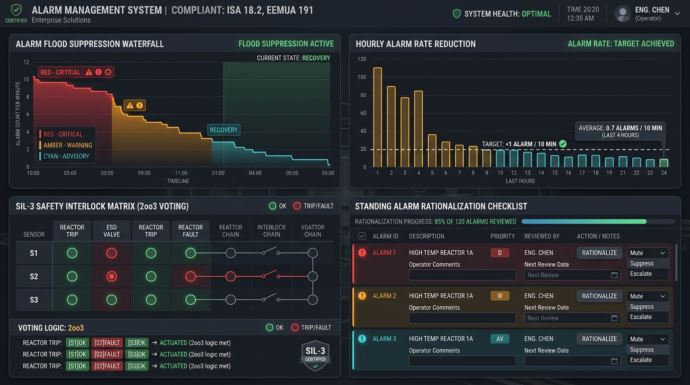
TERRESTRIAL PLATFORM | TERRAALARM | OPERATIONAL INTERFACE
TerraAlarm ANSI/ISA-101 Operational Interface & Real-Time System Representation
ANSI/ISA-101 Ergonomic High-Performance HMI · Real-Time System Representation
Notes:
TerraAlarm - ANSI/ISA-101 Verified Operational Interface
Representation: TerraAlarm ANSI/ISA-101 Operational Interface & Real-Time System Representation
Compliance: ANSI/ISA-101 Verified HMI
Asset File: terra_alarm_showcase.jpg

Slide 3
TERRESTRIAL PLATFORM | TERRAALARM | CORE CAPABILITIES
What TerraAlarm Will Do
Specific operational functions and engineering capabilities directly sourced from technical documentation.
PILLAR 01 | ENGINEERING CAPABILITY
Alarm Lifecycle Management
Configurable alarm generation, prioritization, acknowledgment, shelving, suppression, escalation, and closure.
PILLAR 02 | ENGINEERING CAPABILITY
Event Correlation & SOE Synchronization
Centralized event correlation with synchronized timestamps for Sequence of Events (SOE) disturbance investigation.
PILLAR 03 | ENGINEERING CAPABILITY
Chattering Alarm Detection & Suppression
Detects rapid oscillatory alarms and automatically applies deadbands or temporary shelving.
PILLAR 04 | ENGINEERING CAPABILITY
Enterprise High-Throughput Event Core
Enterprise architecture with dedicated tenant data segregation, secure multi-tenant access, and deterministic real-time event streaming.
Notes:
What TerraAlarm Will Do:
[1] Alarm Lifecycle Management:
Configurable alarm generation, prioritization, acknowledgment, shelving, suppression, escalation, and closure.
[2] Event Correlation & SOE Synchronization:
Centralized event correlation with synchronized timestamps for Sequence of Events (SOE) disturbance investigation.
[3] Chattering Alarm Detection & Suppression:
Detects rapid oscillatory alarms and automatically applies deadbands or temporary shelving.
[4] Enterprise High-Throughput Event Core:
Enterprise architecture with dedicated tenant data segregation, secure multi-tenant access, and deterministic real-time event streaming.

Slide 4
TERRESTRIAL PLATFORM | TERRAALARM | FIELD USE CASES
Operational Use Cases & Field Impact
Actual documented use cases across Quality Assurance, Reduced Manpower, Efficiency, and Asset Productivity.
CASE 01 | PRODUCTIVITY & SAFETY
Productivity & Safety (Alarm Lifecycle Management)
Configurable alarm generation, prioritization, acknowledgment, shelving, suppression, escalation, and closure conforming to ISA 18.2 standards.
CASE 02 | QA & FORENSICS
QA & Forensics (Event Correlation & SOE)
Centralized event correlation with synchronized microsecond timestamps for Sequence of Events (SOE) analysis and fast disturbance investigation.
CASE 03 | EFFICIENCY
Efficiency (Alarm Analytics & Chattering Suppression)
Automated alarm trending, chattering alarm detection, nuisance alarm pattern analysis, and dynamic alarm flood suppression.
CASE 04 | REDUCED MANPOWER
Reduced Manpower (Substation Cascade Trip Protection)
When a transmission line trips, automatically suppresses downstream secondary feeder alarms, guiding operators to the root cause.
Notes:
TerraAlarm - Operational Use Cases & Field Impact:
[Productivity & Safety] Productivity & Safety (Alarm Lifecycle Management):
Configurable alarm generation, prioritization, acknowledgment, shelving, suppression, escalation, and closure conforming to ISA 18.2 standards.
[QA & Forensics] QA & Forensics (Event Correlation & SOE):
Centralized event correlation with synchronized microsecond timestamps for Sequence of Events (SOE) analysis and fast disturbance investigation.
[Efficiency] Efficiency (Alarm Analytics & Chattering Suppression):
Automated alarm trending, chattering alarm detection, nuisance alarm pattern analysis, and dynamic alarm flood suppression.
[Reduced Manpower] Reduced Manpower (Substation Cascade Trip Protection):
When a transmission line trips, automatically suppresses downstream secondary feeder alarms, guiding operators to the root cause.

Slide 5
TERRESTRIAL PLATFORM | TERRAALARM | ARCHITECTURAL CONTRAST
Comparison with Traditional SCADA / Legacy Systems
Point-by-point contrast demonstrating the technological shift from legacy industrial automation to the Terrestrial Platform.
TRADITIONAL LEGACY SYSTEMS / SILOED SCADA
TERRAALARM TERRESTRIAL PLATFORM ADVANTAGE
Hundreds of alarms firing every minute during a trip, overwhelming operators into cognitive paralysis.
Dynamic state-based shelving and alarm suppression isolating the single initiating event.
Chattering alarms flickering due to bad sensor wiring or loose thresholds left unaddressed for months.
Automated chattering detection algorithms with automated deadband adjustments and health flagging.
Alarms with cryptic 8-character tag names and zero actionable guidance.
Context-rich alarm cards with verified Standard Operating Procedures (SOPs) and 1-click mitigation actions.
Notes:
TerraAlarm - Architectural Contrast (Legacy SCADA vs Terrestrial Platform):
LEGACY:
Hundreds of alarms firing every minute during a trip, overwhelming operators into cognitive paralysis.
TERRESTRIAL ADVANTAGE:
Dynamic state-based shelving and alarm suppression isolating the single initiating event.
LEGACY:
Chattering alarms flickering due to bad sensor wiring or loose thresholds left unaddressed for months.
TERRESTRIAL ADVANTAGE:
Automated chattering detection algorithms with automated deadband adjustments and health flagging.
LEGACY:
Alarms with cryptic 8-character tag names and zero actionable guidance.
TERRESTRIAL ADVANTAGE:
Context-rich alarm cards with verified Standard Operating Procedures (SOPs) and 1-click mitigation actions.

Slide 6
TERRESTRIAL PLATFORM | TERRAALARM | SYSTEM ARCHITECTURE
End-to-End System Diagram & Data Pipeline
Visual architecture diagram representing field telemetry ingestion, deterministic edge fabric, AI reasoning, and closed-loop actuation.
LAYER 01
Alarm & SOE Ingestion
Sub-millisecond alarm acquisition from substation IEDs, DCS controllers, safety interlocks, and sequence of events (SOE) recorders.
PROTOCOLS & STANDARDS:
• IEC 61850 MMS Alarms
• OPC UA A&C
• SOE Contact Inputs
LAYER 02
Microsecond Event Stamping
GPS/IRIG-B synchronized microsecond timestamp correlation, high-throughput alarm event buffering, and deduplication fabric.
PROTOCOLS & STANDARDS:
• GPS/IRIG-B Time-Sync
• SOE Event Pipeline
• Alarm Stream Bus
LAYER 03
Flood Suppression Core
Dynamic alarm chatter suppression, state-based alarm masking, root-cause propagation trees, and ANSI/ISA 18.2 / EEMUA 191 KPIs.
PROTOCOLS & STANDARDS:
• Flood Suppression AI
• ISA 18.2 Rationalizer
• Root-Cause Trees
LAYER 04
Operator Shelving Cockpit
Dynamic alarm priority gating, automated operator shelving workflows, SIL-3 2oo3 interlock audits, and ISA-101 alarm summary banners.
PROTOCOLS & STANDARDS:
• Priority Gating
• Automated Shelving
• ISA-101 Alarm Banner
UNIFIED DATA PIPELINE FLOW
Sub-Millisecond SOE Inputs ➔ GPS-Synchronized Event Stream ➔ Dynamic Flood & Chattering Suppression ➔ Automated Shelving & Operator Dispatch
Notes:
TerraAlarm - End-to-End System Diagram & Data Pipeline:
Layer 01: Alarm & SOE Ingestion
Sub-millisecond alarm acquisition from substation IEDs, DCS controllers, safety interlocks, and sequence of events (SOE) recorders.
Protocols: IEC 61850 MMS Alarms, OPC UA A&C, SOE Contact Inputs
Layer 02: Microsecond Event Stamping
GPS/IRIG-B synchronized microsecond timestamp correlation, high-throughput alarm event buffering, and deduplication fabric.
Protocols: GPS/IRIG-B Time-Sync, SOE Event Pipeline, Alarm Stream Bus
Layer 03: Flood Suppression Core
Dynamic alarm chatter suppression, state-based alarm masking, root-cause propagation trees, and ANSI/ISA 18.2 / EEMUA 191 KPIs.
Protocols: Flood Suppression AI, ISA 18.2 Rationalizer, Root-Cause Trees
Layer 04: Operator Shelving Cockpit
Dynamic alarm priority gating, automated operator shelving workflows, SIL-3 2oo3 interlock audits, and ISA-101 alarm summary banners.
Protocols: Priority Gating, Automated Shelving, ISA-101 Alarm Banner
Pipeline Flow:
DATA PIPELINE FLOW: Sub-Millisecond SOE Inputs ➔ GPS-Synchronized Event Stream ➔ Dynamic Flood & Chattering Suppression ➔ Automated Shelving & Operator Dispatch

Slide 7
TERRESTRIAL PLATFORM | TERRAALARM | DEPLOYMENT & SI VALUE
System Integrator Deployment Framework & Commercial Model
Zero rip-and-replace turnkey onboarding with recurring enterprise margins and co-selling enablement.
PHASE 01 | CONNECTIVITY & AUDIT
Zero Rip-and-Replace Onboarding
Non-intrusive protocol discovery across field PLCs, RTUs, and historians. Plug-and-play mapping of tags into the unified TPIM semantic namespace without stopping ongoing plant production.
PHASE 02 | TWIN CALIBRATION
Physics-Model Synchronization
Deploy high-frequency Edge Gateway on premise. Calibrate first-principles thermodynamic and kinematic models against historical telemetry to achieve 99.4%+ deterministic accuracy.
PHASE 03 | AUTONOMOUS GO-LIVE
Closed-Loop Setpoint Actuation
Supervisory closed-loop setpoint dispatch with bumpless transfer. Comprehensive ISA-101 verified cockpit handoff with continuous SI recurring monitoring and support tiers.
COMMERCIAL VALUE PROPOSITION FOR SYSTEM INTEGRATORS (TERRAALARM)
• High-Margin Software Recurring Revenue: Earn 25%–35% continuous recurring margin on every TerraAlarm software deployment, maintenance tier, and AI compute instance.
• Turnkey Engineering Velocity: Deploy within 7 to 14 days leveraging pre-trained neural networks and automated semantic tag mapping, avoiding expensive months-long custom PLC code rewrites.
• Enterprise Co-Selling & Ecosystem: Access joint executive pipeline opportunities, certified engineering documentation, and board-level C-Suite presentation toolkits.
Notes:
TerraAlarm - System Integrator Deployment Framework & Commercial Model:
Phase 1: Connectivity & Audit
Phase 2: Twin Calibration
Phase 3: Autonomous Go-Live
Commercial Enablement:
- 25%-35% recurring SaaS margins
- 7-14 day rapid commissioning
- Co-selling and enterprise enablement support

