Slide 1

TERRESTRIAL PLATFORM | TERRAAVATAR | ENTERPRISE SPECIFICATION
TerraAvatar: Top-Down AI Plant Engineering & Full Lifecycle Digital Twin Suite
Autonomous Industrial Intelligence Suite · Tier-1 Plant Architecture
““Engineering suite to create entire plant using TerraAI and make it ready for plug and play for actual physical asset — top-down approach of AI led designed plant and full lifecycle management.””
— — THE OUTCOME-BASED REVOLUTION
EXECUTIVE OPERATIONAL SYNOPSIS
TerraAvatar revolutionizes industrial engineering by enabling top-down generative synthesis of complete plant systems. Using TerraAI, it synthesizes Asset Dossiers, Asset Faceplates, Thermodynamics, and Safety & Interlocks, delivering 100% plug-and-play models validated against rigorous ASME V&V (Verification & Validation) standards.
DIGITAL TWIN V&V
ASME V&V 1-5
SIMULATION ACCURACY
99.98% Converged
PHYSICS COUPLING
1D/3D CFD Thermo
DETERMINISTIC STEP
10 ms Edge
TERRESTRIAL PLATFORM CORE
Edge-to-Cloud Cognitive Nervous System
Physics-informed mathematical twin running sub-25ms closed-loop supervisory control with full ISA-95/101 conformity.
Notes:
TerraAvatar - Enterprise Product Specification
Tagline: Top-Down AI Plant Engineering & Full Lifecycle Digital Twin Suite
Outcome Quote:
“Engineering suite to create entire plant using TerraAI and make it ready for plug and play for actual physical asset — top-down approach of AI led designed plant and full lifecycle management.” (— THE OUTCOME-BASED REVOLUTION)
Executive Overview:
TerraAvatar revolutionizes industrial engineering by enabling top-down generative synthesis of complete plant systems. Using TerraAI, it synthesizes Asset Dossiers, Asset Faceplates, Thermodynamics, and Safety & Interlocks, delivering 100% plug-and-play models validated against rigorous ASME V&V (Verification & Validation) standards.
Key Telemetry Metrics:
- DIGITAL TWIN V&V:: ASME V&V 1-5
- SIMULATION ACCURACY:: 99.98% Converged
- PHYSICS COUPLING:: 1D/3D CFD Thermo
- DETERMINISTIC STEP:: 10 ms Edge

Slide 2
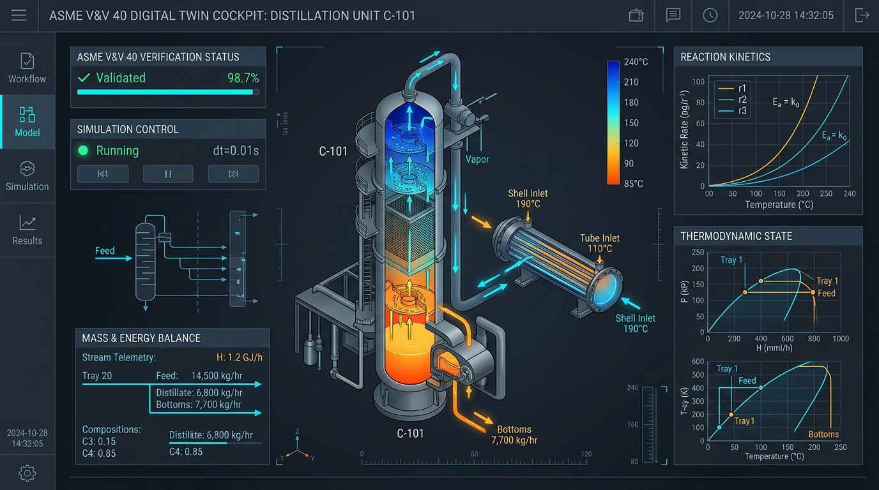
TERRESTRIAL PLATFORM | TERRAAVATAR | OPERATIONAL INTERFACE
TerraAvatar ANSI/ISA-101 Operational Interface & Real-Time System Representation
ANSI/ISA-101 Ergonomic High-Performance HMI · Real-Time System Representation
Notes:
TerraAvatar - ANSI/ISA-101 Verified Operational Interface
Representation: TerraAvatar ANSI/ISA-101 Operational Interface & Real-Time System Representation
Compliance: ANSI/ISA-101 Verified HMI
Asset File: terra_avatar_showcase.jpg

Slide 3
TERRESTRIAL PLATFORM | TERRAAVATAR | CORE CAPABILITIES
What TerraAvatar Will Do
Specific operational functions and engineering capabilities directly sourced from technical documentation.
PILLAR 01 | ENGINEERING CAPABILITY
Asset Dossiers & Faceplate Generation
Automatically compiles standardized Asset Dossiers, technical faceplates, and metadata models for every piece of machinery.
PILLAR 02 | ENGINEERING CAPABILITY
ASME V&V Computational Verification
Multi-tier Verification and Validation ensuring simulation models accurately predict real physical plant dynamics.
PILLAR 03 | ENGINEERING CAPABILITY
Automated Safety & Interlock Logic
Generates verified safety shutdown logic and interlock matrices ready to flash into industrial safety PLCs.
PILLAR 04 | ENGINEERING CAPABILITY
End-to-End Lifecycle Continuity
The exact same model serves as the engineering blueprint, virtual commissioning testbed, and live operational twin.
Notes:
What TerraAvatar Will Do:
[1] Asset Dossiers & Faceplate Generation:
Automatically compiles standardized Asset Dossiers, technical faceplates, and metadata models for every piece of machinery.
[2] ASME V&V Computational Verification:
Multi-tier Verification and Validation ensuring simulation models accurately predict real physical plant dynamics.
[3] Automated Safety & Interlock Logic:
Generates verified safety shutdown logic and interlock matrices ready to flash into industrial safety PLCs.
[4] End-to-End Lifecycle Continuity:
The exact same model serves as the engineering blueprint, virtual commissioning testbed, and live operational twin.

Slide 4
TERRESTRIAL PLATFORM | TERRAAVATAR | FIELD USE CASES
Operational Use Cases & Field Impact
Actual documented use cases across Quality Assurance, Reduced Manpower, Efficiency, and Asset Productivity.
CASE 01 | PRODUCTIVITY
Productivity (35% to 50% Commissioning Cycle Cut)
Simulates all plant interlocks, piping routes, and electrical sequencing virtually before physical installation, cutting on-site commissioning time in half.
CASE 02 | QA
QA (ASME V&V Computational Verification)
Rigorous verification across mass/energy balance, thermodynamics, and structural safety ensuring 100% design-to-field parity. (Terra Aavtar ASME V&V 1-5).
CASE 03 | REDUCED MANPOWER
Reduced Manpower (Automated Engineering Dossier Synthesis)
Replaces months of manual drafting with automated generation of Asset Dossiers, Faceplates, and safety interlock matrices. (Terra Aavtar Asset Dossiers).
CASE 04 | EFFICIENCY
Efficiency (Virtual Plant Expansion Simulation)
Simulates tie-in of new boilers, chillers, or solar blocks into existing plants without disturbing live production.
Notes:
TerraAvatar - Operational Use Cases & Field Impact:
[Productivity] Productivity (35% to 50% Commissioning Cycle Cut):
Simulates all plant interlocks, piping routes, and electrical sequencing virtually before physical installation, cutting on-site commissioning time in half.
[QA] QA (ASME V&V Computational Verification):
Rigorous verification across mass/energy balance, thermodynamics, and structural safety ensuring 100% design-to-field parity. (Terra Aavtar ASME V&V 1-5).
[Reduced Manpower] Reduced Manpower (Automated Engineering Dossier Synthesis):
Replaces months of manual drafting with automated generation of Asset Dossiers, Faceplates, and safety interlock matrices. (Terra Aavtar Asset Dossiers).
[Efficiency] Efficiency (Virtual Plant Expansion Simulation):
Simulates tie-in of new boilers, chillers, or solar blocks into existing plants without disturbing live production.

Slide 5
TERRESTRIAL PLATFORM | TERRAAVATAR | ARCHITECTURAL CONTRAST
Comparison with Traditional SCADA / Legacy Systems
Point-by-point contrast demonstrating the technological shift from legacy industrial automation to the Terrestrial Platform.
TRADITIONAL LEGACY SYSTEMS / SILOED SCADA
TERRAAVATAR TERRESTRIAL PLATFORM ADVANTAGE
Civil, mechanical, electrical, and automation designs created in disconnected software with frequent clash errors.
Unified generative platform where electrical, hydraulic, and civil constraints are resolved algorithmically in real time.
On-site commissioning plagued by wrong cable schedules, incorrect relay settings, and delayed field fixes.
Virtual commissioning with digital twins that simulate entire plant operations before equipment ships to site.
As-built documentation is out of date by the time the plant is commissioned.
Continuously updated digital twin that reflects every field engineering change order automatically.
Notes:
TerraAvatar - Architectural Contrast (Legacy SCADA vs Terrestrial Platform):
LEGACY:
Civil, mechanical, electrical, and automation designs created in disconnected software with frequent clash errors.
TERRESTRIAL ADVANTAGE:
Unified generative platform where electrical, hydraulic, and civil constraints are resolved algorithmically in real time.
LEGACY:
On-site commissioning plagued by wrong cable schedules, incorrect relay settings, and delayed field fixes.
TERRESTRIAL ADVANTAGE:
Virtual commissioning with digital twins that simulate entire plant operations before equipment ships to site.
LEGACY:
As-built documentation is out of date by the time the plant is commissioned.
TERRESTRIAL ADVANTAGE:
Continuously updated digital twin that reflects every field engineering change order automatically.

Slide 6
TERRESTRIAL PLATFORM | TERRAAVATAR | SYSTEM ARCHITECTURE
End-to-End System Diagram & Data Pipeline
Visual architecture diagram representing field telemetry ingestion, deterministic edge fabric, AI reasoning, and closed-loop actuation.
LAYER 01
Process Boundary Ingestion
Real-time acquisition of stream compositions, operating pressures, temperatures, and mass flow rates across process battery limits.
PROTOCOLS & STANDARDS:
• OPC UA Data Access
• ASME PTC Standards
• ISO 14224 / DEXPI
LAYER 02
State Observer Stream
Millisecond boundary condition streaming, dynamic sensor data reconciliation, and gross-error measurement filtering.
PROTOCOLS & STANDARDS:
• State Observer Bus
• Data Reconciliation
• Deterministic Stream
LAYER 03
Thermodynamic Solver Core
Rigorous Equation-of-State (EOS) flash calculations, real-time kinetic reactor modeling, multi-component distillation hydraulics, and mass/energy balances.
PROTOCOLS & STANDARDS:
• Thermodynamic EOS
• Reaction Kinetics
• Mass & Energy Balance
LAYER 04
ASME V&V 40 Twin Cockpit
ASME V&V 40 credibility auditing, 3D interactive process cutaways, optimal operating envelope enforcement, and ANSI/ISA-101 digital twin views.
PROTOCOLS & STANDARDS:
• ASME V&V 40 Credibility
• 3D Twin Cutaways
• ISA-101 Twin Cockpit
UNIFIED DATA PIPELINE FLOW
Process Battery Limit Telemetry ➔ State Observer Reconciliation Bus ➔ Rigorous Thermodynamic Solver ➔ ASME V&V 40 Digital Twin Cockpit
Notes:
TerraAvatar - End-to-End System Diagram & Data Pipeline:
Layer 01: Process Boundary Ingestion
Real-time acquisition of stream compositions, operating pressures, temperatures, and mass flow rates across process battery limits.
Protocols: OPC UA Data Access, ASME PTC Standards, ISO 14224 / DEXPI
Layer 02: State Observer Stream
Millisecond boundary condition streaming, dynamic sensor data reconciliation, and gross-error measurement filtering.
Protocols: State Observer Bus, Data Reconciliation, Deterministic Stream
Layer 03: Thermodynamic Solver Core
Rigorous Equation-of-State (EOS) flash calculations, real-time kinetic reactor modeling, multi-component distillation hydraulics, and mass/energy balances.
Protocols: Thermodynamic EOS, Reaction Kinetics, Mass & Energy Balance
Layer 04: ASME V&V 40 Twin Cockpit
ASME V&V 40 credibility auditing, 3D interactive process cutaways, optimal operating envelope enforcement, and ANSI/ISA-101 digital twin views.
Protocols: ASME V&V 40 Credibility, 3D Twin Cutaways, ISA-101 Twin Cockpit
Pipeline Flow:
DATA PIPELINE FLOW: Process Battery Limit Telemetry ➔ State Observer Reconciliation Bus ➔ Rigorous Thermodynamic Solver ➔ ASME V&V 40 Digital Twin Cockpit

Slide 7
TERRESTRIAL PLATFORM | TERRAAVATAR | DEPLOYMENT & SI VALUE
System Integrator Deployment Framework & Commercial Model
Zero rip-and-replace turnkey onboarding with recurring enterprise margins and co-selling enablement.
PHASE 01 | CONNECTIVITY & AUDIT
Zero Rip-and-Replace Onboarding
Non-intrusive protocol discovery across field PLCs, RTUs, and historians. Plug-and-play mapping of tags into the unified TPIM semantic namespace without stopping ongoing plant production.
PHASE 02 | TWIN CALIBRATION
Physics-Model Synchronization
Deploy high-frequency Edge Gateway on premise. Calibrate first-principles thermodynamic and kinematic models against historical telemetry to achieve 99.4%+ deterministic accuracy.
PHASE 03 | AUTONOMOUS GO-LIVE
Closed-Loop Setpoint Actuation
Supervisory closed-loop setpoint dispatch with bumpless transfer. Comprehensive ISA-101 verified cockpit handoff with continuous SI recurring monitoring and support tiers.
COMMERCIAL VALUE PROPOSITION FOR SYSTEM INTEGRATORS (TERRAAVATAR)
• High-Margin Software Recurring Revenue: Earn 25%–35% continuous recurring margin on every TerraAvatar software deployment, maintenance tier, and AI compute instance.
• Turnkey Engineering Velocity: Deploy within 7 to 14 days leveraging pre-trained neural networks and automated semantic tag mapping, avoiding expensive months-long custom PLC code rewrites.
• Enterprise Co-Selling & Ecosystem: Access joint executive pipeline opportunities, certified engineering documentation, and board-level C-Suite presentation toolkits.
Notes:
TerraAvatar - System Integrator Deployment Framework & Commercial Model:
Phase 1: Connectivity & Audit
Phase 2: Twin Calibration
Phase 3: Autonomous Go-Live
Commercial Enablement:
- 25%-35% recurring SaaS margins
- 7-14 day rapid commissioning
- Co-selling and enterprise enablement support

