Slide 1

TERRESTRIAL PLATFORM | TERRAEMBODIMENT | ENTERPRISE SPECIFICATION
TerraEmbodiment: Autonomous Ground-Floor Physical AI Actuation & OT Edge Execution
Autonomous Industrial Intelligence Suite · Tier-1 Plant Architecture
““Taking action on floor with AI: autonomous or human assisted — controlling PLCs, controllers, robotics, or UAVs directly with TerraAI.””
— — THE OUTCOME-BASED REVOLUTION
EXECUTIVE OPERATIONAL SYNOPSIS
TerraEmbodiment bridges cognitive AI decisions with physical reality on the industrial floor. Deploying hardened, containerized edge runtimes directly on industrial IPCs, it injects deterministic setpoints into PLCs, RTUs, robotic manipulators, and autonomous inspection drones, eliminating human risk in dangerous environments.
SWARM DRONE LINK
2.4/5.8 GHz Mesh
AGV LOCALIZATION
SLAM ±2.5cm
SAFETY RATING
SIL 2 / PL d
CONTROL LATENCY
8 ms Deterministic
TERRESTRIAL PLATFORM CORE
Edge-to-Cloud Cognitive Nervous System
Physics-informed mathematical twin running sub-25ms closed-loop supervisory control with full ISA-95/101 conformity.
Notes:
TerraEmbodiment - Enterprise Product Specification
Tagline: Autonomous Ground-Floor Physical AI Actuation & OT Edge Execution
Outcome Quote:
“Taking action on floor with AI: autonomous or human assisted — controlling PLCs, controllers, robotics, or UAVs directly with TerraAI.” (— THE OUTCOME-BASED REVOLUTION)
Executive Overview:
TerraEmbodiment bridges cognitive AI decisions with physical reality on the industrial floor. Deploying hardened, containerized edge runtimes directly on industrial IPCs, it injects deterministic setpoints into PLCs, RTUs, robotic manipulators, and autonomous inspection drones, eliminating human risk in dangerous environments.
Key Telemetry Metrics:
- SWARM DRONE LINK:: 2.4/5.8 GHz Mesh
- AGV LOCALIZATION:: SLAM ±2.5cm
- SAFETY RATING:: SIL 2 / PL d
- CONTROL LATENCY:: 8 ms Deterministic

Slide 2
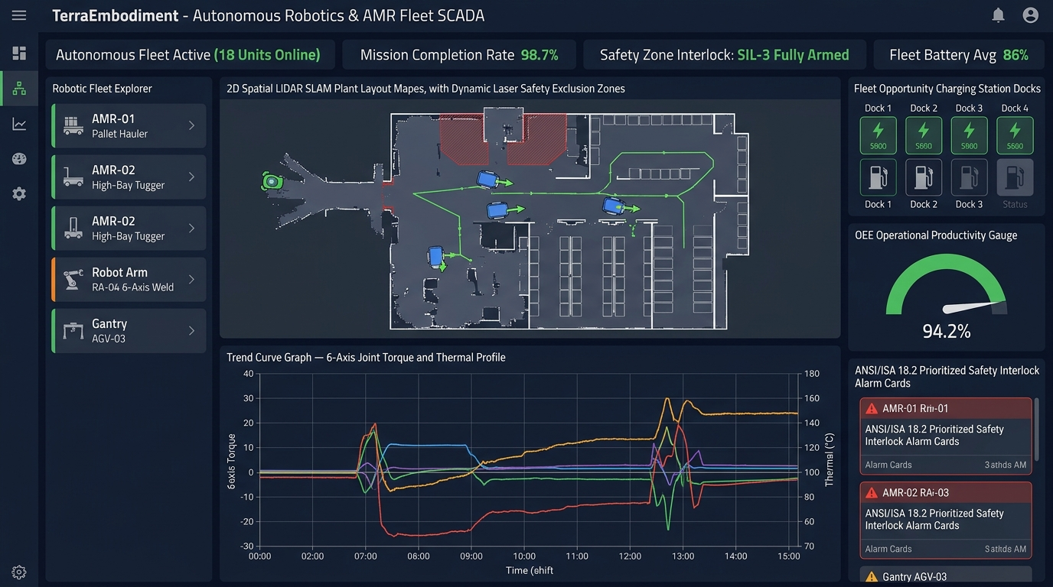
TERRESTRIAL PLATFORM | TERRAEMBODIMENT | OPERATIONAL INTERFACE
TerraEmbodiment ANSI/ISA-101 Operational Interface & Real-Time System Representation
ANSI/ISA-101 Ergonomic High-Performance HMI · Real-Time System Representation
Notes:
TerraEmbodiment - ANSI/ISA-101 Verified Operational Interface
Representation: TerraEmbodiment ANSI/ISA-101 Operational Interface & Real-Time System Representation
Compliance: ANSI/ISA-101 Verified HMI
Asset File: terra_embodiment_isa101_showcase.jpg

Slide 3
TERRESTRIAL PLATFORM | TERRAEMBODIMENT | CORE CAPABILITIES
What TerraEmbodiment Will Do
Specific operational functions and engineering capabilities directly sourced from technical documentation.
PILLAR 01 | ENGINEERING CAPABILITY
Direct OT Actuation
Sub-millisecond deterministic setpoint injection to industrial field controllers and PLCs.
PILLAR 02 | ENGINEERING CAPABILITY
Autonomous / Assisted Execution Modes
Configurable execution governance: from closed-loop autonomy to supervised operator sign-off.
PILLAR 03 | ENGINEERING CAPABILITY
Edge-Native Microservices
High-reliability containerized runtime deployed directly on industrial edge IPC hardware.
PILLAR 04 | ENGINEERING CAPABILITY
Robotics & UAV Control
Direct mission dispatch and waypoint navigation for inspection drones and robotic crawlers.
Notes:
What TerraEmbodiment Will Do:
[1] Direct OT Actuation:
Sub-millisecond deterministic setpoint injection to industrial field controllers and PLCs.
[2] Autonomous / Assisted Execution Modes:
Configurable execution governance: from closed-loop autonomy to supervised operator sign-off.
[3] Edge-Native Microservices:
High-reliability containerized runtime deployed directly on industrial edge IPC hardware.
[4] Robotics & UAV Control:
Direct mission dispatch and waypoint navigation for inspection drones and robotic crawlers.

Slide 4
TERRESTRIAL PLATFORM | TERRAEMBODIMENT | FIELD USE CASES
Operational Use Cases & Field Impact
Actual documented use cases across Quality Assurance, Reduced Manpower, Efficiency, and Asset Productivity.
CASE 01 | SAFETY & REDUCED MANPOWER
Safety & Reduced Manpower (Hazardous Switchgear Actuation)
Racks in/out 33kV circuit breakers and closes earth switches autonomously during arc flash hazard conditions without humans in the room.
CASE 02 | PRODUCTIVITY & MACHINE SAFETY
Productivity & Machine Safety (CNC Load Reduction)
When TerraAI detects high vibration on CNC machines, TerraEmbodiment automatically modulates PLC feed rates to prevent tool breakage.
CASE 03 | QA & AUTONOMOUS ROBOTIC INSPECTION
QA & Autonomous Robotic Inspection
Dispatches autonomous robotic crawlers and thermal drones to wash solar panels and locate hot spots without manual workers.
CASE 04 | EFFICIENCY
Efficiency (High-Speed Valve Modulation)
Directly modulates thermal injection valves and high-pressure pumps to suppress water hammer transients.
Notes:
TerraEmbodiment - Operational Use Cases & Field Impact:
[Safety & Reduced Manpower] Safety & Reduced Manpower (Hazardous Switchgear Actuation):
Racks in/out 33kV circuit breakers and closes earth switches autonomously during arc flash hazard conditions without humans in the room.
[Productivity & Machine Safety] Productivity & Machine Safety (CNC Load Reduction):
When TerraAI detects high vibration on CNC machines, TerraEmbodiment automatically modulates PLC feed rates to prevent tool breakage.
[QA & Autonomous Robotic Inspection] QA & Autonomous Robotic Inspection:
Dispatches autonomous robotic crawlers and thermal drones to wash solar panels and locate hot spots without manual workers.
[Efficiency] Efficiency (High-Speed Valve Modulation):
Directly modulates thermal injection valves and high-pressure pumps to suppress water hammer transients.

Slide 5
TERRESTRIAL PLATFORM | TERRAEMBODIMENT | ARCHITECTURAL CONTRAST
Comparison with Traditional SCADA / Legacy Systems
Point-by-point contrast demonstrating the technological shift from legacy industrial automation to the Terrestrial Platform.
TRADITIONAL LEGACY SYSTEMS / SILOED SCADA
TERRAEMBODIMENT TERRESTRIAL PLATFORM ADVANTAGE
AI systems only provide advisory charts; human technicians must physically walk to switchgear to turn knobs or trip breakers.
Closed-loop, deterministic execution straight to industrial bus controllers with microsecond safety boundaries.
Fragile cloud-dependent automation that fails whenever plant internet or WAN connectivity drops.
Edge-native microservices that continue autonomous local execution even during total WAN blackout.
Manual visual inspections requiring staff to climb tall boilers, flare stacks, or live switchyards.
Automated dispatch of autonomous UAVs and tracked robots with real-time waypoint guidance.
Notes:
TerraEmbodiment - Architectural Contrast (Legacy SCADA vs Terrestrial Platform):
LEGACY:
AI systems only provide advisory charts; human technicians must physically walk to switchgear to turn knobs or trip breakers.
TERRESTRIAL ADVANTAGE:
Closed-loop, deterministic execution straight to industrial bus controllers with microsecond safety boundaries.
LEGACY:
Fragile cloud-dependent automation that fails whenever plant internet or WAN connectivity drops.
TERRESTRIAL ADVANTAGE:
Edge-native microservices that continue autonomous local execution even during total WAN blackout.
LEGACY:
Manual visual inspections requiring staff to climb tall boilers, flare stacks, or live switchyards.
TERRESTRIAL ADVANTAGE:
Automated dispatch of autonomous UAVs and tracked robots with real-time waypoint guidance.

Slide 6
TERRESTRIAL PLATFORM | TERRAEMBODIMENT | SYSTEM ARCHITECTURE
End-to-End System Diagram & Data Pipeline
Visual architecture diagram representing field telemetry ingestion, deterministic edge fabric, AI reasoning, and closed-loop actuation.
LAYER 01
Spatial LiDAR & Robot Ingestion
High-bandwidth sensory acquisition aggregating 2D/3D LiDAR point clouds, depth cameras, joint servo encoders, and IMU inertial sensors.
PROTOCOLS & STANDARDS:
• ROS2 / DDS Protocol
• CANopen / EtherCAT
• Safety LiDAR Bus
LAYER 02
Deterministic Robotic Fabric
Sub-5ms spatial point cloud filtering, real-time wheel odometry synchronization, and collision exclusion zone monitoring.
PROTOCOLS & STANDARDS:
• Deterministic DDS Bus
• LiDAR Point-Cloud Stream
• Sub-5ms Edge Fabric
LAYER 03
Spatial SLAM & Fleet Planner
Multi-agent cooperative SLAM, dynamic obstacle avoidance, warehouse traffic deadlock resolution, and robotic 6-axis inverse kinematics.
PROTOCOLS & STANDARDS:
• Dynamic SLAM AI
• Fleet Path Planner
• Inverse Kinematics
LAYER 04
Fleet Teleoperation Cockpit
Closed-loop AMR velocity drive execution, 6-axis joint torque commands, automatic dock opportunity charging, and ANSI/ISA-101 fleet consoles.
PROTOCOLS & STANDARDS:
• Drive Velocity Dispatch
• Servo Torque Control
• ISA-101 Robot Cockpit
UNIFIED DATA PIPELINE FLOW
LiDAR & Joint Encoder Telemetry ➔ Deterministic ROS2/DDS Fabric ➔ Multi-Agent Spatial SLAM & Path Planning ➔ Closed-Loop Drive & Servo Actuation (< 5ms)
Notes:
TerraEmbodiment - End-to-End System Diagram & Data Pipeline:
Layer 01: Spatial LiDAR & Robot Ingestion
High-bandwidth sensory acquisition aggregating 2D/3D LiDAR point clouds, depth cameras, joint servo encoders, and IMU inertial sensors.
Protocols: ROS2 / DDS Protocol, CANopen / EtherCAT, Safety LiDAR Bus
Layer 02: Deterministic Robotic Fabric
Sub-5ms spatial point cloud filtering, real-time wheel odometry synchronization, and collision exclusion zone monitoring.
Protocols: Deterministic DDS Bus, LiDAR Point-Cloud Stream, Sub-5ms Edge Fabric
Layer 03: Spatial SLAM & Fleet Planner
Multi-agent cooperative SLAM, dynamic obstacle avoidance, warehouse traffic deadlock resolution, and robotic 6-axis inverse kinematics.
Protocols: Dynamic SLAM AI, Fleet Path Planner, Inverse Kinematics
Layer 04: Fleet Teleoperation Cockpit
Closed-loop AMR velocity drive execution, 6-axis joint torque commands, automatic dock opportunity charging, and ANSI/ISA-101 fleet consoles.
Protocols: Drive Velocity Dispatch, Servo Torque Control, ISA-101 Robot Cockpit
Pipeline Flow:
DATA PIPELINE FLOW: LiDAR & Joint Encoder Telemetry ➔ Deterministic ROS2/DDS Fabric ➔ Multi-Agent Spatial SLAM & Path Planning ➔ Closed-Loop Drive & Servo Actuation (< 5ms)

Slide 7
TERRESTRIAL PLATFORM | TERRAEMBODIMENT | DEPLOYMENT & SI VALUE
System Integrator Deployment Framework & Commercial Model
Zero rip-and-replace turnkey onboarding with recurring enterprise margins and co-selling enablement.
PHASE 01 | CONNECTIVITY & AUDIT
Zero Rip-and-Replace Onboarding
Non-intrusive protocol discovery across field PLCs, RTUs, and historians. Plug-and-play mapping of tags into the unified TPIM semantic namespace without stopping ongoing plant production.
PHASE 02 | TWIN CALIBRATION
Physics-Model Synchronization
Deploy high-frequency Edge Gateway on premise. Calibrate first-principles thermodynamic and kinematic models against historical telemetry to achieve 99.4%+ deterministic accuracy.
PHASE 03 | AUTONOMOUS GO-LIVE
Closed-Loop Setpoint Actuation
Supervisory closed-loop setpoint dispatch with bumpless transfer. Comprehensive ISA-101 verified cockpit handoff with continuous SI recurring monitoring and support tiers.
COMMERCIAL VALUE PROPOSITION FOR SYSTEM INTEGRATORS (TERRAEMBODIMENT)
• High-Margin Software Recurring Revenue: Earn 25%–35% continuous recurring margin on every TerraEmbodiment software deployment, maintenance tier, and AI compute instance.
• Turnkey Engineering Velocity: Deploy within 7 to 14 days leveraging pre-trained neural networks and automated semantic tag mapping, avoiding expensive months-long custom PLC code rewrites.
• Enterprise Co-Selling & Ecosystem: Access joint executive pipeline opportunities, certified engineering documentation, and board-level C-Suite presentation toolkits.
Notes:
TerraEmbodiment - System Integrator Deployment Framework & Commercial Model:
Phase 1: Connectivity & Audit
Phase 2: Twin Calibration
Phase 3: Autonomous Go-Live
Commercial Enablement:
- 25%-35% recurring SaaS margins
- 7-14 day rapid commissioning
- Co-selling and enterprise enablement support

