Slide 1

TERRESTRIAL PLATFORM | TERRAGRIDG | ENTERPRISE SPECIFICATION
TerraGridG: City Gas Distribution, Custody Transfer & Pipeline Safety Platform
Autonomous Industrial Intelligence Suite · Tier-1 Plant Architecture
““City gas distribution monitoring, custody flow regulation, and micro-leak gas balance algorithms eliminating unaccounted-for-gas (UFG).””
— — THE OUTCOME-BASED REVOLUTION
EXECUTIVE OPERATIONAL SYNOPSIS
TerraGridG manages city gas distribution (CGD) networks, City Gate Stations (CGS), and pressure reduction stations. It features real-time electronic volume correction (EVC), gas chromatography logging, automated odorant injection monitoring, and micro-leak gas balance models to eliminate Unaccounted-For-Gas (UFG) losses.
GAS PIPELINE CODE
ASME B31.8 / AGA
PRESSURE REGULATION
±0.05 bar Precision
ODORIZATION SYNC
Online PPM Injection
COMPRESSOR EFFICIENCY
88.2% Optimal
TERRESTRIAL PLATFORM CORE
Edge-to-Cloud Cognitive Nervous System
Physics-informed mathematical twin running sub-25ms closed-loop supervisory control with full ISA-95/101 conformity.
Notes:
TerraGridG - Enterprise Product Specification
Tagline: City Gas Distribution, Custody Transfer & Pipeline Safety Platform
Outcome Quote:
“City gas distribution monitoring, custody flow regulation, and micro-leak gas balance algorithms eliminating unaccounted-for-gas (UFG).” (— THE OUTCOME-BASED REVOLUTION)
Executive Overview:
TerraGridG manages city gas distribution (CGD) networks, City Gate Stations (CGS), and pressure reduction stations. It features real-time electronic volume correction (EVC), gas chromatography logging, automated odorant injection monitoring, and micro-leak gas balance models to eliminate Unaccounted-For-Gas (UFG) losses.
Key Telemetry Metrics:
- GAS PIPELINE CODE:: ASME B31.8 / AGA
- PRESSURE REGULATION:: ±0.05 bar Precision
- ODORIZATION SYNC:: Online PPM Injection
- COMPRESSOR EFFICIENCY:: 88.2% Optimal

Slide 2
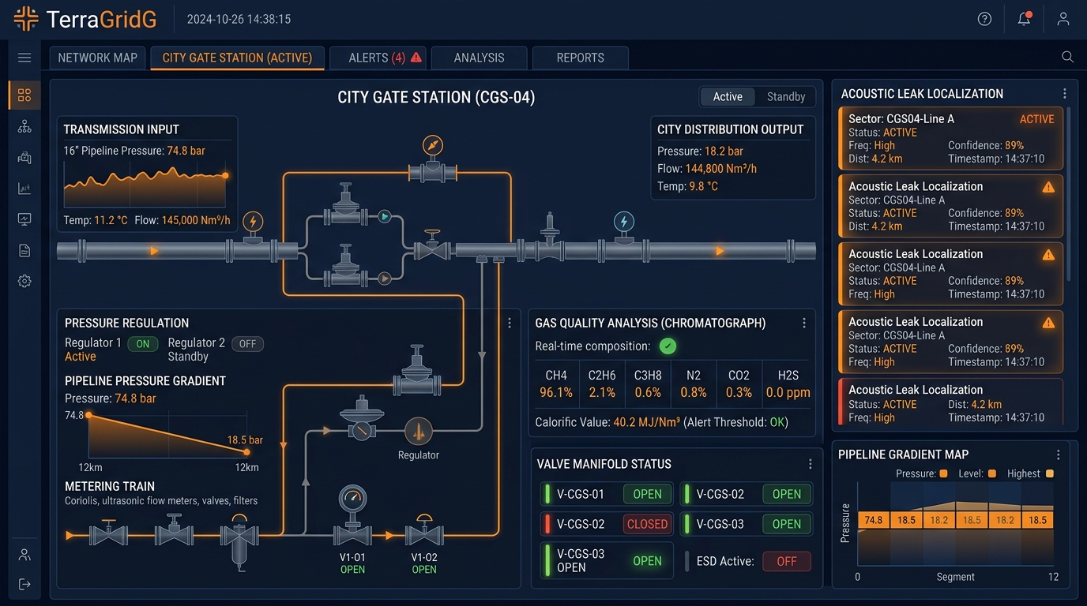
TERRESTRIAL PLATFORM | TERRAGRIDG | OPERATIONAL INTERFACE
TerraGridG ANSI/ISA-101 Operational Interface & Real-Time System Representation
ANSI/ISA-101 Ergonomic High-Performance HMI · Real-Time System Representation
Notes:
TerraGridG - ANSI/ISA-101 Verified Operational Interface
Representation: TerraGridG ANSI/ISA-101 Operational Interface & Real-Time System Representation
Compliance: ANSI/ISA-101 Verified HMI
Asset File: terra_gridg_showcase.jpg

Slide 3
TERRESTRIAL PLATFORM | TERRAGRIDG | CORE CAPABILITIES
What TerraGridG Will Do
Specific operational functions and engineering capabilities directly sourced from technical documentation.
PILLAR 01 | ENGINEERING CAPABILITY
Station Control & Telemetry
Continuous pressure, temperature, and odorant monitoring with automated emergency shut-off protocols.
PILLAR 02 | ENGINEERING CAPABILITY
Custody Flow Analytics (EVC)
Electronic volume correction (EVC) and integrated gas chromatography logging conforming to AGA standards.
PILLAR 03 | ENGINEERING CAPABILITY
Rupture & Overpressure Safety
Algorithmic gas balance models detecting micro-leaks and line pressure drops instantly.
PILLAR 04 | ENGINEERING CAPABILITY
Zone-1 Flameproof Edge RTUs
Hardware designs certified for ATEX and IECEx hazardous environments with solar battery backups.
Notes:
What TerraGridG Will Do:
[1] Station Control & Telemetry:
Continuous pressure, temperature, and odorant monitoring with automated emergency shut-off protocols.
[2] Custody Flow Analytics (EVC):
Electronic volume correction (EVC) and integrated gas chromatography logging conforming to AGA standards.
[3] Rupture & Overpressure Safety:
Algorithmic gas balance models detecting micro-leaks and line pressure drops instantly.
[4] Zone-1 Flameproof Edge RTUs:
Hardware designs certified for ATEX and IECEx hazardous environments with solar battery backups.

Slide 4
TERRESTRIAL PLATFORM | TERRAGRIDG | FIELD USE CASES
Operational Use Cases & Field Impact
Actual documented use cases across Quality Assurance, Reduced Manpower, Efficiency, and Asset Productivity.
CASE 01 | EFFICIENCY & CUSTODY PRECISION
Efficiency & Custody Precision (EVC & GC Integration)
Electronic volume correction (EVC) and integrated gas chromatography logging compute standard volume flow per AGA standards.
CASE 02 | SAFETY & ASSET PROTECTION
Safety & Asset Protection (Rupture & Overpressure Safety)
Algorithmic gas balance models detect micro-leaks and trip emergency shut-off valves in under 500 milliseconds.
CASE 03 | QA
QA (Automated Station Control & Odorant Telemetry)
Continuous pressure, temperature, and mercaptan odorant monitoring guarantee statutory gas safety compliance.
CASE 04 | REDUCED MANPOWER
Reduced Manpower (CNG Station Telemetry & Billing)
Supervises dispenser sales, cascade storage pressures, and compressor temperatures with automated payment sync.
Notes:
TerraGridG - Operational Use Cases & Field Impact:
[Efficiency & Custody Precision] Efficiency & Custody Precision (EVC & GC Integration):
Electronic volume correction (EVC) and integrated gas chromatography logging compute standard volume flow per AGA standards.
[Safety & Asset Protection] Safety & Asset Protection (Rupture & Overpressure Safety):
Algorithmic gas balance models detect micro-leaks and trip emergency shut-off valves in under 500 milliseconds.
[QA] QA (Automated Station Control & Odorant Telemetry):
Continuous pressure, temperature, and mercaptan odorant monitoring guarantee statutory gas safety compliance.
[Reduced Manpower] Reduced Manpower (CNG Station Telemetry & Billing):
Supervises dispenser sales, cascade storage pressures, and compressor temperatures with automated payment sync.

Slide 5
TERRESTRIAL PLATFORM | TERRAGRIDG | ARCHITECTURAL CONTRAST
Comparison with Traditional SCADA / Legacy Systems
Point-by-point contrast demonstrating the technological shift from legacy industrial automation to the Terrestrial Platform.
TRADITIONAL LEGACY SYSTEMS / SILOED SCADA
TERRAGRIDG TERRESTRIAL PLATFORM ADVANTAGE
Monthly manual reconciliation of gas volume differences between supplier city gate and consumer meters.
Real-time continuous reconciliation comparing line pack, temperature/pressure corrected volumes, and deliveries.
Slow identification of pipeline ruptures resulting in hazardous gas clouds and environmental damage.
Algorithmic rate-of-pressure-drop (RoP) detection that trips emergency shut-off valves in under 500 milliseconds.
Manual smell checks to verify gas odorization levels across remote distribution skids.
Automated telemetry of mercaptan injection pumps, gas chromatography, and electronic sniffer sensors.
Notes:
TerraGridG - Architectural Contrast (Legacy SCADA vs Terrestrial Platform):
LEGACY:
Monthly manual reconciliation of gas volume differences between supplier city gate and consumer meters.
TERRESTRIAL ADVANTAGE:
Real-time continuous reconciliation comparing line pack, temperature/pressure corrected volumes, and deliveries.
LEGACY:
Slow identification of pipeline ruptures resulting in hazardous gas clouds and environmental damage.
TERRESTRIAL ADVANTAGE:
Algorithmic rate-of-pressure-drop (RoP) detection that trips emergency shut-off valves in under 500 milliseconds.
LEGACY:
Manual smell checks to verify gas odorization levels across remote distribution skids.
TERRESTRIAL ADVANTAGE:
Automated telemetry of mercaptan injection pumps, gas chromatography, and electronic sniffer sensors.

Slide 6
TERRESTRIAL PLATFORM | TERRAGRIDG | SYSTEM ARCHITECTURE
End-to-End System Diagram & Data Pipeline
Visual architecture diagram representing field telemetry ingestion, deterministic edge fabric, AI reasoning, and closed-loop actuation.
LAYER 01
Fiscal Flow & Gas Ingestion
Industrial acquisition from gas chromatographs, Coriolis mass flowmeters, ultrasonic fiscal meters, and pipeline pressure transmitters.
PROTOCOLS & STANDARDS:
• AGA-3 / AGA-7 / AGA-8
• Enron Modbus
• Flow Computer Protocol
LAYER 02
Fiscal Metering Stream
Real-time calorific value calculation, high-pressure gas gradient buffering, and acoustic transient leak wave streaming.
PROTOCOLS & STANDARDS:
• Fiscal Metering Bus
• Calorific Stream
• Acoustic Wave Buffer
LAYER 03
Gas Hydraulics & Leak AI
Non-steady state gas transient hydraulics, acoustic frequency wave localization, linepack inventory forecasting, and gas quality validation.
PROTOCOLS & STANDARDS:
• Gas Hydraulics Model
• Acoustic Leak AI
• Linepack Predictor
LAYER 04
Pressure & SSV Cockpit
Closed-loop pilot regulator setpoint modulation, emergency slam-shut valve (SSV) interlocks, and ANSI/ISA-101 city gate control consoles.
PROTOCOLS & STANDARDS:
• Pilot Regulator Control
• Slam-Shut Interlocks
• ISA-101 Gas HMI
UNIFIED DATA PIPELINE FLOW
Fiscal Flow & Chromatograph Ingestion ➔ High-Pressure Gas Stream ➔ Gas Transient Hydraulics & Leak AI ➔ Closed-Loop Pressure Regulator Actuation
Notes:
TerraGridG - End-to-End System Diagram & Data Pipeline:
Layer 01: Fiscal Flow & Gas Ingestion
Industrial acquisition from gas chromatographs, Coriolis mass flowmeters, ultrasonic fiscal meters, and pipeline pressure transmitters.
Protocols: AGA-3 / AGA-7 / AGA-8, Enron Modbus, Flow Computer Protocol
Layer 02: Fiscal Metering Stream
Real-time calorific value calculation, high-pressure gas gradient buffering, and acoustic transient leak wave streaming.
Protocols: Fiscal Metering Bus, Calorific Stream, Acoustic Wave Buffer
Layer 03: Gas Hydraulics & Leak AI
Non-steady state gas transient hydraulics, acoustic frequency wave localization, linepack inventory forecasting, and gas quality validation.
Protocols: Gas Hydraulics Model, Acoustic Leak AI, Linepack Predictor
Layer 04: Pressure & SSV Cockpit
Closed-loop pilot regulator setpoint modulation, emergency slam-shut valve (SSV) interlocks, and ANSI/ISA-101 city gate control consoles.
Protocols: Pilot Regulator Control, Slam-Shut Interlocks, ISA-101 Gas HMI
Pipeline Flow:
DATA PIPELINE FLOW: Fiscal Flow & Chromatograph Ingestion ➔ High-Pressure Gas Stream ➔ Gas Transient Hydraulics & Leak AI ➔ Closed-Loop Pressure Regulator Actuation

Slide 7
TERRESTRIAL PLATFORM | TERRAGRIDG | DEPLOYMENT & SI VALUE
System Integrator Deployment Framework & Commercial Model
Zero rip-and-replace turnkey onboarding with recurring enterprise margins and co-selling enablement.
PHASE 01 | CONNECTIVITY & AUDIT
Zero Rip-and-Replace Onboarding
Non-intrusive protocol discovery across field PLCs, RTUs, and historians. Plug-and-play mapping of tags into the unified TPIM semantic namespace without stopping ongoing plant production.
PHASE 02 | TWIN CALIBRATION
Physics-Model Synchronization
Deploy high-frequency Edge Gateway on premise. Calibrate first-principles thermodynamic and kinematic models against historical telemetry to achieve 99.4%+ deterministic accuracy.
PHASE 03 | AUTONOMOUS GO-LIVE
Closed-Loop Setpoint Actuation
Supervisory closed-loop setpoint dispatch with bumpless transfer. Comprehensive ISA-101 verified cockpit handoff with continuous SI recurring monitoring and support tiers.
COMMERCIAL VALUE PROPOSITION FOR SYSTEM INTEGRATORS (TERRAGRIDG)
• High-Margin Software Recurring Revenue: Earn 25%–35% continuous recurring margin on every TerraGridG software deployment, maintenance tier, and AI compute instance.
• Turnkey Engineering Velocity: Deploy within 7 to 14 days leveraging pre-trained neural networks and automated semantic tag mapping, avoiding expensive months-long custom PLC code rewrites.
• Enterprise Co-Selling & Ecosystem: Access joint executive pipeline opportunities, certified engineering documentation, and board-level C-Suite presentation toolkits.
Notes:
TerraGridG - System Integrator Deployment Framework & Commercial Model:
Phase 1: Connectivity & Audit
Phase 2: Twin Calibration
Phase 3: Autonomous Go-Live
Commercial Enablement:
- 25%-35% recurring SaaS margins
- 7-14 day rapid commissioning
- Co-selling and enterprise enablement support

