Slide 1

TERRESTRIAL PLATFORM | TERRAGRIDX | ENTERPRISE SPECIFICATION
TerraGridX: Automated Substation Disturbance Analytics & Transmission Intelligence
Autonomous Industrial Intelligence Suite · Tier-1 Plant Architecture
““Transforming transmission grid operations through automated COMTRADE harvest, waveform AI diagnostics, and nanosecond SOE timeline stitching.””
— — THE OUTCOME-BASED REVOLUTION
EXECUTIVE OPERATIONAL SYNOPSIS
TerraGridX is the disturbance intelligence platform for transmission utilities and substations. It automatically harvests COMTRADE oscillography files from distributed protection relays, uses AI waveform diagnostics (DFT, Fortescue sequence components, impedance loops) to locate fault distance down to tower numbers, and stitches nanosecond Sequence of Events (SOE).
SUBSTATION BUS
IEC 61850 MMS
GOOSE TRIPPING
< 4 ms Wire-Speed
FAULT LOCATION
±100m Precision
DUAL BUS PROTOCOL
PRP / HSR Zero-Loss
TERRESTRIAL PLATFORM CORE
Edge-to-Cloud Cognitive Nervous System
Physics-informed mathematical twin running sub-25ms closed-loop supervisory control with full ISA-95/101 conformity.
Notes:
TerraGridX - Enterprise Product Specification
Tagline: Automated Substation Disturbance Analytics & Transmission Intelligence
Outcome Quote:
“Transforming transmission grid operations through automated COMTRADE harvest, waveform AI diagnostics, and nanosecond SOE timeline stitching.” (— THE OUTCOME-BASED REVOLUTION)
Executive Overview:
TerraGridX is the disturbance intelligence platform for transmission utilities and substations. It automatically harvests COMTRADE oscillography files from distributed protection relays, uses AI waveform diagnostics (DFT, Fortescue sequence components, impedance loops) to locate fault distance down to tower numbers, and stitches nanosecond Sequence of Events (SOE).
Key Telemetry Metrics:
- SUBSTATION BUS:: IEC 61850 MMS
- GOOSE TRIPPING:: < 4 ms Wire-Speed
- FAULT LOCATION:: ±100m Precision
- DUAL BUS PROTOCOL:: PRP / HSR Zero-Loss

Slide 2
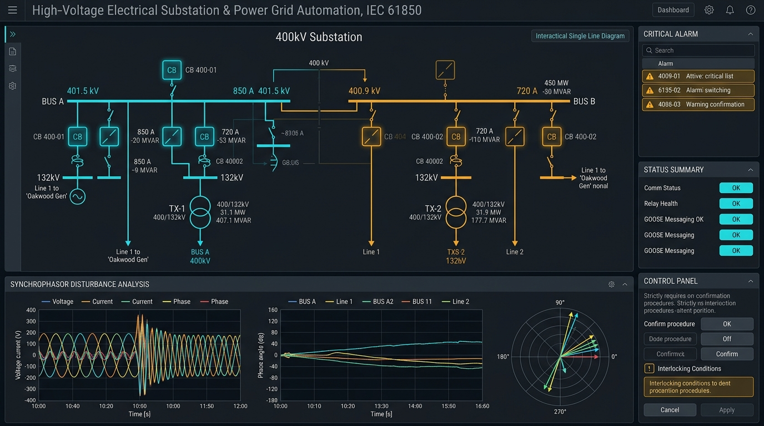
TERRESTRIAL PLATFORM | TERRAGRIDX | OPERATIONAL INTERFACE
TerraGridX ANSI/ISA-101 Operational Interface & Real-Time System Representation
ANSI/ISA-101 Ergonomic High-Performance HMI · Real-Time System Representation
Notes:
TerraGridX - ANSI/ISA-101 Verified Operational Interface
Representation: TerraGridX ANSI/ISA-101 Operational Interface & Real-Time System Representation
Compliance: ANSI/ISA-101 Verified HMI
Asset File: terra_gridx_showcase.jpg

Slide 3
TERRESTRIAL PLATFORM | TERRAGRIDX | CORE CAPABILITIES
What TerraGridX Will Do
Specific operational functions and engineering capabilities directly sourced from technical documentation.
PILLAR 01 | ENGINEERING CAPABILITY
Automated COMTRADE Harvest
Continuous retrieval of IEEE C37.111-1991/1999/2013 CFG, DAT, and CFF files across distributed IEDs.
PILLAR 02 | ENGINEERING CAPABILITY
Full-Cycle Sliding-Window DFT Phasor Engine
Extracts instantaneous fundamental phasors and symmetrical sequence components (positive, negative, zero).
PILLAR 03 | ENGINEERING CAPABILITY
K₀-Compensated R-X Impedance Loops
Computes fault impedance trajectory on complex R-X plane to pinpoint distance to line fault.
PILLAR 04 | ENGINEERING CAPABILITY
IEC 60255 IDMT Protection Curve Verification
Validates Standard Inverse, Very Inverse, and Extremely Inverse overcurrent trip curves against actual relay times.
Notes:
What TerraGridX Will Do:
[1] Automated COMTRADE Harvest:
Continuous retrieval of IEEE C37.111-1991/1999/2013 CFG, DAT, and CFF files across distributed IEDs.
[2] Full-Cycle Sliding-Window DFT Phasor Engine:
Extracts instantaneous fundamental phasors and symmetrical sequence components (positive, negative, zero).
[3] K₀-Compensated R-X Impedance Loops:
Computes fault impedance trajectory on complex R-X plane to pinpoint distance to line fault.
[4] IEC 60255 IDMT Protection Curve Verification:
Validates Standard Inverse, Very Inverse, and Extremely Inverse overcurrent trip curves against actual relay times.

Slide 4
TERRESTRIAL PLATFORM | TERRAGRIDX | FIELD USE CASES
Operational Use Cases & Field Impact
Actual documented use cases across Quality Assurance, Reduced Manpower, Efficiency, and Asset Productivity.
CASE 01 | PRODUCTIVITY & SAIDI/SAIFI REDUCTION
Productivity & SAIDI/SAIFI Reduction (Fault Localization)
Calculates exact fault distance down to tower numbers within 30 seconds of line trip, guiding repair crews directly to the spot. (TerraGridX openwiki).
CASE 02 | REDUCED MANPOWER
Reduced Manpower (Automated Remote COMTRADE Ingestion)
Replaces manual substation visits with automated background harvesting of IEEE C37.111 COMTRADE files across all connected relays. (TerraGridX openwiki).
CASE 03 | QA & PROTECTION COORDINATION
QA & Protection Coordination (IEC 60255 IDMT Verification)
Compares recorded trip times against Standard Inverse, Very Inverse, and Extremely Inverse curves to flag miscoordinated relay settings. (TerraGridX openwiki).
CASE 04 | EFFICIENCY
Efficiency (Circuit Breaker Arcing & Timing Audit)
Measures trip coil currents and breaker arcing times during each fault to schedule breaker overhauls before failures occur.
Notes:
TerraGridX - Operational Use Cases & Field Impact:
[Productivity & SAIDI/SAIFI Reduction] Productivity & SAIDI/SAIFI Reduction (Fault Localization):
Calculates exact fault distance down to tower numbers within 30 seconds of line trip, guiding repair crews directly to the spot. (TerraGridX openwiki).
[Reduced Manpower] Reduced Manpower (Automated Remote COMTRADE Ingestion):
Replaces manual substation visits with automated background harvesting of IEEE C37.111 COMTRADE files across all connected relays. (TerraGridX openwiki).
[QA & Protection Coordination] QA & Protection Coordination (IEC 60255 IDMT Verification):
Compares recorded trip times against Standard Inverse, Very Inverse, and Extremely Inverse curves to flag miscoordinated relay settings. (TerraGridX openwiki).
[Efficiency] Efficiency (Circuit Breaker Arcing & Timing Audit):
Measures trip coil currents and breaker arcing times during each fault to schedule breaker overhauls before failures occur.

Slide 5
TERRESTRIAL PLATFORM | TERRAGRIDX | ARCHITECTURAL CONTRAST
Comparison with Traditional SCADA / Legacy Systems
Point-by-point contrast demonstrating the technological shift from legacy industrial automation to the Terrestrial Platform.
TRADITIONAL LEGACY SYSTEMS / SILOED SCADA
TERRAGRIDX TERRESTRIAL PLATFORM ADVANTAGE
Engineers must manually travel to remote substations with laptops to download oscillography files after grid blackouts.
Instant automated harvesting of CFG, DAT, and HDR files across hundreds of distributed IEDs over WAN.
Manual inspection of raw sine wave traces taking days to determine breaker opening times and fault types.
Instantaneous AI waveform diagnostics calculating fault impedance, arc resistance, and clearing times in seconds.
Unsynchronized relay clocks leading to conflicting theories of what caused the blackout.
GPS and PTP nanosecond-synchronized timeline stitching proving the precise root cause without dispute.
Notes:
TerraGridX - Architectural Contrast (Legacy SCADA vs Terrestrial Platform):
LEGACY:
Engineers must manually travel to remote substations with laptops to download oscillography files after grid blackouts.
TERRESTRIAL ADVANTAGE:
Instant automated harvesting of CFG, DAT, and HDR files across hundreds of distributed IEDs over WAN.
LEGACY:
Manual inspection of raw sine wave traces taking days to determine breaker opening times and fault types.
TERRESTRIAL ADVANTAGE:
Instantaneous AI waveform diagnostics calculating fault impedance, arc resistance, and clearing times in seconds.
LEGACY:
Unsynchronized relay clocks leading to conflicting theories of what caused the blackout.
TERRESTRIAL ADVANTAGE:
GPS and PTP nanosecond-synchronized timeline stitching proving the precise root cause without dispute.

Slide 6
TERRESTRIAL PLATFORM | TERRAGRIDX | SYSTEM ARCHITECTURE
End-to-End System Diagram & Data Pipeline
Visual architecture diagram representing field telemetry ingestion, deterministic edge fabric, AI reasoning, and closed-loop actuation.
LAYER 01
Substation Process Bus Ingestion
Ultra-fast signal acquisition from optical CT/PT instrument transformers, merging units (MU), protection relays, and circuit breaker controllers.
PROTOCOLS & STANDARDS:
• IEC 61850-9-2 (Sampled Values)
• IEC 61850-8-1 (GOOSE)
• IEEE COMTRADE
LAYER 02
Microsecond Process Bus
Hardware-accelerated PRP/HSR redundant Ethernet streaming, IEEE 1588 PTP nanosecond synchronization, and sub-cycle waveform capture.
PROTOCOLS & STANDARDS:
• IEEE 1588 PTP Time-Sync
• PRP/HSR Redundant Bus
• Sub-Cycle Waveform Stream
LAYER 03
Synchrophasor Stability Core
Real-time phasor measurement unit (PMU) angle divergence analysis, transmission grid oscillation damping, and fault location estimation.
PROTOCOLS & STANDARDS:
• PMU Angle Analysis
• Grid Oscillation AI
• Fault Location Engine
LAYER 04
Breaker Trip & Grid Cockpit
Sub-4ms GOOSE protective trip command verification, automated synchrocheck breaker closing, and ANSI/ISA-101 single-line substation cockpits.
PROTOCOLS & STANDARDS:
• Sub-4ms GOOSE Trips
• Synchrocheck Closing
• ISA-101 Grid HMI
UNIFIED DATA PIPELINE FLOW
IEC 61850 Sampled Values ➔ Redundant Microsecond Process Bus ➔ Synchrophasor Dynamic Stability AI ➔ Sub-4ms GOOSE Breaker Trip Execution
Notes:
TerraGridX - End-to-End System Diagram & Data Pipeline:
Layer 01: Substation Process Bus Ingestion
Ultra-fast signal acquisition from optical CT/PT instrument transformers, merging units (MU), protection relays, and circuit breaker controllers.
Protocols: IEC 61850-9-2 (Sampled Values), IEC 61850-8-1 (GOOSE), IEEE COMTRADE
Layer 02: Microsecond Process Bus
Hardware-accelerated PRP/HSR redundant Ethernet streaming, IEEE 1588 PTP nanosecond synchronization, and sub-cycle waveform capture.
Protocols: IEEE 1588 PTP Time-Sync, PRP/HSR Redundant Bus, Sub-Cycle Waveform Stream
Layer 03: Synchrophasor Stability Core
Real-time phasor measurement unit (PMU) angle divergence analysis, transmission grid oscillation damping, and fault location estimation.
Protocols: PMU Angle Analysis, Grid Oscillation AI, Fault Location Engine
Layer 04: Breaker Trip & Grid Cockpit
Sub-4ms GOOSE protective trip command verification, automated synchrocheck breaker closing, and ANSI/ISA-101 single-line substation cockpits.
Protocols: Sub-4ms GOOSE Trips, Synchrocheck Closing, ISA-101 Grid HMI
Pipeline Flow:
DATA PIPELINE FLOW: IEC 61850 Sampled Values ➔ Redundant Microsecond Process Bus ➔ Synchrophasor Dynamic Stability AI ➔ Sub-4ms GOOSE Breaker Trip Execution

Slide 7
TERRESTRIAL PLATFORM | TERRAGRIDX | DEPLOYMENT & SI VALUE
System Integrator Deployment Framework & Commercial Model
Zero rip-and-replace turnkey onboarding with recurring enterprise margins and co-selling enablement.
PHASE 01 | CONNECTIVITY & AUDIT
Zero Rip-and-Replace Onboarding
Non-intrusive protocol discovery across field PLCs, RTUs, and historians. Plug-and-play mapping of tags into the unified TPIM semantic namespace without stopping ongoing plant production.
PHASE 02 | TWIN CALIBRATION
Physics-Model Synchronization
Deploy high-frequency Edge Gateway on premise. Calibrate first-principles thermodynamic and kinematic models against historical telemetry to achieve 99.4%+ deterministic accuracy.
PHASE 03 | AUTONOMOUS GO-LIVE
Closed-Loop Setpoint Actuation
Supervisory closed-loop setpoint dispatch with bumpless transfer. Comprehensive ISA-101 verified cockpit handoff with continuous SI recurring monitoring and support tiers.
COMMERCIAL VALUE PROPOSITION FOR SYSTEM INTEGRATORS (TERRAGRIDX)
• High-Margin Software Recurring Revenue: Earn 25%–35% continuous recurring margin on every TerraGridX software deployment, maintenance tier, and AI compute instance.
• Turnkey Engineering Velocity: Deploy within 7 to 14 days leveraging pre-trained neural networks and automated semantic tag mapping, avoiding expensive months-long custom PLC code rewrites.
• Enterprise Co-Selling & Ecosystem: Access joint executive pipeline opportunities, certified engineering documentation, and board-level C-Suite presentation toolkits.
Notes:
TerraGridX - System Integrator Deployment Framework & Commercial Model:
Phase 1: Connectivity & Audit
Phase 2: Twin Calibration
Phase 3: Autonomous Go-Live
Commercial Enablement:
- 25%-35% recurring SaaS margins
- 7-14 day rapid commissioning
- Co-selling and enterprise enablement support

